Slide 1

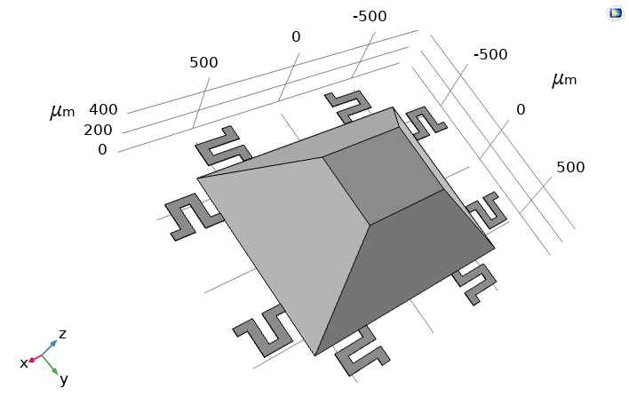
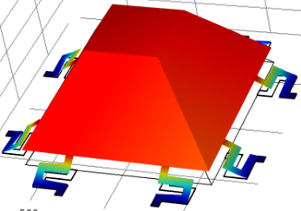
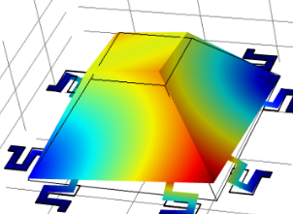


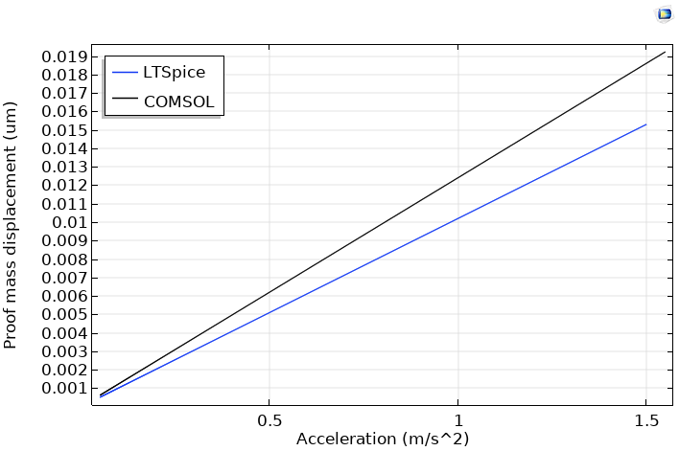
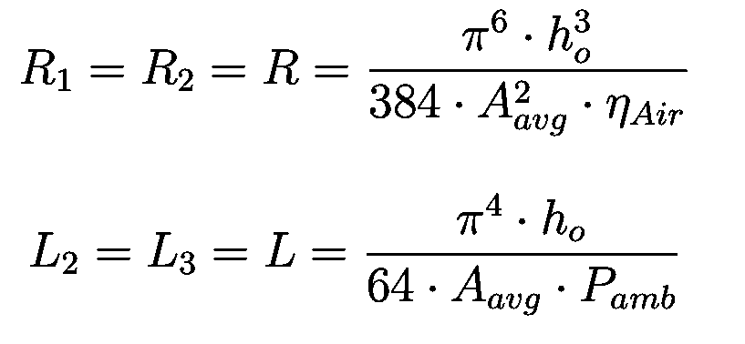

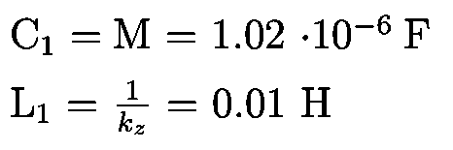
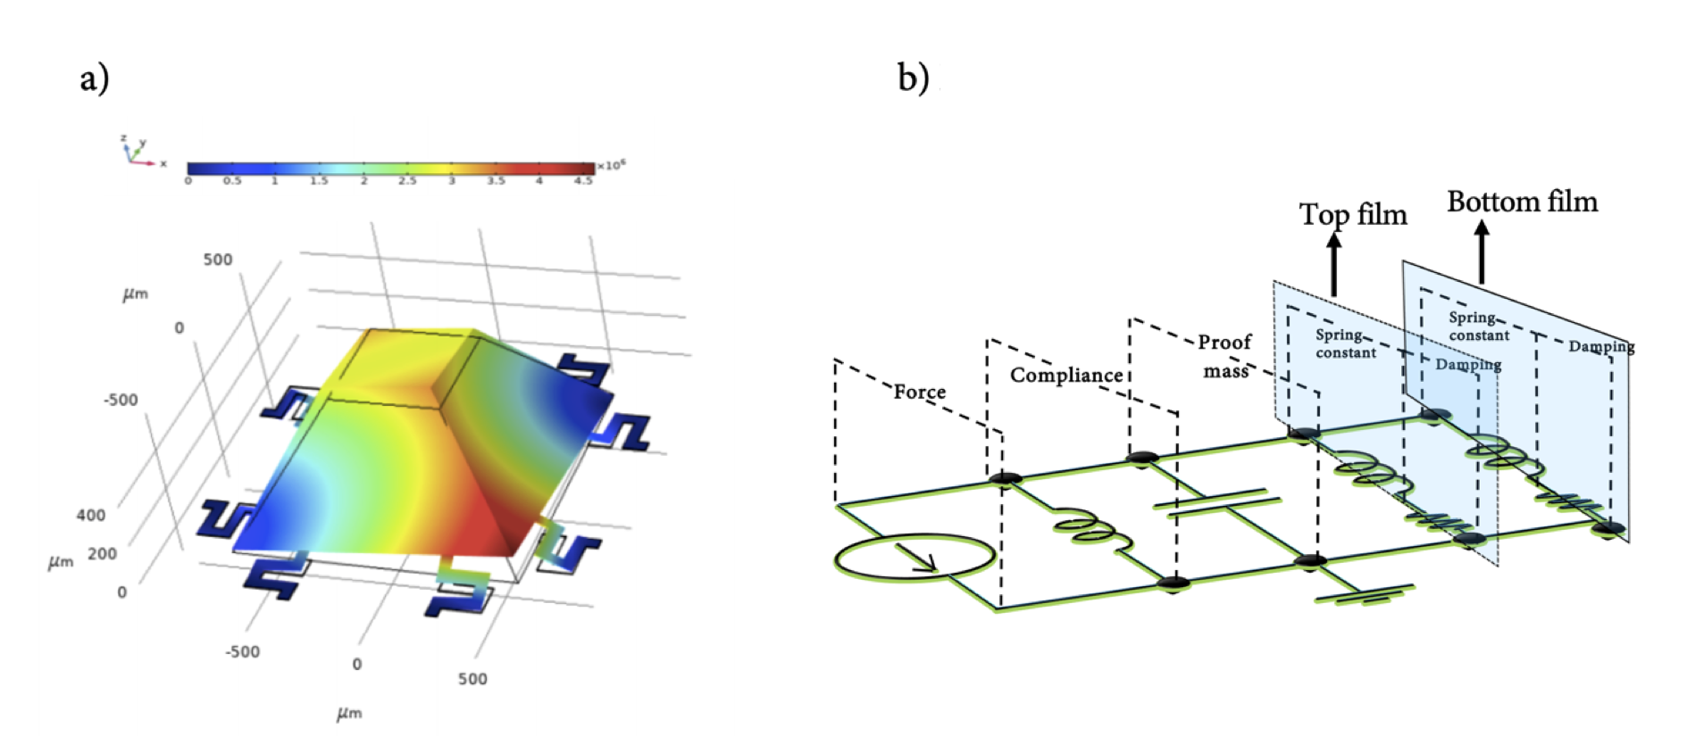

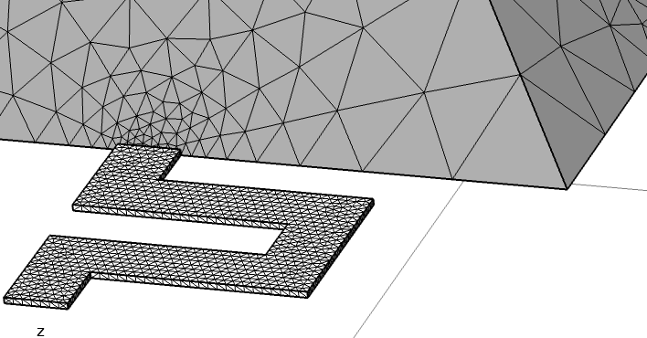
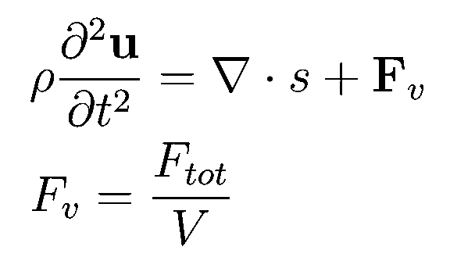


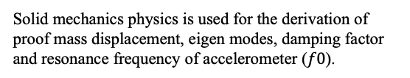
Cross Domain Modelling of a Meander Beam MEMS Bulk Micromachined Accelerometer in COMSOL Multiphysics® and SPICE
Mahdieh Shojaei Baghini¹
1. Delft University of Technology, Delft, Netherlands
Introduction
Results
Static and dynamic modelling of MEMS accelerometers using COMSOL and lumped circuit elements enables cross domain design, analysis and simulation of these devices. Meander beams are utilized due to their lower effective vertical stiffness as compared to rectangular beams and placed at the edges of the proof mass to reduce parasitic frequencies which lead to tilts [1,2].
The sensor exhibits a stable transient response on application of a body load. The presence of parasitic frequencies leading to tilts in the proof mass is highlighted by the higher order eigen modes. As acceleration increases, the SPICE derived displacement diverges from that of COMSOL since validity of small deformation theory is not satisfied.
Fig. 1. Eight-beam Si accelerometer with squeeze film damping fabricated using anisotropic wet etching.
Color bar: Surface displacement (μm)
SPICE Analytical Model
Fig. 3. First eigen mode corresponding to the natural frequency.
Fig. 4. Third eigen mode corresponding to the second parasitic frequency.
The force applied on the proof mass is modeled by a current source. Consequently, each discrete element models a mechanical variable, conserving energy. The damping is modeled by R and L. The damping ratio
(ζ) is 0.7.
$ζ$_{COMSOL} = 1.1
$ζ$_{SPICE} = 0.7
f0_{COMSOL} = 1.454 kHz
f0_{SPICE} = 1.575 kHz
Fig. 5. SPICE and COMSOL simulated proof mass displacement vs acceleration.
Conclusion
The placement of meander beams away from the center leads to a reduction of parasitic effects and off-axis sensitivity. The drop in resonance frequency causes an increase in the damping factor of the sensor.
As the beams are moved
towards the center, operation
bandwidth reduces.
In order to improve
performance,
closed loop capacitive
accelerometers can be
designed with feedback.
Fig. 2. Lumped element circuit model of accelerometer with thin film damping.
Computational Model
Solid mechanics physics is used for the derivation of proof mass displacement, eigen modes, damping factor and resonance frequency of accelerometer ($f0$).
First four eigen modes of designed meander and rectangular beam MEMS accelerometers.
Transient modelling
Eigen-frequencies modelling
Fig. 3. Distribution of finer
mesh elements at beam-mass interface.
Wall height for thin film damping is derived previously using SPICE models based on desired damping factor.
References
Acknowledgements
1. E. Westby, “Macromodelling of Microsystems”, 2004.
2. H. V. Allen et al;. “Accelerometer systems with self-testable features,” Sensors and Actuators, 1989.
The author would like to thank Dr. Andre Bossche for his valuable inputs.
Excerpt from the Proceedings of the 2020 COMSOL Conference

