Slide 1





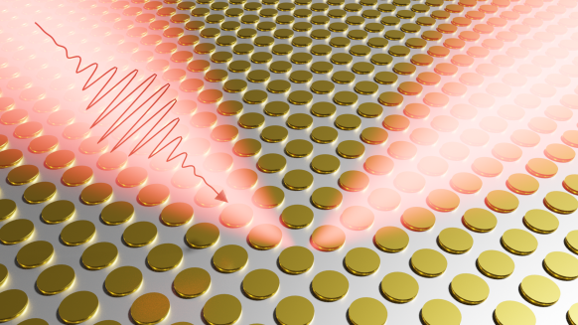
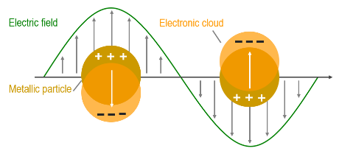
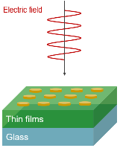
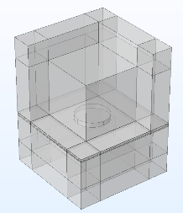

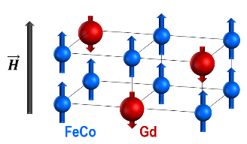
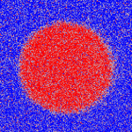
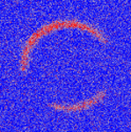
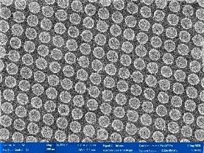
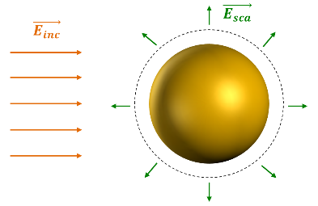
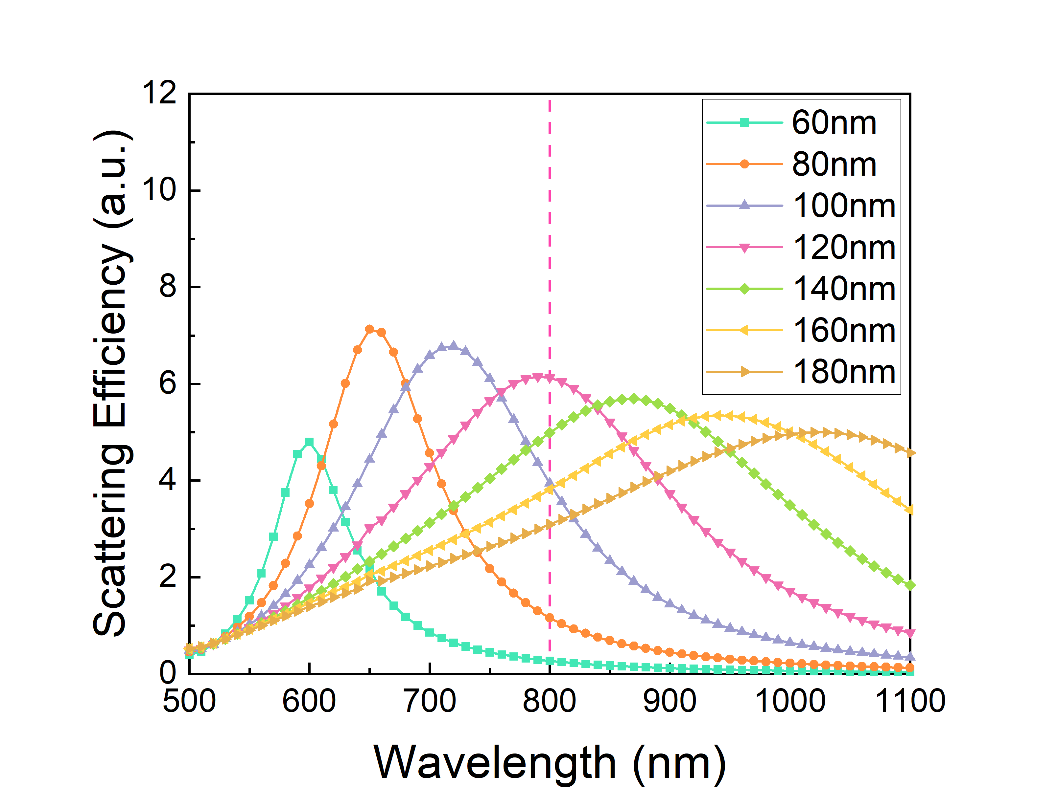
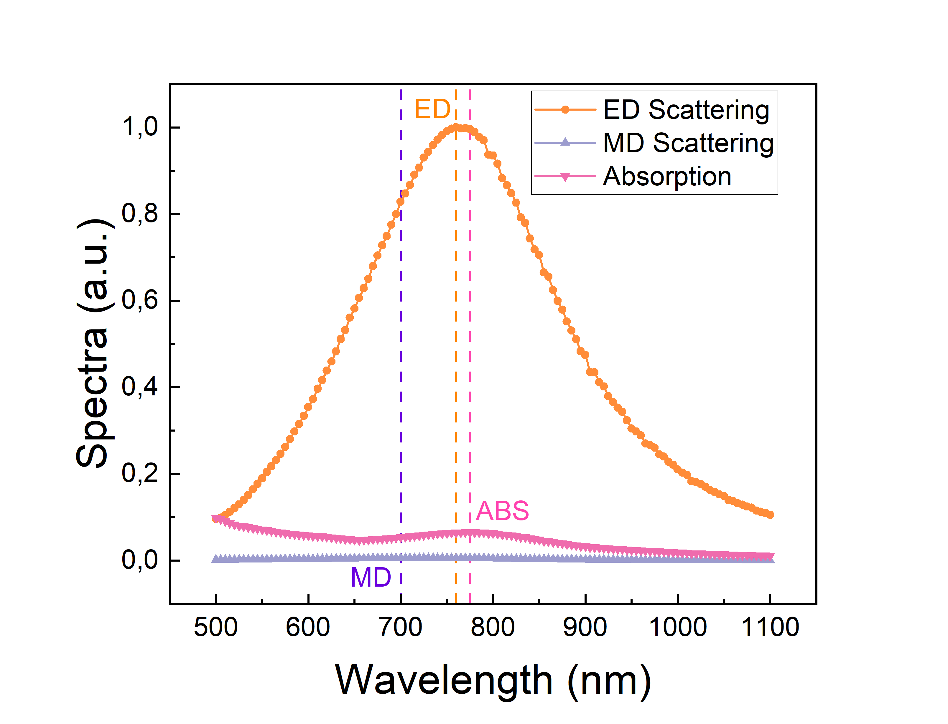
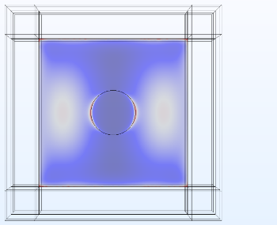

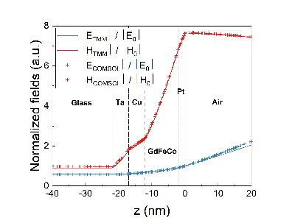
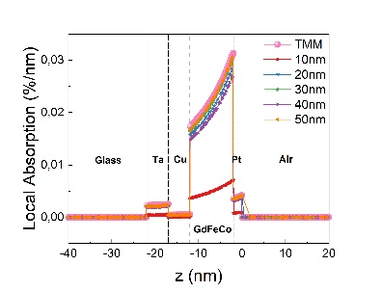
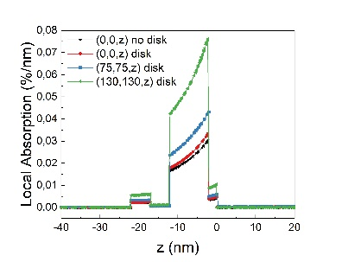


Plasmonic nanoantenna for energy-efficient All-Optical Switching
M. Vergès¹, A. Larin², J. Hohlfeld¹, M.Hehn¹, R. Savelev ², D. Zuev², S. Mangin¹
¹ Institut Jean Lamour, CNRS UMR 7198, Université de Lorraine, France
² ITMO University, Russian Federation
Corresponding author: maxime.verges@univ-lorraine.fr
Our goal is to create plasmons to enhance All Optical Switching (AOS) of the magnetization^{1,2}. We used a finite-element model in order to understand the impact of plasmonic disk-shaped nanoantennas on magneto-optical effects. We first tested our model without an antenna and compare it with analytical solutions. The plasmonic nanoantenna tends to enhance the energy absorption in the layers, especially the magnetic layer (GdFeCo), but
also induces a field confinement around the antenna. These results sound promising for developing energy-efficient plasmonic magneto-optical devices.
Combining Plasmonics and All-Optical Switching in RE – TM alloy GdFeCo
(a)
(b)
(c)
Rayleigh scattering
$α=$ $4πR^{3}\frac{ε−ε_{m}}{ε+{2ε}_{m}}$
Fig 1 : Plasmonic systems. (a) Localized surface plasmon resonance. (b) Sketch of the system. (b) COMSOL main model.
(a)
(b)
(c)
40 fs
Single fs-pulse, helicity independent, pure thermal effect
Fig 2 : AOS with GdFeCo. (a) Sketch of ferrimagnetic system. (b) MOKE images describing AOS. (c) SEM image (r = 120nm, a = 300nm).
Design of the device
At 800nm, plasmon resonance (electric dipole) occurs for a radius of 120nm
(a)
(b)
(c)
(d)
Fig 3 : Design. (a) Sketch of scattering definition. (b) σ_{sc} for different radius. (c) Multipoles decomposition. (d) Electric field distribution ($\left\|\vec{E}\right\|$/ $\left\|\vec{E_{0}}\right\|$).
Absorption enhancement in GdFeCo
Conclusion
(a)
(b)
(c)
Plasmonic disks enhance absorption in GdFeCo significantly
Next step : further calculations and complete experiments
Fig 4 : (a) Normalized fields in structure without disk (COMSOL vs. TMM method). (b) Mesh refinement (maximum mesh size in thin layers). (c) Absorption enhancement in GdFeCo.
References
[1] F. Cheng. et al., Nano Letters, 20, 6437 – 6443 (2020)
[2] D. Ignatyeva et al., Nature Communications 10(1), 4786 (2019)
[3] S. Wienholdt et al., Phys. Rev. B 88, 020406 (2013).
Mesh refinement has been done in comparison with analytical method for thin films
Antenna enhances the absorption in GdFeCo

