Slide 1


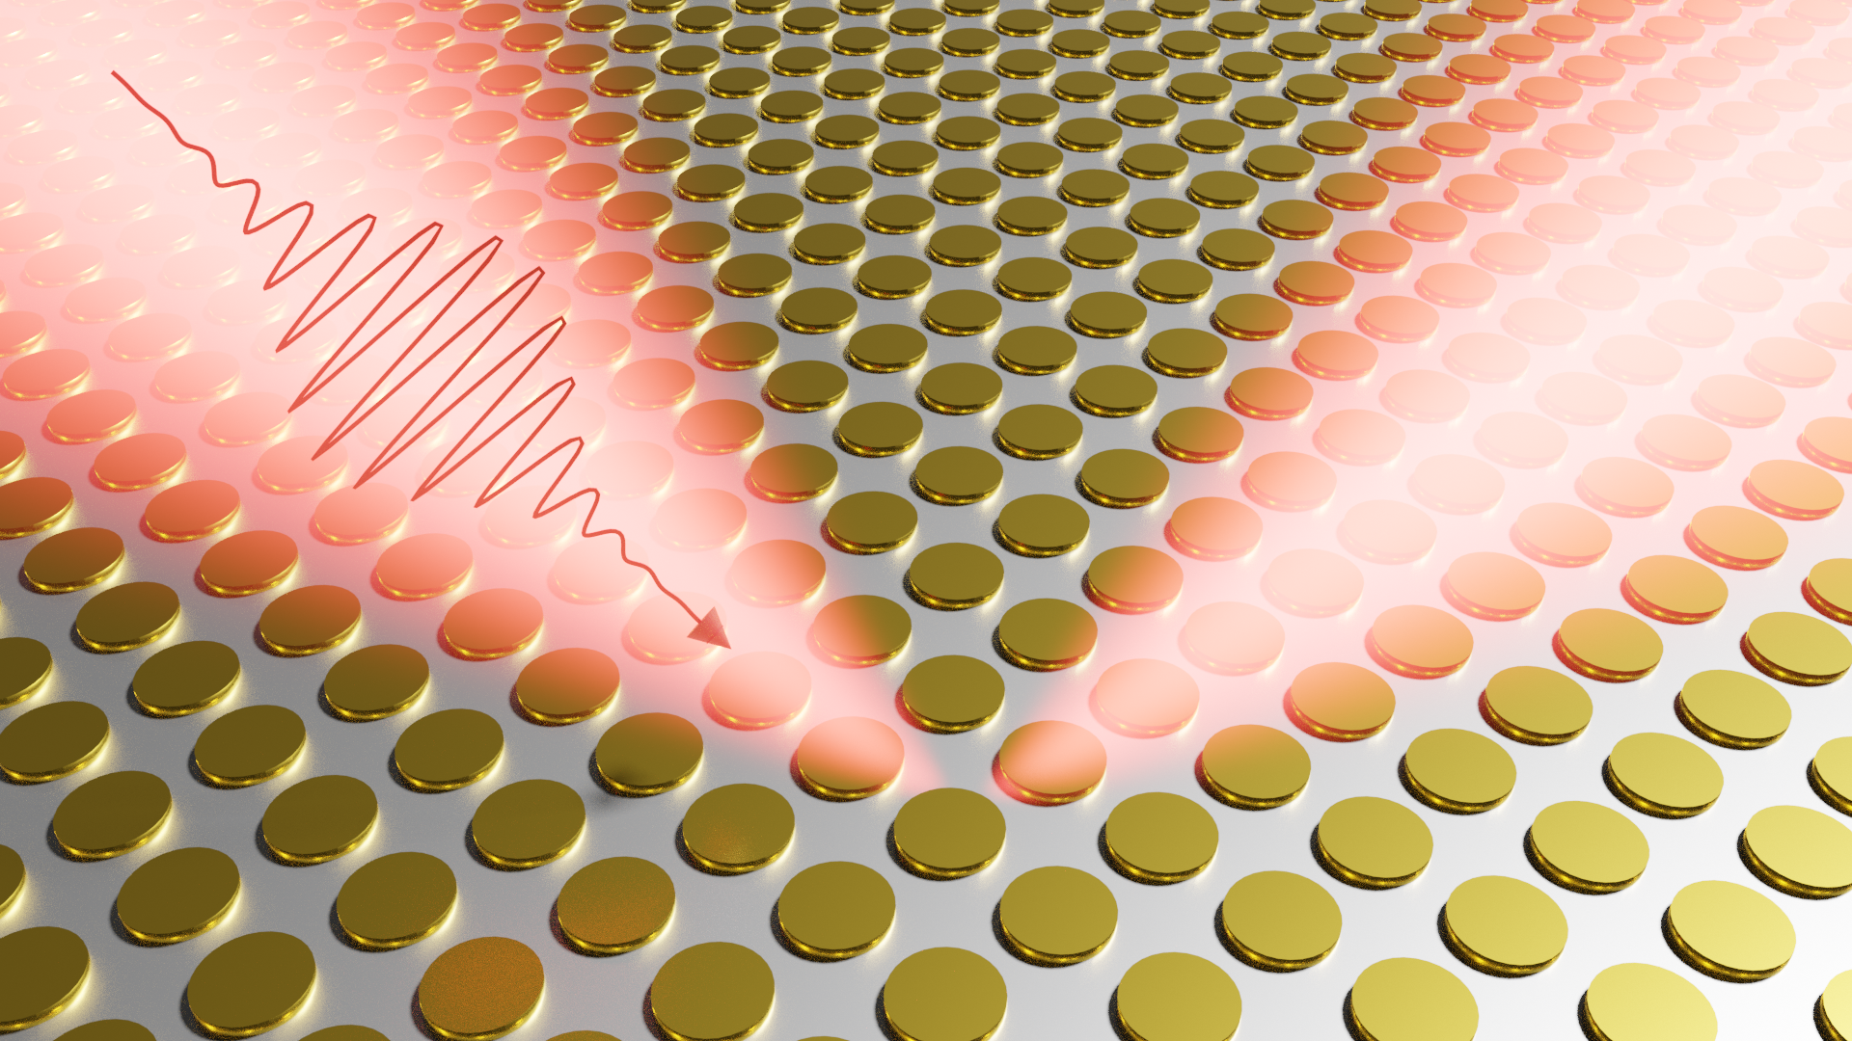

Plasmonic nanoantenna for energy-efficient All-Optical Switching
Impact of plasmonics on All-Optical Switching
M. Vergès¹, A. Larin², J. Hohlfeld¹, M.Hehn¹, R. Savelev ², D. Zuev², S. Mangin¹
14th-15th of October, 2020

Slide 2


Outline
Context
State of the art and objectives
Theoretical background
Design of the antenna
Impact of a single disk on local absorption
Conclusion and perspectives

Slide 3
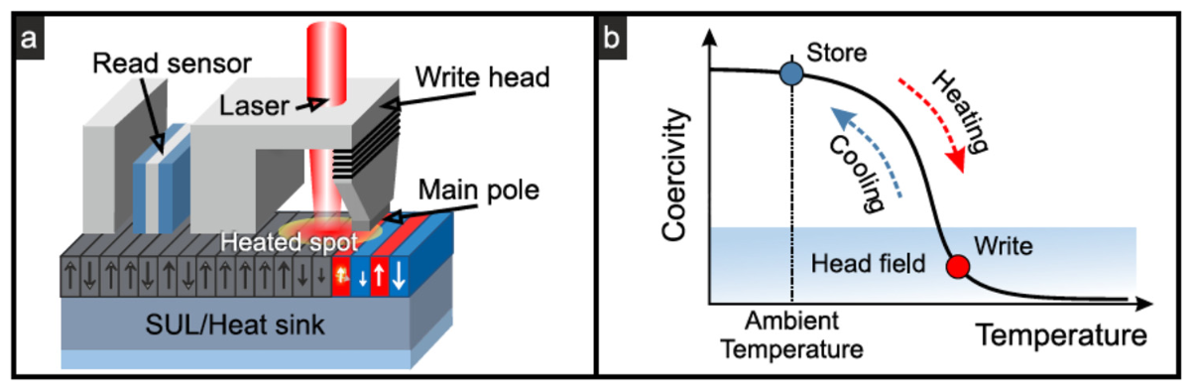
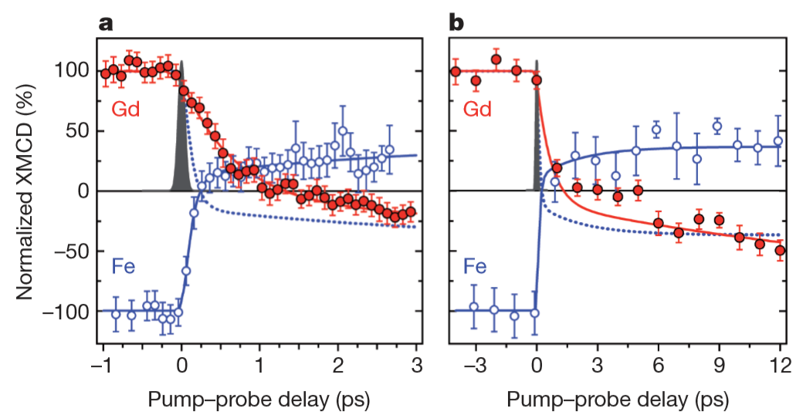
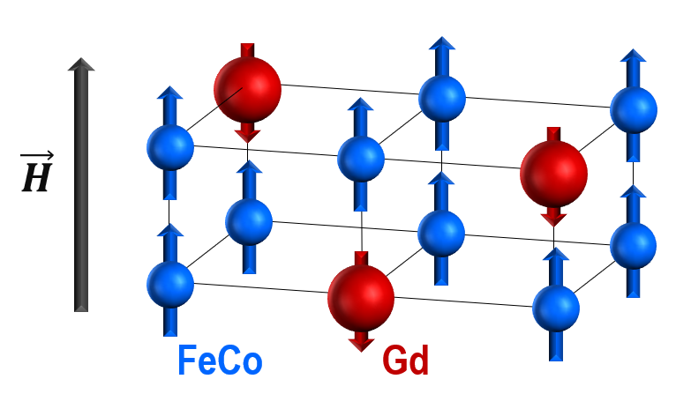

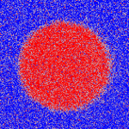
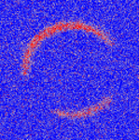
Context
Interest in thermal effect
J. Vac. Sci. Technol. B 2016, 34, 060801
Heat Assisted Magnetic Recording, a way to come from 1 Tb/in² to 3-4 Tb/in² !
Nature 2011, 472, 205 – 209
All-Optical Switching : ultrafast writing of information
Single pulse
Single pulse
40 fs
40 fs
GdFeCo : single pulse, helicity independent
GdFeCo : pure thermal effect

Slide 4
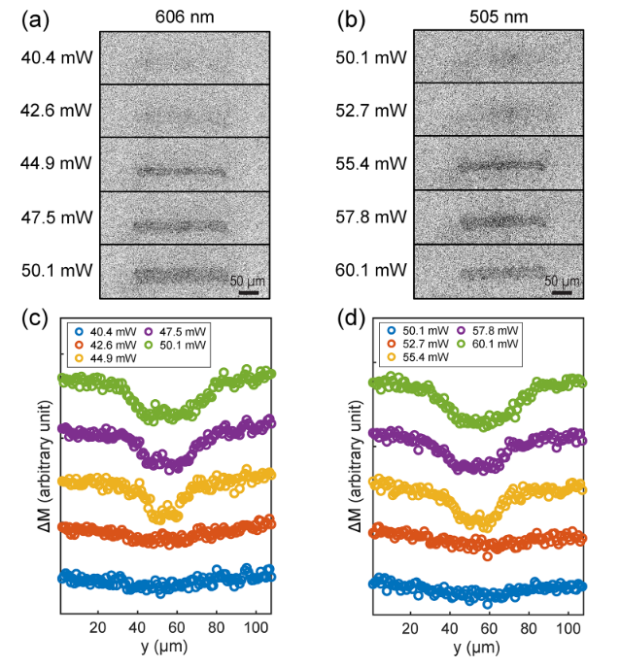

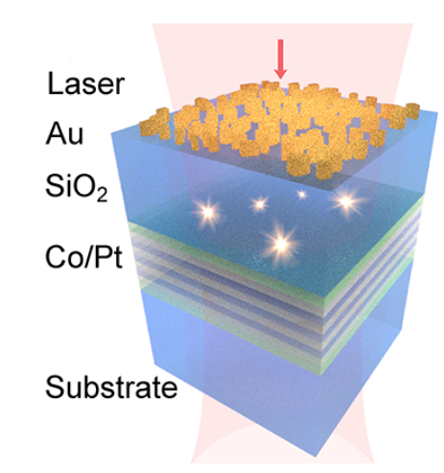
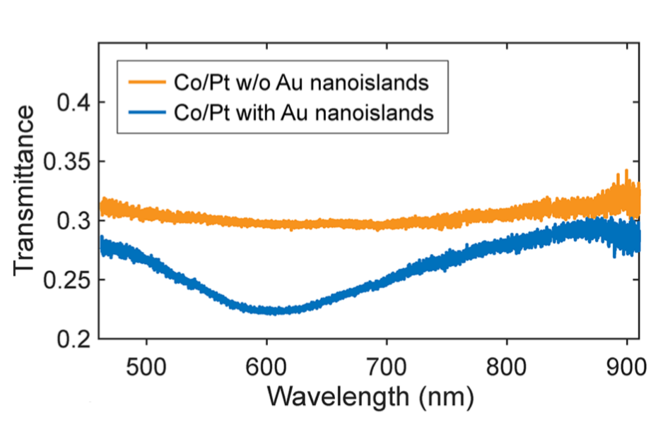
State of the art and objectives
Magnetoplasmonics
Heat assisted All-Optical Switching in Co/Pt ferromagnet due to loss of transmission (absorption enhanced) induced by Au nanoislands
Absorption resonance makes threshold power decrease : 18.5% of energy saved !
Nanoletters 2020, 20, 6437 - 6443

Slide 5
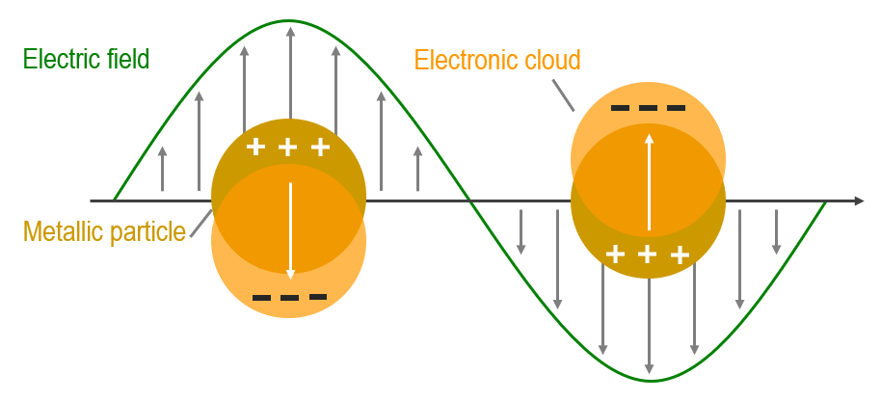
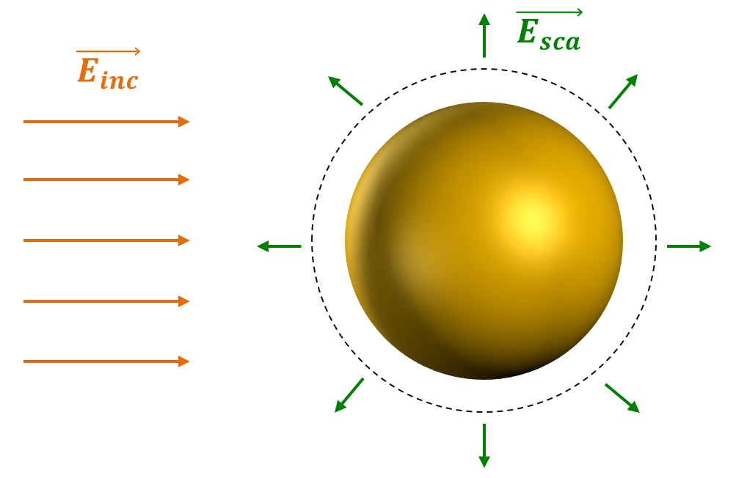
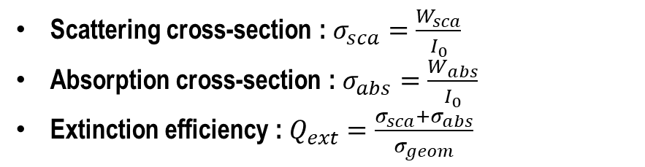
Theoretical Background
Localized Surface Plasmon Resonance
Coherent oscillations of conduction electrons in a metallic nanoparticle excited by electromagnetic radiation
Resonance depends on size, shape, composition and environment
No momentum matching is required
Applications : Biophotonics, SERS
Scattering cross-section : $σ_{sca}=\frac{W_{sca}}{I_{0}}$
Absorption cross-section : $σ_{abs}=\frac{W_{abs}}{I_{0}}$
Extinction efficiency : $Q_{ext}=\frac{σ_{sca}+σ_{abs}}{σ_{geom}}$

Slide 6
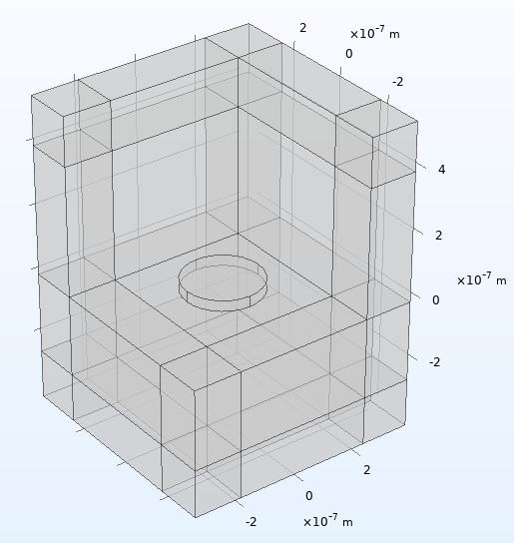

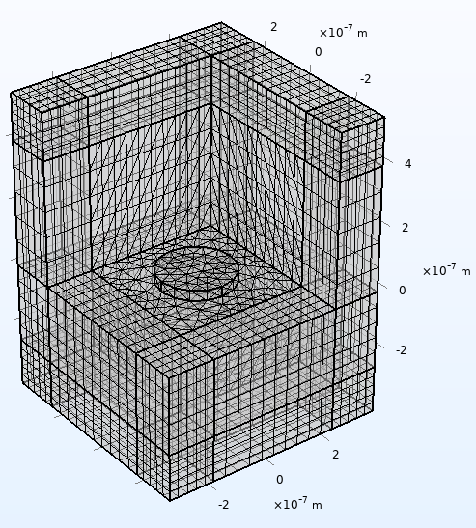
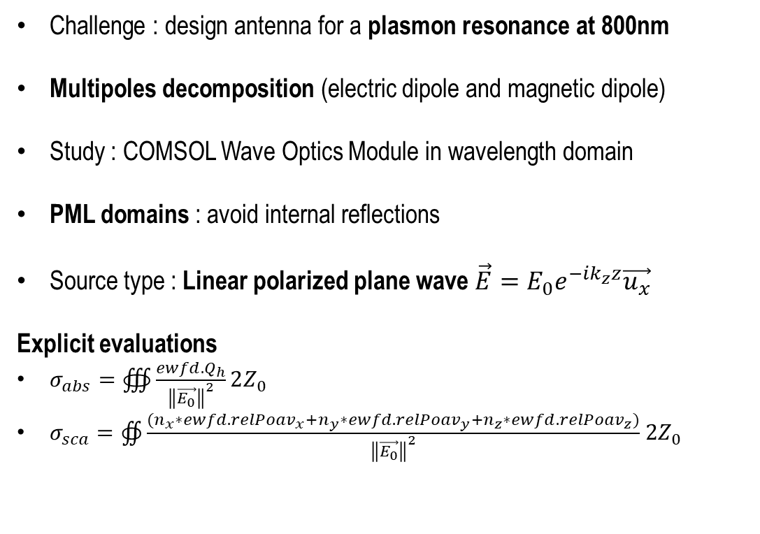
Design of the antenna
Resonance depending on radius
Challenge : design antenna for a plasmon resonance at 800nm
Multipoles decomposition (electric dipole and magnetic dipole)
Study : COMSOL Wave Optics Module in wavelength domain
PML domains : avoid internal reflections
Source type : Linear polarized plane wave $\vec{E}=E_{0}e^{−ik_{z}z}\vec{u_{x}}$
Explicit evaluations
$σ_{abs}=∰{\frac{ewfd.Q_{h}}{{\left\|\vec{E_{0}}\right\|}^{2}}2Z_{0}}$
$σ_{sca}=∯{\frac{{(n}_{x}∗ewfd.{relPoav}_{x}+n_{y}∗ewfd.{relPoav}_{y}+n_{z}∗ewfd.{relPoav}_{z})}{{\left\|\vec{E_{0}}\right\|}^{2}}}$ $2Z_{0}$

Slide 7
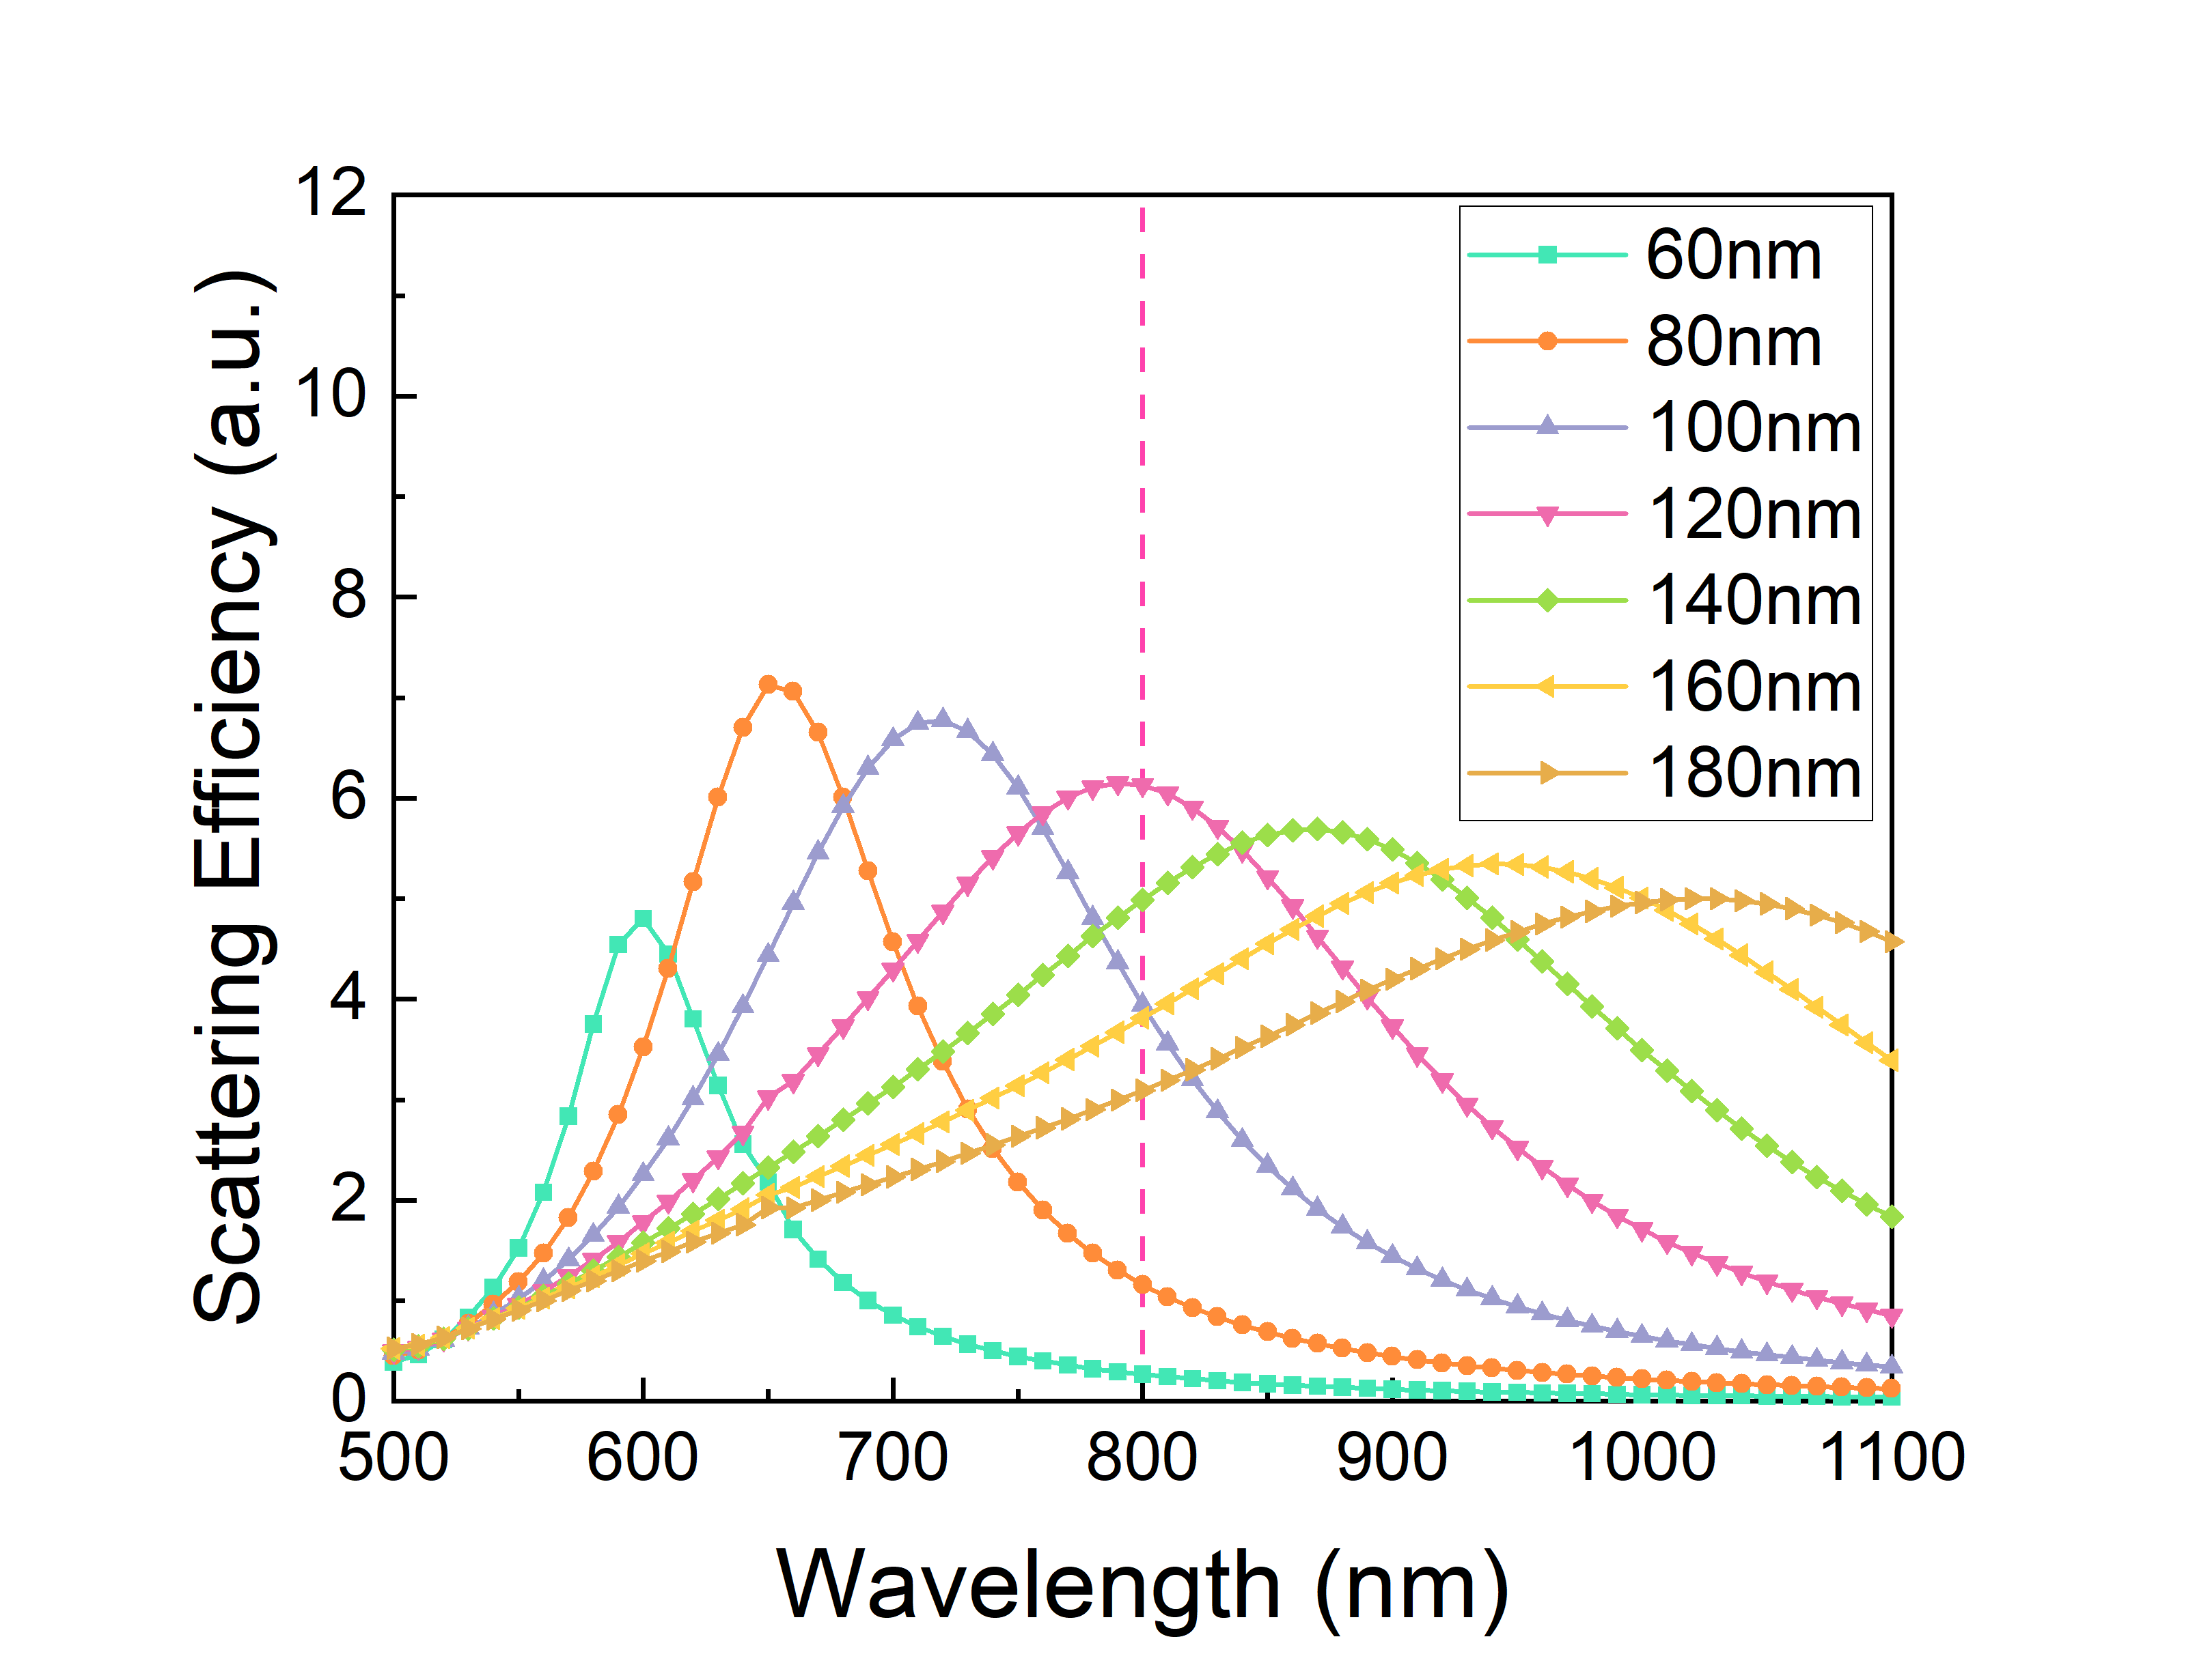
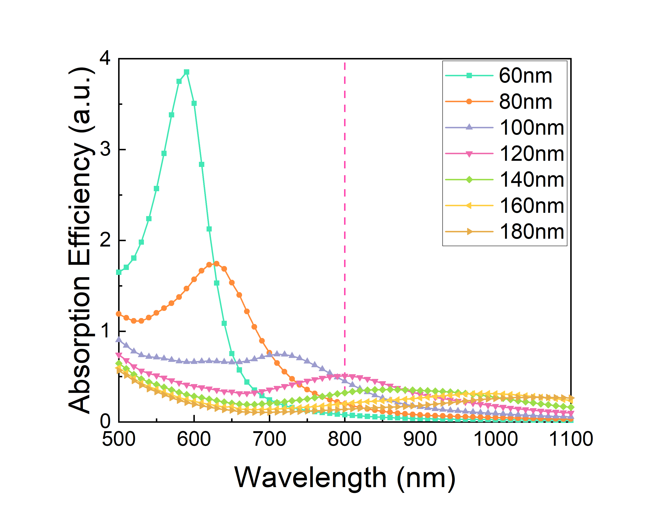
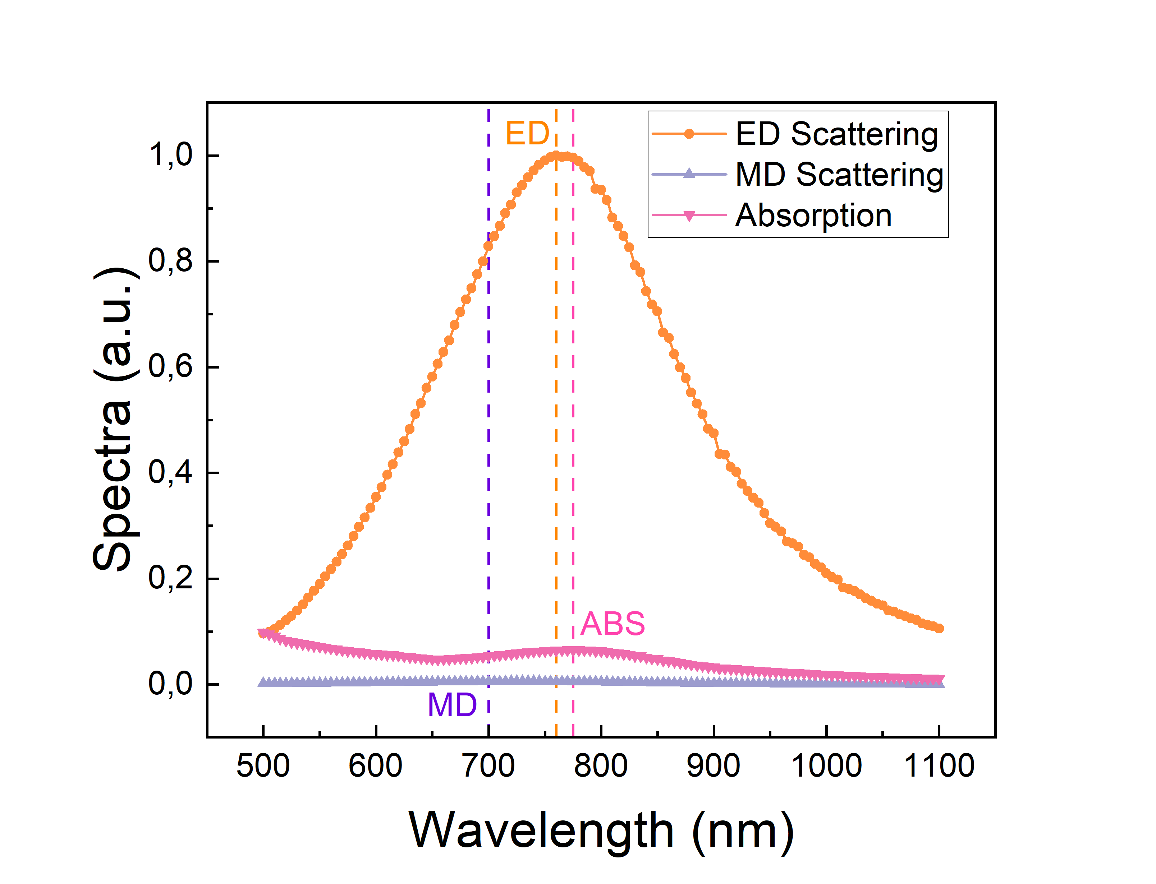

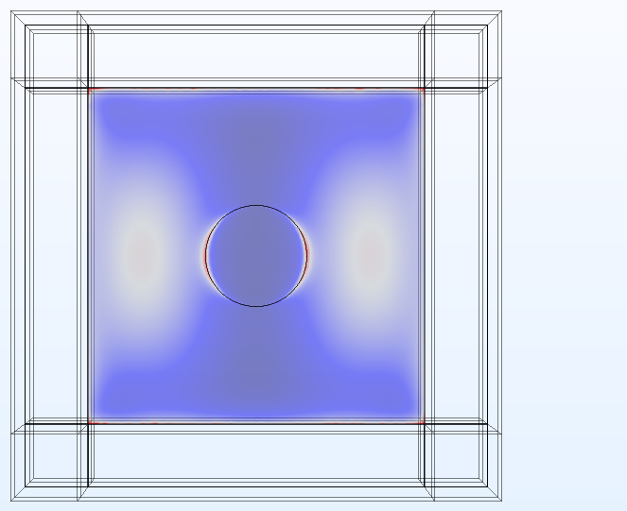

Design of the antenna
Results
Multipoles decompositon (in air)
Au nanoantenna exhibits high near field enhancement
120nm-radius antenna exhibit LSPR at 800 nm
Electric dipole resonance

Slide 8
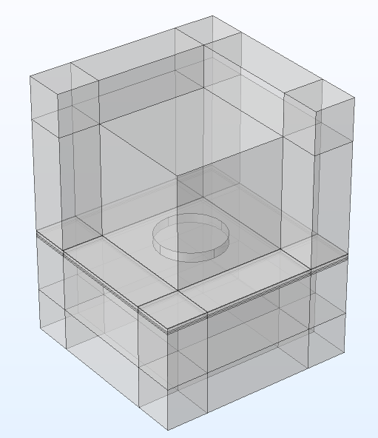
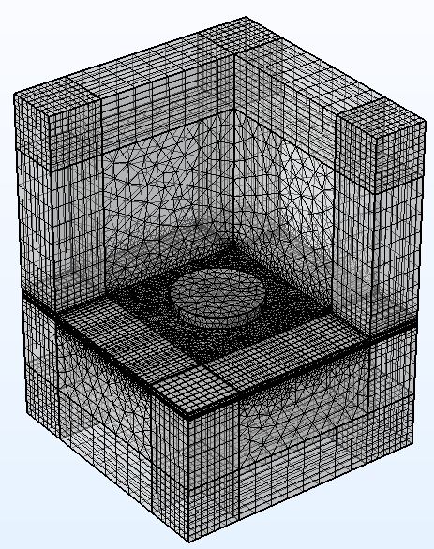
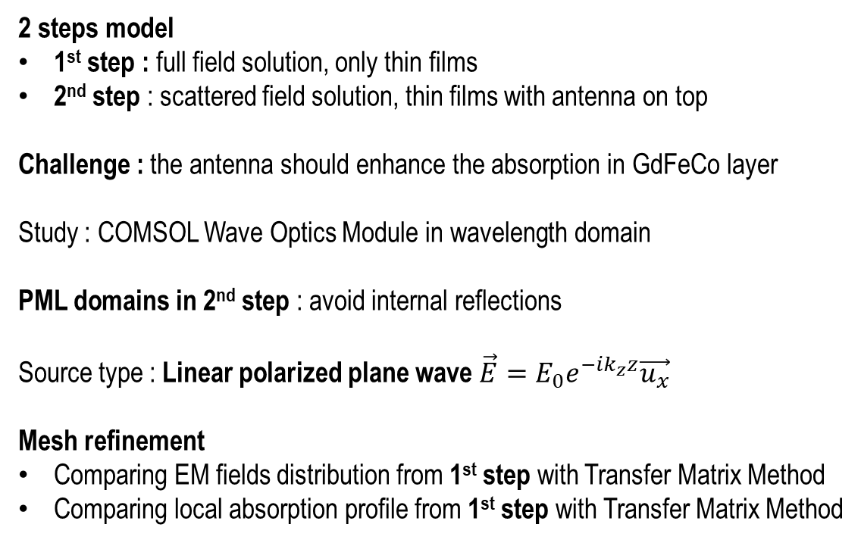
Impact of an antenna on local absorption
Method
2 steps model
1st step : full field solution, only thin films
2nd step : scattered field solution, thin films with antenna on top
Challenge : the antenna should enhance the absorption in GdFeCo layer
Study : COMSOL Wave Optics Module in wavelength domain
PML domains in 2nd step : avoid internal reflections
Source type : Linear polarized plane wave $\vec{E}=E_{0}e^{−ik_{z}z}\vec{u_{x}}$
Mesh refinement
Comparing EM fields distribution from 1st step with Transfer Matrix Method
Comparing local absorption profile from 1st step with Transfer Matrix Method

Slide 9
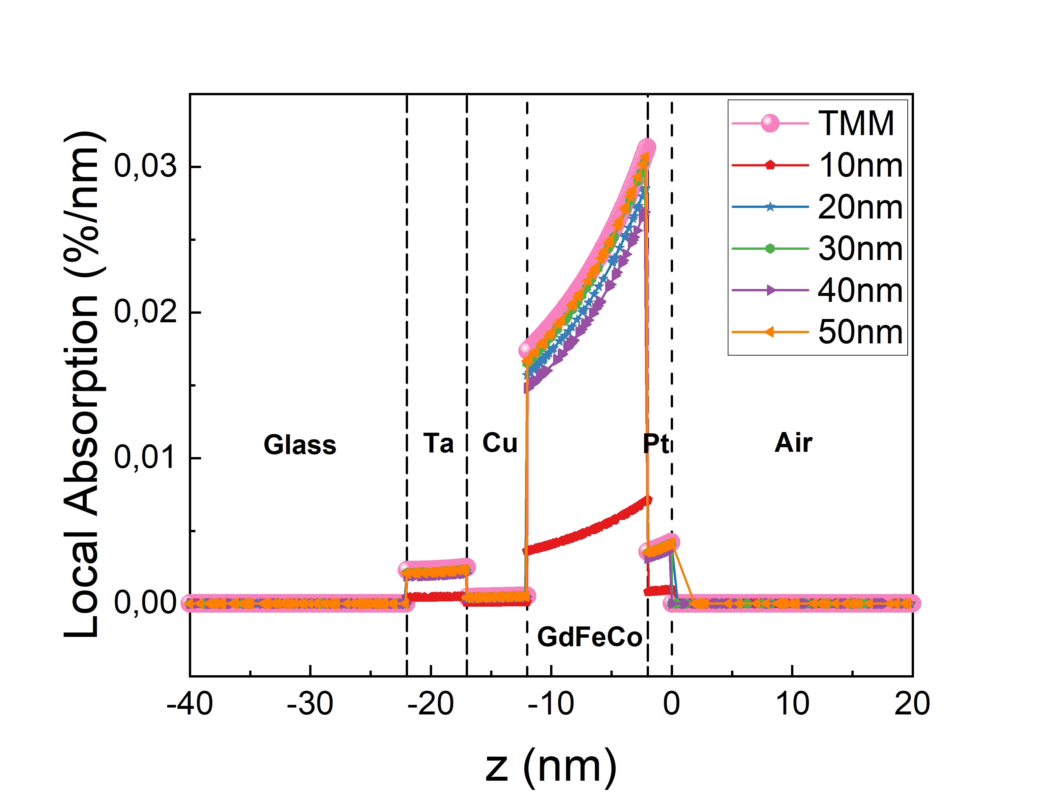
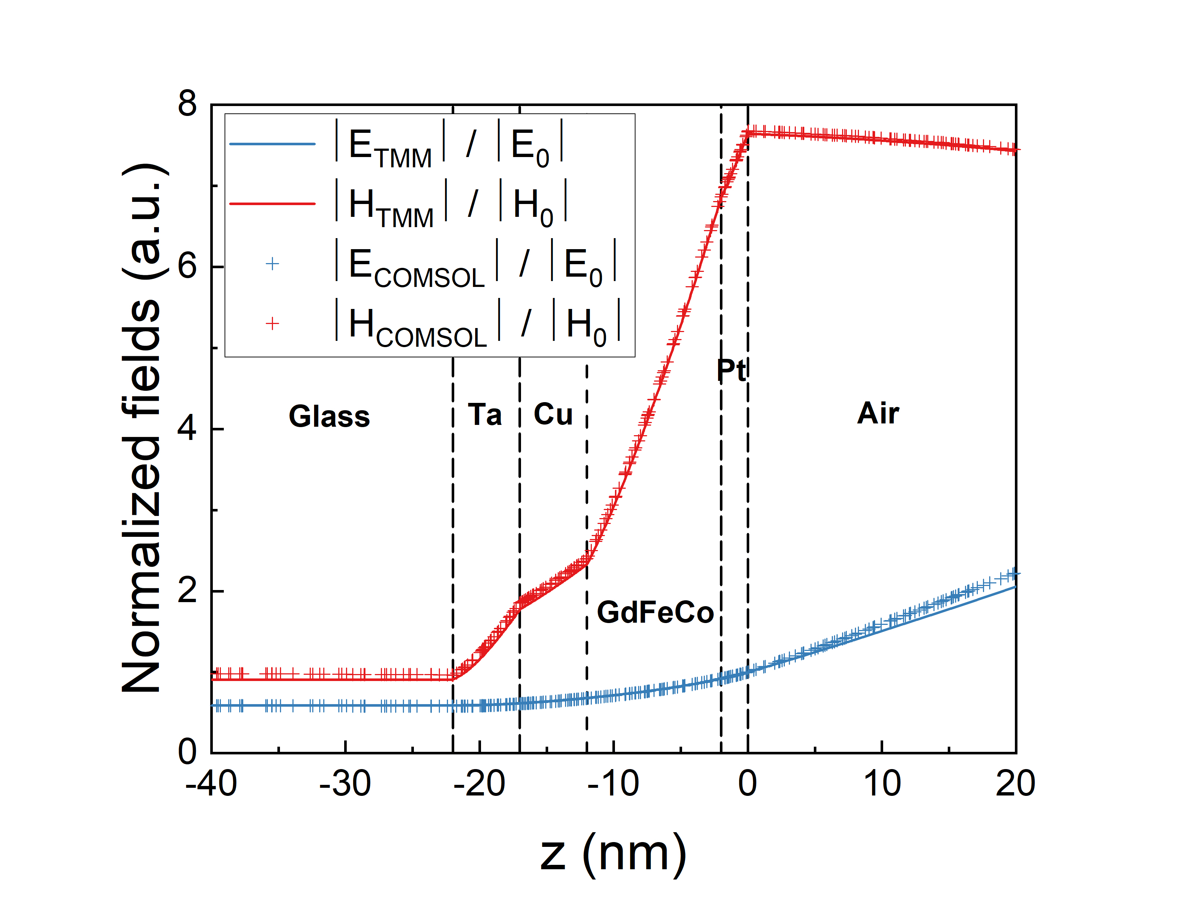
Impact of an antenna on local absorption
Mesh refinement
Mesh refinement for local absorption allows to determine the maximum element size in the mesh of thin layers
Excellent agreement between COMSOL and Transfer Matrix Method !

Slide 10
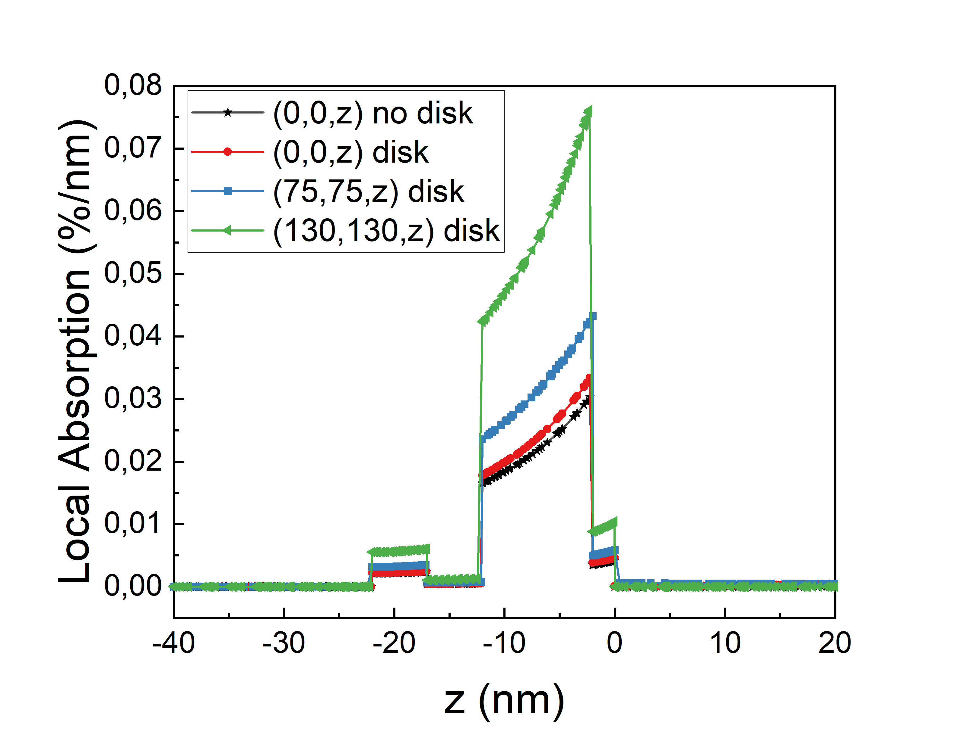
Impact of an antenna on local absorption
Results
1 : Cut Line (0, 0, from 20nm to -40nm)
2 : Cut Line (75nm, 75nm, from 20nm to -40nm)
3 : Cut Line (130nm, 130nm, from 20nm to -40nm)
Absorption multiplied by more than 2 where there is high near field enhancement at the edges of the antenna
+ 3
+ 2
+ 1

Slide 11
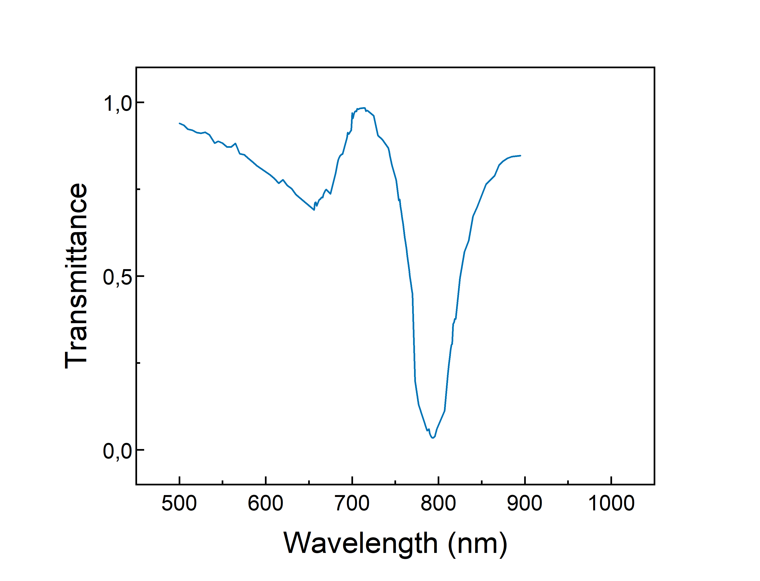
Conclusion
Future work, perspectives
Considering Surface Lattice Resonance for the final design of the array to improve the quality factor Q
Single antenna already provides a good enhancement in absorption in the magnetic layer
Comparing the real shape of antenna with the expected shape seems necessary to provide the most realistic calculations
We are working on measurements to support calculations
THANKS FOR YOUR ATTENTION !

