Slide 1
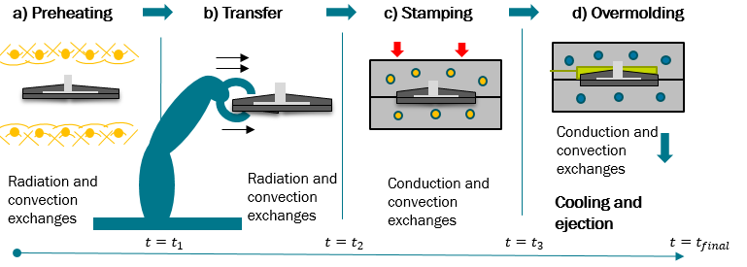
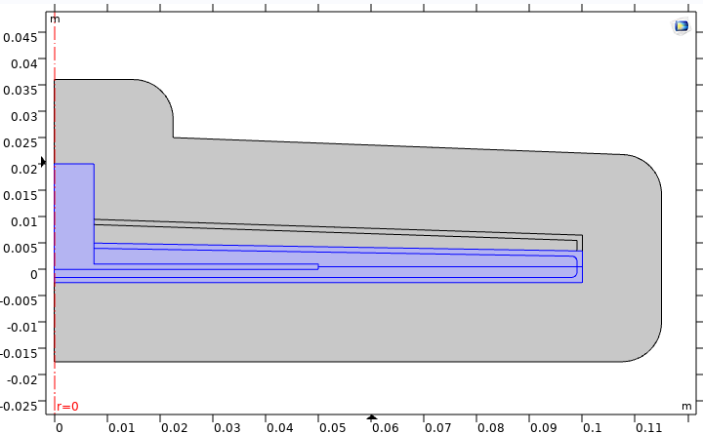
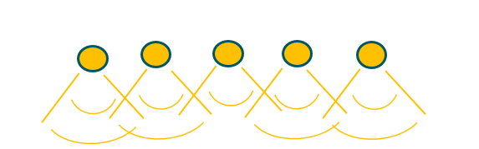
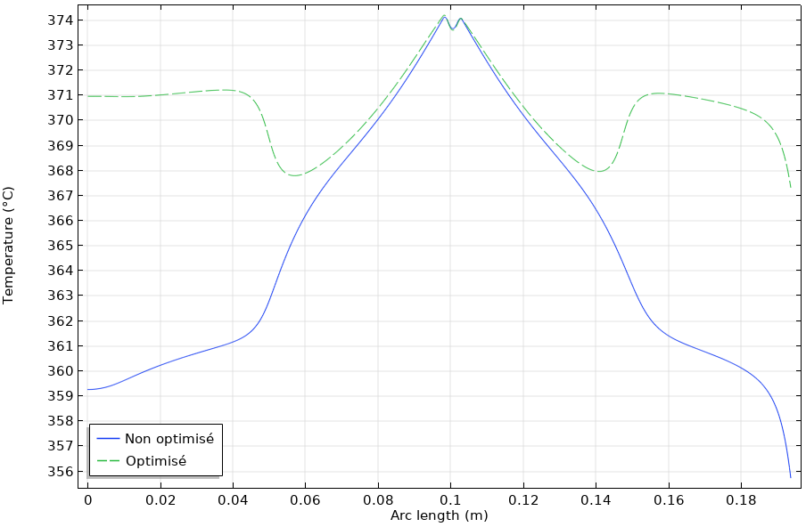
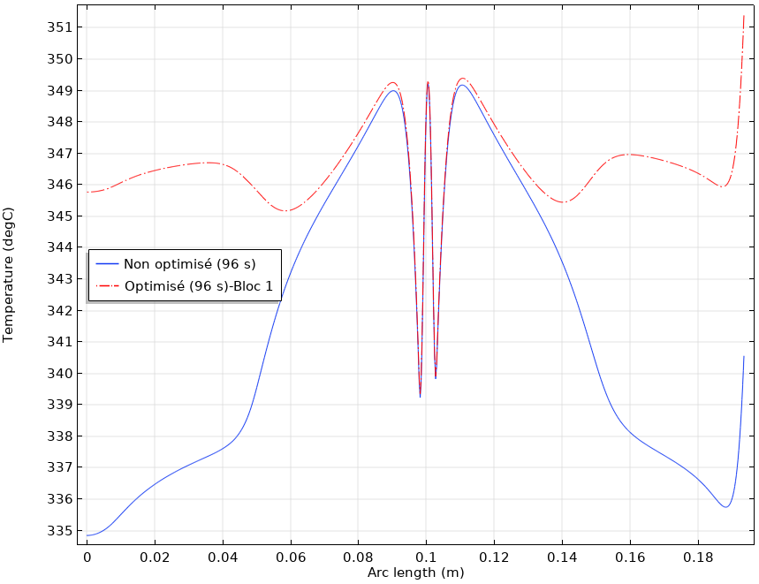
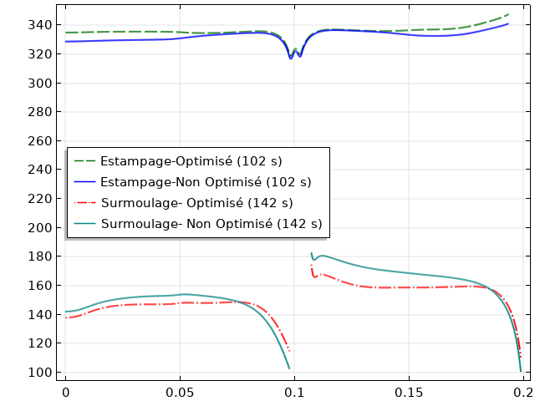
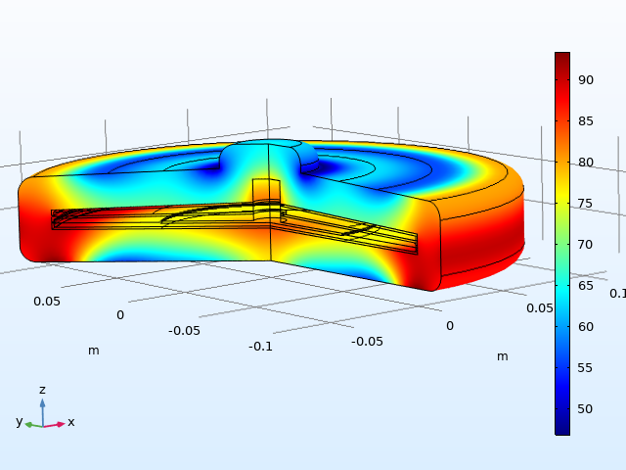
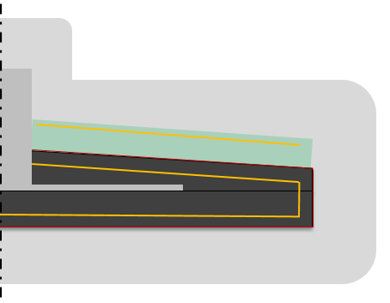
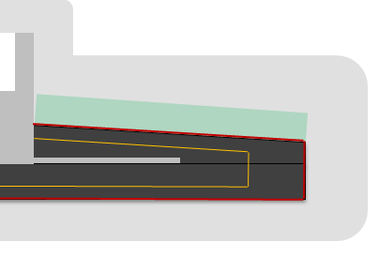

















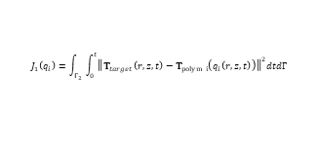


Heat transfer optimization in hybrid manufacturing processes involving high performance composites using COMSOL MULTIPHYSICS® and Livelink® for Matlab
Enrique Reyes Rodriguez ^{(1,2)}, Xavier Tardif ⁽¹⁾, Jean-Luc Bailleul ⁽³⁾, Nadine Allanic ⁽³⁾, Vincent Sobotka ⁽²⁾
(1)IRT Jules Verne, Chemin du Chaffault, 44340 Bouguenais; (2) Nantes université, CNRS, Laboratoire de thermique et énergie de Nantes, LTeN, UMR 6607, F-44000 Nantes; (3) Laboratoire de Génie des Procédés–Environnement–Agro-alimentaire (GEPEA) UMR CNRS 6144, Nantes
Introduction: An inadequate temperature control, during forming of High Properties Thermoplastic Composites (HP-TC) , could not only lead to mechanical and surface defects but also to an inefficient energy consumption. These problems become difficult to avoid with the interaction of different materials within the part, and also with the influence of subsequent stages on the process.
As part of the Project PERFORM, conducted by the IRT Jules Verne, this work aims to describe how to determine the spatial and temporal distribution of the heat sources that must be applied during different stages of a forming process to reach a thermal objective within the part. To do this, a thermal design methodology that could be adapted to different manufacturing processes of HP-TC is proposed based on the concept of conformal cooling [1] and on an inverse optimization method.
1
Hybrid manufacturing process
2
Approach and Computation model
The conformal approach proposes the creation of contour (dilated zone) reproducing the shape of the part, as close as possible to the mold’s surface [1], where heat fluxes are searched.
Metal insert
(Aluminium)
Dilated zone
(Steel)
Overmolding
(PEEK)
This allows us to create only a dilated zone[2] around the part, instead of the entire mold to analyze the heat transfer, reducing computational time and separating the process from the actual physics.
Organosheets
(PEEK+ Carbon fiber)
Figure 1. Hybrid manufacturing process stages
Figure 1. Dilated zone created around the piece. (Conformal approach)
The analysis is focused only on the heat transfer. A 2D axysimetric, incompressible and non-deformable system is considered with contact thermal resistances between all the domain parts (insert, composite, polymer, tools)
3
4
Boundary Conditions
Solving equations
Sensivity problem
$$T_{∞}$$
$$q_{2}\left(r,z,t\right)={h_{g}}^{∗}(t) (T_{2}\left(r,z,t\right)−T_{∞}\left(r,z,t\right))$$
Direct problem
Adjoint problem
a)
b)
$$q_{1}\left(r,z,t\right)=h_{g} (t) (T_{1}\left(r,z,t\right)−T_{∞}\left(r,z,t\right))$$
$ρ_{i}C_{pi}\frac{∂\left(T_{i}\right)}{∂t}={λ_{i}ΔT}_{i}$ on${ Ω }_{i}$
$ρ_{i}C_{pi}\frac{∂\left(δT_{i}\right)}{∂t}={λ_{i}ΔδT}_{i}$ o$n{ Ω }_{i}$
$ρ_{i}C_{pi}\frac{∂ψ_{i}}{∂t}=−{λ_{i}Δψ}_{i}$ ${on Ω }_{i}$
$$∀ i=1:4$$
$$z$$
Radiation and convection exchanges
$$z$$
$$h_{g}=Fσ(T_{1/2}+T_{∞1})({{{T_{1/2}}^{2}+T}_{∞1}}^{2})$$
$${ Ω }_{1}$$
$$q_{1}\left(r,z,t\right)$$
$$q_{1}\left(r,z,t\right)$$
$$T_{∞}$$
$$h_{convection}$$
$$q_{2}\left(r,z,t\right)$$
$$q_{2}\left(r,z,t\right)$$
5
Conjugate gradient algorithm
$${ Ω }_{2}$$
Initialization:
$${T_{∞}\left(r,z,t\right)}^{k}, k=0$$
Gradient ${∇J}_{T_{∞}}$ → descent direction
$${W^{k}={−∇J}_{T_{∞}}}^{k}$$
${W^{k}={−∇J}_{T_{∞} }}^{k}+\frac{{\left\|{{∇J}_{T_{∞}}}^{k}\right\|}^{2}}{{\left\|{∇J}_{T_{∞}}^{k−1}\right\|}^{2}}$:$W^{k−1}$
Gradient
$${ Ω }_{2}$$
$$r$$
$$r$$
$${{∇J}_{T_{∞}}}_{i}^{k}=h_{Γ}\int_{0}^{t}{\int_{Γ}{ψ_{3}\left(r,z,t\right)dΓdt}}$$
$${Γ^{∗}}_{}$$
$$Γ_{2}$$
$h_{g}=$global exchange coeff(Insert/Composite*)
$σ=\text{Boltzmann} \text{constant}$ / $F$= Shape factor
Solve Direct Problem
$$ψ_{3}\left(r,z,t\right)=Adjoint variable$$
c)
$$T_{∞}\left(r,z,t\right)$$
$$z$$
Evaluate Cost Fonction $J(q_{i}(T_{∞}))$
Deepest descent
$$z$$
$$q_{3}\left(r,z,t\right)$$
d)
$$q_{3}\left(r,z,t\right)$$
$$T_{∞}\left(r,z,t\right)$$
$${ρ^{k}=Argmin(φ\left(r\right))}^{k}$$
Descent
Convection
$$Γ$$
Convection
$$φ\left(r\right)=J({T_{∞}\left(r,z,t\right)}^{k}+rW)$$
$$ρ^{k}=\frac{{∇J}_{T_{∞}}^{k}∗w^{k}}{\int_{0}^{t}{\int_{Γ_{2}}{{{(δT}_{2})}_{i }^{k}dΓ_{2}dt}}+\int_{0}^{t}{\int_{Γ^{∗}}{{{\left(\overline{δT_{2}}−{δT}_{2}\right)}^{2}}_{i }^{k}dΓ^{∗}dt}}}$$
Conduction
$J$<$ε$
no
Update
Conduction
$${ Ω }_{4}$$
$$q_{1}\left(r,z,t\right)$$
$${ Ω }_{3}$$
$$q_{4}\left(r,z,t\right)$$
yes
Optimal
$${T_{∞}\left(r,z,t\right)}^{k+1}={T_{∞}\left(r,z,t\right)}^{k}+ρ^{k}W^{k}$$
$$r$$
$$r$$
Cost Fonction
$$J_{1}\left(q_{i}\right)=\int_{Γ_{2}}{\int_{0}^{t}{{\left\|T_{target}\left(r,z,t\right)−T_{polym i}\left(q_{i}\left(r,z,t\right)\right)\right\|}^{2}dtdΓ}}$$
Conduction
$$q_{2}\left(r,z,t\right)$$
$$q_{3}\left(r,z,t\right)=h_{Γ} (T_{3}\left(r,z,t\right)−T_{∞}\left(r,z,t\right))$$
$$J_{2}(q_{i})= \int_{Γ^{∗}}{\int_{0}^{t}{{\left\|{\overline{T}}_{polym i} (q_{i}(r,z,t))−T_{polym i}(q_{i}(r,z,t))\right\|}^{2}dt}dΓ}$$
Target temperature
Figure 2. Boundary conditions: a) Preheating, b) Transfer, c) Stamping, d) Overmolding.
Uniform temperature distribution
$$J(q_{i})=J_{1}(q_{i})+J_{2}(q_{i})$$
$∀ q_{i}=1:$3
6
Results: Profile temperature distribution
B
Zone in contact with the insert
Zone in contact with the insert
Zone in contact with the insert
Zone in contact with the insert
A
F
Target
G
A
B
A
B
B
Botton Side
Top Side
Melting point
A
A’
F
G
A
B
B
A
Target
A
A’
Figure 3. Preheating temperature profiles on the AB segment at $t=t_{1}$
Figure 4.Transfert temperature profiles on the AB segment at $t=t_{2}$
Figure 5. Stamping and overmolding temperature profiles and the end of each stage
Figure 6. Temperature profile distribution after optimization
7
Conclusions
• The proposed algorithm can effectively obtain improved heat flux conditions in comparison with a trial-error simulation. Maximum profile temperature at the top of the surface goes from 15°C à 6.5°C and form 18°C to 7°C at bottom.
• The optimization process allows us to take the optimized condition in one stage as the initial condition for the next stage in the process.
• Further analysis will include experimental validation and constrained optimization based in process requirements.
REFERENCES:
1. Xiaorong, & Xu. Conformal Cooling and Rapid Thermal Cycling in Injection Molding With 3D Printed Tools. (1999).
2. Agazzi, A. Contribution à l’optimisation de la thermique des outillages dans le procédé d’injection des polymères thermoplastiques (2011).
Confidential. Reproduction/ communication of all or part of this document is prohibited © IRT Jules Verne and the Laboratory thermal and energy of Nantes/ University of Nantes
Excerpt from the Proceedings of the 2020 COMSOL Conference- 14, 15 October2020
Notes:
Note:
All abstracts, papers, posters, and presentations must comply with, and are subject to, our Copyright Notice:
www.comsol.com/conference/copyright-notice
Reproduction/communication of all of part of this document is prohibited IRT Jules Verne

