Slide 1




Heat transfer optimization in hybrid manufacturing processes involving high performance composites using COMSOL MULTIPHYSICS® and Livelink® for Matlab
Auteurs: Enrique Reyes Rodriguez (1,2), Xavier Tardif (1), Jean-Luc Bailleul (2), Nadine Allanic (3), Vincent Sobotka (2)
(1)IRT Jules Verne, Chemin du Chaffault, 44340 Bouguenais; (2) Nantes université, CNRS, Laboratoire de thermique et energy de Nantes, LTeN, UMR 6607, F-44000 Nantes; (3) Laboratoire de Génie des Procédés– Environnement–Agro- alimentaire (GEPEA) UMR CNRS 6144, Nantes
Presented by: Enrique Reyes Rodriguez
14-15 October 2020
PROGRAM PERFORM
Confidential. Reproduction/ communication of all or part of this document is prohibited © IRT Jules Verne and the Laboratory thermal and energy of Nantes/ University of Nantes
Notes:
Hi, wellcome everyone,
My name ir Enrique Reyes im a PhD Student
I’m gonna be talking about how to perform thermal optimisationi hybird manufacturing procees involving high performance composites

Slide 2
Summary
1
Results
General context
(Introduction)
Theoretical and experimental parts
Study case
2
3
Where are we?
Where do we want to go?
Advantages
How do we get there?

Slide 3
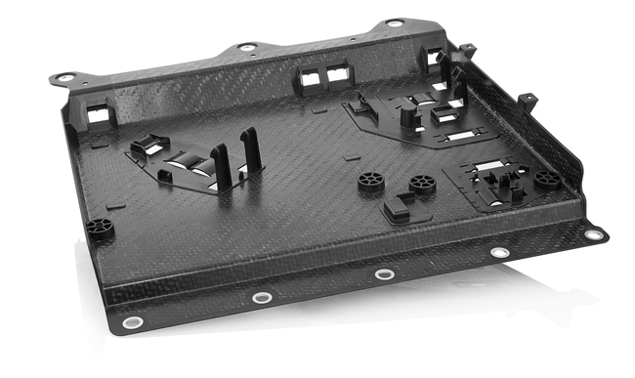




Introduction
Heating
Forming
Cooling
1
Hybrid parts
a) Preheating
b) Transfer
c) Stamping
d) Overmolding
2
Manufacturing processes
3
Thermal optimization
Conduction and convection exchanges
Organosheet
Radiation and convection exchanges
Radiation and convection exchanges
Conduction and convection exchanges
Cooling and ejection
$$t=t_{1}$$
$$t=t_{2}$$
$$t=t_{3}$$
$$t=t_{final}$$
Initial parameters in term of boundary conditions during the entire process
Optimization algorithm
Controlled temperature field
(Varying parameter: Time and space heat flux distribution around the part)
Methodology
Objective
Overmolded parts
Metal insert
Heat transfer Module
Livelink® for Matlab
© Pöppelmann Kunststoff-Technik GmbH & Co. KG, 2020
Notes:
HMP are used to fabricate parts with multiple materials in a quasi simultaneous way , with the intention of atteint
Differect requirement in termes of mechanical solititation, and to reduce production time or avoid complex secondary process.
The enrire proceess looks as follow:
Wraping, surface defact, deformation,
Reduce cristalliniy and hence mechanical properties of the part.

Slide 4
Global design methodology
Perform heat transfer analysis
(Direct problem)
Definition of the objective function and constraints for optimization
Perform heat transfer analysis
(Direct problem)
Definition of the objective function and constraints for optimization
Implementation of the optimization algorithm
Build the model geometry
Implementation of the optimization algorithm
Build the model geometry

Slide 5
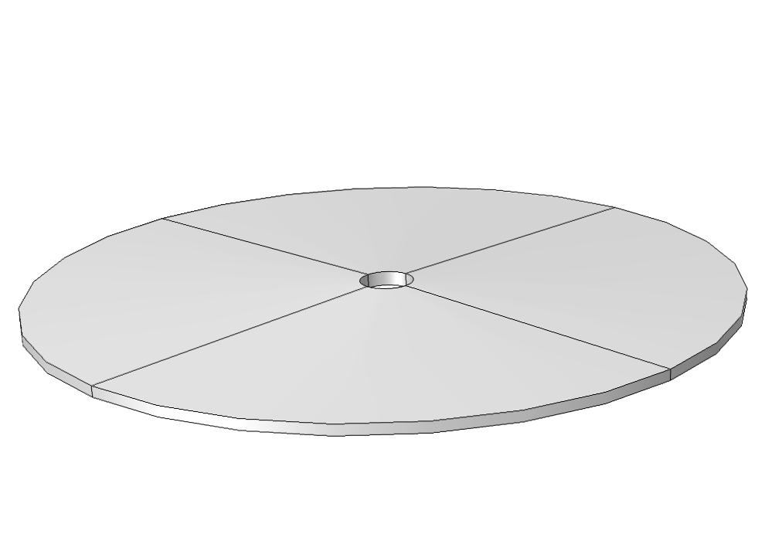
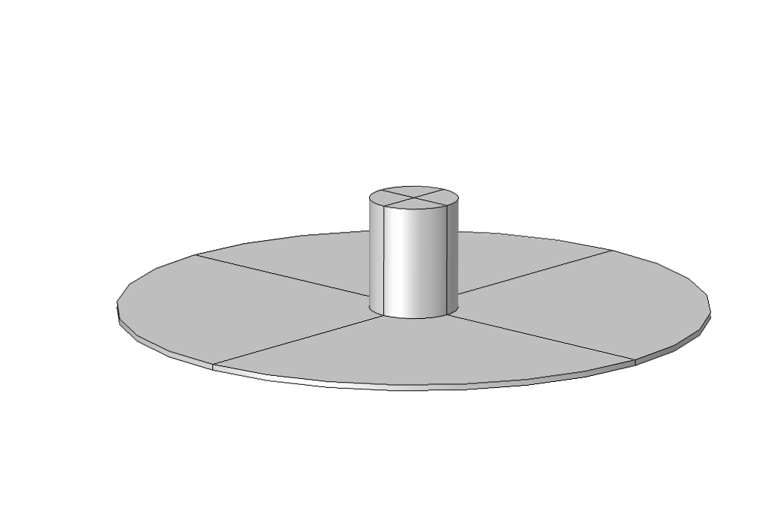
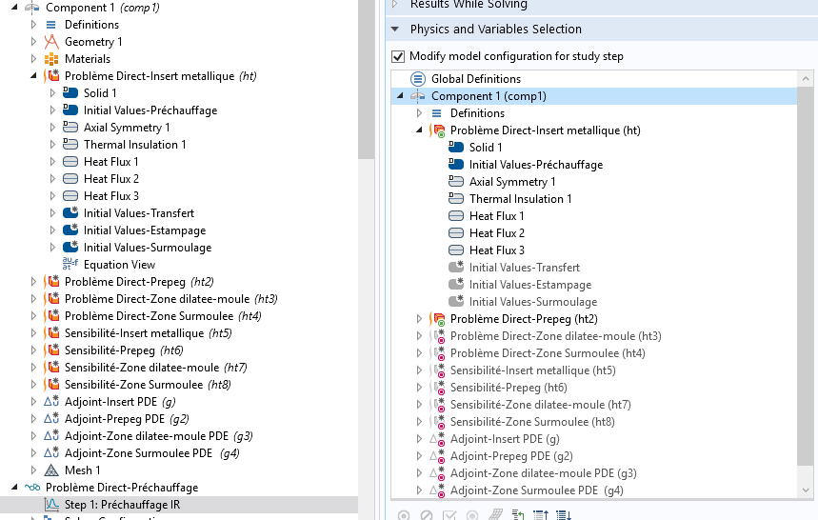
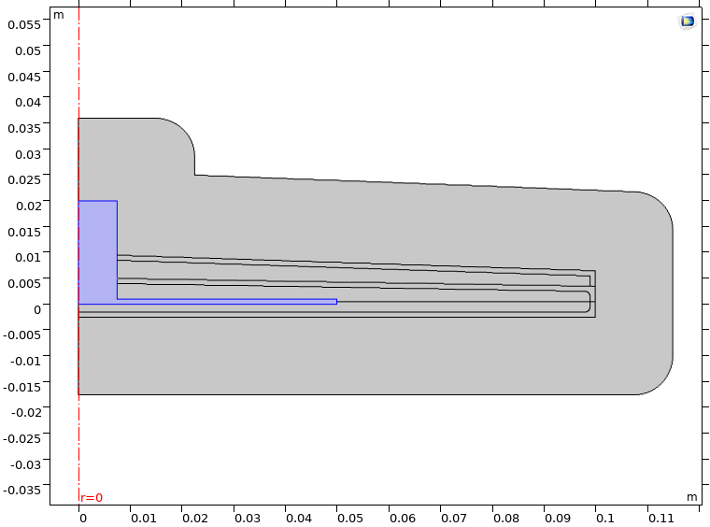
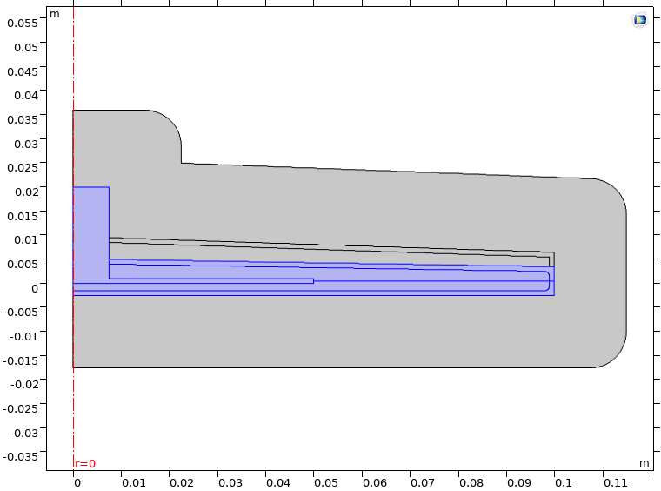
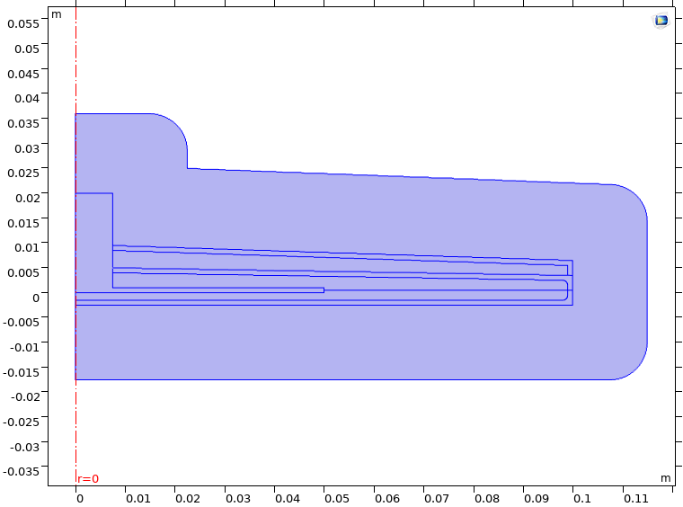


A-Building the model geometry
3D Model:
Overmolding
(PEEK)
Organosheet sup.
(PEEK +Fibre de Carbonne)
Metal insert
(Aluminium)
Organosheet inf.
(PEEK +Fibre de Carbone)
$$f(Ω,t)$$

Slide 6
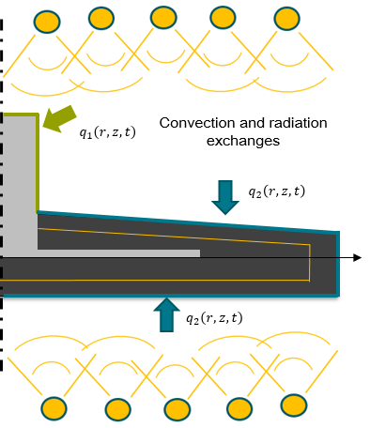
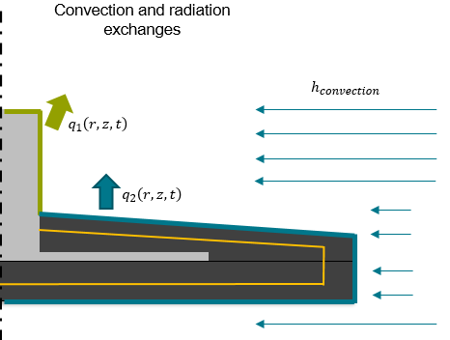
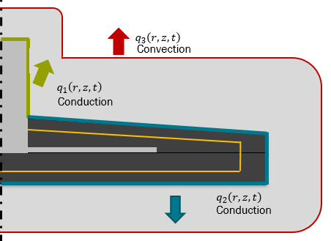
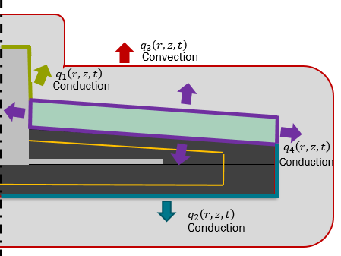















B- Performing heat transfer analysis
$$z$$
$$T_{∞1}$$
Preheating
$$z$$
$$T_{∞2}$$
Transfer
$$q_{1}\left(r,z,t\right)=h_{1} (T_{1}−T_{∞1})$$
$$q_{1}\left(r,z,t\right)=h_{2} (T_{1}−T_{∞2})$$
$$q_{2}\left(r,z,t\right)=h_{1}^{∗}(T_{2}−T_{∞1})$$
$$q_{2}\left(r,z,t\right)=h_{2}^{∗}(T_{2}−T_{∞2})$$
$$h_{1}=global exchange coeff$$
(Insert- environnement )
$$h_{2}=global exchange coeff$$
(Insert- environnement )
$$h_{1}^{∗}=global exchange coeff$$
(Composite- environnement )
$$r$$
$$h_{2}^{∗}=global exchange coeff$$
(Composite- environnement )
$$r$$
$$h_{r}=Fσ(T_{1}+T_{∞1})({{{T_{1}}^{2}+T}_{∞1}}^{2})$$
Stamping
$$z$$
$$z$$
Overmolding
$$T_{∞3}$$
$$T_{∞3}$$
$$q_{3}\left(r,z,t\right)=h_{3} (T_{3}−T_{∞3})$$
$$q_{3}\left(r,z,t\right)=h_{3} (T_{3}−T_{∞3})$$
Conformal cooling approach
$$r$$
$$r$$

Slide 7












C-Definition of the objective function
Bloc 1 (OPT1)
Bloc 2 (OPT2)
Transfer
Overmolding-cooling
Preheating
Stamping
$$T_{target}=357°C$$
$$T_{target}=340°C$$
$$T_{injection}=360°C$$
$$T_{target}=143°C$$
$$t=90s$$
$$t=96s$$
$$t=102s$$
$t=142$s
Cost Function:
$$J_{2}(q_{i})= \int_{Γ}{\int_{0}^{t}{{\left\|{\overline{T}}_{polym i} (q_{i}(r,z,t))−T_{polym i}(q_{i}(r,z,t))\right\|}^{2}dt}dΓ}$$
$$J_{1}(q_{i})=\int_{Γ}{\int_{0}^{t}{{\left\|T_{cible}(r,z,t)−T_{polym i}(q_{i}(r,z,t))\right\|}^{2}dtdΓ} }$$
Target temperature
Uniform temperature distribution
Cost Function
$$J(q_{i})=J_{1}(q_{i})+J_{2}(q_{i})$$
$$∀i=1,3,4$$
$$∀i=1,3,4$$

Slide 8




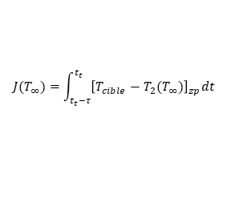



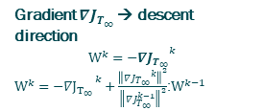
D –Implementation of the optimization model- Livelink® Matlab
*
Conjugate gradient algorithm
Initialization:
$${T_{∞}\left(r,z,t\right)}^{k}, k=0$$
Gradient ${∇J}_{T_{∞}}$ → descent direction
$${W^{k}={−∇J}_{T_{∞}}}^{k}$$
${W^{k}={−∇J}_{T_{∞} }}^{k}+\frac{{\left\|{{∇J}_{T_{∞}}}^{k}\right\|}^{2}}{{\left\|{∇J}_{T_{∞}}^{k−1}\right\|}^{2}}$:$W^{k−1}$
Solve Direct Problem
Gradient
$ψ_{2}$= Adjoint variable (Lagrange multiplier) in the dilated area.
Deepest descent
Evaluate Cost Fonction $J(q_{i}(T_{∞}))$
$${ρ^{k}=Argmin(φ\left(r\right))}^{k}$$
$$φ\left(r\right)=J({T_{∞}\left(r,z,t\right)}^{k}+rW)$$
$J$<$ε$
no
Update
$${T_{∞}\left(r,z,t\right)}^{k+1}={T_{∞}\left(r,z,t\right)}^{k}+ρ^{k}W^{k}$$
Constrained optimization
yes
Optimal
Adjoint method- Lagrangien
Cost-Function
$$J(T_{∞})=\int_{t_{t}−τ}^{t_{t}}{{\left[T_{cible}−T_{2}(T_{∞})\right]}_{zp}dt}$$
The adjoint method consists in considering a stationary condition 𝑑𝐿 = 0 to determine the adjoint equations and subsequently the gradient equation. . [Y Jarny ,2010]
Target temperature
*Agazzi, 2011

Slide 9
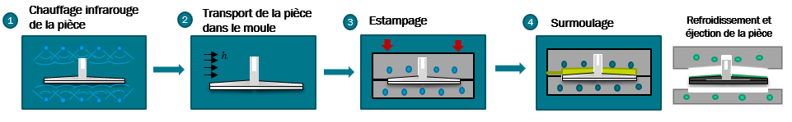
First results
1
Preheating
2
Transfer
3
Stamping
4
Overmolding
Cooling and ejection

Slide 10
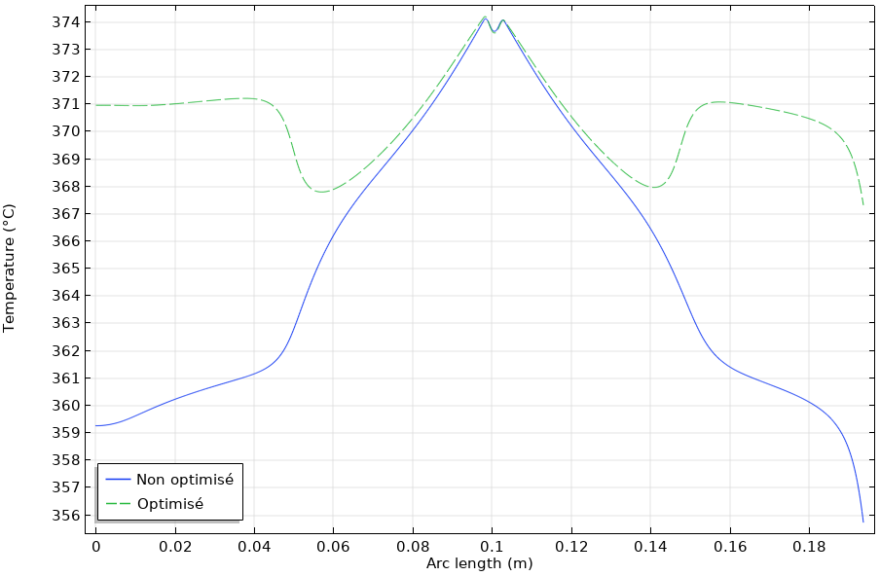
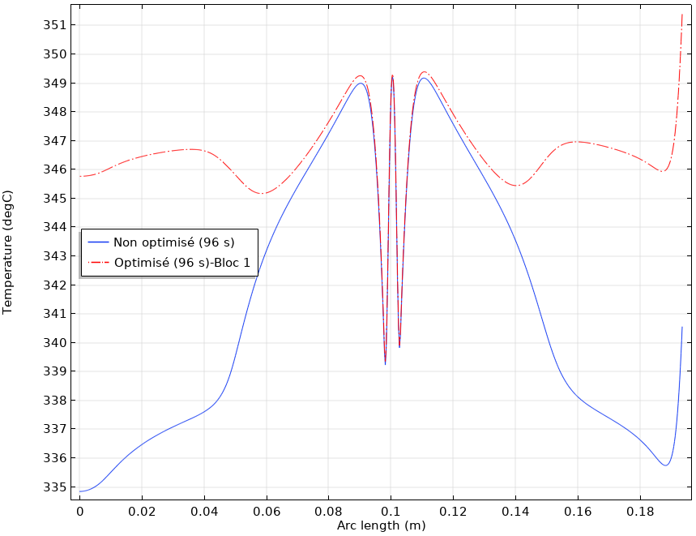
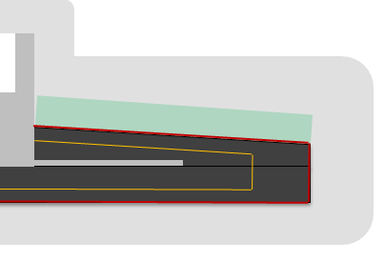



OPT1
Optimization (1/2)
Preheating
Transfer
$$q_{1}\left(r,z,t\right)=h(T−T_{∞1})$$
$T_{target}$=347°C
Preheating
Transfer
Zone in contact with the metal insert
Zone in contact between two organosheets
Zone in contact between two organosheets
Zone in contact with the metal insert
Zone in contact with the metal insert
Zone in contact between two organosheets
Zone in contact between two organosheets
Zone in contact with the metal insert
A
B
B
A
Target
Top
Bottom
Optimized
Non Optimized
Melting Point
B
A
Optimized
Non Optimized
B
$$t=t_{f}$$
A

Slide 11
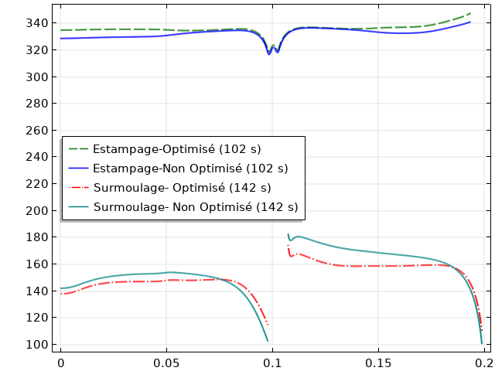
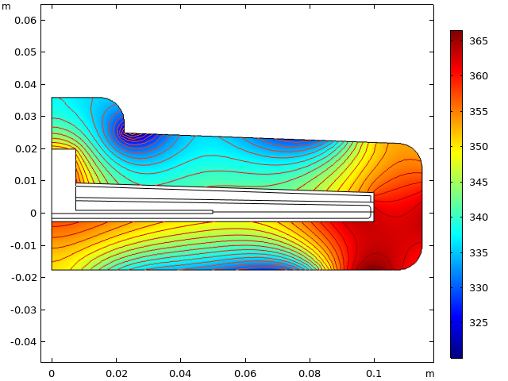
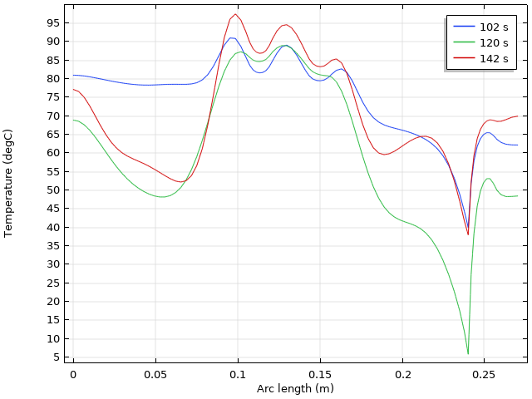
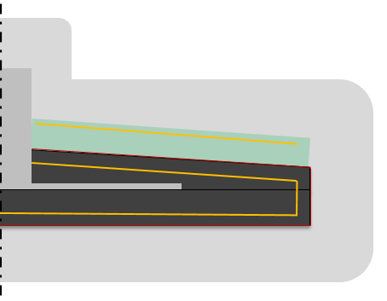

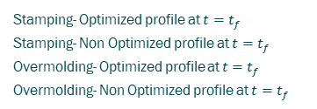
Optimization (2/2)
Bloc 2 (OPT2)
Stamping
Overmolding
Stamping- Overmolding
A
B
Zone in contact with the metal insert
Zone -two organosheets in contact
E
F
G
Stamping- Optimized profile at $t=t_{f}$
Stamping- Non Optimized profile at $t=t_{f}$
Overmolding- Optimized profile at $t=t_{f}$
Overmolding- Non Optimized profile at $t=t_{f}$
B
A
A’
$$Γ_{3}$$
F
E
A
Target
A’
G

Slide 12
Conclusions
One single geometry is enough to optimize all the stages, working with sequential solutions.
Boundary conditions depending on time and space were established for each physics.
Adjoint -state is obtained solving a backwards heat diffusion equation trough a PDE physics on the heat transfer module.
Optimization: an optimization algorithm, that would help in the decision making about the thermal parameters or strategy, is proposed using Livelink® for Matlab

Slide 13
THANKS FOR YOUR ATTENTION

Slide 14
This research is part of the Project PERFORM, conducted by the IRT Jules Verne.
Confidential. Reproduction/ communication of all or part of this document is prohibited © IRT Jules Verne and the Laboratory thermal and energy of Nantes/ University of Nantes

