Slide 1
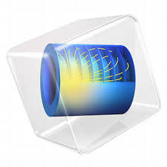
Multi-Physical Simulation of Aerostatic Bearings
F. Colombo, L. Lentini, T. Raparelli, A. Trivella, V. Viktorov
Department of Mechanical and Aerospace Engineering
Politecnico di Torino,Turin (Italy)

Slide 2
OUTLINE
INTRODUCTION
  Aerostatic Pads
  Aim of This Study
MATERIALS AND METHODS
  Experimental Set-up
  Numerical Model
RESULTS AND DISCUSSIONS
CONCLUSIONS

Slide 3
OUTLINE
INTRODUCTION
  Aerostatic Pads
  Aim of This Study
MATERIALS AND METHODS
  Experimental Set-up
  Numerical Model
RESULTS AND DISCUSSIONS
CONCLUSIONS

Slide 4
OUTLINE
INTRODUCTION
  Aerostatic Pads
  Aim of This Study
MATERIALS AND METHODS
  Experimental Set-up
  Numerical Model
RESULTS AND DISCUSSIONS
CONCLUSIONS

Slide 5
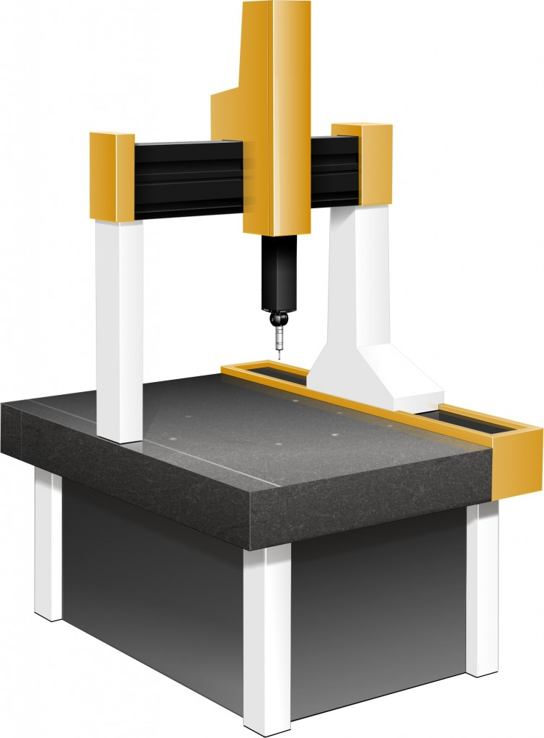
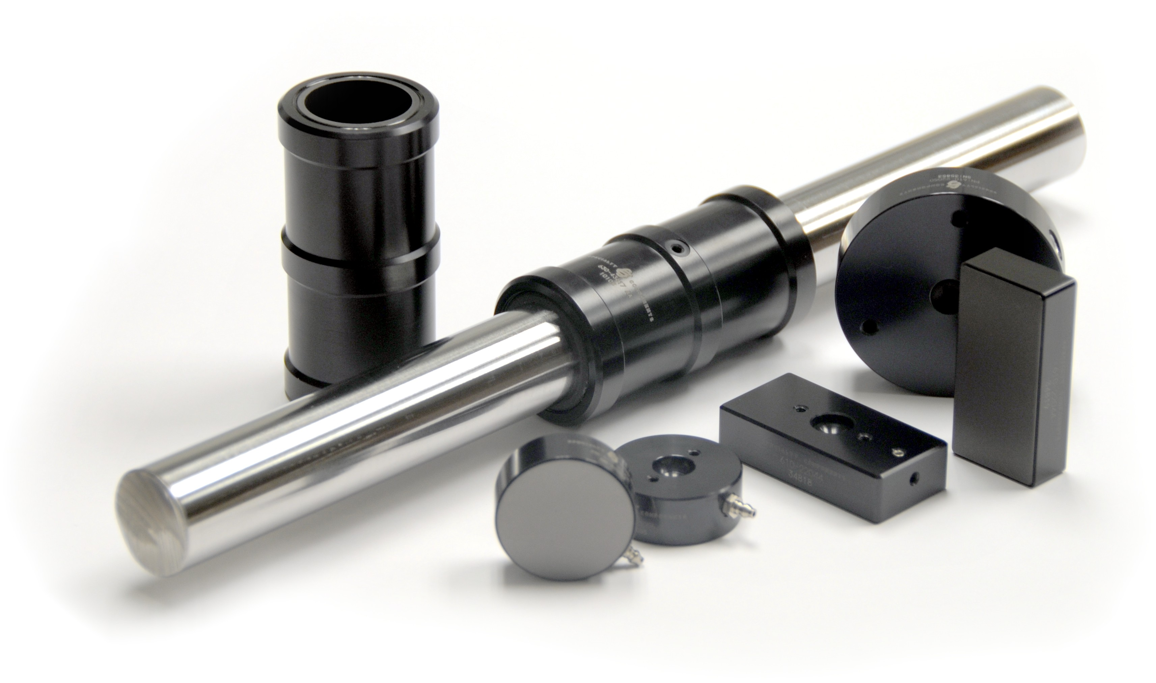
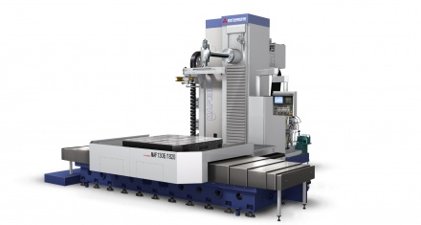
INTRODUCTION
AEROSTATIC PADS: APPLICATIONS
Aerostatic pads are widely used in applications where high precision is required, e.g.:
Machine Tools
Measuring Machine
Power Board Testing

Slide 6
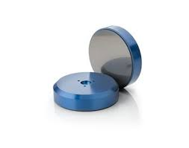
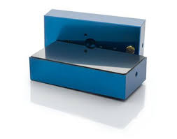
INTRODUCTION
AEROSTATIC PADS: FEATURES
Aerostatic pads are characterized by:
PROS:
Low Friction
Low Wear
Limited Heat Generations
Long Life
Excellent Start-Up Performance

Slide 7
INTRODUCTION
AEROSTATIC PADS: FEATURES
Their performance depends on many geometrical and physical parameters, e.g.,
Supply Pressure
Type, location and number of restrictors
Shape of the bearing land
Manufacturing
Deformations
…

Slide 8
INTRODUCTION
AEROSTATIC PADS: FEATURES
Their performance depends on many geometrical and physical parameters, e.g.,
Supply Pressure
Type, location and number of restrictors
Shape of the bearing land
Manufacturing
Deformations
…
The relevance of some of these aspects is
not taken into account in numerical models!

Slide 9
INTRODUCTION
AEROSTATIC PADS: FEATURES
The aim of this study to evaluate to what extent the accuracy of numerical models can influenced by some of these “secondary” aspects:

Slide 10
INTRODUCTION
AIM OF THE STUDY
The aim of this study to evaluate to what extent the accuracy of numerical models can influenced by some of these “secondary” aspects:
Tilting

Slide 11
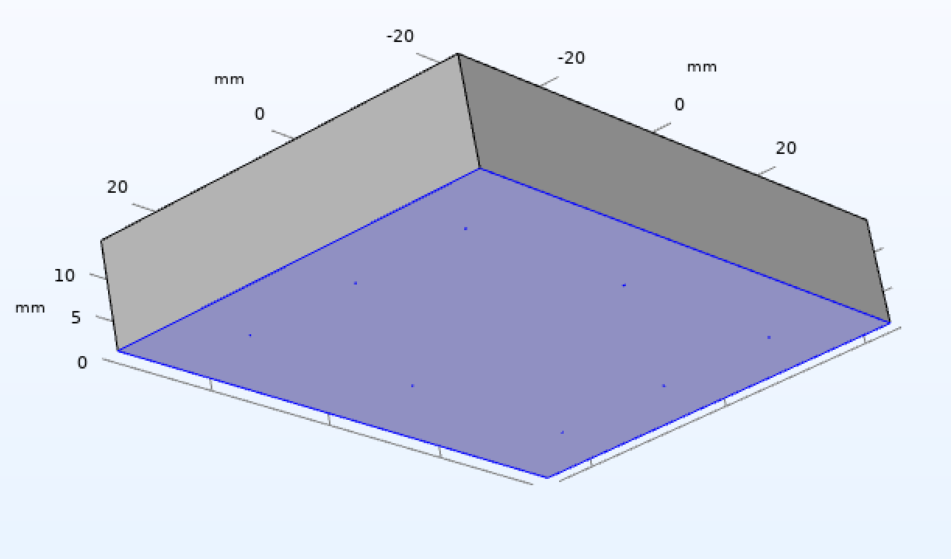
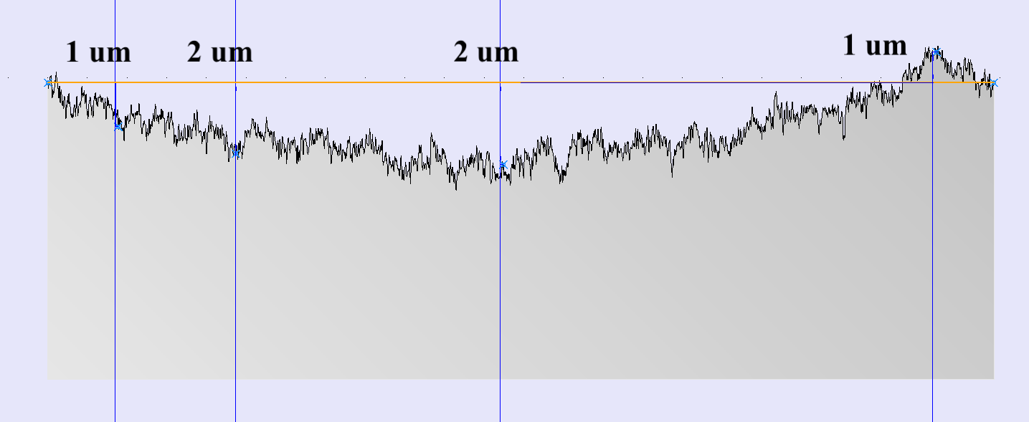
INTRODUCTION
AIM OF THE STUDY
The aim of this study to evaluate to what extent the accuracy of numerical models can influenced by some of these “secondary” aspects:
Tilting
Concavity of the Bearing Land

Slide 12
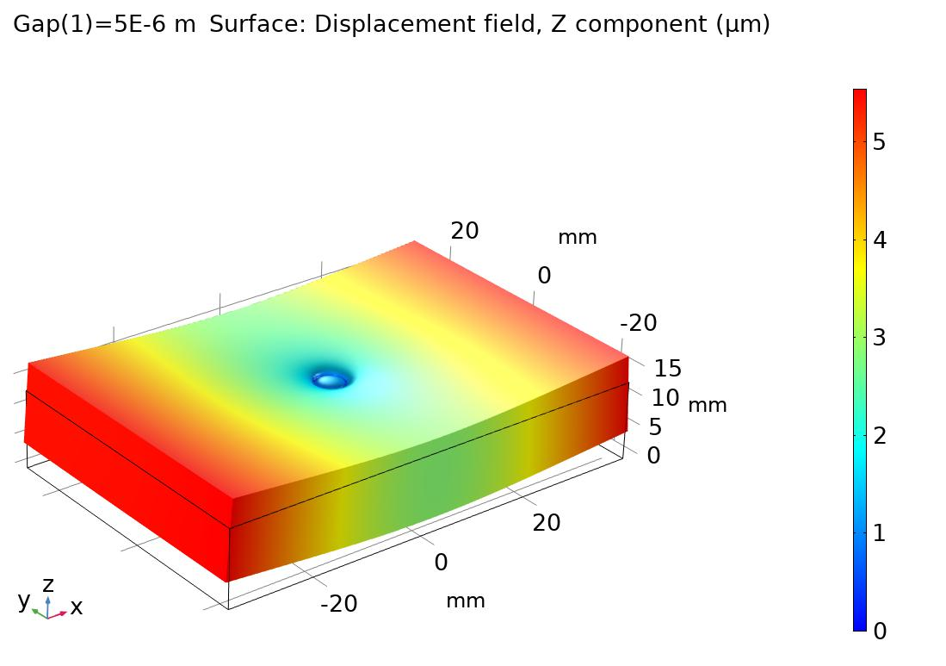
INTRODUCTION
AIM OF THE STUDY
The aim of this study to evaluate to what extent the accuracy of numerical models can influenced by some of these “secondary” aspects:
Tilting
Concavity of the Bearing Land
Deformations

Slide 13
INTRODUCTION
AIM OF THE STUDY
The aim of this study to evaluate to what extent the accuracy of numerical models can influenced by some of these “secondary” aspects:
Tilting
Concavity of the Bearing Land
Deformations
Combination of the previous ones

Slide 14
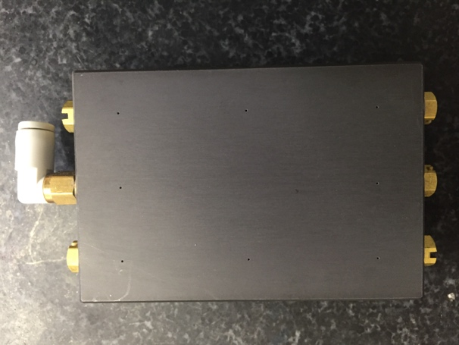
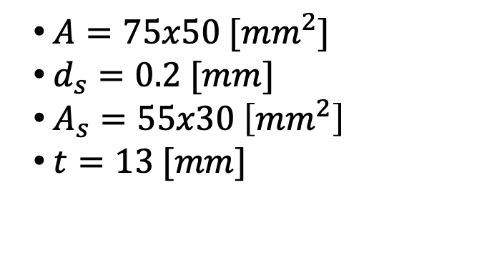
EXPERIMENTAL SET-UP
THE AEROSTATIC PAD
$A=75x50 [{mm}^{2}]$
$d_{s}=0.2 [mm]$
$A_{s}=55x30 \left[{mm}^{2}\right]$
$t=13 [mm]$
Figure: Photograph of the bearing land.
Figure: Scheme of the bearing land.

Slide 15
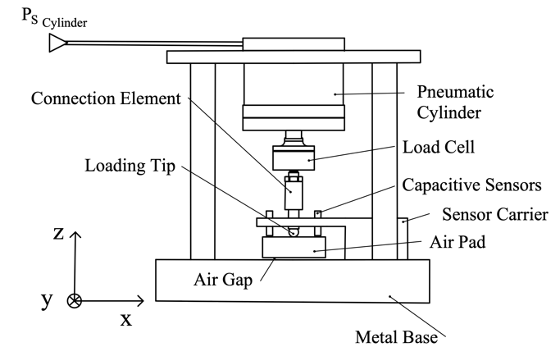
EXPERIMENTAL SET-UP
THE STATIC TEST BENCH
Static Characterization of the pad
Load Capacity (F vs h)
Air Consumption (G vs h)
Figure: Scheme of the static test bench

Slide 16
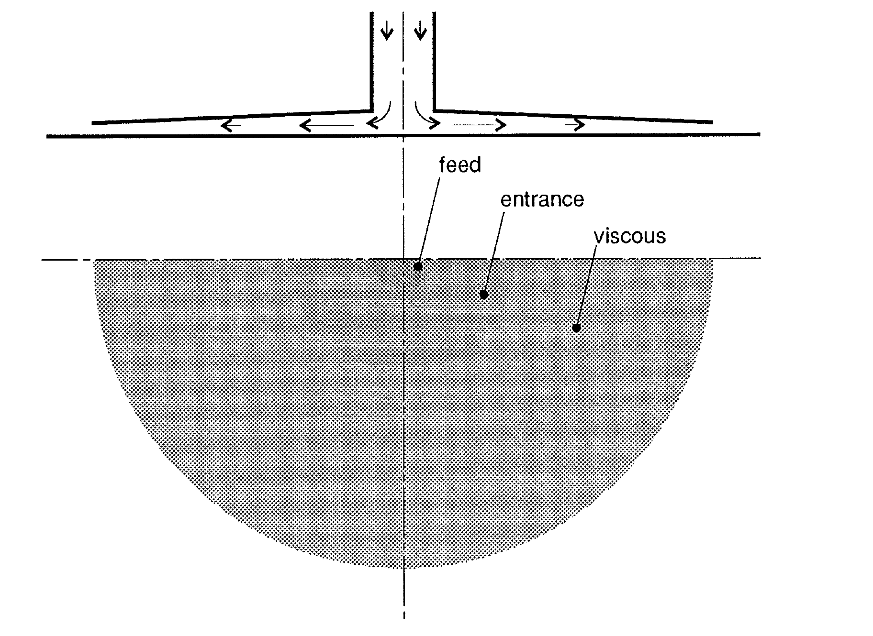
NUMERICAL MODEL
PHYSICAL DESCRIPTION OF THE PROBLEM
The model consist of the bearing can be divide in different regions that have to be described through different types of flow models:
Feed Region (Euler’s equation)
Entrance Region (Boundary layer theory)
Viscous Region (Reynolds’ equation)
Figure: Main regions of the bearings.

Slide 17
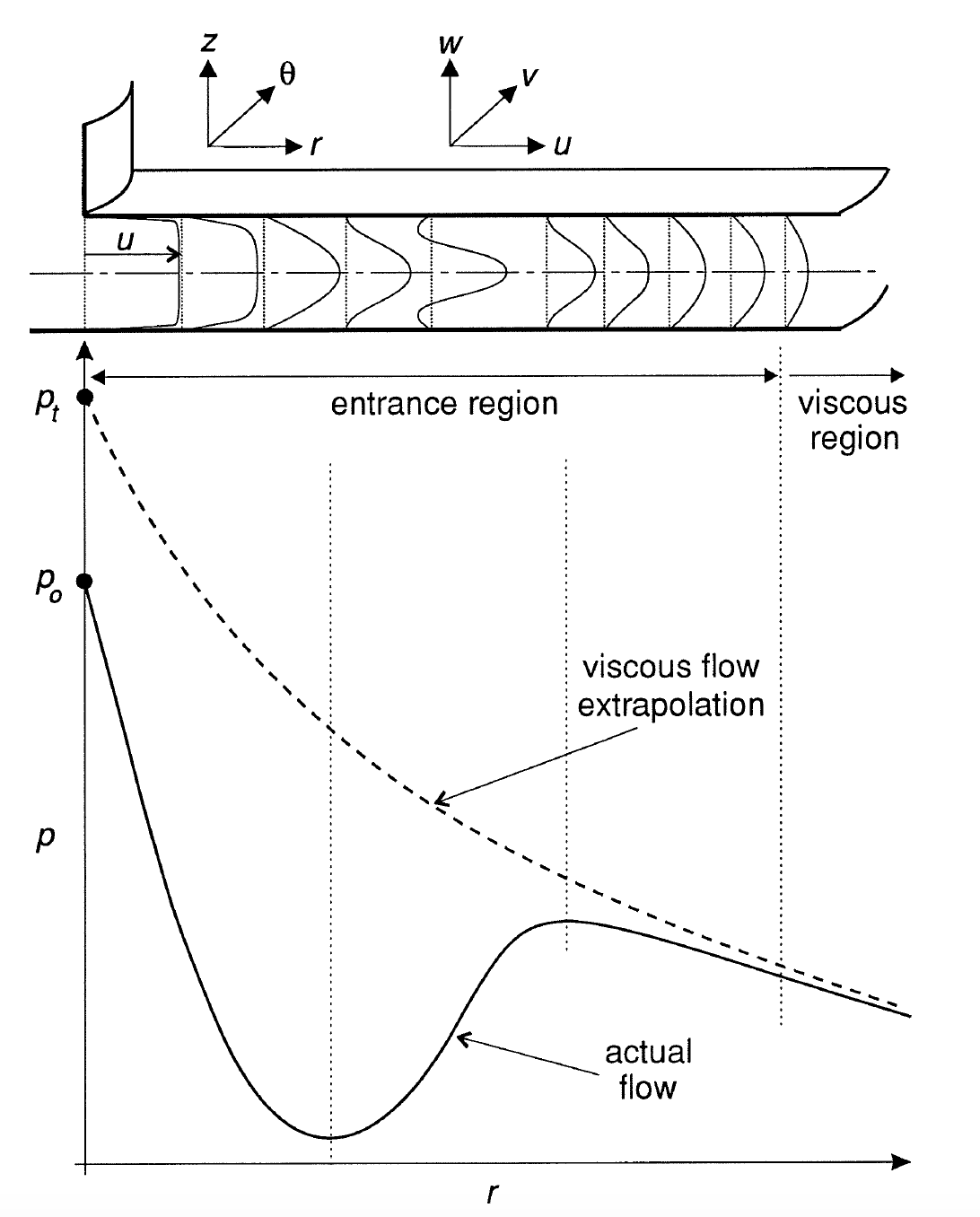
NUMERICAL MODEL
PHYSICAL DESCRIPTION OF THE PROBLEM
The model consist of the bearing can be divide in different regions that have to be described through different types of flow models:
Feed Region (Euler’s equation)
Entrance Region (Boundary layer theory)
Viscous Region (Reynolds’ equation)
The more common solution consist in using an equilibrium pressure that links the inertial and the viscous region neglecting the growth of the boundary layer through the entrance region
Figure: Film flow configuration.

Slide 18
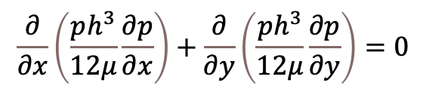
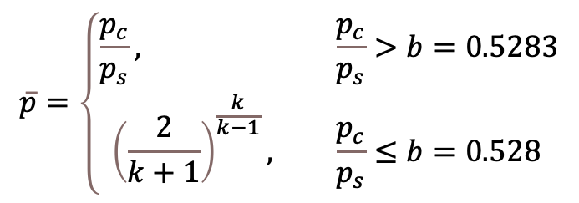
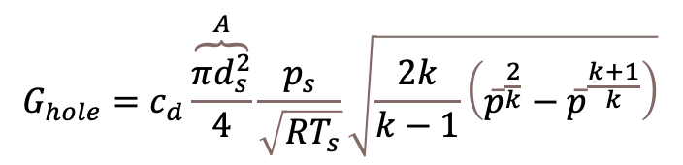
NUMERICAL MODEL
MAIN EQUATIONS
Feed Region (Euler’s equation)
$$G_{hole}=c_{d}\overset{A}{\overbrace{\frac{πd_{s}^{2}}{4}}}\frac{p_{s}}{\sqrt{RT_{s}}}\sqrt{\frac{2k}{k−1}\left({\overline{p}}^{\frac{2}{k}}−{\overline{p}}^{\frac{k+1}{k}}\right)}$$
$$\overline{p}=\left\{\begin{aligned}\frac{p_{c}}{p_{s}}, &\frac{p_{c}}{p_{s}}>b=0.5283 \\ {\left(\frac{2}{k+1}\right)}^{\frac{k}{k−1}}, &\frac{p_{c}}{p_{s}}≤b=0.528\end{aligned}\right.$$
Viscous Region (Reynolds’ equation)
$$\frac{∂}{∂x}\left(\frac{ph^{3}}{12μ}\frac{∂p}{∂x}\right)+\frac{∂}{∂y}\left(\frac{ph^{3}}{12μ}\frac{∂p}{∂y}\right)=0$$
Figure: Main regions of the bearings.

Slide 19


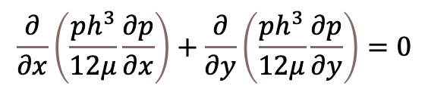
NUMERICAL MODEL
MAIN EQUATIONS
Feed Region (Euler’s equation)
$$G_{hole}=c_{d}\overset{A}{\overbrace{\frac{πd_{s}^{2}}{4}}}\frac{p_{s}}{\sqrt{RT_{s}}}\sqrt{\frac{2k}{k−1}\left({\overline{p}}^{\frac{2}{k}}−{\overline{p}}^{\frac{k+1}{k}}\right)}$$
1-3 Continuity equation
$$\overline{p}=\left\{\begin{aligned}\frac{p_{c}}{p_{s}}, &\frac{p_{c}}{p_{s}}>b=0.5283 \\ {\left(\frac{2}{k+1}\right)}^{\frac{k}{k−1}}, &\frac{p_{c}}{p_{s}}≤b=0.528\end{aligned}\right.$$
$$G_{hole}−G_{gap}=0$$
$$p_{c}$$
Viscous Region (Reynolds’ equation)
$$\frac{∂}{∂x}\left(\frac{ph^{3}}{12μ}\frac{∂p}{∂x}\right)+\frac{∂}{∂y}\left(\frac{ph^{3}}{12μ}\frac{∂p}{∂y}\right)=0$$

Slide 20
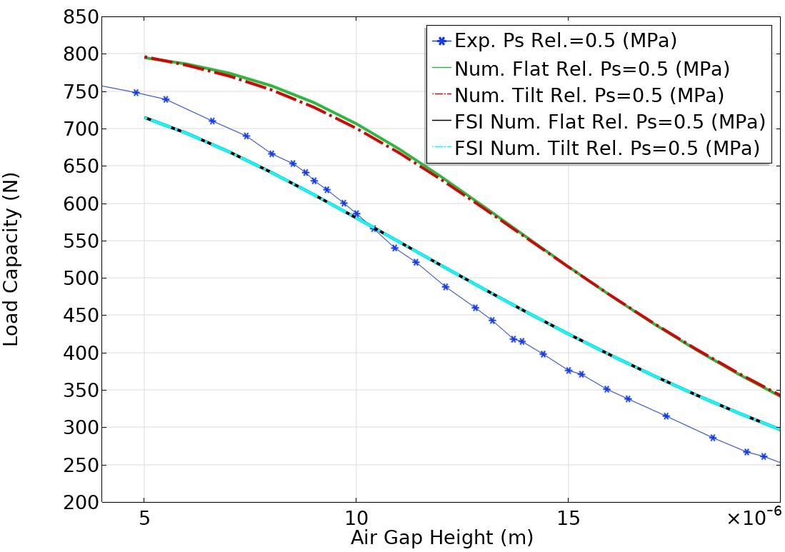
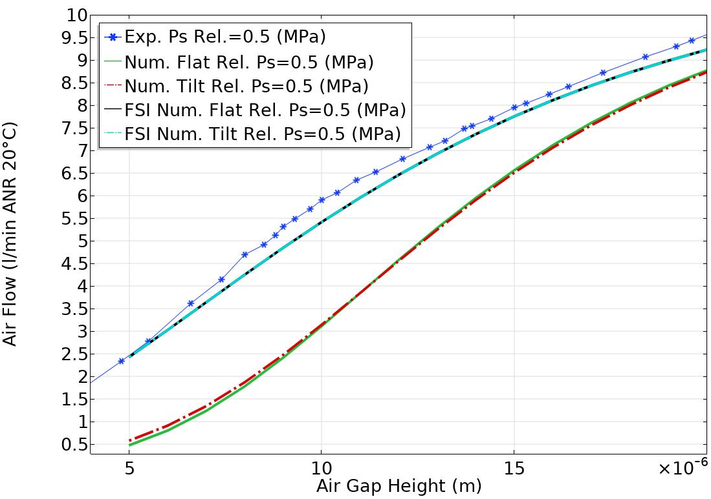
RESULTS AND DISCUSSIONS
TILTING
Figure: Numerical and experimental load capacity curves
Figure: Numerical and experimental air consumption curves

Slide 21
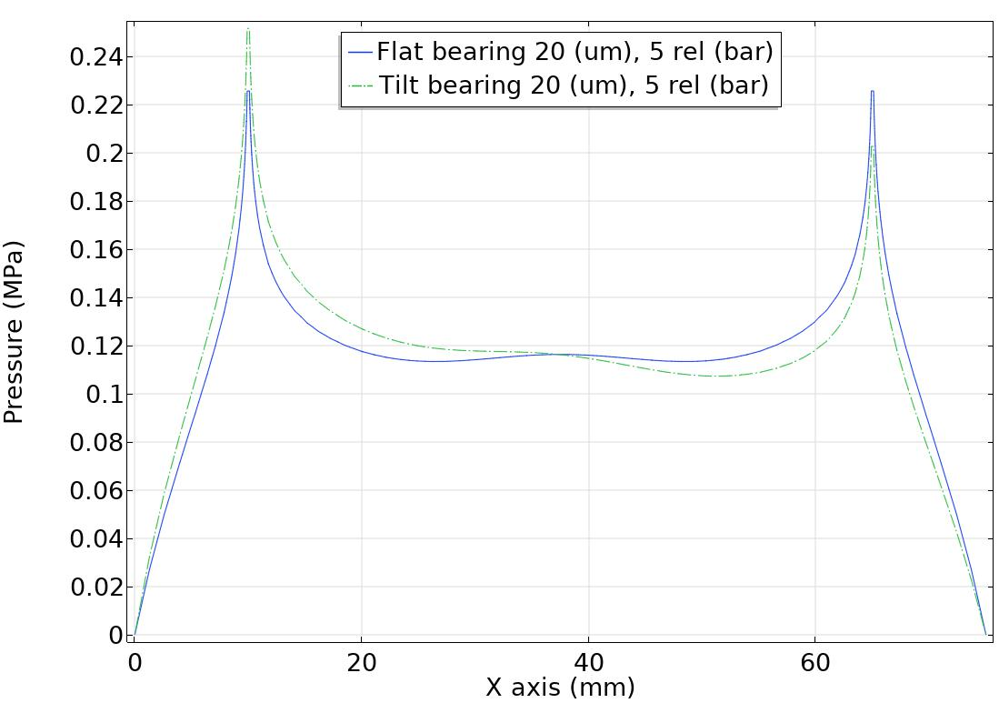
RESULTS AND DISCUSSIONS
TILTING
Figure: Comparison between the pressure distributions of the simulated pad

Slide 22
RESULTS AND DISCUSSIONS
DEFORMATIONS
Figure: Pad deflection in the presence of an air gap height of 5 $μ$m.
Figure: Numerical and experimental load capacity curves

Slide 23
RESULTS AND DISCUSSIONS
DEFORMATIONS
The effect of the pad deflection in not negligible, especially in the presence of small air gap heights!
Figure: Pad deflection in the presence of an air gap height of 5 $μ$m.

Slide 24
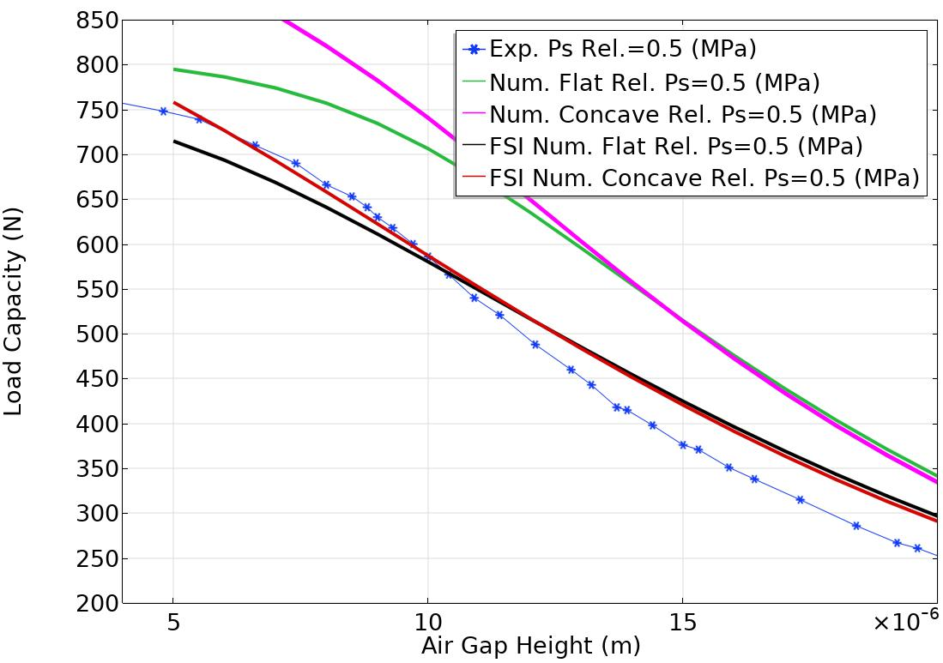
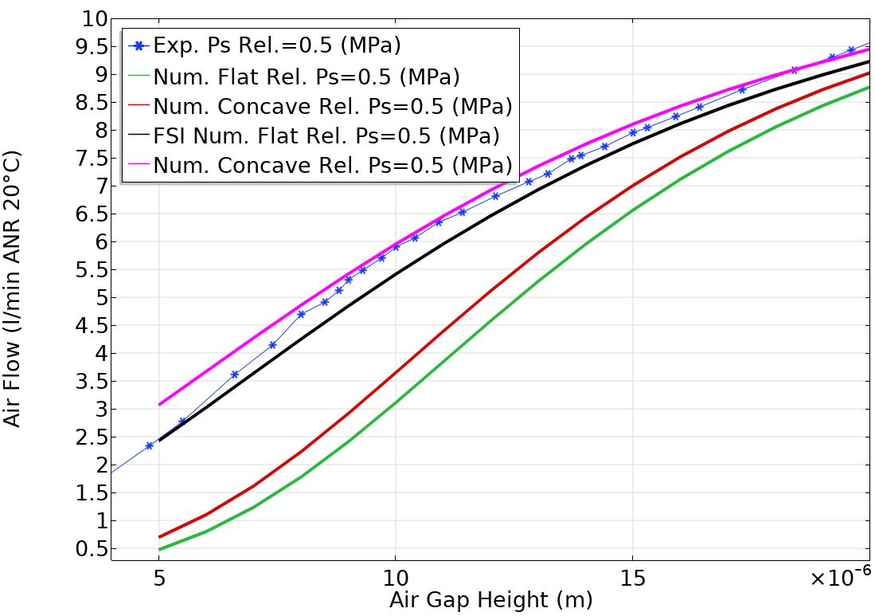
RESULTS AND DISCUSSIONS
DEFORMATIONS & CONCAVITY
Figure: Numerical and experimental load capacity curves
Figure: Numerical and experimental air consumption curves

Slide 25
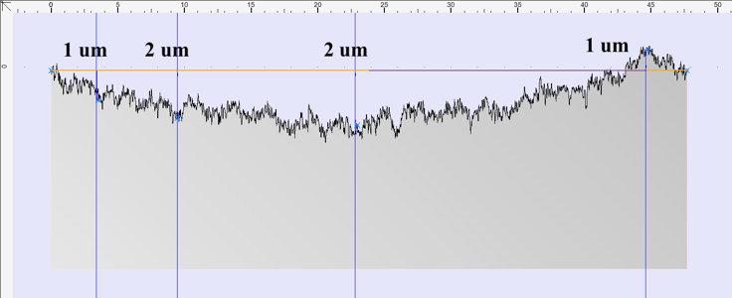
RESULTS AND DISCUSSIONS
CONCAVITY
The presence of concavity was experimentally verified.
Figure: Experimental profile of the pad.

Slide 26

CONCLUSIONS
This paper has presented a numerical and experimental investigation on some of the main parameter that can compromise the accuracy aerostatic pad numerical models: shape of the bearing land (concavity/convexity), tilting and deformations.
It was found that the theoretical tilting has no effect on the pad performance.
Conversely, the shape of the bearing land and the deflection exhibited by the pad significantly compromise the accuracy of numerical predictions.

