Slide 1

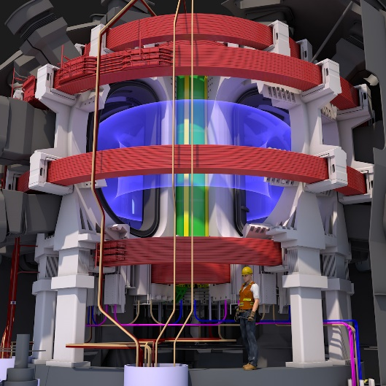
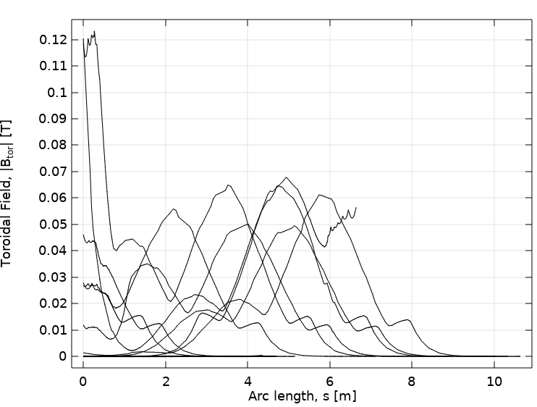
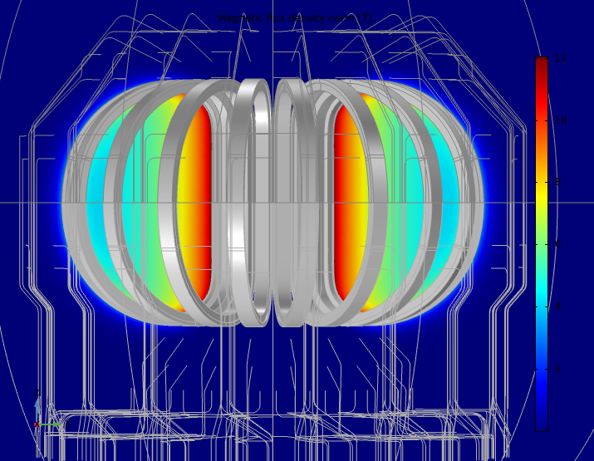
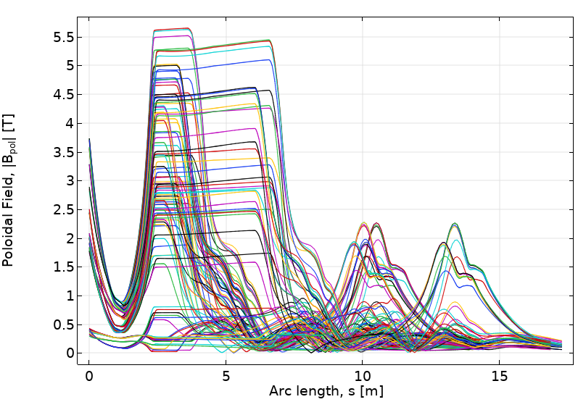
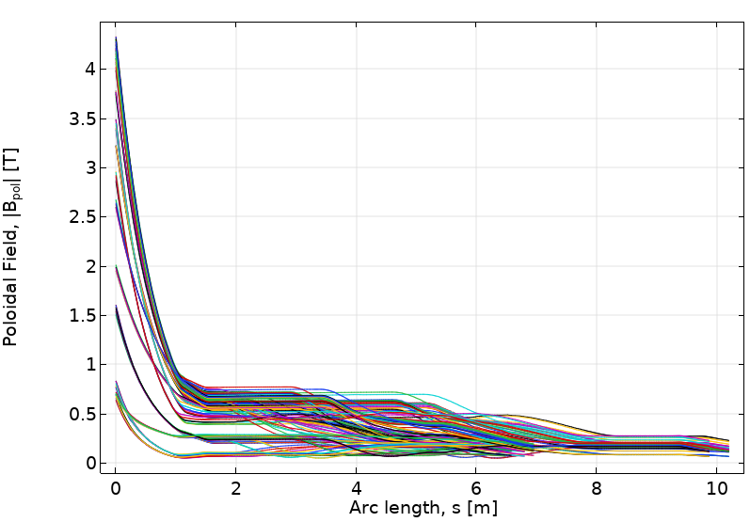
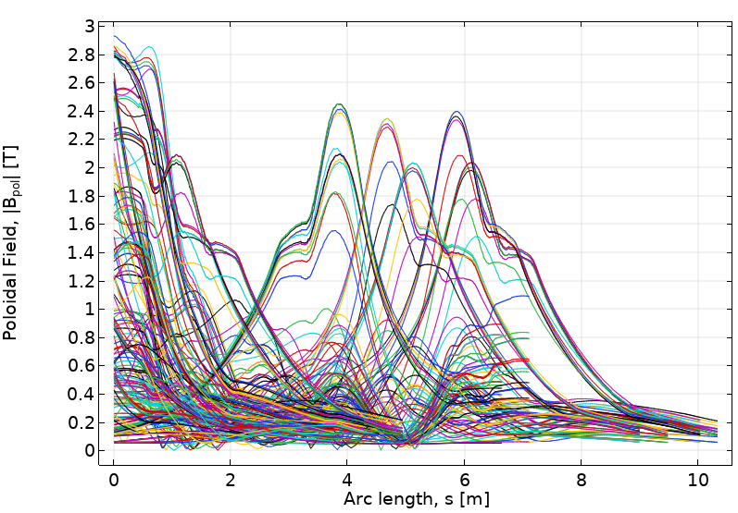
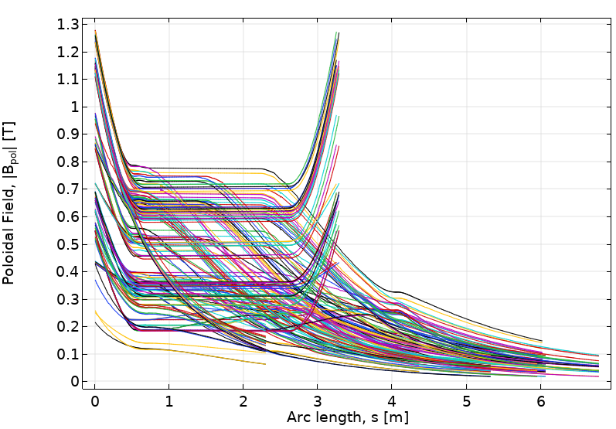
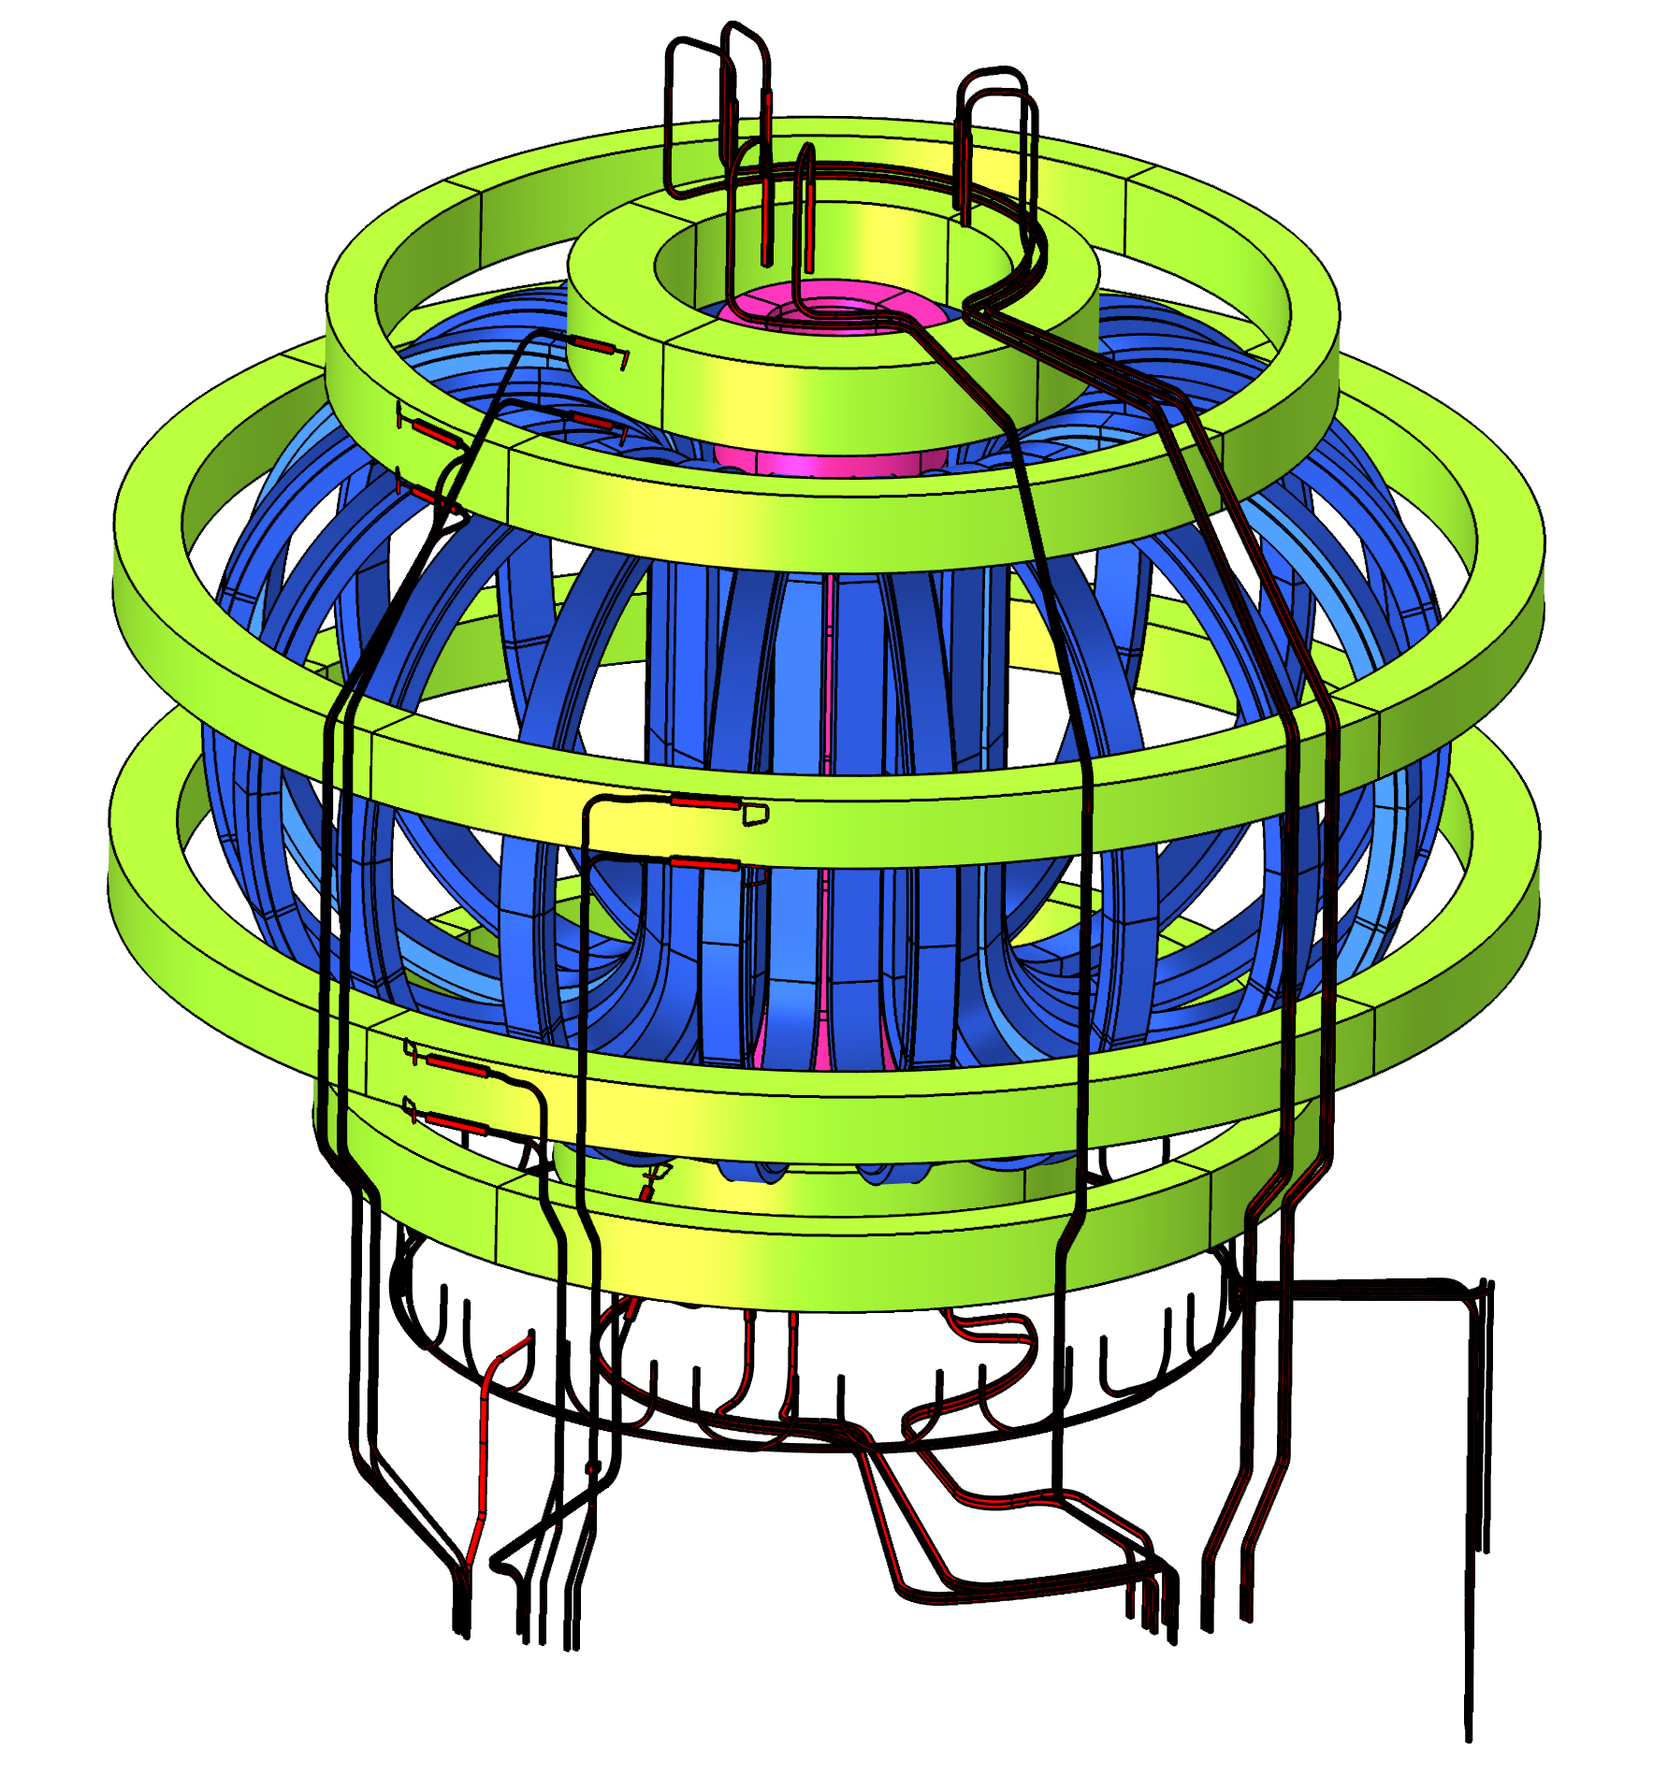
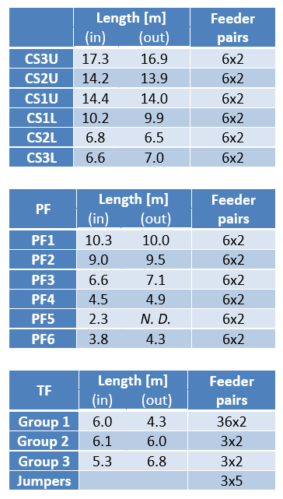




Electromagnetic Analysis of the Superconducting Magnet Feeders System of the Divertor Tokamak Testing Facility
G. De Marzi¹, A. Cucchiaro^{2,3}, F. De Baggis⁴, A. della Corte¹, L. Giannini¹, L. Muzzi¹, and A. Di Zenobio¹
1. Department of Fusion and Technology for Nuclear Safety and Security, ENEA, Frascati, Italy
2. DTT S. C. a r.l., Frascati, Italy; 3. Consorzio CREATE, Naples, Italy
4. Department of Mechanical Engineering, Sapienza Università di Roma, Rome, Italy
INTRODUCTION
RESULTS
As part of the European Research Roadmap to the Realization of Fusion Energy [1] the Divertor Tokamak Test facility (DTT) [2] aims to study alternative divertor configurations in view of the EU-DEMO [3] power exhaust handling issues.
The superconducting (SC) coils are connected to the current leads by a system of current feeders (figure 2). To finalize the project in the most appropriate way, it is advisable to carry out a detailed evaluation of the magnetic field seen by the SC feeders, to facilitate:
- the choice of the superconducting material to use;
- the definition of the best paths for the feeders;
- the design of the mechanical supports that counteract the Lorentz loads.
The cases analyzed are those of the normal operation scenarios (Single Null, Double Null, Snow Flake, XDivertor, Negative Triangularity).
Toroidal Fields: 18-fold, 3D Model
The field generated by the TF coils at full current (about 42 kA) is evaluated using a 18-fold 3D model.
The magnetic field map thus obtained is shown in Figure 3, along with the norm of the toroidal field, |B_{tor}| evaluated along the feeders’ arc lengths.
Poloidal & Central Solenoid: 2D axisymmetric Model
Figure 4 shows the magnitude of the poloidal magnetic field |B_{pol}| along the path of the feeders (all scenarios)
Figure 3. The field generated by the 18 TF coils along the feeders’ paths.
Figure 1. The DTT superconducting magnet system comprises 18 Toroidal Field (TF) coils, 6 Poloidal Field (PF) coils, and a Central Solenoid (CS).
Source: DTT Plant Integration Document ver. 2.4
.
(a)
(b)
(c)
(d)
COMPUTATIONAL METHODS
In this work, the magnetic field interface (mf) of the AC/DC module of COMSOL Multiphysics® has been used to calculate the magnetic field profiles along the paths of the current feeders, in some particular time instants of the most important
Figure 4. |B_{pol}| calculated for all scenarios at any time, along the entire arc lengths of the feeders: (a) CSU; (b) CSL; (c) PF; and (d) TF feeders and jumpers.
plasma scenarios
CONCLUSIONS
Table 1. Parameters of the superconducting feeders.
The toroidal field can be safely neglected (< 120 mT).
The highest values for |B_{pol}| have been obtained in the Double Null scenario at t = 27 s (CS feeders), and in the Single Null scenario at EOF (PF and TF feeders), close to the coil terminal joints, with peaks of 4.3 T (CSL), 2.9 T (PF), and 1.25 T (TF feeders and jumpers).
Acknowledgments – This work is carried out in the frame of the DTT activity. The authors are very grateful to all the colleagues is involved in the DTT project for their precious contribution.
REFERENCES
https://www.euro fusion.org/eurofusion/roadmap/
R. Albanese et al., Design review for the Italian Divertor Tokamak Test facility, Fus. Eng. Des. 146 A, 194, 2019.
G. Federici et al., DEMO design activity in Europe: Progress and updates, Fus. Eng. Des., 136 A, 729, 2018.
Figure 2. The DTT magnet system and its current feeders, as modelled in Comsol: TF coils (blue); PF coils (green); CS (magenta); and feeders (black).
Excerpt from the Proceedings of the 2020 COMSOL Conference

