Slide 1
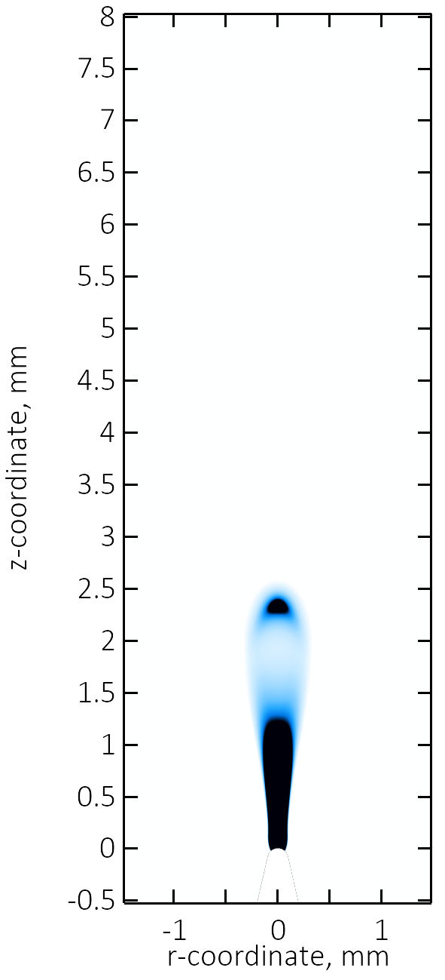
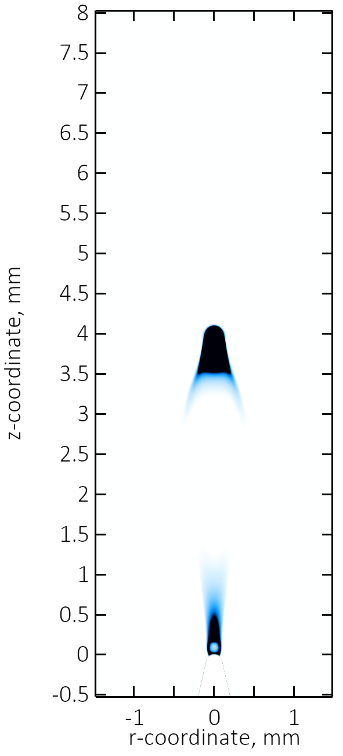
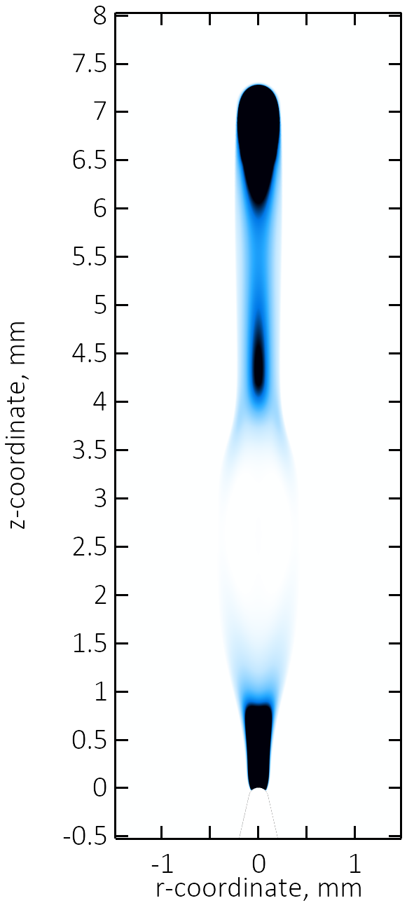
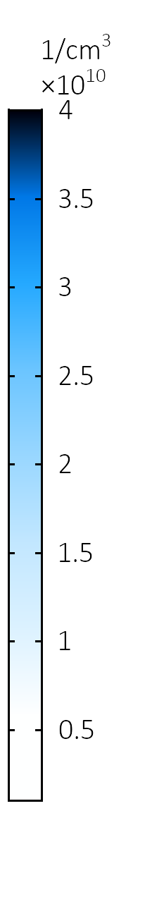
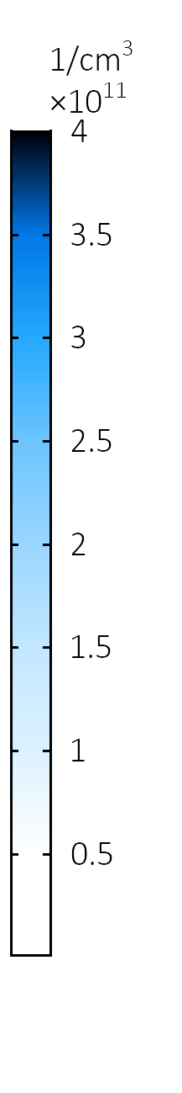
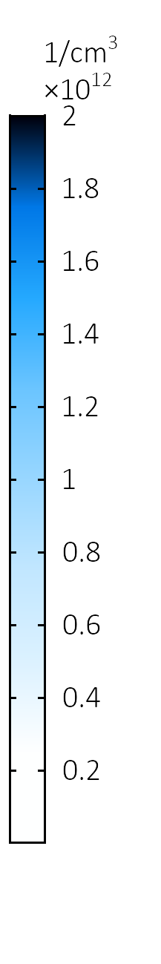



Theoretical Simulation of Positive Corona Discharge in Atmospheric-pressure Air
A. O. Kokovin, A.V, Kozyrev, V. Yu. Kozhevnikov, and V. S. Igumnov
Laboratory of Theoretical Physics, Institute of High Current Electronics SB RAS, Tomsk, Russia
INTRODUCTION: Theoretical simulation of gas breakdown development has difficulties due to a wide range of initial conditions, under which gas breakdown occurs, a large number of species and plasma-chemical reactions, and the physical mechanisms that are extremely complex for experimental diagnostics and theoretical description.
Reaction | Rate expression | Reference
Photoionization hν + O₂ → e + O₂⁺ | R_{ph} = S₁ + S₂ + S₃ | 1
Impact ionization e + N₂ → e + e + N₂⁺ e + O₂ → e + e + O₂⁺ | Townsend coefficients were calculated using the BOLSIG+ code | 2
Electron attachment e + O₂ + O₂ → O₂ + O₂– | 1.9∙10^{–30}∙(0.026/T_{e})∙ exp[(1 – 0.026/T_{e})∙7/3] | 3
O₄⁺ production O₂ + N₂ + O₂⁺ → N₂ + O₄⁺ | 2.4∙10^{–30} | 3
Three-body recombination N₂ + O₂– + O₄⁺ → N₂ + 3O₂ N₂ + O₂– + O₂⁺ → N₂ + 2O₂ | 2∙10^{–25} | 3
Impact dissociation e + O₂ → e + O + O | 4.2∙10^{–9}∙exp(-5.6/T_{e}) | 4
2D Axisymmetric
computational domain
Ground
d = 1 cm
Plasma channel
Air
1 atm
r_{curv} = 100 μm
z
BCs:
$$−n∙D=0$$
$$−n∙Γ_{e,ε}=0$$
Table 1. Minimal reactions set (units of two-body reaction rates – cm³/s, three-bodies – cm⁶/s). Electron temperature T_{e} given in eV.
U₀ = 10 kV
Tip
r
RESULTS: Time-dependent numerical study allows to obtain the detailed spatio-temporal characteristics of discharge, such as plasma components distribution, electric field, full current etc.
Figure 1. Domain configuration
COMPUTATIONAL METHODS: The Plasma Module represents the hydrodynamic description of non-equilibrium gas discharges using the two-moment and drift-diffusion approaches:
t = 42.5 μs
t = 43.4 μs
t = 43.6 μs
$$\left\{\begin{aligned}\frac{∂n_{e}}{∂t}−∇\left[n_{e}μ_{e}\vec{E}+D_{e}∇n_{e}\right]=R_{e} \\ \frac{∂n_{ε}}{∂t}−∇\left[n_{ε}μ_{ε}\vec{E}+D_{ε}∇n_{ε}\right]+\vec{E}∙\left[n_{e}μ_{e}\vec{E}+D_{e}∇n_{e}\right]=R_{ε} \\ ∆V=\frac{q}{ε_{0}}\left(\sum_{k=1}^{N}{Z_{k}ρω_{k}}−n_{e}\right),\vec{E}=−∇V \\ ρ\frac{∂ω_{k}}{∂t}−∇\left[ρω_{k}\vec{V_{k}}\right]=R_{k}\end{aligned}\right.$$
where n_{e} and n_{ε} are the electron density and energy density respectively, ρ is the mixture density, ω_{k} is the mass fraction of k-th species, R_{e} is either a source or a sink of electrons, R_{ε} is the energy loss or gain due to inelastic collisions, R_{k} is the rate expression of k-th species computed using the BOLSIG+ code.
Figure 2. Plasma density distribution
The plasma channel structure consists of two areas: ionization area (“corona glow”) near the tip in form of thin (≈ 0.2 mm) jet and streamer propagating from corona glow towards the grounded electrode.
Photoionization process is described by three linear Helmholtz equations using the Coefficient Form PDE Interface of Mathematics Module:
CONCLUSIONS: The theoretical model of positive corona discharge was developed. The model allows to study the breakdown development in detail. The minimal plasma-chemical reactions set and algorithms for describing the charged particles kinetics of air plasma were developed.
$$∆S_{j}−{\left[λ_{j}p_{O_{2}}\right]}^{2}S_{j}=−A_{j}{p_{O_{2}}}^{2}\frac{0.1p_{q}}{p+p_{q}}R_{e}$$
where j = 1,2,3, λ_{j}, A_{j} and p_{q} are constants defined in [1], p_{O2} is the partial pressure of molecular oxygen.
REFERENCES:
Bourdon et al., “Efficient models for photoionization …”, Plas. So. Sci. and Tech., 16, 656–678, (2007)
Hagelaar et al., “Solving the Boltzmann equation …” Plas. So. Sci. and Tech., 14, 722–733, (2005)
Pancheshnyi et al., “Development of a cathode-directed streamer …” Phys. Rev. E, 71, (2005).
He et al., “Modeling Study on the Generation of Reactive Oxygen …”, Plas. Proc. and Pol., 9, (2012).
Excerpt from the Proceedings of the 2020 COMSOL Conference

