Slide 1


Theoretical Simulation of Positive Corona Discharge in Atmospheric-pressure Air
A. O. Kokovin, A.V, Kozyrev, V. Yu. Kozhevnikov, and V. S. Igumnov
Laboratory of Theoretical Physics, Institute of High Current Electronics SB RAS, Tomsk, Russia
Notes:
Hi everyone! My name is Aleksandr Kokovin, and I going to tell you about how do you can simulate a corona discharge using the COMSOL Multiphysics software.

Slide 2
Introduction Gas discharge simulation features
A wide range of initial conditions, under which gas breakdown occurs
The physical mechanisms that are extremely complex for experimental diagnostics and theoretical description and are responsible for behavior pattern of this phenomenon
Three-dimensional spatio-temporal structure of discharge, which makes very high demands on the computational resources (primarily performance)
Notes:
Gas discharge simulation is a very compute-intensive problem. In addition to the requirements for computational resources, the calculation has some difficulties, mainly related to a wide range of initial conditions, the extremely complex physical mechanisms and a three-dimensional structure of discharge. Despite these features we developed a time-dependent theoretical model of corona discharge, which describes the breakdown process in detail and allows to predict the parameters in specific experimental arrangement. Now let’s move to the model description.

Slide 3
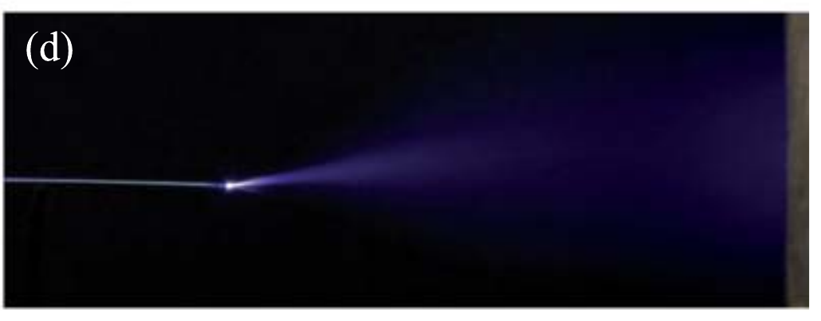

Experimental background Positive corona discharge*
Curvature radius of tip r_{curv} = 10…100 μm
Interelectrode distance d = 10…30 mm
Air pressure p = 1 atm
DC voltage applied U₀ = +5-15 kV
Photograph of the corona glow
1 cm
Tip-to-plane geometry configuration
*Tarasenko, V.F., Baksht, E.Kh. // Plasma Physics Reports. 44(5), pp. 520-532 (2018)
Notes:
Our simulation is based on the experimental investigation of corona discharge characteristics, carried out in the Institute of High-Current Electronics. A specific feature of the corona discharge is that, for its formation, it sufficient to apply a high-voltage to the electrode with small radius of curvature. In this case, the discharge was excited in atmospheric-pressure air between thin high-voltage tip and plane grounded electrode. The corona discharge was observed near the high-voltage tip. Based on the experiment, we build a simplified computational geometry.

Slide 4

Geometry configuration Computation domain
2.5D model instead of 3D real configuration
Curvature radius of tip r_{curv} = 100 μm
Interelectrode distance d = 1 cm
DC voltage applied U₀ = +10 kV
Width of computation domain L = 1 cm
2D Axisymmetric
computation domain
Ground
d
Air
1 atm
Plasma channel
r_{curv}
BCs:
$$−n∙D=0$$
$$−n∙Γ_{e,ε}=0$$
z
r
U₀
Tip
Notes:
Based on the experiment, we build a simplified computational geometry. A three-dimensional experimental configuration was substituted by a two-dimensional axisymmetric configuration. The geometry parameters was taken from the experiment. The width of computational domain must be large enough so that the open boundaries do not affect the plasma channel.

Slide 5
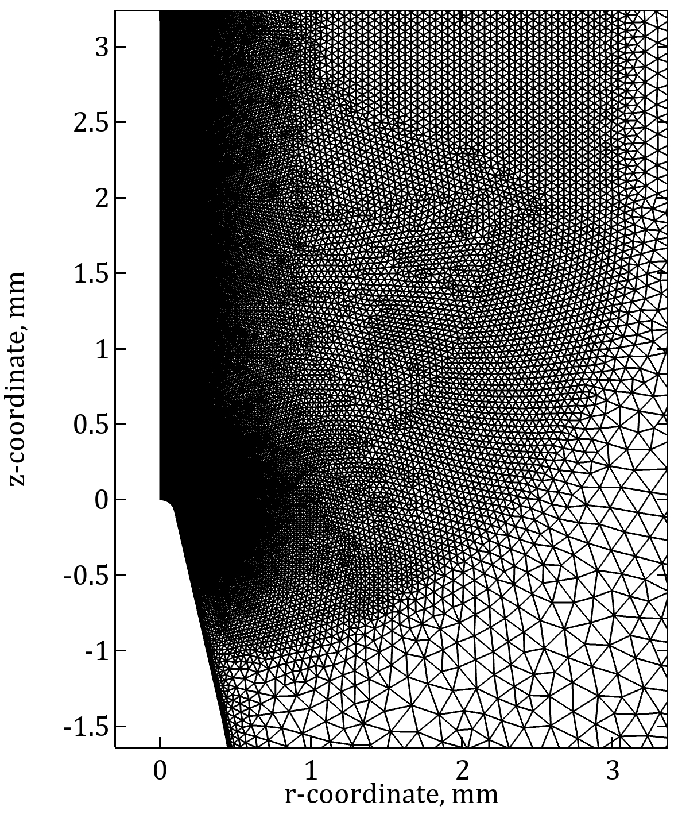
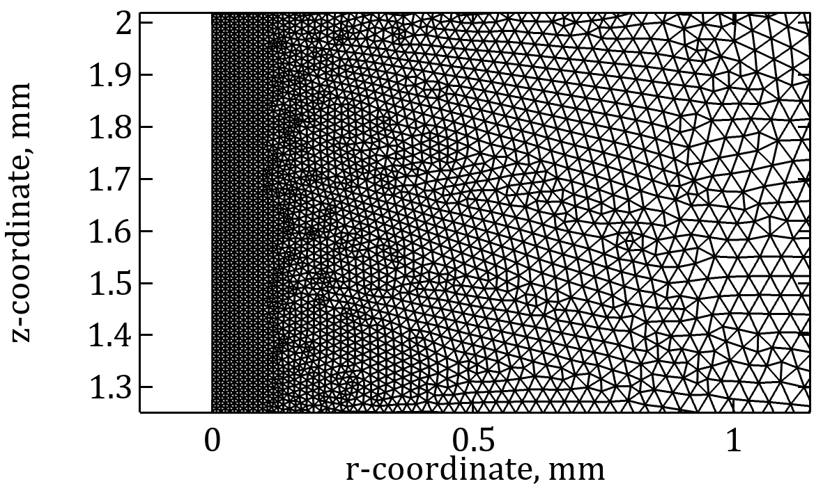
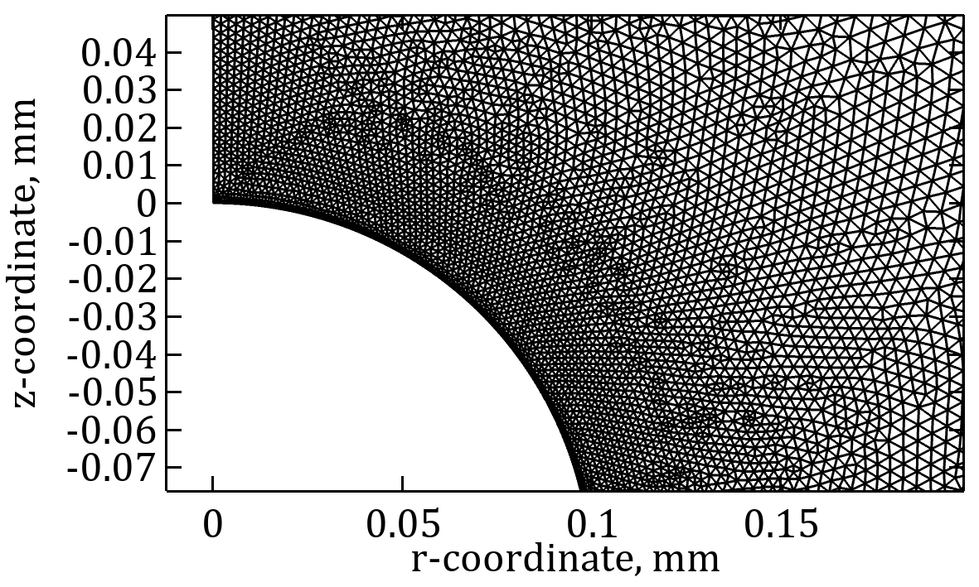
Mesh Computation domain
User-controlled mesh:
Mesh size << Debye length
Boundary layers on the electrodes surface
Number of elements ≈ 140k
Average element quality ≈ 0.9
Minimal element quality ≈ 0.3
r_{curv}/10
2r_{curv}
r_{curv}/60
Notes:
And now I’ll briefly tell you about the mesh. A physics-controlled mesh is not suitable for the problem of local plasma generation. That is why we applied an user-controlled mesh. To calculate the plasma variables correctly, it is necessary that the mesh size in the entire computation domain be several times smaller than the Debye length. It is also necessary to refine mesh near the tip curvature and the axis of symmetry, where the high plasma density is observed.

Slide 6
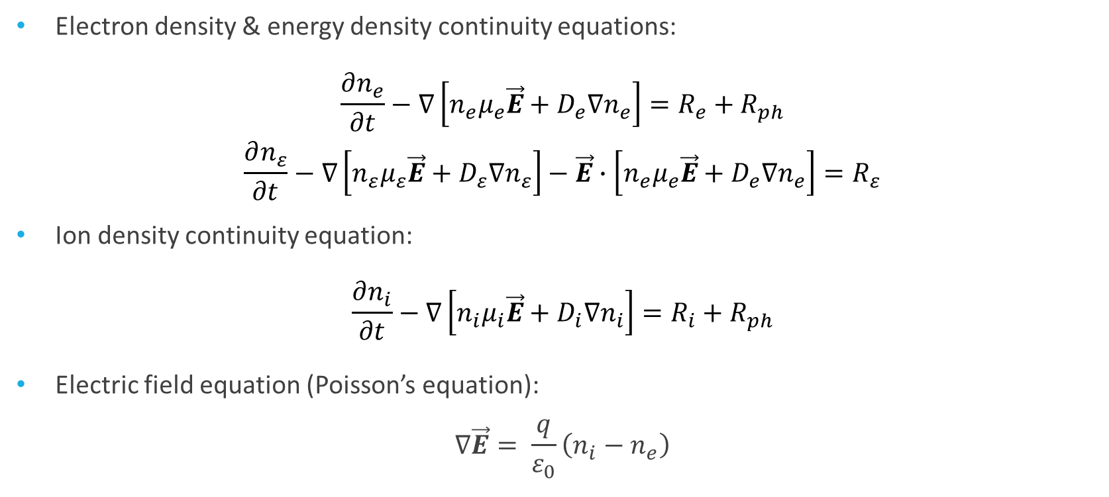
Plasma Module Two-moment model equations* with drift-diffusion approximation
Electron density & energy density continuity equations:
$$\frac{∂n_{e}}{∂t}−∇\left[n_{e}μ_{e}\vec{E}+D_{e}∇n_{e}\right]=R_{e}+R_{ph}$$
$$\frac{∂n_{ε}}{∂t}−∇\left[n_{ε}μ_{ε}\vec{E}+D_{ε}∇n_{ε}\right]−\vec{E}∙\left[n_{e}μ_{e}\vec{E}+D_{e}∇n_{e}\right]=R_{ε}$$
Ion density continuity equation:
$$\frac{∂n_{i}}{∂t}−∇\left[n_{i}μ_{i}\vec{E}+D_{i}∇n_{i}\right]=R_{i}+R_{ph}$$
Electric field equation (Poisson’s equation):
$$∇\vec{E}= \frac{q}{ε_{0}}\left(n_{i}−n_{e}\right)$$
*Young, F.F., Wu, C.H. // IEEE Trans. on Plas. Sci., 21(3), pp. 312–321 (1993)
Notes:
A hydrodynamic approach used in the Plasma Module is a well-established theoretical method for describing a high-pressure gas discharge. The approach describes plasma as a mixture of electron and ionic “liquids”, moving one through the other. Such “liquids” can be described using the continuity equations coupled with Poisson’s equation for electric field. Pay attention to the right-hand side of the continuity equations: we’ve added a photoionization source term.

Slide 7
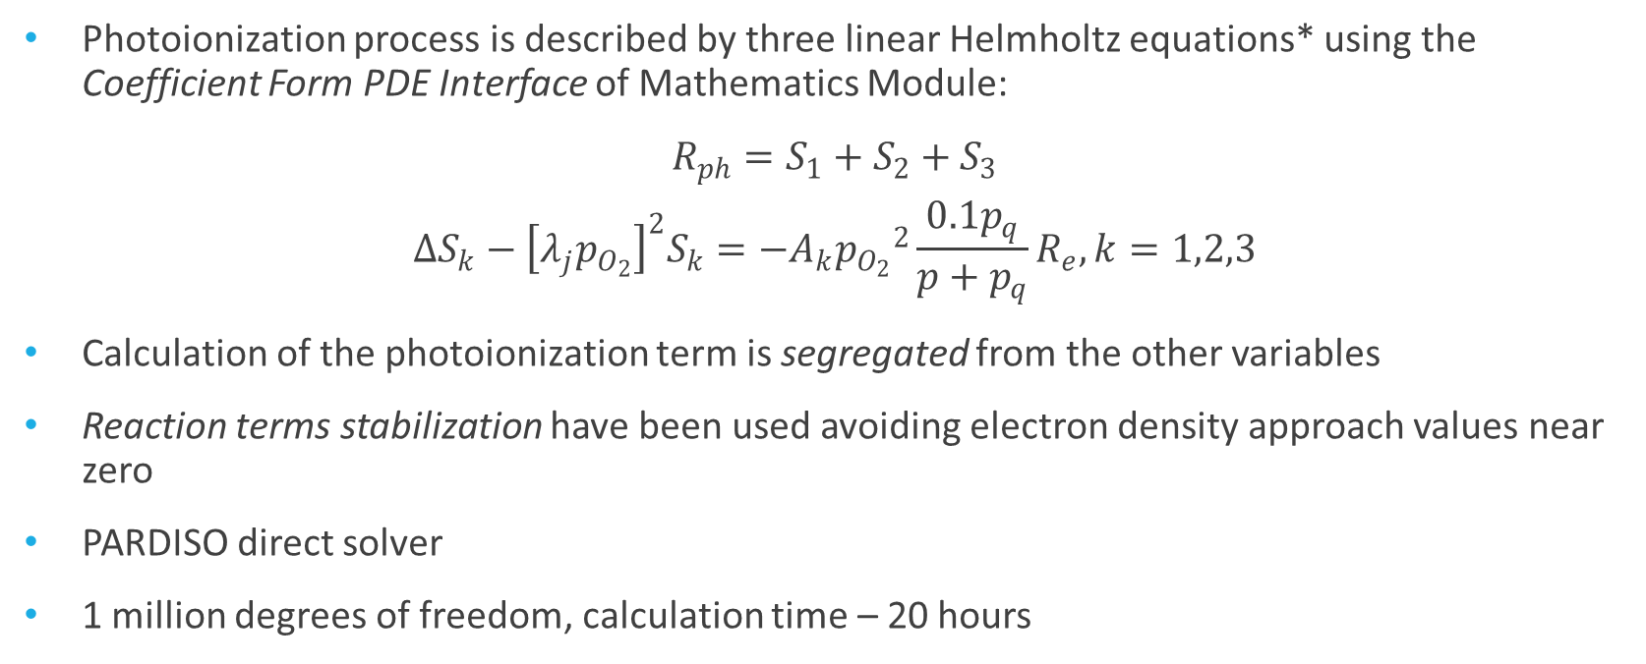
Simulation model Additional conditions & numerical method details
Photoionization process is described by three linear Helmholtz equations* using the Coefficient Form PDE Interface of Mathematics Module:
$$R_{ph}=S_{1}+S_{2}+S_{3}$$
$$∆S_{k}−{\left[λ_{j}p_{O_{2}}\right]}^{2}S_{k}=−A_{k}{p_{O_{2}}}^{2}\frac{0.1p_{q}}{p+p_{q}}R_{e},k=1,2,3$$
Calculation of the photoionization term is segregated from the other variables
Reaction terms stabilization have been used avoiding electron density approach values near zero
PARDISO direct solver
1 million degrees of freedom, calculation time – 20 hours
*Bourdon A. et al. // Plas. Sourc. Sci. Technol., 16, pp. 656-678 (2007)
Notes:
Photoionization process is described by the linear Helmholtz equation set using the Coefficient Form PDE Interface of Mathematics Module, and the term is segregated from the plasma variables. We also used the reaction terms stabilization in order to avoid approaching zero the electron density values.

Slide 8
Plasma-chemical kinetics Minimal reaction set in air*
Type of reaction | Reaction | Rate expression
Photoionization | hν + O₂ → e + O₂⁺ | Calculated using the Helmholtz equation set
Impact ionization | e + N₂ → e + e + N₂⁺ e + O₂ → e + e + O₂⁺ | Townsend coefficients were calculated using the BOLSIG+ code
Electron attachment | e + O₂ + O₂ → O₂ + O₂– | 1.9∙10^{–30}∙(0.026[eV]/T_{e}[eV])∙ exp[(1 – 0.026[eV]/T_{e}[eV])∙7/3] cm⁶/s
O₄⁺ production | O₂ + N₂ + O₂⁺ → N₂ + O₄⁺ | 2.4∙10^{–30} cm⁶/s
Three-body recombination | N₂ + O₂– + O₄⁺ → N₂ + 3O₂ N₂ + O₂– + O₂⁺ → N₂ + 2O₂ | 2∙10^{–25} cm⁶/s
Impact dissociation | e + O₂ → e + O + O | 4.2∙10^{–9}∙exp(-5.6[eV]/T_{e}[eV]) cm³/s
based on *Pancheshnyi S., Nudnova M. // Phys. Rev. E, 71(1), (2005).
Notes:
And the last thing to discuss before the results is the plasma-chemical kinetics of atmospheric-pressure air. A complete kinetics of air (excluding any admixtures) includes over 300 reactions. But most of these reactions do not affect the plasma transport properties. For example, the transitions to various exited states, productions of unstable complexes and radicals, and so on. So our task was to determine the minimal reactions set that allows to correctly describe the development of positive corona discharge. The minimal set includes photoionization, ionization, attachment, O4+ production, recombination and dissociation.

Slide 9
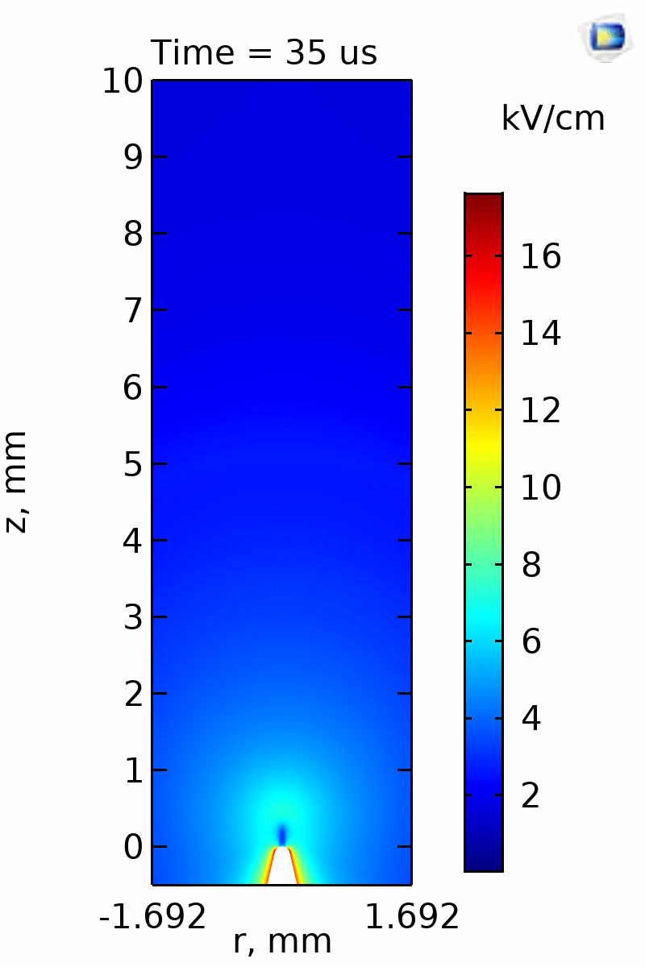
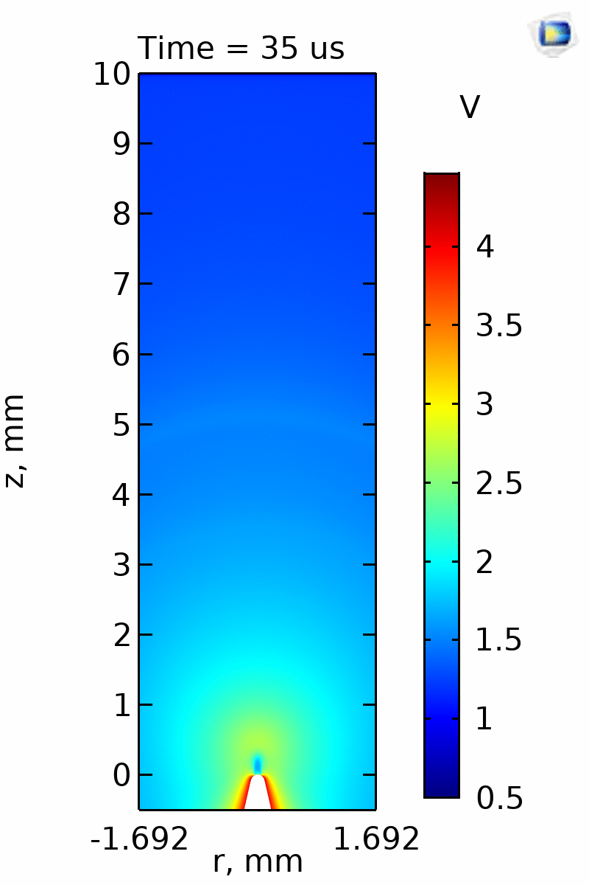
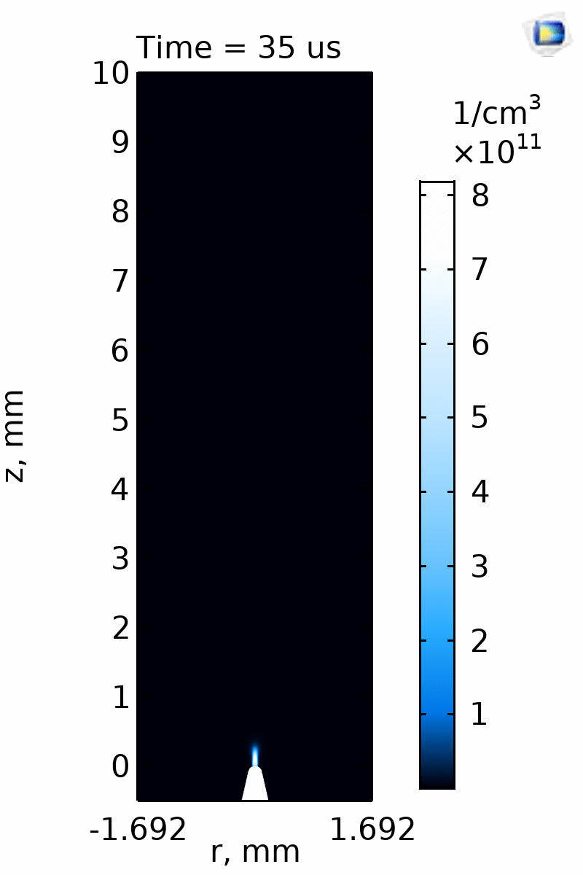





Results
$$\left|\vec{E}\right|$$
$$T_{e}$$
$$n_{e}$$
$$n_{O2−}$$
Notes:
What results did we get? On this slide you can see the evolution of plasma variables, such as magnitude of electric field, electron temperature, electron density and negative ion density. A plasma cloud in form of thin jet is produced near the tip curvature. This is so-called corona glow. Jet expansion along the axis of symmetry leads to the abrupt decrease of plasma density in the middle of jet, caused by electron attachment to the molecules. At the front of jet we can see an electric field amplification leading to the streamer formation. Streamer propagation is determined by the photoionization process. The photoelectrons are produced ahead of the front, which leads to their acceleration and gas ionization. Such plasma structure consisting of corona glow and streamer is observed in various experiments.

Slide 10
Conclusions
The development of positive corona discharge in atmospheric-pressure air was numerically simulated. The plasma channel structure consists of two areas: ionization area (“corona glow”) near the tip electrode in form of thin jet and streamer propagating from corona glow towards the grounded electrode
The minimal plasma-chemical reaction set in air including electron attachment, dissociation, photoionization etc. was developed
Comparison with experiment has showed that the simulation results are in good agreement with experimental data
Notes:
What conclusions can we draw? We developed the theoretical model of positive corona discharge in atmospheric-pressure air. The simulation results show that the plasma channel consists of two areas: corona glow in form of thin jet near the tip electrode and streamer propagating from corona glow towards the grounded electrode. We developed the minimal reaction set in air, which includes electron attachment, impact dissociation, photoionization and so on, which correctly describes the breakdown development. We compared the simulation results with experimental data and obtained good agreement.

Slide 11
Thank you!
Notes:
Thank you for your attention!

