Slide 1
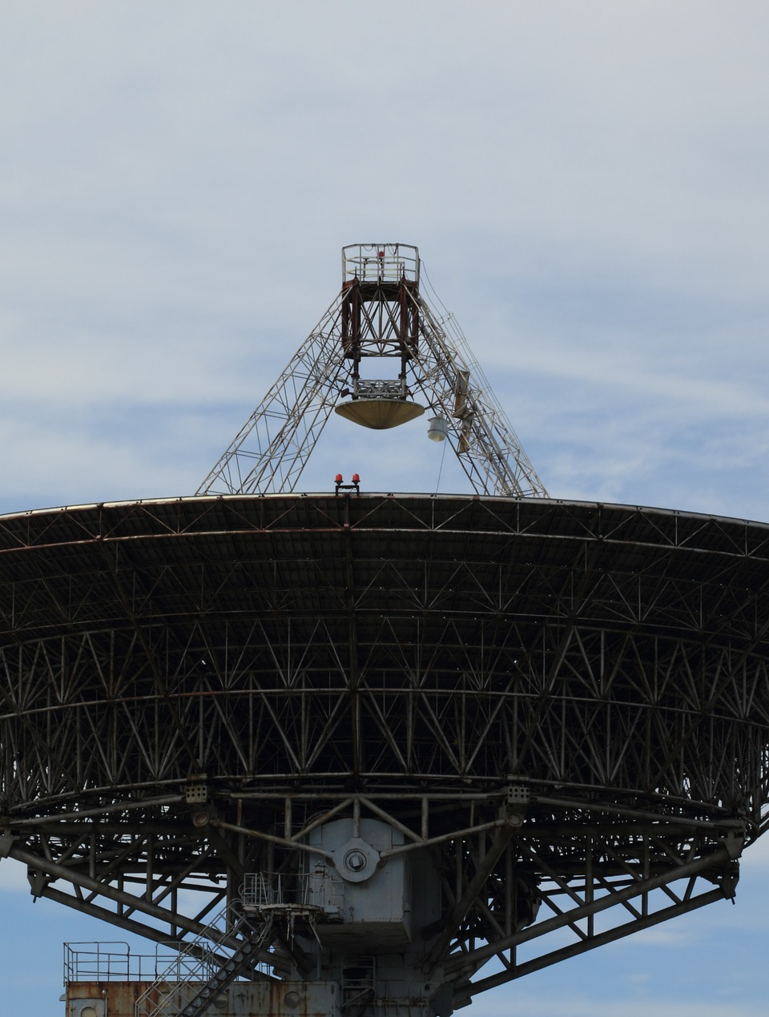



Compact antennas for digital TV reception on mobile terminals
COMSOL Conference – Europe | 14-15 October 2020
R. Gaffoglio¹, A. De Vita², B. Sacco², G. Giordanengo¹, M. Zucchi³, G. Vecchi³
¹ Advanced Computing and Applications, Fondazione LINKS, Torino, ITALY, rossella.gaffoglio@linksfoundation.com
giorgio.giordanengo@linksfoundation.com
² Centre for Research, Technology Innovation and Experimentation,
RAI Radiotelevisione Italiana, Torino, ITALY,
assunta.devita@rai.it, bruno.sacco@rai.it
³ Department of Electronics and Telecommunications, Politecnico di Torino, Torino, ITALY,
giuseppe.vecchi@polito.it, marcello.zucchi@polito.it

Slide 2
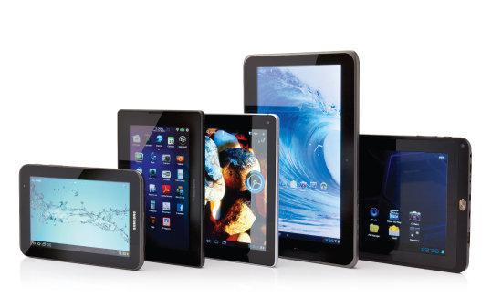

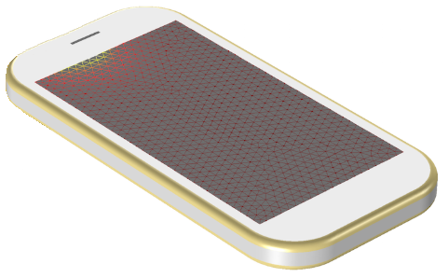
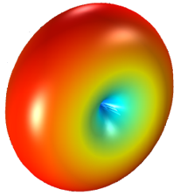
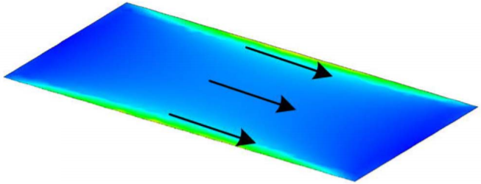
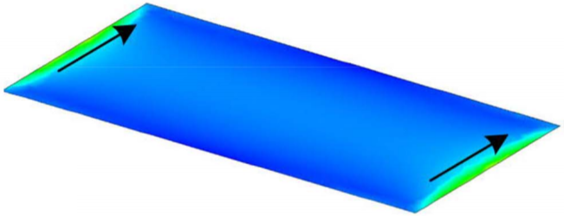
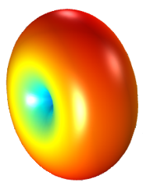
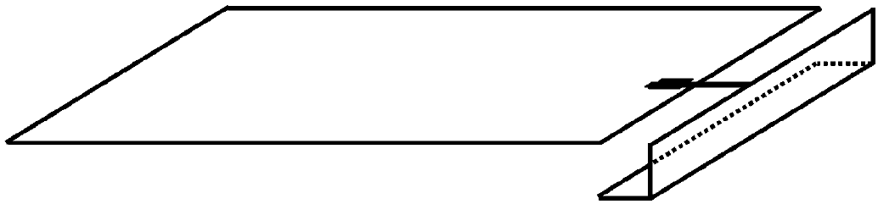
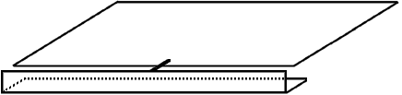


DTT receivers on mobile terminals
Capacitive Coupling Element (CCE) based antenna solutions
With Release 14, the Third Generation Partnership Project (3GPP) [1] paved the way to the possibility of delivering digital television services on mobile terminals, such as smartphones and tablets.
This poses a great challenge for the antenna designers:
whole digital terrestrial television (DTT) band to cover (470-694 MHz)
limited volume available for the antennas on a mobile device
Characteristic modes eigen-currents of the chassis:
[1] 3GPP TR 38.913 V0.4.0, 2016.
The only solution seems to be the possibility to excite the characteristic modes of the ground layers and metal shielding of the entire device (chassis) by means of properly-shaped capacitive coupling elements (CCE), moving the resonances across the DTT band with a matching circuit.
$$J_{1}$$
[2]
chassis
chassis
CCE
CCE
$$J_{2}$$
[2] J. Holopainen, et al., IEEE Trans. Antennas Propag., vol. 58, no. 10, 2010.

Slide 3
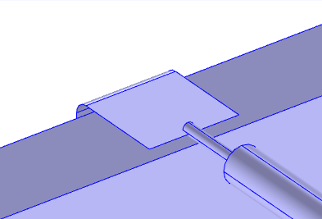
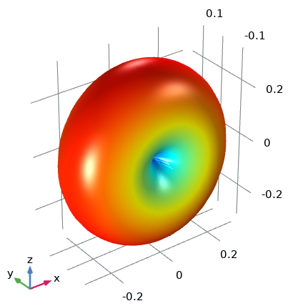
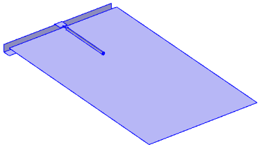
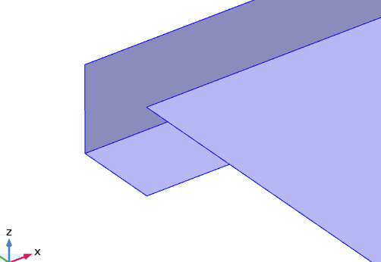
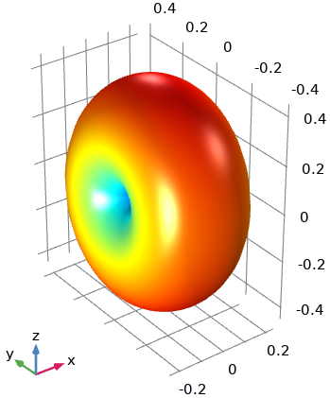
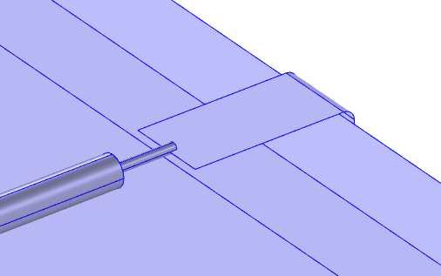
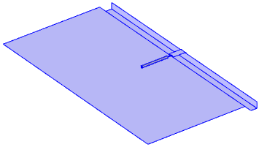
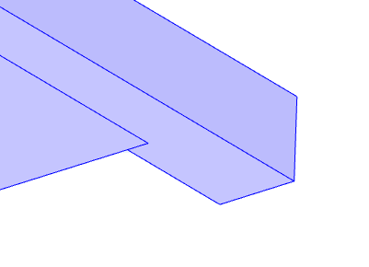
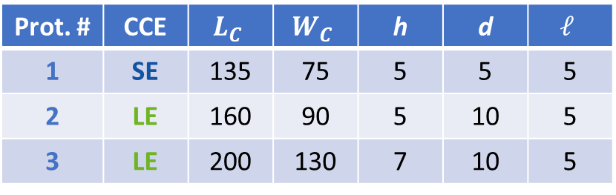


CCE-based antenna solutions
Simulated prototypes (COMSOL)
The CCE-based antenna solution has been analysed in two configurations:
CCE on the short edge (SE) of the chassis
  (which basically excites the chassis fundamental
characteristic mode) (Prot. #1)
CCE on the long edge (LE) of the chassis
(which excites the first higher-order chassis
characteristic mode) (Prot. #2,3)
L_{c}
d
h
W_{c}
$$ℓ$$
(SE)
(LE)
Prot. # | CCE | $$L_{C}$$ | $$W_{C}$$ | h | d | $$ℓ$$
1 | SE | 135 | 75 | 5 | 5 | 5
2 | LE | 160 | 90 | 5 | 10 | 5
3 | LE | 200 | 130 | 7 | 10 | 5
L_{c}
d
W_{c}
h
[mm]
$$ℓ$$

Slide 4
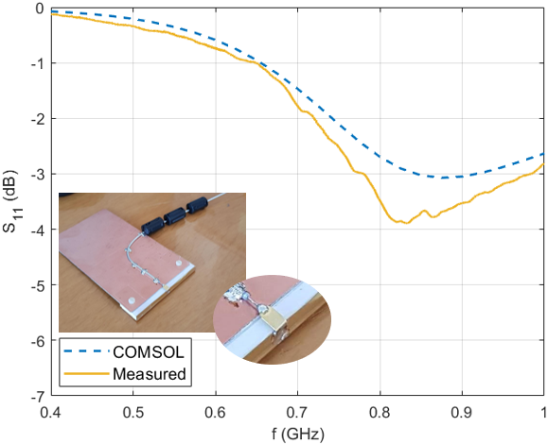
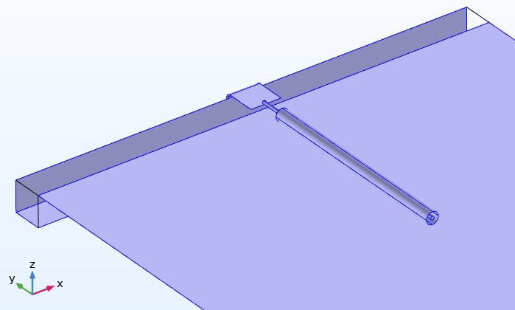
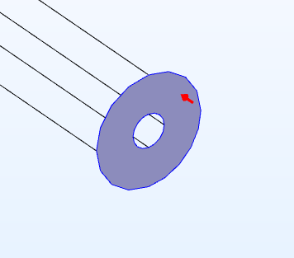
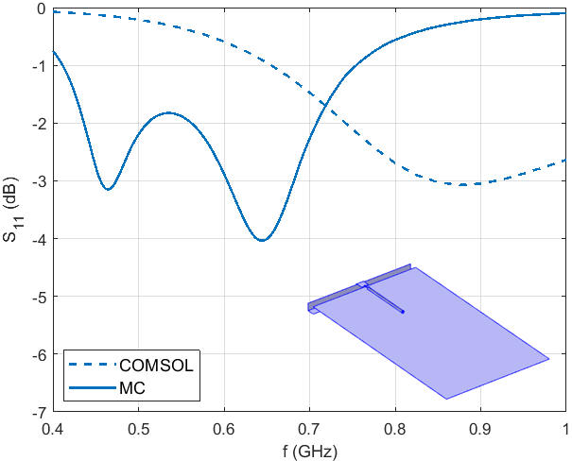


S11 parameter: SE configuration (#1)
COMSOL Multiphysics vs experiment
Coaxial Lumped Port
$$Z_{ref}=50 Ω$$
The reflection coefficient (S11) provided by COMSOL is compared to the S11
computed with the
VNA and correctly
de-embedded
DVB-H spec.
The S11 is matched across the DTT band with a proper matching circuit
The MC evaluated on the simulated S11 curve leads to a matching circuit which is very similar to that found using the experimental curve
DTT

Slide 5
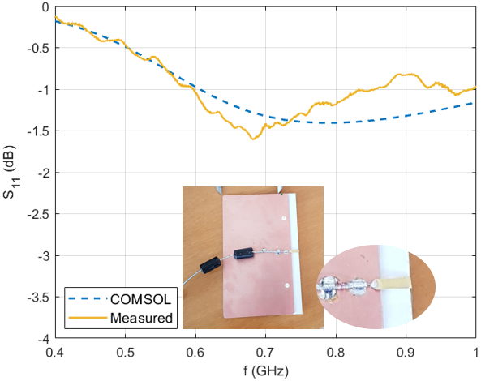
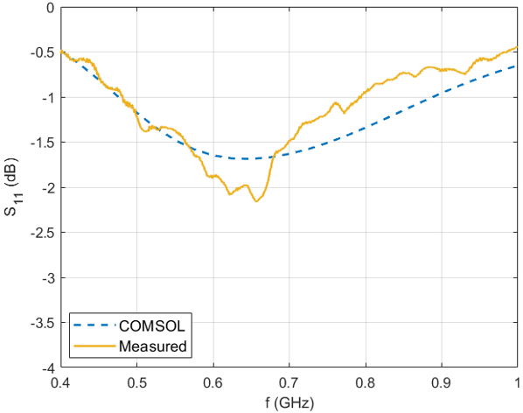
S11 parameter: LE configurations (#2,3)
COMSOL Multiphysics vs experiment
Prot. #2
Prot. #3
A sufficiently good agreement between the numerical and experimental results is observed for all the prototypes.
The robustness of the numerical results allows to perform a priori optimization of the chassis-CCE structure, providing a realistic forecast of what will be the coverage quality in the DTT band.

Slide 6
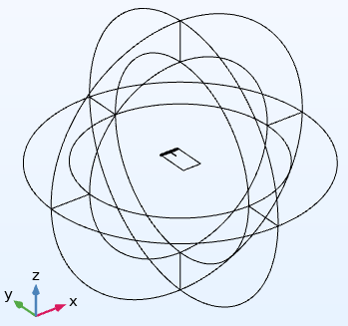
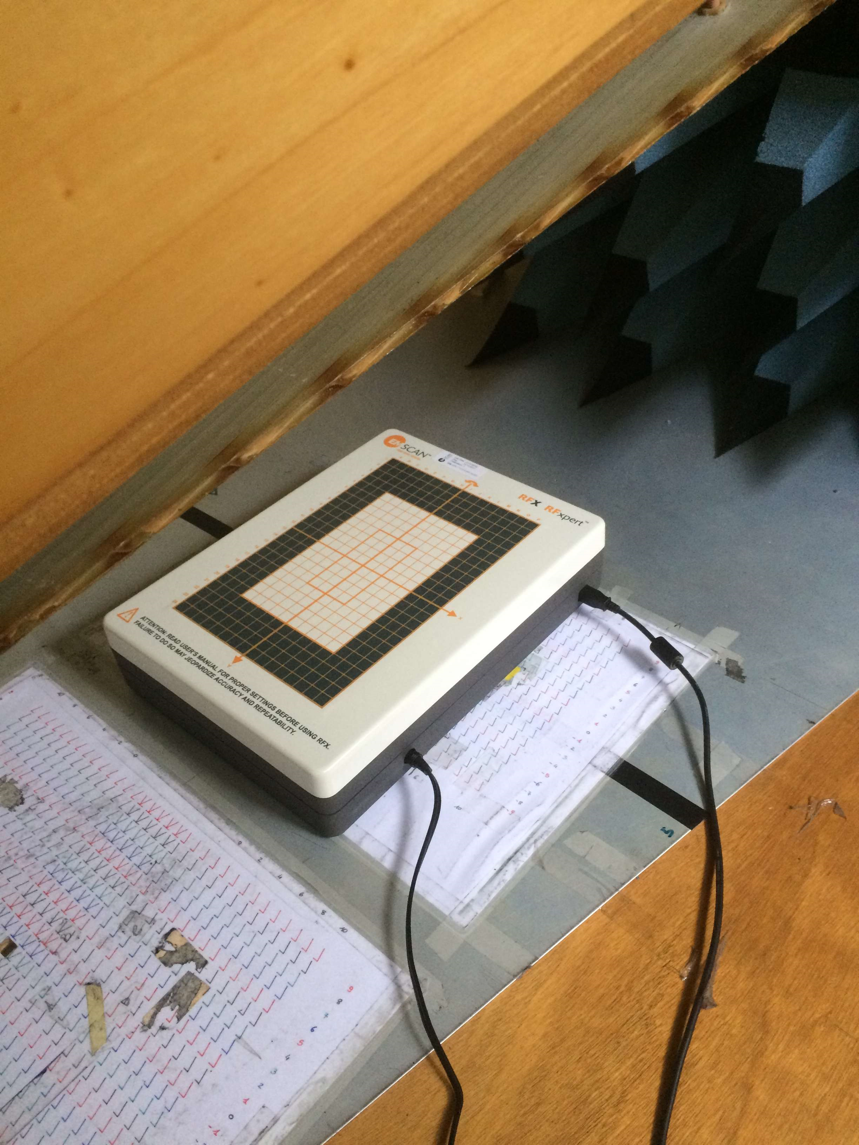
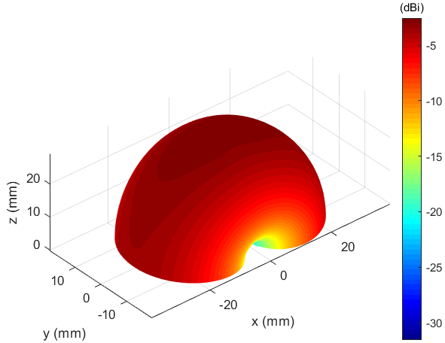
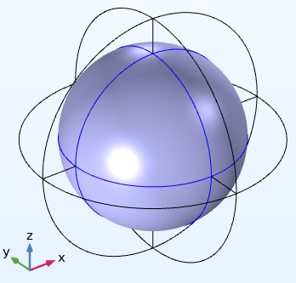
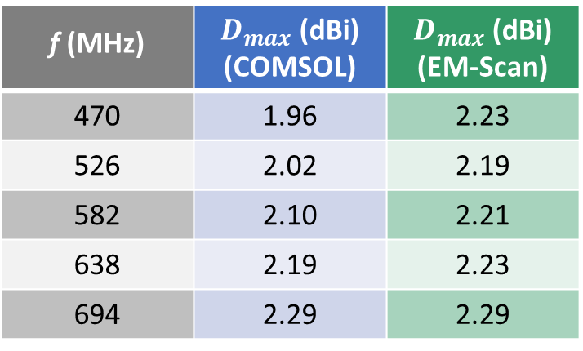
Directivity patterns: SE configuration
COMSOL Multiphysics vs EM-Scan RFX
COMSOL Multiphysics
EM-Scan RFX ^{[3]}
The Far-Field Calculation feature in COMSOL Multiphysics allowed us to analyse the radiation pattern of the simulated antenna solutions
f (MHz) | $D_{max}$ (dBi) (COMSOL) | $D_{max}$ (dBi) (EM-Scan)
470 | 1.96 | 2.23
526 | 2.02 | 2.19
582 | 2.10 | 2.21
638 | 2.19 | 2.23
694 | 2.29 | 2.29
Compact bench-top electromagnetic scanner that allows a real time antenna characterization in the laboratory environment
Far-Field domain
[3] EM-Scan-RFX2-Datasheet, Calgary, Canada.

Slide 7
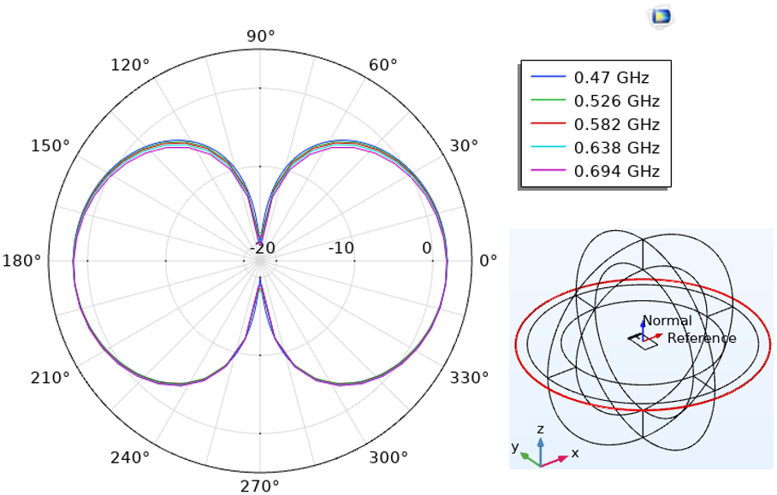
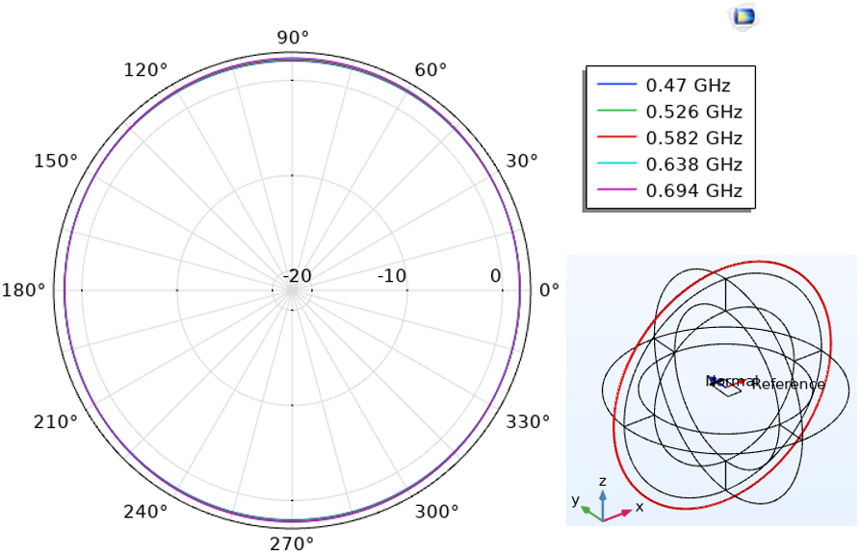
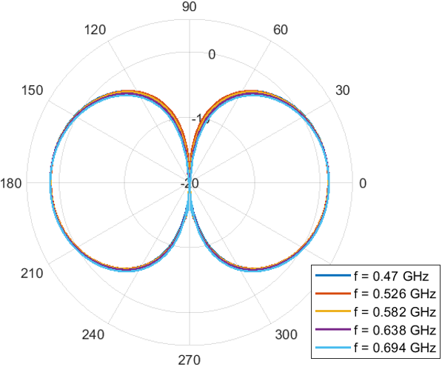

Directivity patterns: SE configuration
COMSOL Multiphysics vs EM-Scan RFX: θ = 90° plane
COMSOL
EM-Scan RFX
$$D\left(θ,φ,f\right)=\frac{G_{COMSOL}(θ,φ,f)}{η_{rad}(f)}$$
Directivity patterns on the xy plane relative to the Prot. #1 at different frequencies, evaluated with COMSOL (left) and measured with the EM-Scan RFX (right)
Good agreement between the simulated and experimental results

Slide 8
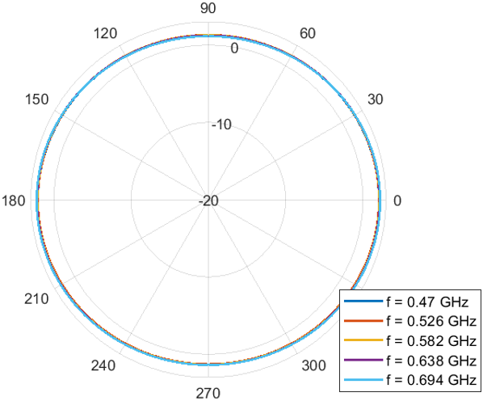
Directivity patterns: SE configuration
COMSOL Multiphysics vs EM-Scan RFX: φ = 0° plane
COMSOL
EM-Scan RFX
$$D\left(θ,φ,f\right)=\frac{G_{COMSOL}(θ,φ,f)}{η_{rad}(f)}$$
Directivity patterns on the xz plane relative to the Prot. #1 at different frequencies, evaluated with COMSOL (left) and measured with the EM-Scan RFX (right)
Good agreement between the simulated and experimental results

Slide 9
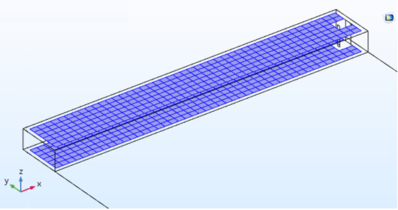
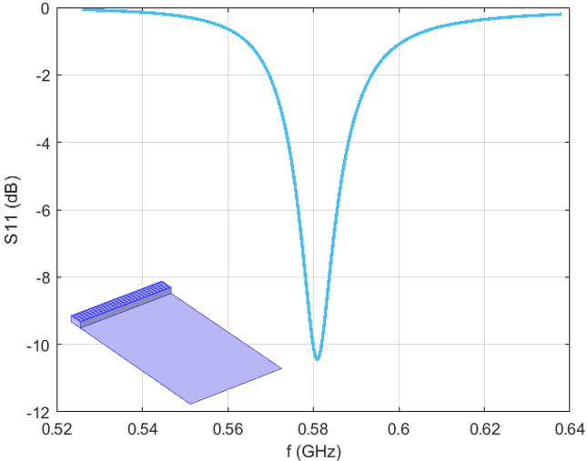
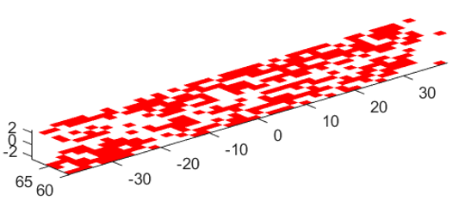
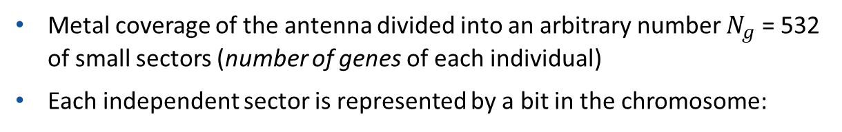



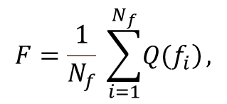
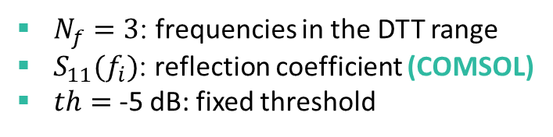
PIFA optimization with Genetic Algorithm (GA)
GA implemented with LiveLinkTM for MATLAB®
Metal coverage of the antenna divided into an arbitrary number $N_{g}$ = 532 of small sectors (number of genes of each individual)
Each independent sector is represented by a bit in the chromosome:
1 means the presence of metal
0 means that the metal is removed
changed in the COMSOL model
Metal regions changed by the GA
Each sequence of $N_{g}$ bits represents a single individual
For each individual, the following fitness function is estimated:
$$F=\frac{1}{N_{f}} \sum_{i=1}^{N_{f}}{\left.Q(f_{i}\right)},$$
$$S_{11}\left(f_{i}\right) if S_{11}\left(f_{i}\right)≥th$$
$$Q\left(f_{i}\right)=$$
$$th if S_{11}\left(f_{i}\right)<th$$
$N_{f}=3$: frequencies in the DTT range
$S_{11}(f_{i})$: reflection coefficient (COMSOL)
$th=$ -5 dB: fixed threshold
Unavoidable narrowband behaviour
After 155 generations
Final configuration

Slide 10
Conclusions
The purpose to realize a compact wideband antenna able to cover the whole DTT band with a sufficient return loss is very ambitious from a physical point of view, due to the limited volume available on a mobile device for the antenna element.
The only way found in literature refers to the excitation of the mobile device's metal structure (chassis) by means of capacitive coupling elements (CCE), moving its resonances across the digital terrestrial television (DTT) band with a matching circuit.
In this work:
We verify with COMSOL Multiphysics and LiveLink for MATLAB how the PIFA cannot be a solution for the considered problem, neither as a self-resonant element nor as an exciting structure
We analysed the performance of the CCE-based antennas using COMSOL Multiphysics, and with the experimental realization of three different prototypes.
The good agreement between simulations and measurements suggests how COMSOL can be used to study and optimize the geometry of the CCE element in order to maximize the excitation of the chassis eigen-currents.

Slide 11

COMSOL Conference – Europe | 14-15 October 2020
CONTACT
ROSSELLA GAFFOGLIO
Researcher
Fondazione LINKS
Via Pier Carlo Boggio 61
10138 Torino (TO), Italia
+39 011 2276 714
rossella.gaffoglio@linksfoundation.com

