Slide 1
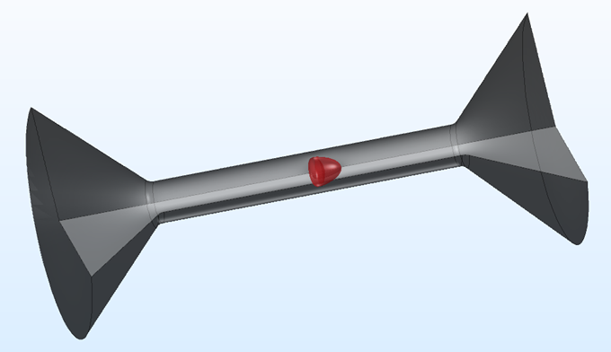
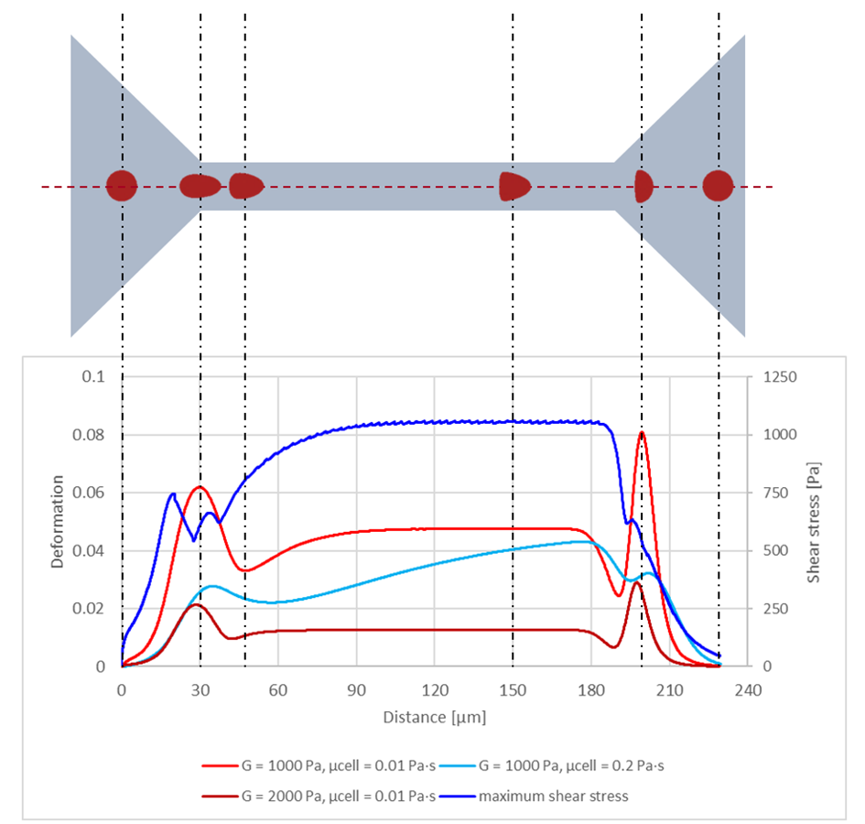
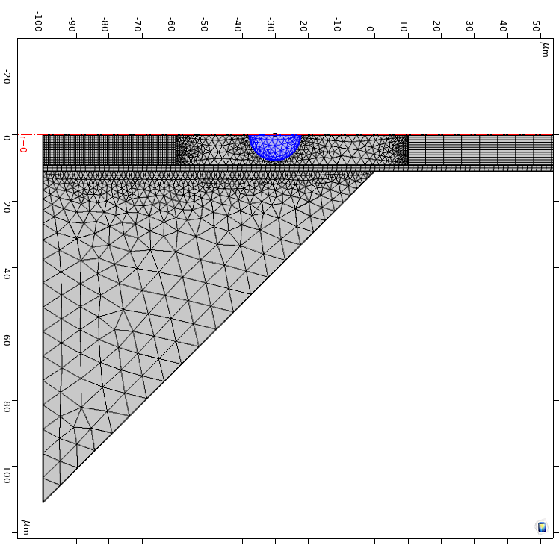

Simulation of cell deformation inside a microfluidic channel
using Fluid-Structure-Interaction
Ralf Schuster¹, Othmar Marti¹
1. Institute of Experimental Physics, Ulm, Germany
INTRODUCTION: The mechanical characterization of certain cell types is important to obtain physiological insights. Simulations help to understand, verify and improve the analysis of deformation-based cell characterization such as flow-based cytometry. We achieve efficient computations by using a 2D-rotational symmetric model, based on Fluid-Structure-Interaction with a hyper-elastic material.
RESULTS: Our simulation is capable to map the deformation of a cell along an entire microfluidic channel. In Figure 3 the computational domain is associated with the deformation dependence on elasticity, technically speaking the shear modulus G, and on the viscosity μ_{cell} of a cell along the entire channel.
Definition of the deformation²: $d=1−c=1−\frac{2\sqrt{πA}}{P}$
Figure 1. Cell moving through a 2D rotational-symmetric model.
COMPUTATIONAL METHODS: Simulating fluid flow at very low Reynolds numbers (Re << 1) implies that the inertial term in the Navier-Stokes equations can be neglected. Our fluid is incompressible, as well as in some of the simulations non-Newtonian. This means that the dynamic viscosity is a function of the shear rate. In our simulations re-meshing of the deforming domain or a sliding mapped mesh¹ is used to be able to handle deformations of cells having a Young’s modulus (E) of less than 1 kPa.
Boundary conditions: At the inlet the intended flow rate is applied and at the outlet, the pressure was set to zero. At the walls, a no-slip boundary condition is set. A prescribed displacement is applied to the rotation axis, which constrains the cell to move only at the channel center in the direction of the flow.
Figure 3. Deformation and maximum shear stress on cell surface over distance for cells with radius = 7.66 μm, starting 30 μm before channel entry. The shown cell shapes are associated with the bright red curve. The channel is 160 μm in length and has an equivalent channel radius of 10.94 μm. The flow rate is 0.04 μl/s and the viscosity of the medium is 0.015 Pa·s.
CONCLUSIONS: In this work the parameters, which have an effect on the deformation of a cell in a microfluidic device are investigated in various simulations. Our results can help to improve the characterization and differentiation of cells. As a next step we are interested in a 3D model, which represents the real geometry with higher accuracy.
ACKNOWLEDGMENTS: We want to thank Dr. Tobias Neckernuss for helpful discussions and reviewing the article. Furthermore, we acknowledge the Comsol support for handing out useful suggestions to approach modeling issues.
CONTACT: ralf.schuster@uni-ulm.de
Rotation axis
Sliding mapped mesh
Inlet
Outlet
Walls
REFERENCES:
Frei, W., 2015. Deformed Mesh Interfaces: Rotations and Linear Translations. COMSOL Multiphysics.
Mietke et al., 2015. Extracting Cell Stiffness from Real-Time Deformability Cytometry: Theory and Experiment. Biophys. J. 109, 2023–2036.
Figure 2. Part of the meshed geometry.
Excerpt from the Proceedings of the 2020 COMSOL Conference

