Slide 1

Time-dependent temperature response in bulk materials from two heat sources
COMSOL Conference 2020 EUROPE
A. R. Stilling-Andersen¹, B. Guralnik^{1,2}, O. Hansen³, S. E. Hansen⁴, T. A. Marangoni⁵, D. H. Petersen¹*
1. Department of Energy Conversion and Storage, Technical University of Denmark, Fysikvej, Building 310, DK-2800 Kgs. Lyngby, Denmark 2. CAPRES A/S, a KLA Company, Diplomvej 373, 2800 Kgs. Lyngby, Denmark 3. DTU Nanolab, Technical University of Denmark, Ørsteds Plads, Building 347 East, DK-2800 Kgs. Lyngby, Denmark 4. Department of Photonics Engineering, Technical University of Denmark, Ørsteds Plads, Building 343, DK-2800 Kgs. Lyngby, Denmark
5. Department of Physics, Technical University of Denmark, Fysikvej, Building 307, DK-2800 Kgs. Lyngby, Denmark * Corresponding author e-mail: dhpe@dtu.dk
Notes:
Welcome. My name is Andreas Stilling-Andersen and I am a master student from the Technical University of Denmark at the Department of Energy conversion and storage. Today I would like to present “Time-dependent temperature response in bulk materials from two heat sources”.

Slide 2
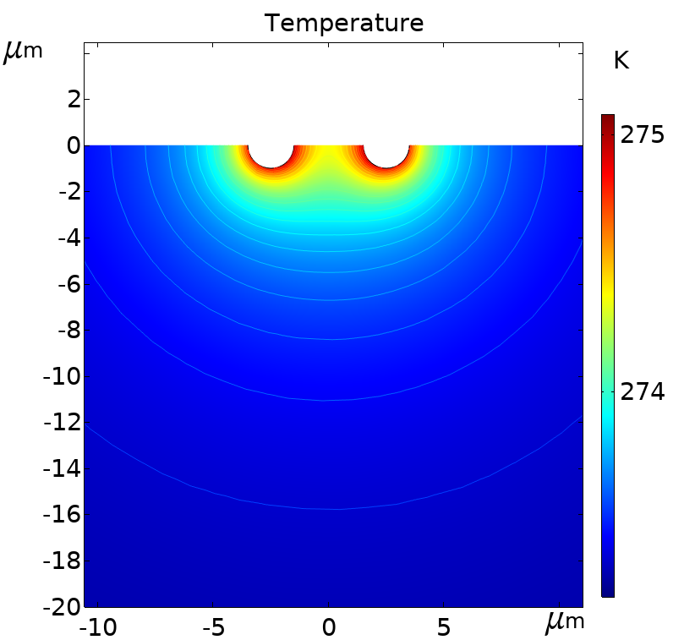
Introduction
Four-point probe resistance measurement
Joule heating at contacts
Thermal effects
Thermoelectric effects
Temperature coefficient of resistivity
Compare analytic and numeric solution
I
V
Probe pitch, s
Current flow
Figure 1 Four-point probe measurement setup.
Figure 2 Illustration of temperature profile.
Notes:
First, I would like to introduce four-point-probe resistance measurements. This is a commonly used technique to measure the resistivity of a bulk material. A current is passed through two probes while a voltage is measured using another set of probes in Figure 1. In this way the resistance can be obtained without also measuring the contact resistance. However, at the current probes the contact resistance causes Joule heating, which heats up the material. Therefore the measurements can be distorted. A preview of a possible temperature distribution can be seen here in Figure 2. When the material is heated several physical effects can distort the measured voltage, for example thermoelectric effects or the temperature dependence of the resistivity. This also implies that these effects possibly can be measured from the voltage when the temperature is known. The goal of this work is to develop an analytical expression for the time-dependent temperature profile and verify it using numerical modelling in COMSOL.

Slide 3








Theory and model
$$P\left(t\right)=P_{0}\sin^{2}{(ω_{0}t)}$$
Time-dependent heat equation
Heat current density injected at contacts
Solution
Constant heat injection:
Time dependent heat injection
Assume $T\left(r,t\right)=R\left(r\right)exp(iωt)$
Boundary conditions
$$ρc_{p}\frac{∂T}{∂t}=κ∇^{2}T=\frac{κ}{r^{2}}\frac{∂T}{∂r}\left\{r^{2}\frac{∂T}{∂r}\right\}$$
$$−∇T\left(r=a,t\right)=J_{q}(t)$$
$$a$$
$$T\left(r→∞,t\right)=T_{0}$$
$$J_{q}\left(t\right)=\frac{P(t)}{A}=\frac{P_{0}}{2πa^{2}}\sin^{2}\left(ω_{0}t\right)=\frac{P_{0}}{4πa^{2}}−\frac{P_{0}}{4πa^{2}}\cos{(2ω_{0}t)}$$
Figure 3 Power dissipated at contact point.
Construction of solution
Single probe
Two probes
$$T_{DC}\left(r\right)=\frac{P_{0}}{4πκr}$$
$$T\left(r,t\right)=T_{DC}\left(r\right)+T_{AC}\left(r,t\right)+T_{0}$$
$T_{AC}\left(r,t\right)=−\frac{P_{0}}{4πκr}exp\left(\sqrt{\frac{ω_{0}}{D}}(a−r)\right)$ $cos\left(\sqrt{\frac{ω_{0}}{D}}\left(a−r\right)+2ω_{0}t\right)$
$$T_{dual}\left(r,t\right)=T\left(r−r_{1},t\right)+T\left(r−r_{2},t\right)−T_{0}$$
Notes:
The analytical model is developed as a solution to the time-dependent heat equation. We assume that the power from the Joule heating is dissipated near the surface of a semi-infinite substrate, illustrated in Figure 3. The heat spreads radially outwards from the injection point, thus it is fair to assume that the solution is spherical symmetric. The injected heat current density is dissipated at a hemisphere of radius “a”, which is assumed to be very small. Infinitely far away from the source the temperature is equal to the background temperature “T_0”. Using an alternating current in the measurements, we can calculate the dissipated power as the resistance times the current squared. Dividing the power by the hemispherical surface area we obtain the heat current density. Using a sine wave as the input the power dissipated follows sine squared. This results in a constant term, named the direct current term, and an alternating current term at twice the driving frequency. The complete solution can then be found as a superposition from these two terms. For the DC term we neglect transient effects and can easily determine the solution. For the AC term we need to assume the temperature has a simple harmonic dependence. When we have found the two terms of the solution, we can simply add them along with background temperature to fulfill the second boundary condition. In the case of two heat sources we can simply superpose two solutions of the temperature distribution. We need to subtract the background temperature since this would otherwise be included twice.

Slide 4
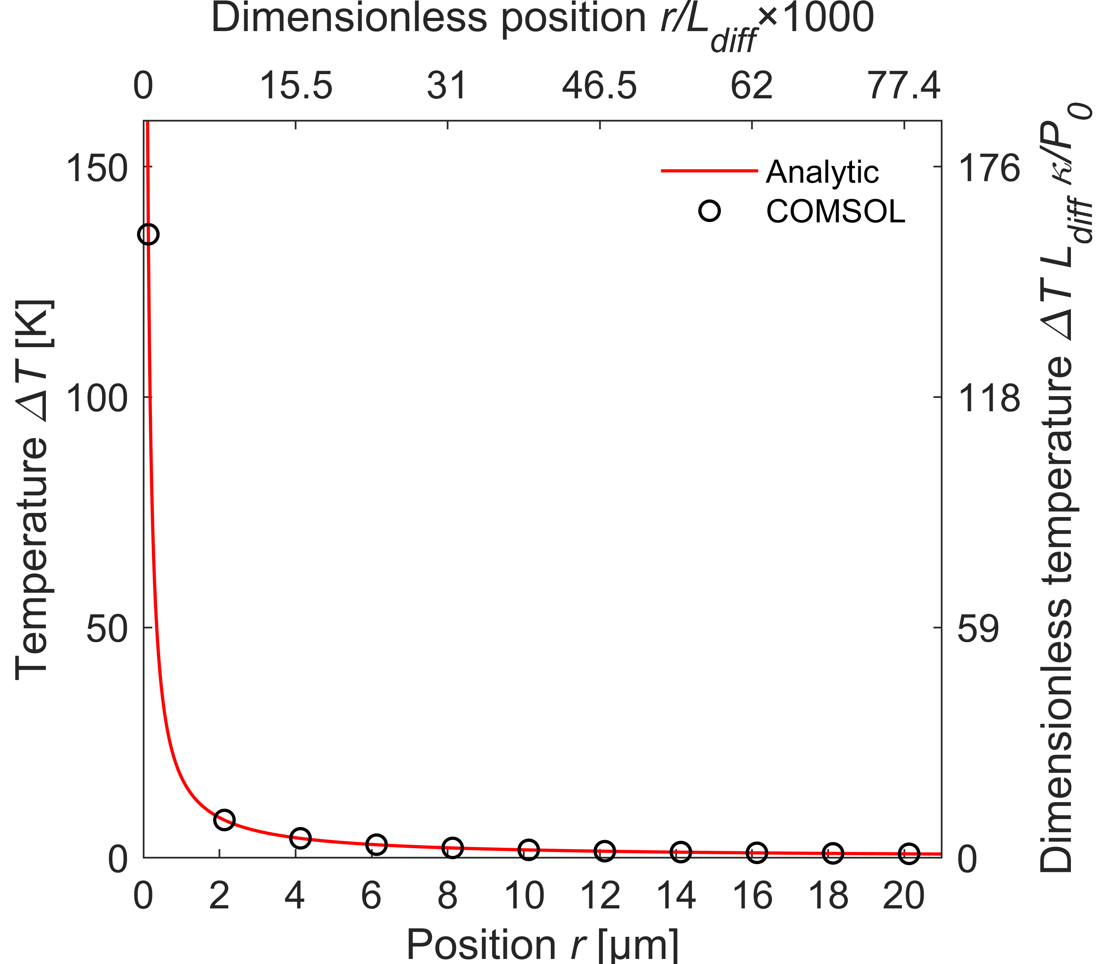
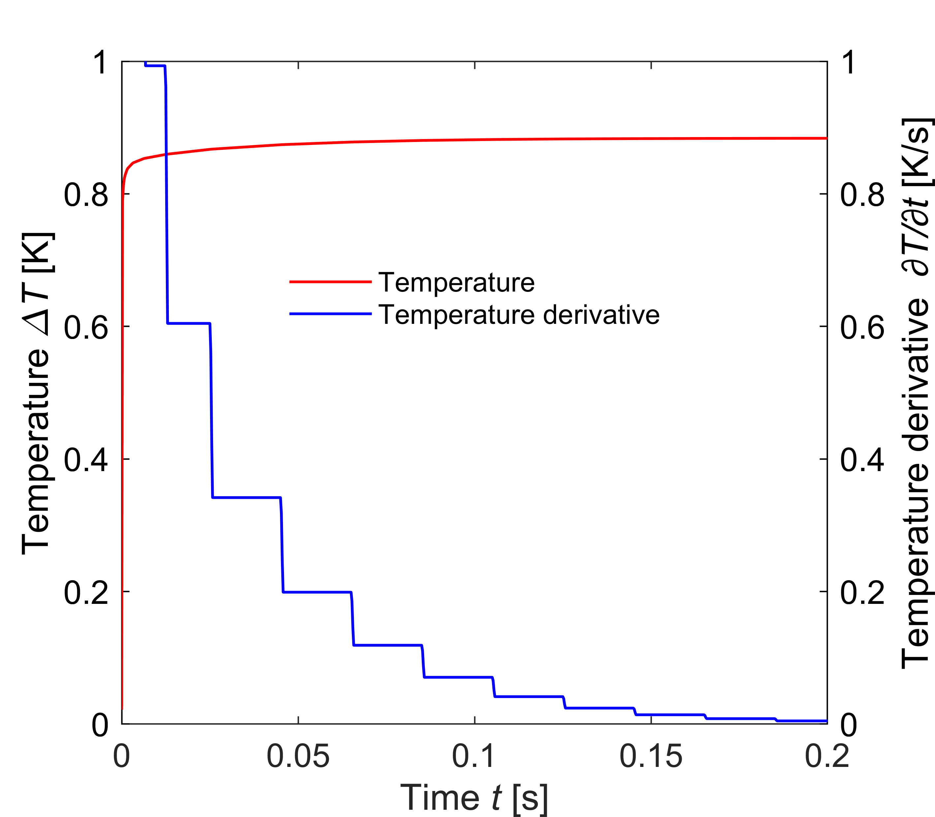
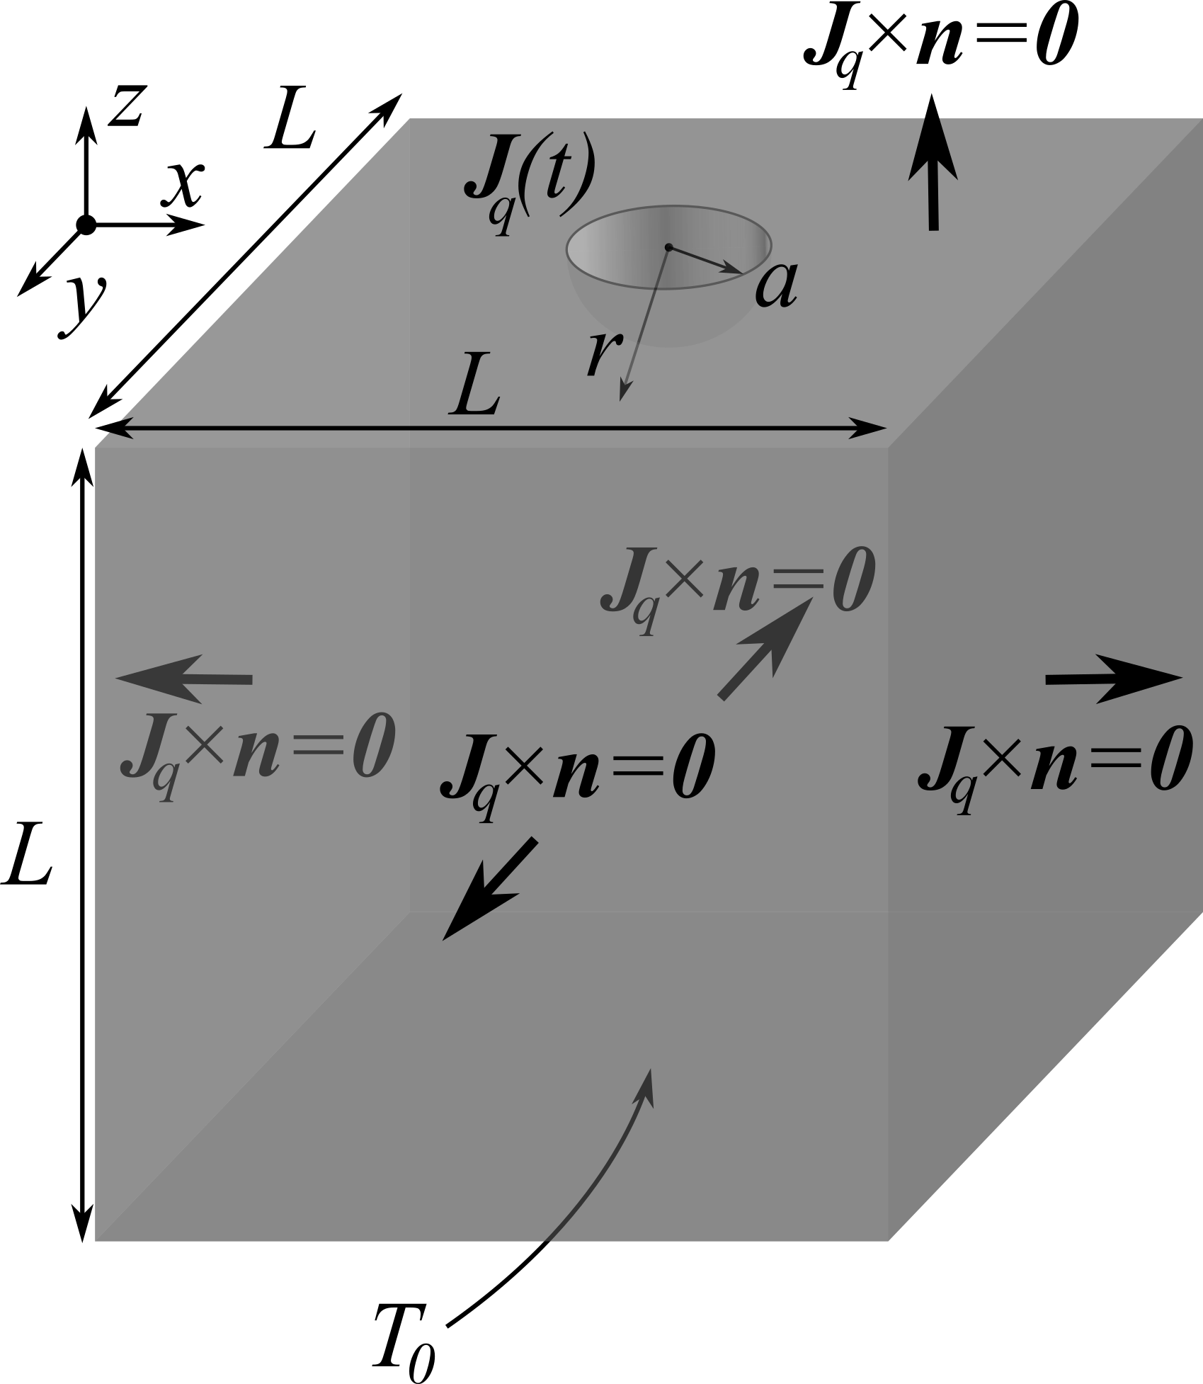
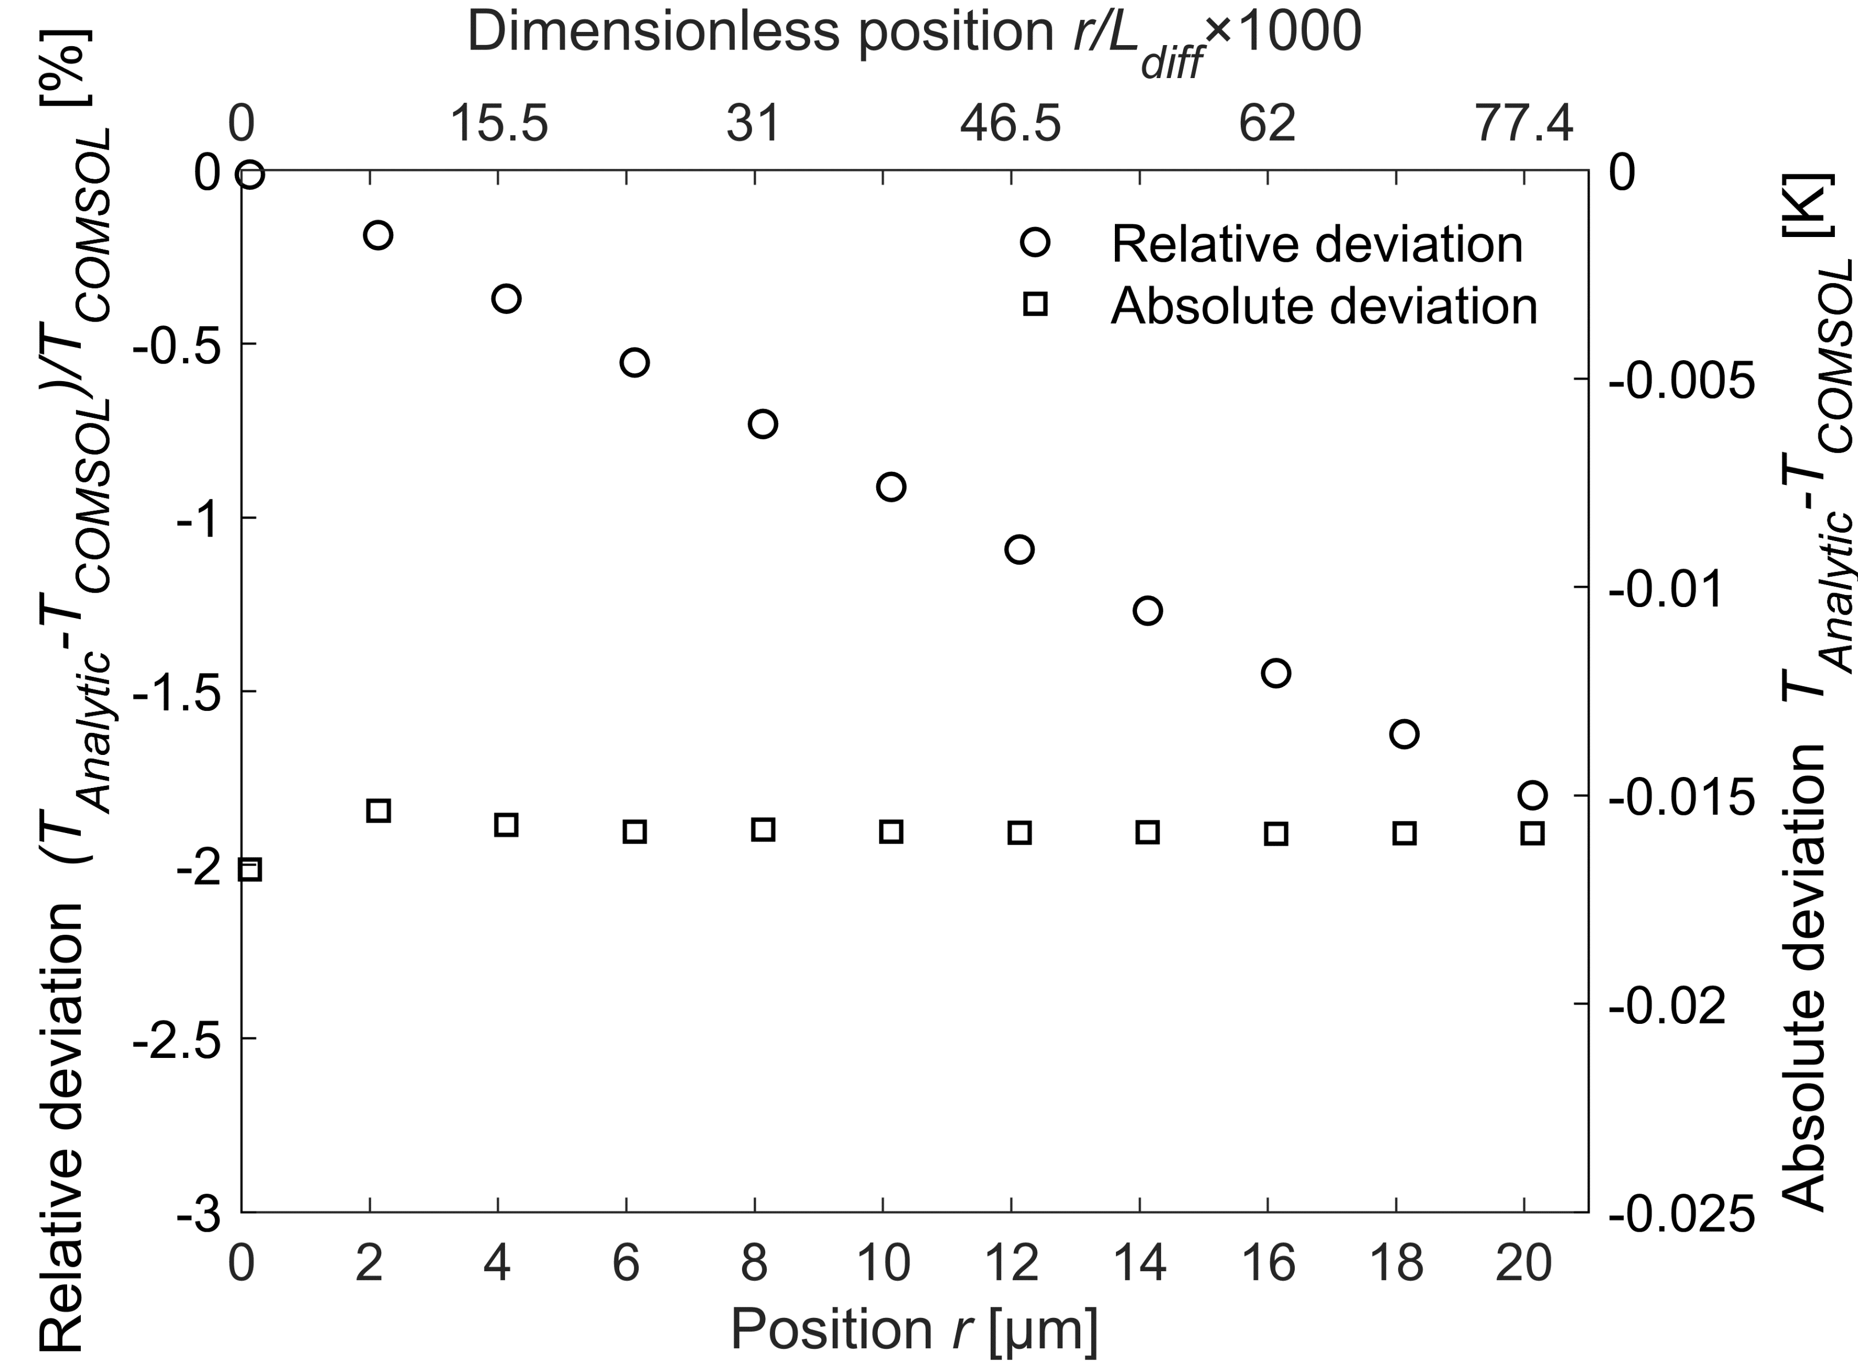

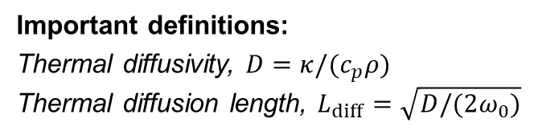
Simulations
Important definitions:
Thermal diffusivity, $D=κ/(c_{p}ρ)$ Thermal diffusion length, $L_{diff}=\sqrt{D/(2ω_{0})}$
Solution:
Setup model in COMSOL
Heat transfer module
Boundary conditions
$$T_{DC}\left(r\right)=\frac{P_{0}}{4πκr}$$
Figure 7 Relative and absolute error for steady-state heating.
Figure 4 Geometry used in COMSOL.
Figure 5 Transient heating of substrate.
Figure 6 Steady-state region.
Notes:
The COMSOL model is build in the Heat Transfer module with the Heat Transfer in solids interface implementing a time-dependent study. In order to build the model I will first introduce the thermal diffusivity, and the thermal diffusion length, which is the characteristic length scale of the problem. We can model our bulk material as a square box with a sidelength “L” equal to 10 times the diffusion length. The backside of the box is kept at fixed temperature, meanwhile the other sides are thermally insulated. The heat current density is injected through a hemispherical cut into the surface of radius “a”, equal to one two thousandth part of the diffusion length, thus resembling a point like source. First, we are going to study the transient heating using only a DC heat source. It was our assumption that we could neglect transient effects. In Figure 5 we can see how the temperature approaches steady-state. The time-derivative goes to zero indicating steady-state have been reached. Comparing the steady-state temperature calculated with COMSOL and the analytic model we can see they fit quite nice in Figure 6. Using this result (click for animation) we can calculate the relative and absolute deviation in Figure 7. As we can observe the absolute deviation is almost constant while the relative error steadily increases. This error could likely be caused by the finite size of our bulk material in COMSOL.

Slide 5
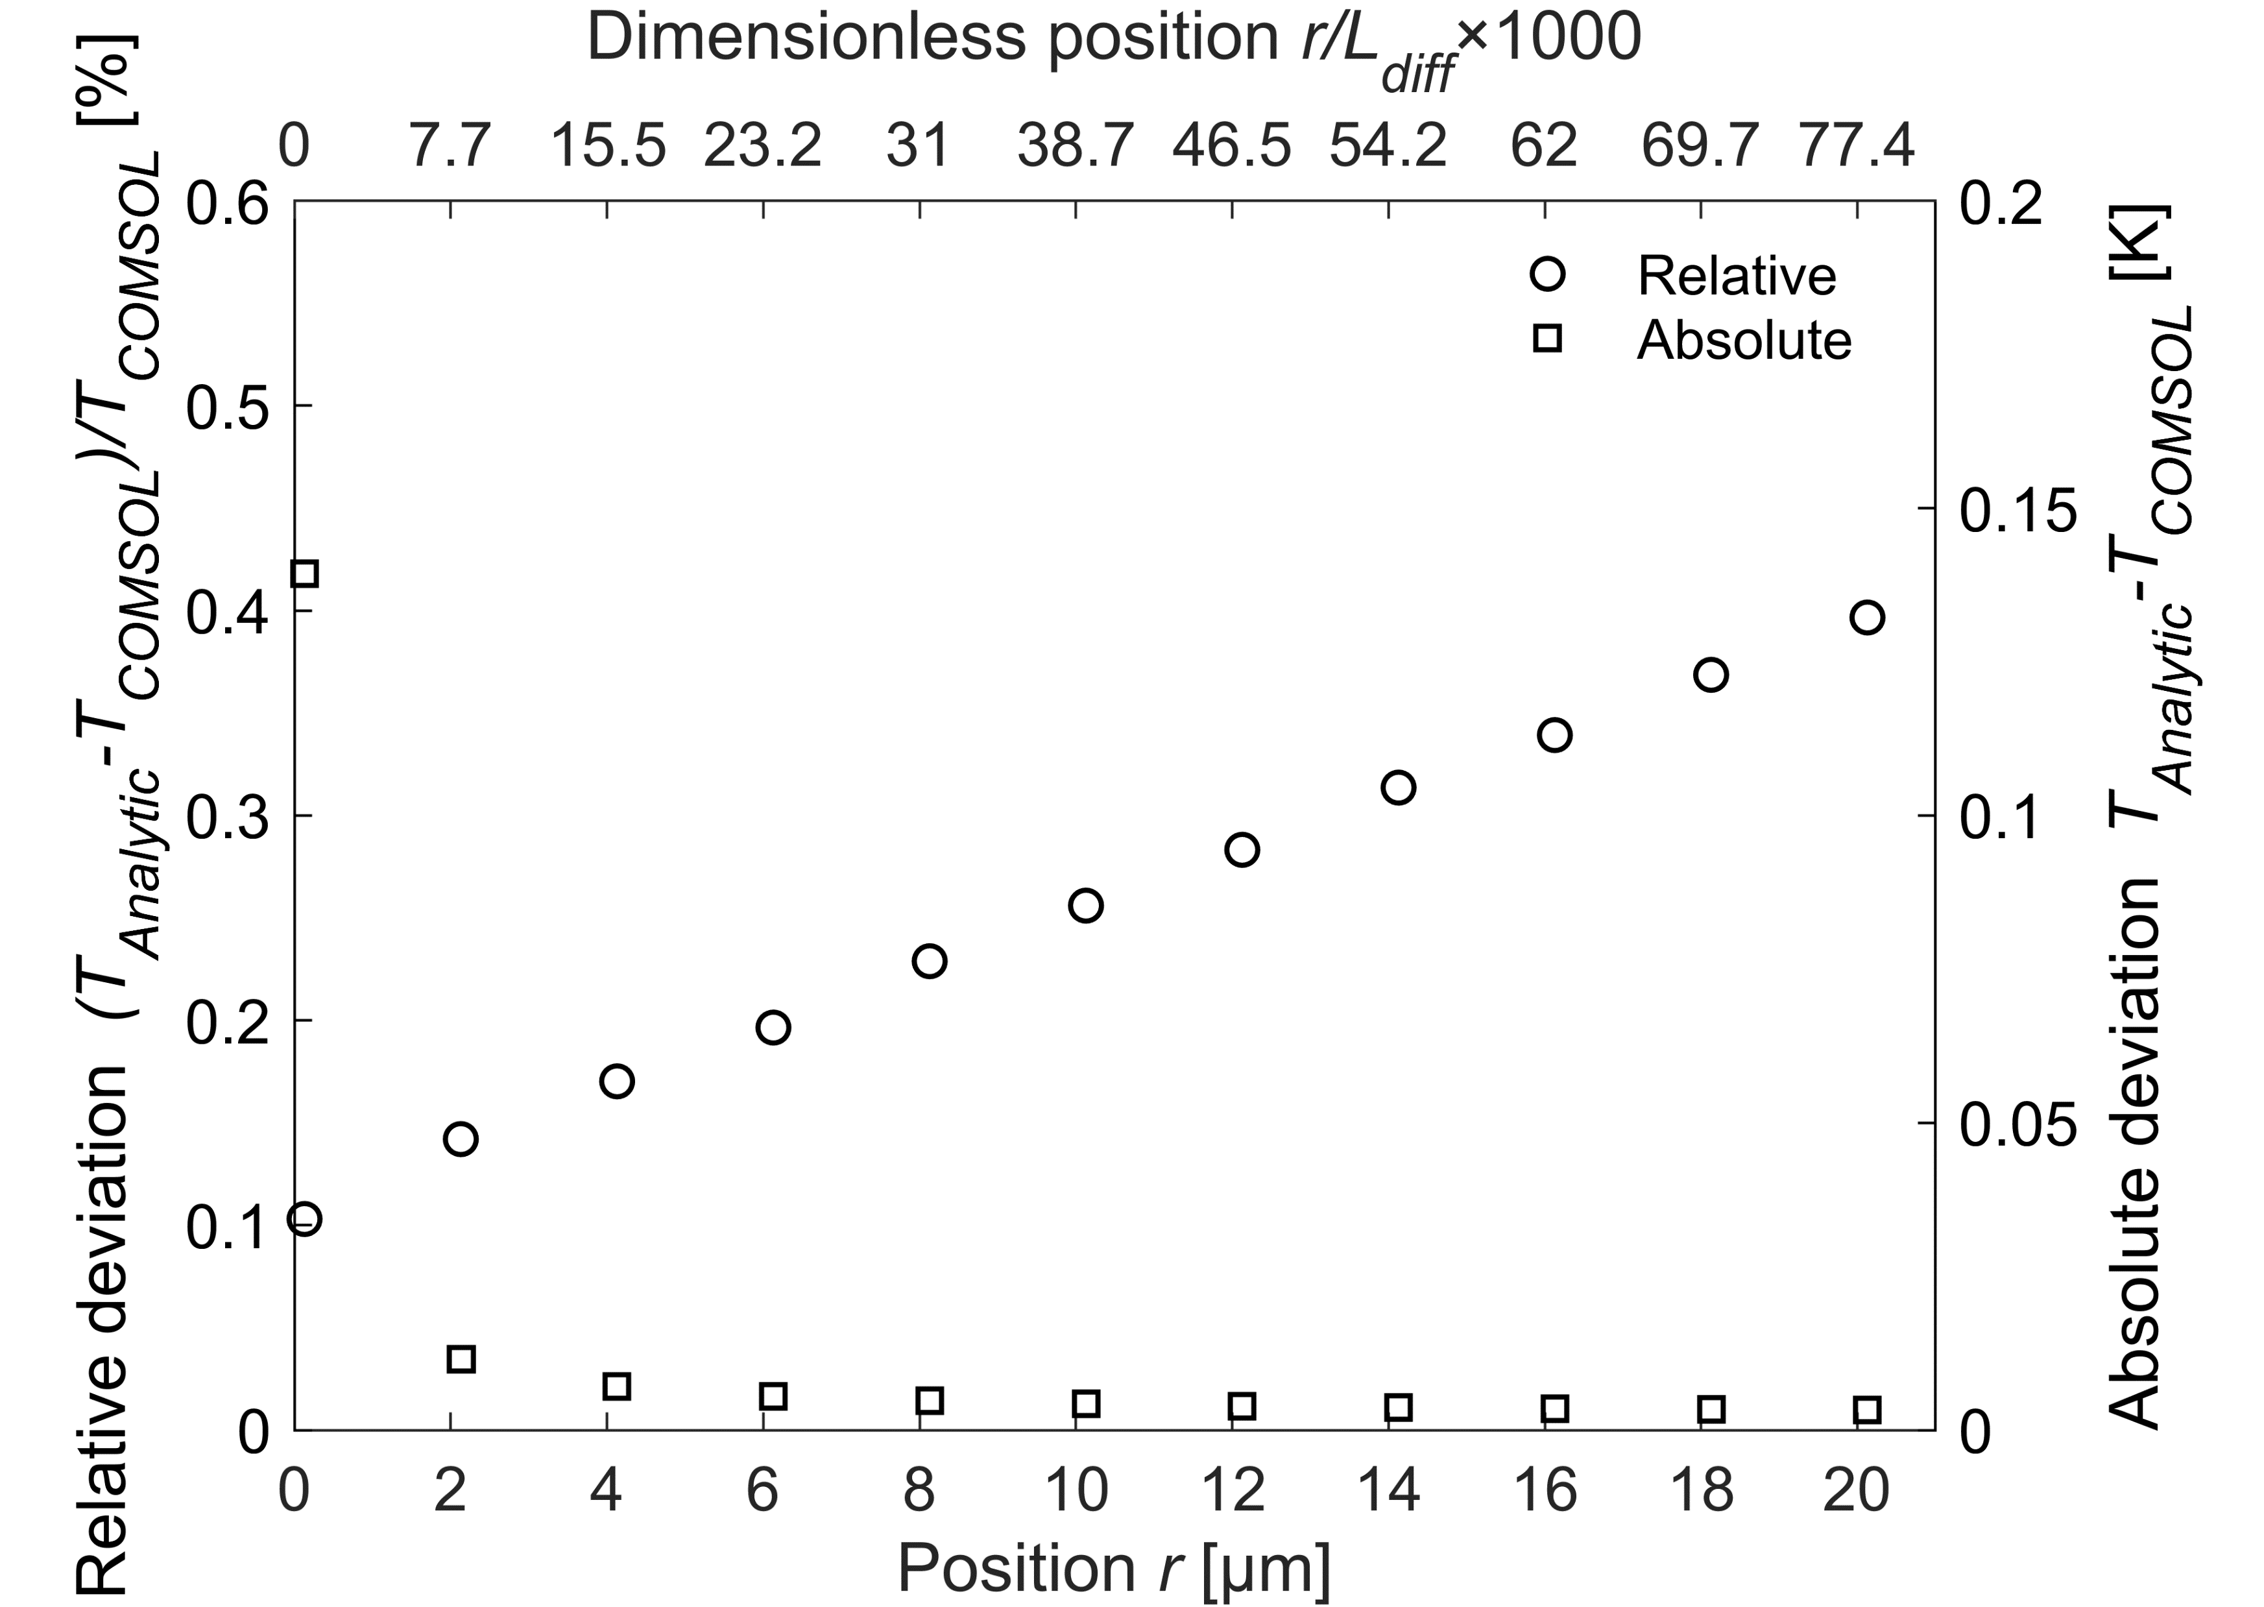
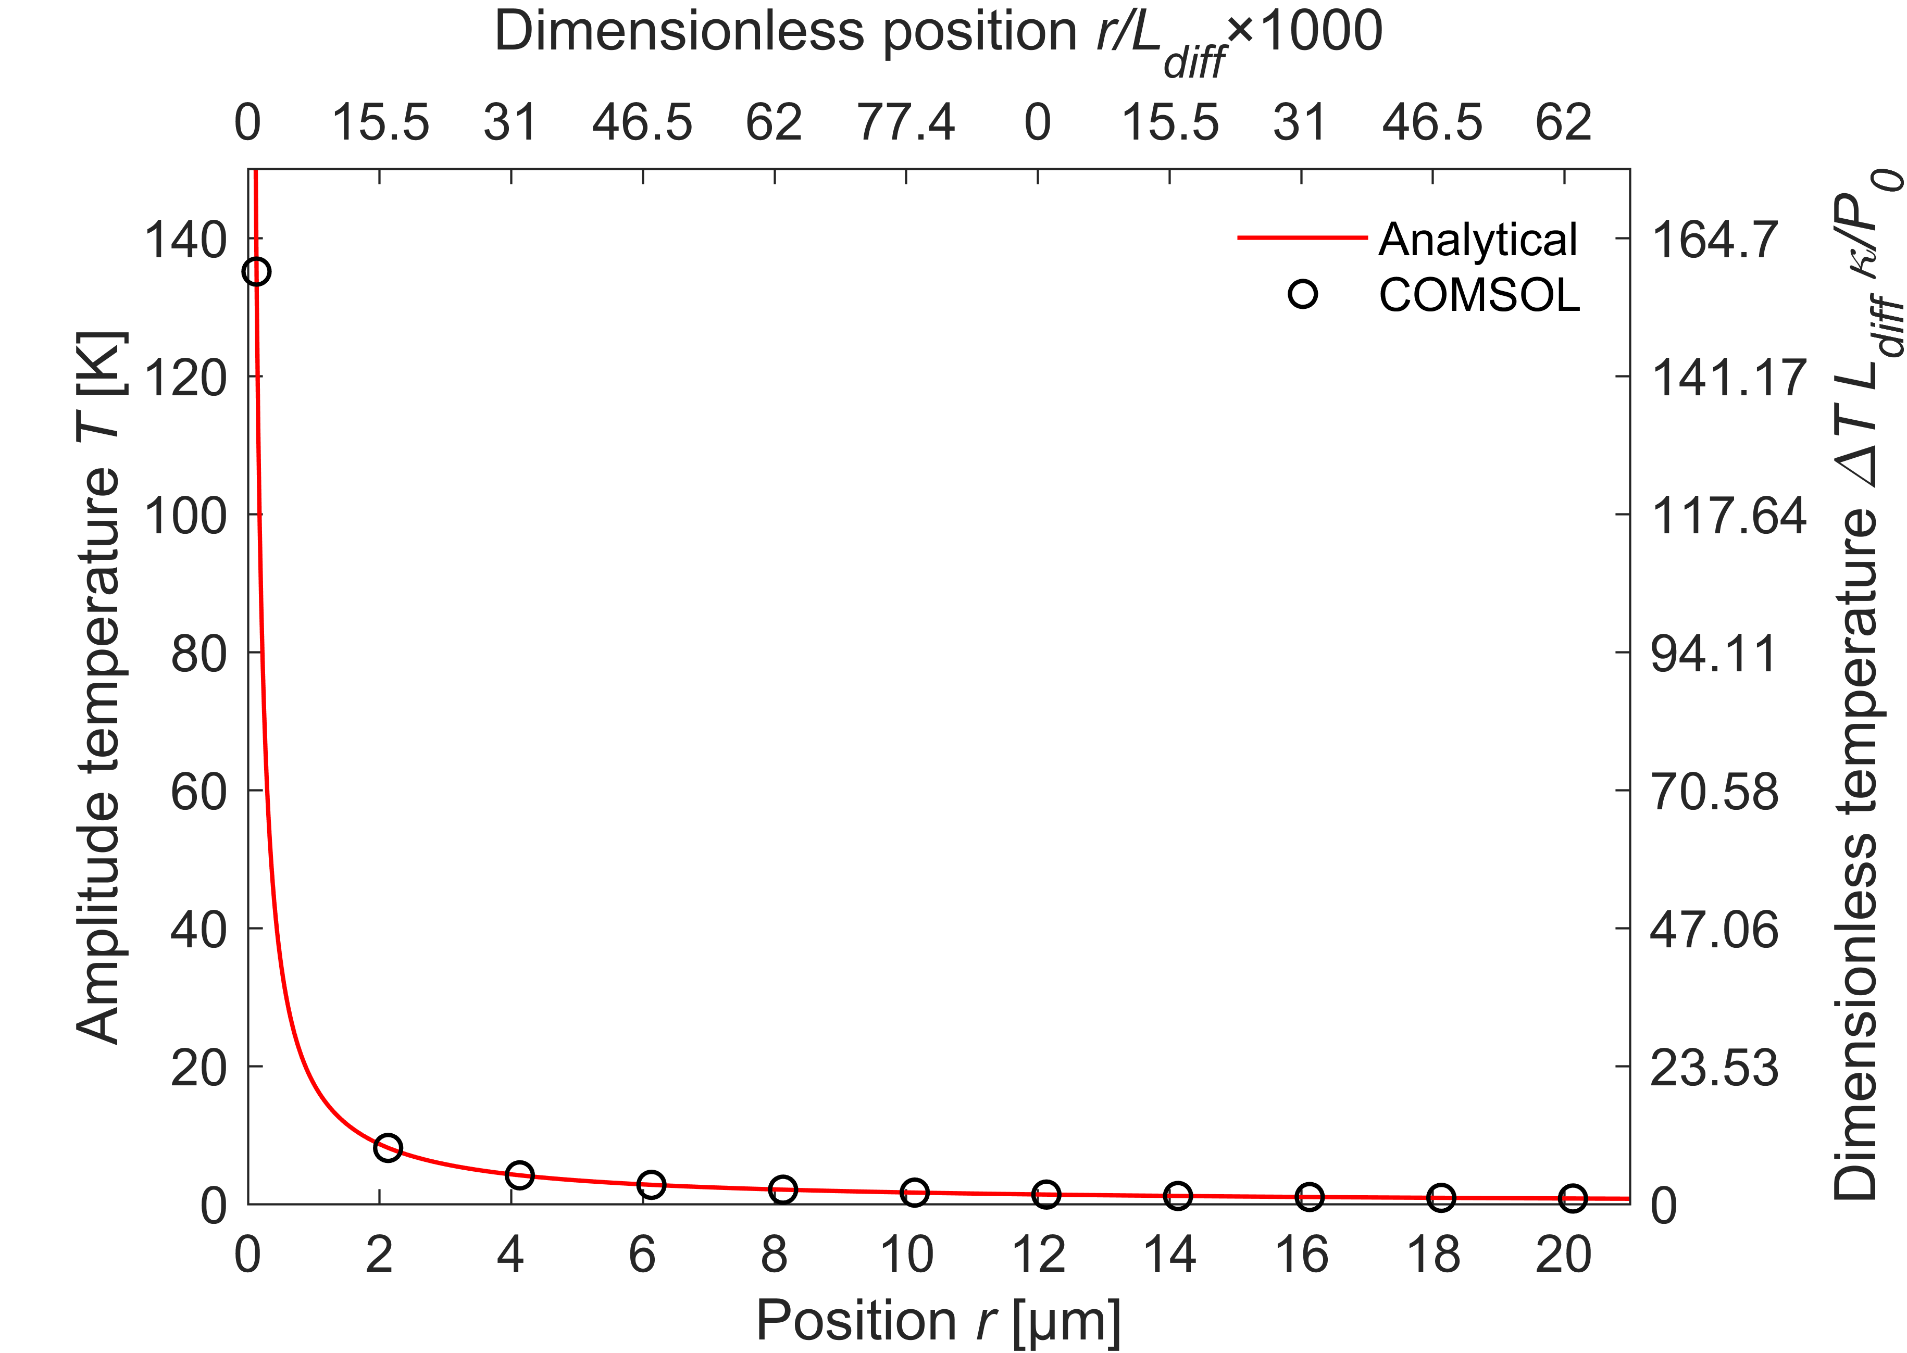
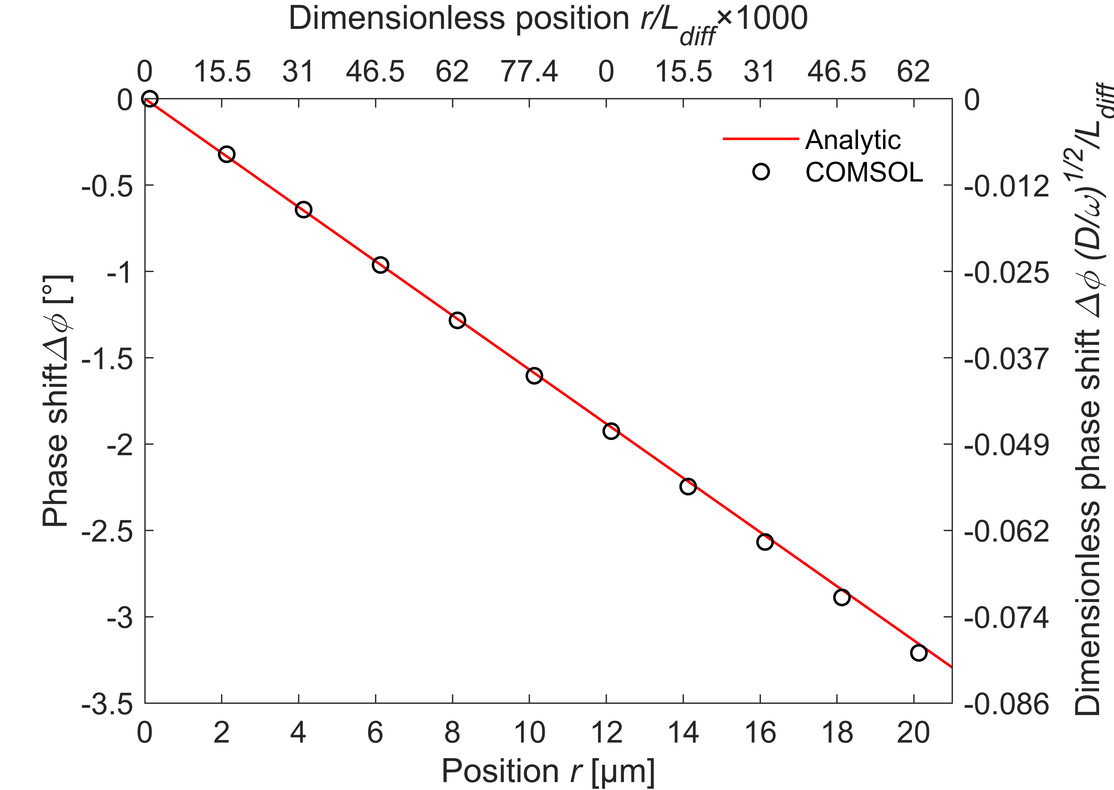
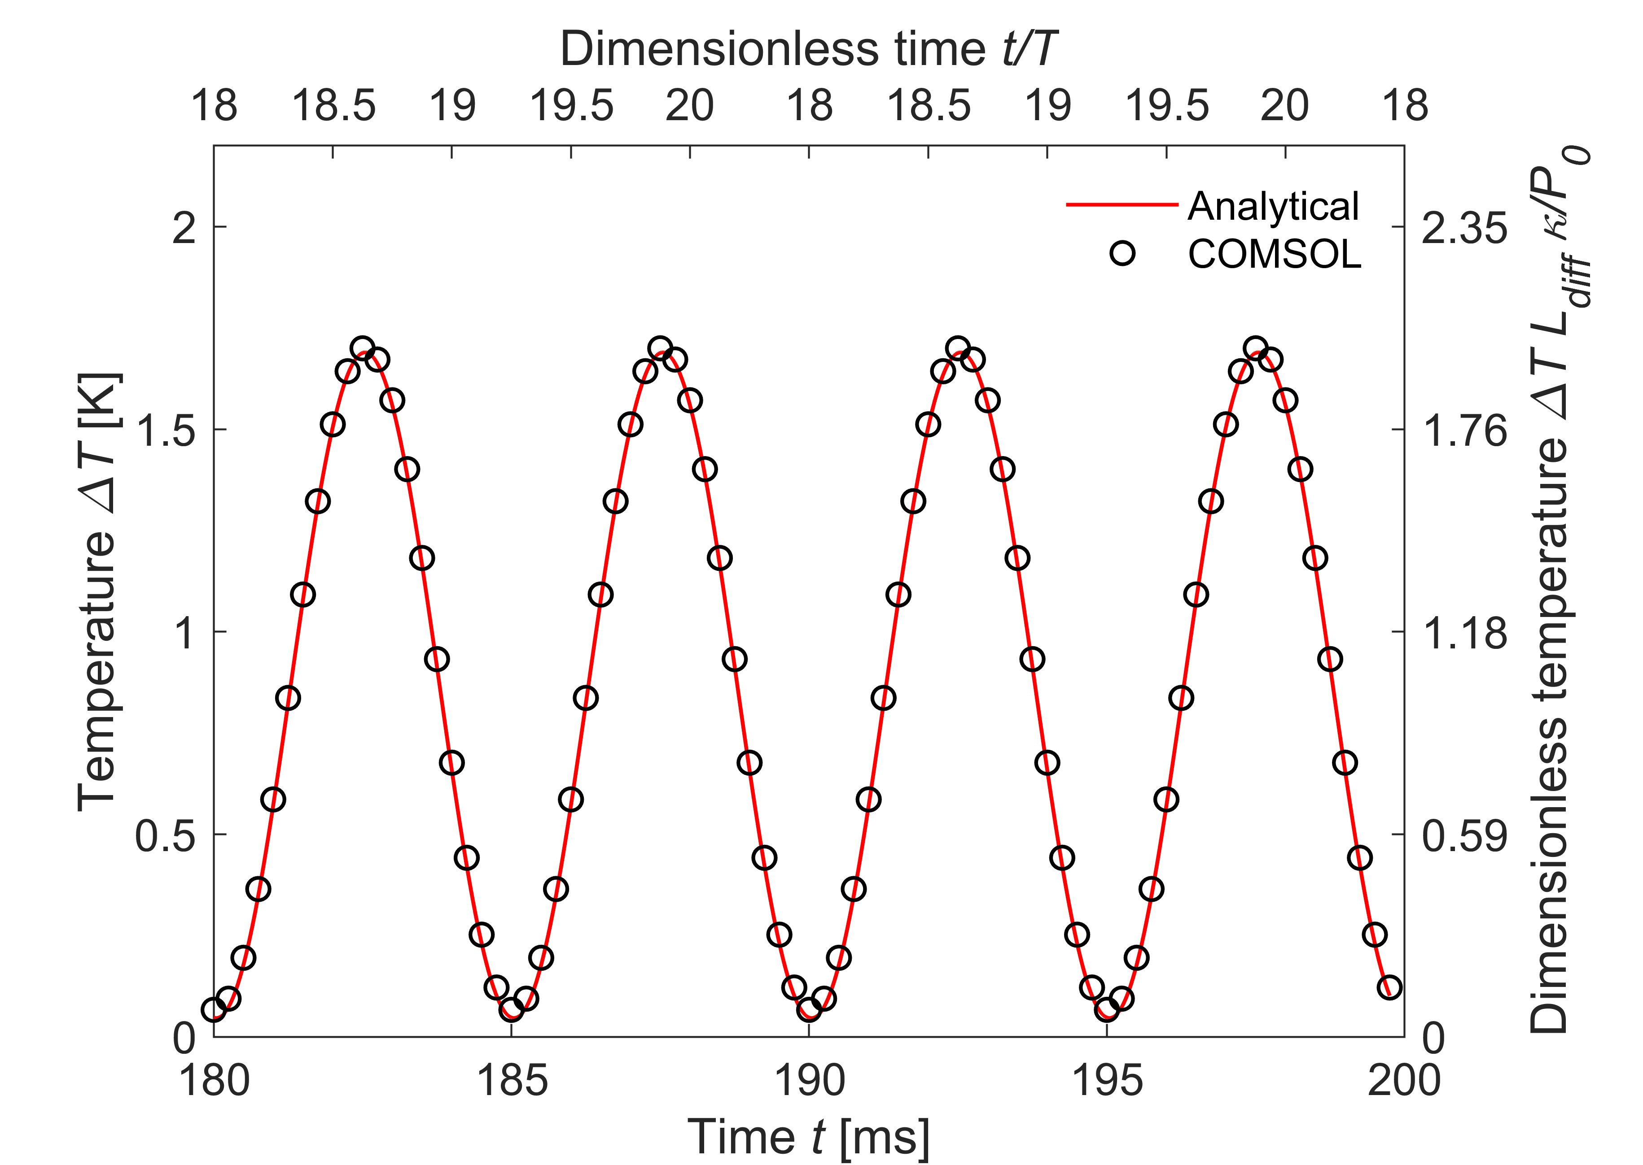
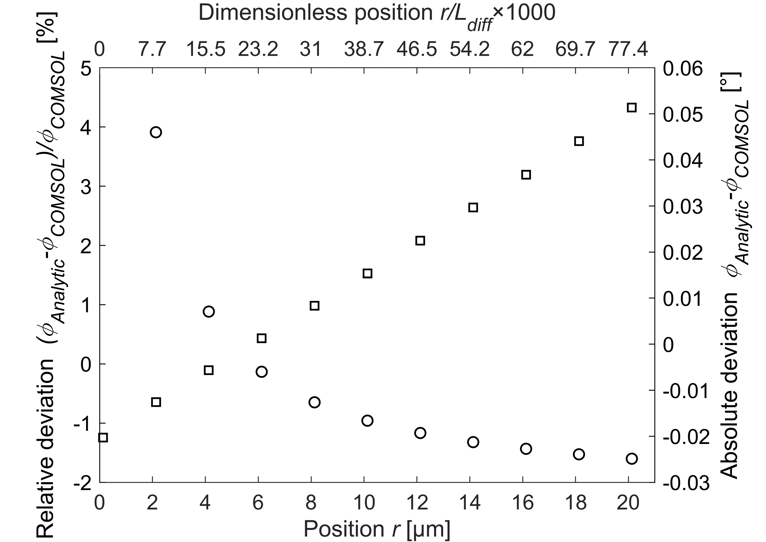
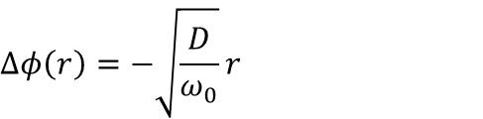
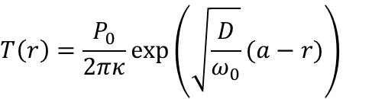

Results – Single probe
Figure 11 Calculated error of the amplitude between COMSOL and the
analytic solution.
Figure 9 Calculated FFT amplitude of temperature signal.
$$J_{q}\left(t\right)=\frac{P_{0}}{2πa^{2}}\sin^{2}{(ω_{0}t)}$$
Dissipated power:
Amplitude:
Phase:
$$T\left(r\right)=\frac{P_{0}}{2πκ}exp\left(\sqrt{\frac{D}{ω_{0}}}(a−r)\right)$$
$$Δφ\left(r\right)=−\sqrt{\frac{D}{ω_{0}}}r$$
Figure 8 Temporal temperature profile for a single probe.
Figure 12 Calculated error of the phase between COMSOL and the analytic solution.
Figure 10 Calculated FFT phase of temperature signal.
Notes:
We have concluded that the DC steady-state solution is a good approximation for a DC heat current. We can now expand the problem to include both the DC and AC term as the heat source. From this we can calculate the change in temperature with the analytic and numeric approach in Figure 8. The wave is characterized by its amplitude and phase. The phase shift is measured from the perimeter of the hemisphere. We can extract the amplitude and phase shift from the data in Figure 8 using the fast fourier transformation. To avoid transient effects we only look at the two lasts periods. We can observe that the numerically and analytically calculated amplitude in Figure 9 match quite well. We can quantify the error by calculating the relative and absolute deviation (click for animation) between the two solutions in Figure 11. Here we can observe a decreasing absolute error further away from the source. However, since the temperature is also lower here the relative error increases. Returning to Figure 10 we can compare the obtained phase shifts. Here it is apparent that the numerical calculated phase shift starts to deviate from the linear analytic predicted trend further away from the source. (click for animation) This trends is clearer if we look at the absolute error in Figure 12 which follows a linear trend. Nonetheless, the phase shift grows larger further away from the source, which results in a decrease in the relative deviation.

Slide 6
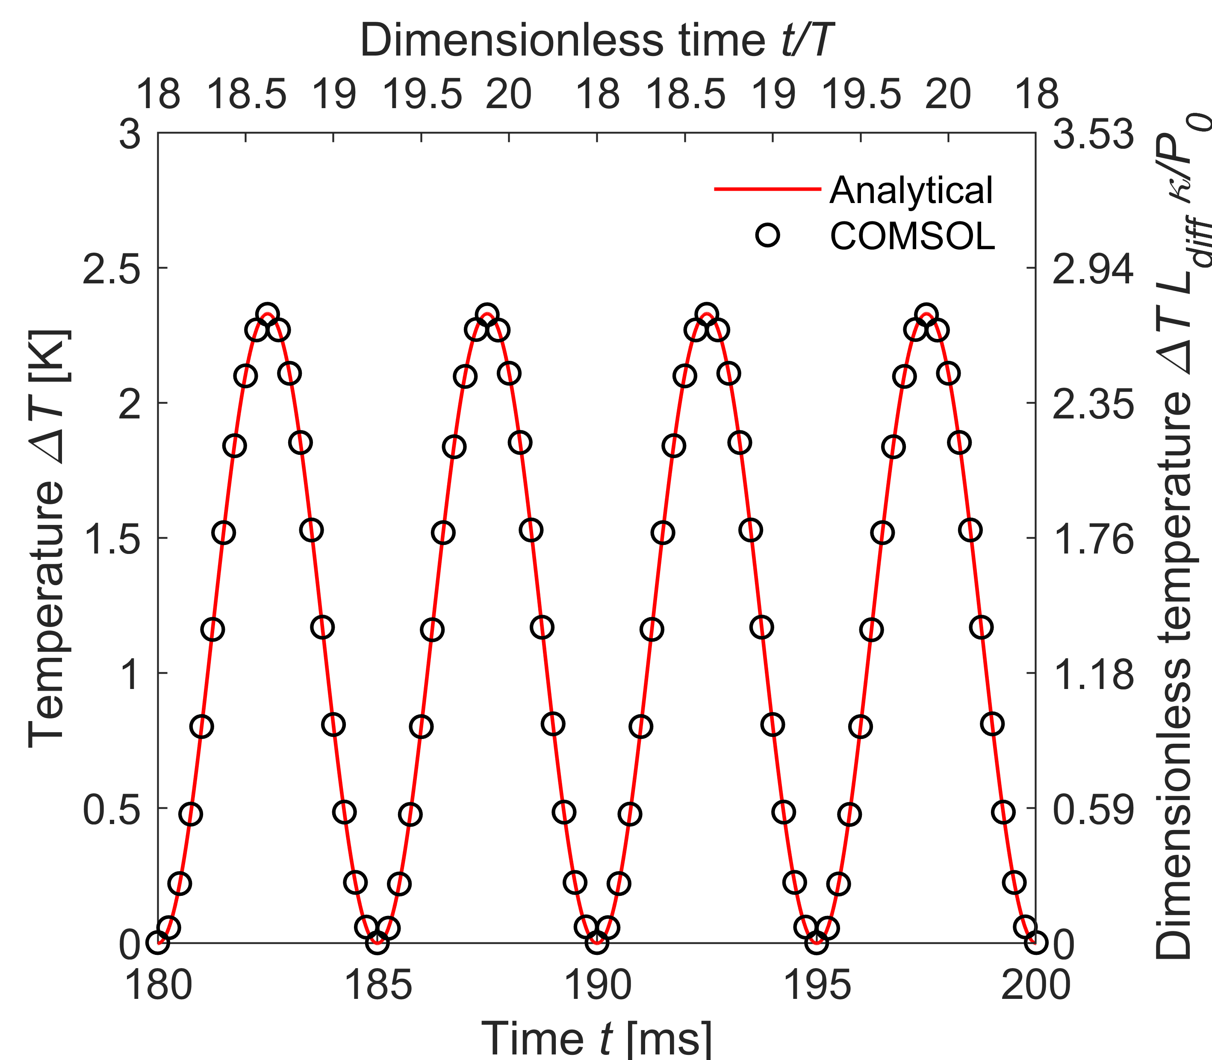



Results – Two probes
Include two heat sources in $r_{1}$ and $r_{2}$
Temperature
Solution to heat equation
$$T_{DC}\left(r\right)=\frac{P_{0}}{4πκr}$$
$$T\left(r,t\right)=T_{DC}\left(r\right)+T_{AC}\left(r,t\right)+T_{0}$$
$T_{AC}\left(r,t\right)=−\frac{P_{0}}{4πκr}exp\left(\sqrt{\frac{ω_{0}}{D}}(a−r)\right)$ $cos\left(\sqrt{\frac{ω_{0}}{D}}\left(a−r\right)+2ω_{0}t\right)$
$$T_{dual}\left(r,t\right)=T\left(r−r_{1},t\right)+T\left(r−r_{2},t\right)−T_{0}$$
Table 1 Results extracted from the temperature profile.
 | Amplitude [K] | Phase [°]
Analytical | 1.1650 | 197.8988
COMSOL | 1.1622 | 197.7326
Absolute deviation | 0.028 | 0.1662
Relative deviation | 2.41% | 0.08%
Figure 13 Temperature profile using two heat sources.
Notes:
Finally, we can start to investigate the temperature profile using two heat sources. Here we use the superposition of the solution for a single probe including both the DC and AC term. The result is shown here (point). When performing four-point probe resistance measurements we are typically interested in the temperature difference between the two probes measuring the voltage drop. Therefore we can calculate the temperature difference between two points using our derived result, and compare it to COMSOL in Figure 13. Using the Fourier transform we can extract the amplitude and phase of the analytic and numeric solution. In this case we do not calculate the phase shift from a reference point, thus the Fourier transform adds an arbitrary phase, since we do not start our Fourier transform at “t = 0”. In table 1 the results are collected. Here we can see the relative deviation for the amplitude is larger than the result using a single probe. For the phase we should not trust the relative deviation, since we have this arbitrary phase contribution, instead we can see the absolute deviation is quite low at 0.16 degrees. This is also larger than the error observed for a single probe. The deviation between the analytic and numeric solution is quite low. This means we can still apply the developed analytic solution for real four-point probe measurements in future work.

Slide 7
Conclusion
Analytical solution developed for the semi-infinite problem
Compared to numerical calculations using COMSOL
High accuracy of solution for a single probe
Phase error of 0.05°
Amplitude error of 0.4%
Analytical solution expanded to include two heat sources
Good agreement between analytic and numerical results
Outlook
Include temperature effects in four-point probe resistance measurements
Notes:
In this work, an analytic solution for the time-dependent temperature response in bulk materials has been developed. The analytic solution was compared to numerical solutions calculated with COMSOL using a finite substrate. Here it was shown that the two solutions matched quite well, even though the analytic solution assumed a semi-infinite substrate. The analytic solution was able to predict the phase with an error of 0.05° and the amplitude with an error of 0.4% compared to the numeric solution for a single probe. Superposing the analytic solution allowed the problem to be expanded to include two heat sources. Once again, a good agreement between the analytic and numeric results was found. The error, however, was larger for the two-probe solution compared to the single probe. This work shows that it is possible to describe the time-dependent temperature profile in four-point probe resistance measurements using a simple analytic equation. This can hopefully help to include thermal effects in the measurements that would ultimately lead to a higher accuracy, or might even allow the measurements of thermal properties using a voltage signal.

