Slide 1
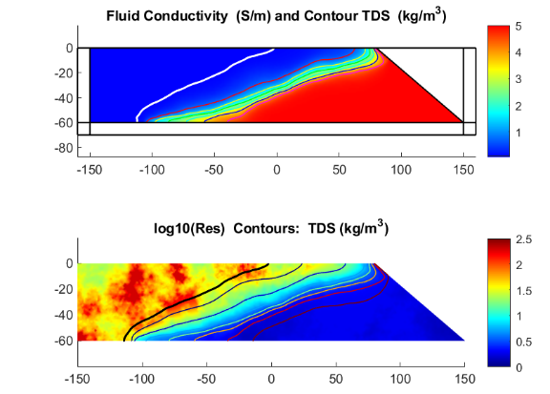
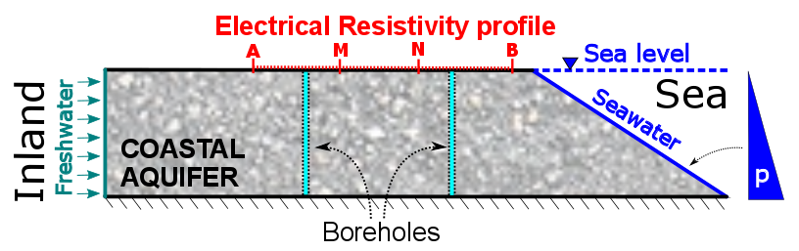
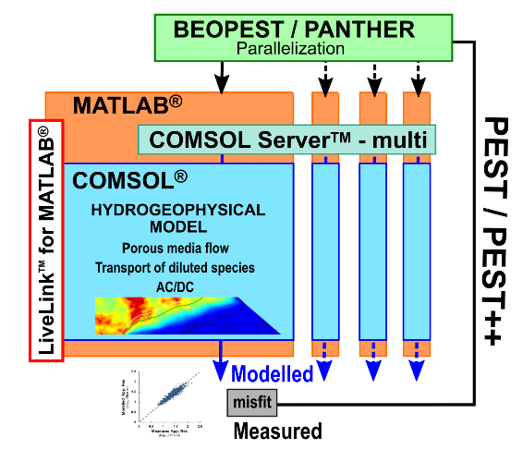
Coupling PEST/PEST++ and COMSOL® for hydrogeophysical model calibration using pilot points
A. González-Quirós, J-C. Comte
School of Geosciences, University of Aberdeen, Aberdeen, Scotland, United Kingdom.
INTRODUCTION: The calibration of groundwater models is usually limited by the scarcity of direct hydraulic data. In this work we present a strategy for parameter estimation of hydraulic properties using jointly hydraulic and geophysical information through a coupled hydrogeophysical inversion.
We show an example in which we delineate saltwater intrusion in a coastal aquifer using electrical resistivity (ERT) and borehole salinities.
RESULTS: The forward model is solved coupled to obtain distribution of hydraulic heads and salinity, bulk electrical resistivity and computed electrical response in the quadripoles of the ERT profile.
Figure 1. Conceptual model of the Hydrogeophysical problem.
COMPUTATIONAL METHODS (The Forward Model):
The flow-transport variable-density groundwater 2D problem was solved using Darcy’s Law and Transport of Diluted Species from the Porous Media Flow module.
The electrical resistivity problem in 2.5D was solved using the PDE Helmholtz equation module.
Both problems were coupled using a petrophysical model. Postprocessing to obtain quadripole data for the desired ERT array was performed in MATLAB® (González-Quirós and Comte, 2020).
COMPUTATIONAL METHODS (The Coupled Inversion):
For model calibration and uncertainty analysis we coupled COMSOL with the calibration software PEST/PEST++ (Doherty, 2019; White et al., 2020) using the COMSOL ServerTM and LiveLink for MATLAB®. The procedure was parallelized to increase efficiency.
Figure 3. Results of the forward model: fluid conductivity and salinity contours (up) and log10 electrical resistivity (bottom).
RESULTS: We solved the inverse problem for disturbed synthetic salinity and ERT data using the PEST GLM mode and the Iterative Ensemble Smoother of PEST ++. For domain parametrization we used pilot points. The results show a good delineation of the saltwater-freshwater mixing zone and an accurate recovery of the spatial distribution of electrical resistivities.
Figure 4. Results of the coupled inversion in the domain of investigation of ERT data: electrical resistivities and salinity reference contours
CONCLUSIONS: We have shown an efficient strategy to solve coupled inverse hydrogeophysical inversion by coupling the widely known software PEST/PEST++ with COMSOL. The methodology can be used with slight modifications in other multiphysical problems.
REFERENCES:
González-Quirós, A., & Comte, J-C. (2020). Relative importance of conceptual and computational errors when delineating saltwater intrusion from resistivity inverse models in heterogeneous coastal aquifers. Advances in Water Resources, 144, 103695.
Doherty (2019). Doherty, J. (2019). PEST, Model-independent Parameter Estimation, User Manual, Watermark Numerical Computing.
White, J. T., Hunt, R. J., , Doherty, J. E., and Fienen, M. N. (2020). PEST++ version 5, a parameter estimation and uncertainty analysis software suite optimized for large environmental models. U.S. Geological Survey.
Figure 2. Flowchart of the coupled inversion procedure.
Excerpt from the Proceedings of the 2020 COMSOL Conference

