Slide 1
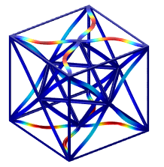
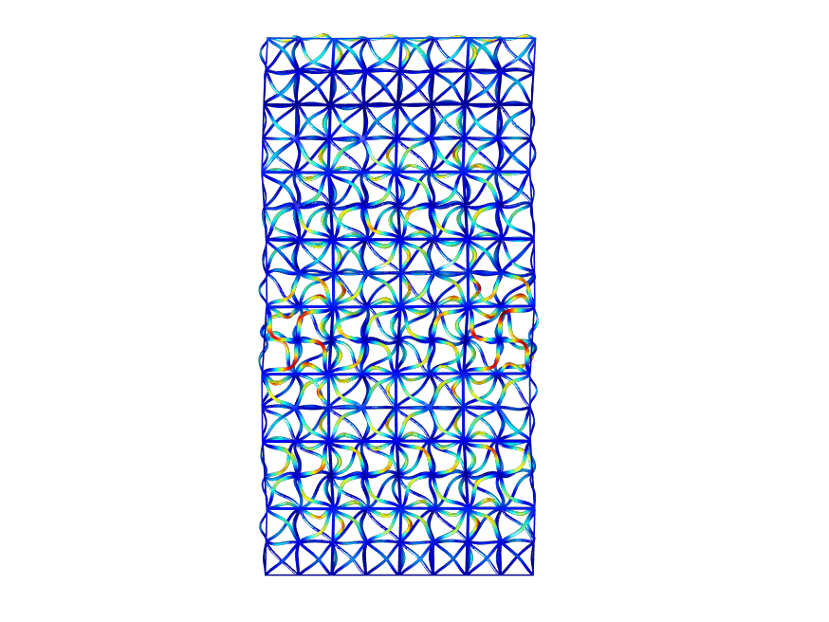
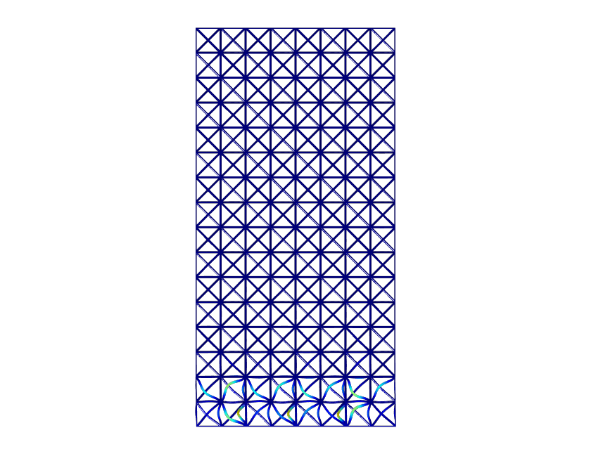

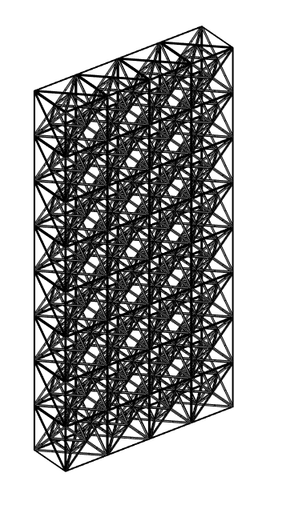
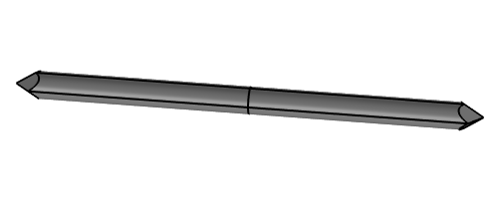
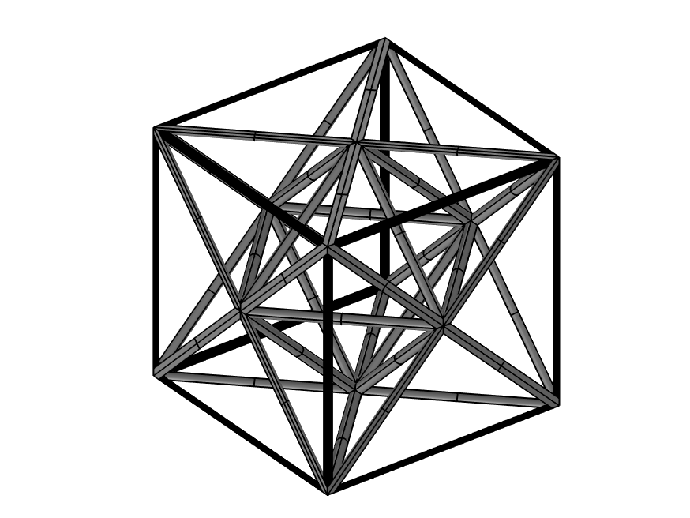
Numerical Investigation Of Structured Materials For Vibration Control
G. Aguzzi¹, A. Colombi¹, E. N. Chatzi¹
1. Department of Civil, Environmental and Geomatic Engineering, ETH Zürich, Zürich, CH
INTRODUCTION: Lattice structures are a subset of periodic architected materials generated by the intricate interweaving of beams. They exhibit attractive wave filtering phenomena at specific frequency ranges, called bandgaps, typically characterized by the exponential decay of propagating waves. In this work, the high connectivity octet lattice [1] is used to design a reticulated panel endowed with a low frequency stop band. This structure, made of elastomeric material, is enclosed by a carbon fiber frame which guarantees the vertical stability of the system. Within this framework, finite element simulations play a key role in the design and performance validation processes.
RESULTS: The dispersion relation in Fig. 2a, namely the relationship between the wave number and frequency of a wave, exhibits a bandgap between 66.8 and 79.7 Hz, originated by the local resonance of the elastomeric struts [2]. This initial estimate is successfully validated by the drop in transmission of the finite panel, Fig. 2b. The wave that propagates freely inside the lattice at frequencies outside the bandgap (Fig. 3a), remains instead localized by the flexural resonance of the beams for frequencies within the stop band (Fig. 3b), which prevent its propagation.
(a)
100
(b)
90
80
Bandgap
COMPUTATIONAL METHODS: The unit cell model (Fig. 1a), developed within the Solid Mechanics interface, consists of a 3D geometry meshed via tetrahedral elements. Here, solid volumes are privileged over simplified Euler Bernoulli beams to account for the actual node stiffness.
The dynamic behavior of the designed cell is preliminarily outlined by means of an eigenfrequency analysis with parametric sweep of the wave vector. Floquet periodic conditions are applied to all boundaries in order to mimic the wave propagation within an infinite lattice and compute the dispersion curves, Fig. 2a. The dynamic response of a finite size panel (Fig. 1b), excited by a horizontal displacement prescribed at its base, is then assessed via frequency domain analysis and compared to the infinite model prediction, Fig. 2.
Eventually, the vertical stability of the system under its own weight, applied as gravity domain load, is inspected via static analysis. It is essential to verify that the vertical sag of the panel lies below a reasonable threshold.
70
60
50
Frequency [Hz]
40
30
20
10
0
Γ
X
M
R
Γ
-50
0
50
Wave vector
Transmission Loss [dB]
Figure 2. Comparison between the infinite model stop band prediction and the finite panel response. (a) Dispersion relation and mode shape that generates the bandgap. (b) Undamped transmission loss.
(a)
(b)
1
0
z
x
Figure 3. Wave propagation within the panel. (a) Before the bandgap at frequency 54.5 Hz. (b) Inside the bandgap at 67.5 Hz.
(a)
l_{strut}
(b)
CONCLUSIONS: In this project we have shown the preliminary design of a beam lattice panel capable of mitigating low frequency vibrations originated by anthropogenic activity. This lightweight structure is intended to be used in civil engineering applications to hinder the propagation of vibrations through existing structural components. Further investigation is required on the material and geometric nonlinearities characterizing the panel and its coupling with structural components, i.e., pillars and slabs.
t
H
l
l
l
z
l
L
y
x
REFERENCES:
Deshpande, Vikram S and Fleck, Norman A and Ashby, Michael F, Effective properties of the octet-truss lattice material, Journal of the Mechanics and Physics of Solids, 49(8), pp.1747-1769 (2001).
Wang, Pai, et al., Locally resonant band gaps in periodic beam lattices by tuning connectivity., Physical Review B, 91.2, 020103 (2015).
Figure 1. (a) Unit cell design: soft octet in light grey and stiffer frame in black . (b) Finite panel geometry built by periodically tessellating in the horizontal and vertical directions the basic unit cell (4x1x8 cells).

