Slide 1
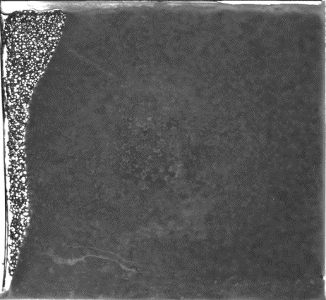
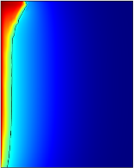
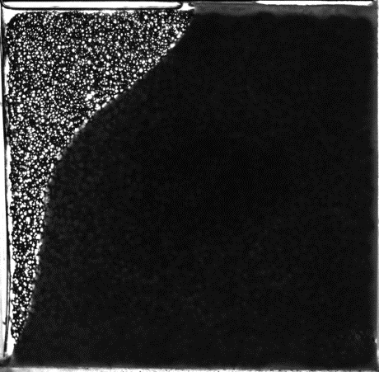
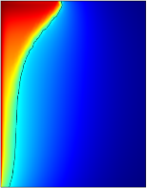
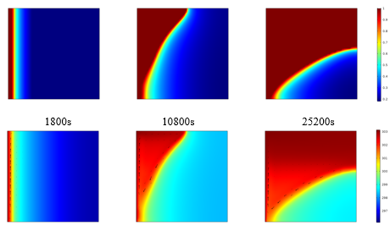
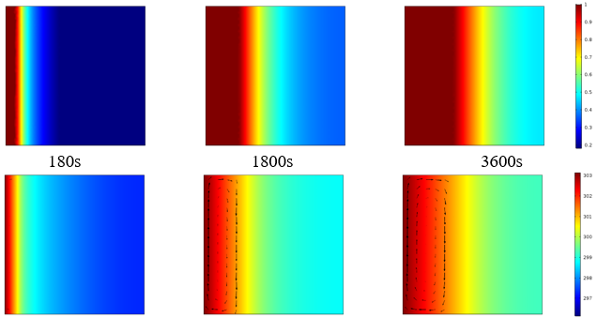
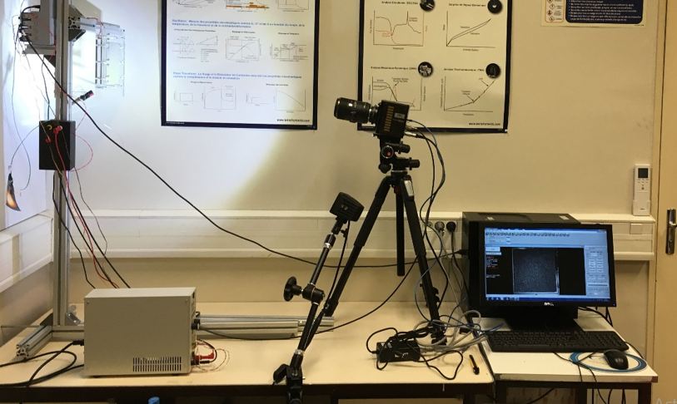
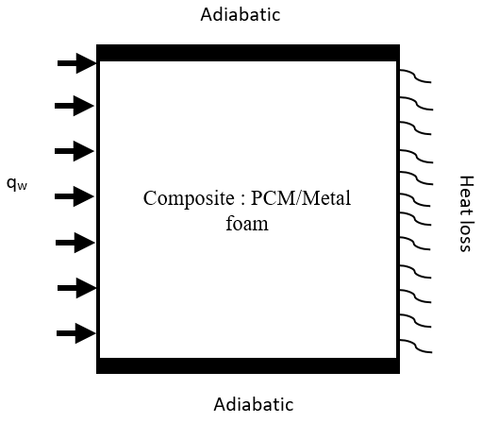
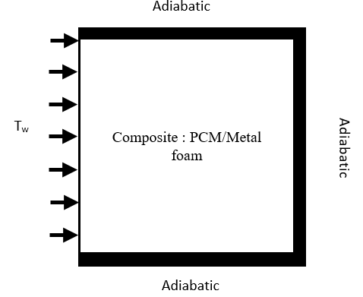
Melting and solidification behavior of PCM embedded in metal foam
M. M. EL IDI¹, M. KARKRI¹
Université Paris Est, CERTES, 61 av. du général de Gaulle, 94010 Créteil Cedex, France
Corresponding author: moussa.elidi@gmail.com
INTRODUCTION: Phase change materials (PCM) are known for their low thermal conductivity which reduces their phase-change kinetic [1]. This paper presents a numerical investigation on the thermal behavior of PCM embedded in Metal Foam and the effect of heating and cooling conditions during melting and solidification using COMSOL Multiphysics. An experimental device is presented. A mathematical model based on the Brinkmann-Forchheimer-extended Darcy equation and the local thermal non- equilibrium model (LTNE) is proposed by applying a two-energy equation. The phase change is modeled by the enthalpy-porosity method. The numerical model was validated by comparison with experimental.
COMPUTATIONAL METHODS. The numerical model is solved using a finite element analysis by the Porous Media and Subsurface flow module (Brinkman Equation (br)), CFD, and the local Thermal Non-Equilibrium modules in COMSOL Multiphysics 5.3a software.
Validation: Comparison between numerical results and experimental
Figure 3. Exp Vs Num after 3600s
Figure 4. Exp Vs Num after 10800s
Results:
Experimental device: The experimental apparatus consists of a Paraffin RT27/ Aluminum foam (0,83, 40PPI) composite container, a heating resistor, a temperature data logger, a PID temperature controller, a computer and CCD camera. The PCM/Metal foam container is a rectangular enclosure 150mmx150mmx10mm. In order to visualize the melt front evolution, photographs were taken at time intervals of 3minutes.
The impact of metal foam on phase and temperature fields
Figure 5. Phase change and
temperature fields RT27
Figure 6. Phase change and temperature
field RT27- Metal foam composite
Camera
Heating and cooling conditions effects on the kinetic of phase change of PCM embedded in metal foam
PCM composite
Computer
Figure 7. New physical model
Figure 1. Experimental device
Physical model: The physical problem to be tackled is illustrated in the figure below.
Figure 8. Liquid fraction evolution with
and without heat loss, constant
Figure 9. Liquid fraction evolution
with and without heat loss, sinusoidal
CONCLUSIONS: A numerical study is carried out on the solid-liquid phase change of PCM embedded in metal foam. The numerical model was validated by comparison with experimental data. It’s found that the conduction is the dominant heat transfer mode during the melting process. It’s observed that with sinusoidal heating the melting time of PCM it’s reduced compared with constant heating. A larger effect of heat loss by natural convection in the boundary in the solidification process compared to the melting process.
Figure 2. Physical model
REFERENCES:
M. M. EL IDI, M. Karkri, Heating and cooling conditions effects on the kinetic of phase change of PCM embedded in metal foam, Case Studies in Thermal Engineering 21 (2020) 100716
Excerpt from the Proceedings of the 2020 COMSOL Conference

