Slide 1

Coupled A-H Field Formulation For HTS Magnets
In COMSOL Multiphysics ®
L. Bortot^{1,2}, I. Cortes Garcia¹, H. De Gersem¹,
M. Mentink², J. Van Nugteren², S. Schöps¹, A. Verweij²
Special Thanks:
B. Auchmann (PSI), F. Grilli (KIT), M. Maciejewski (CERN)
14-15 October 2020, Online Event

Slide 2






INTRODUCTION
High temperature superconductors (HTS)
Copper oxides (CuO2)
Doping with La, Bi-Sr-Ca, Y-Ga-Ba etc.
Higher critical temperature and coercive field with respect to low-temperature superconductors (LTS)
Quench
Local transition from superconducting to normal conducting state
In high energy-density applications (e.g. accelerator magnets), potentially irreversible effects!
Mitigation: artificial resistive zone increase → dilution of the Ohmic loss density
$$T_{hotspot}$$
$$T$$
$${\vec{v}}_{quench}$$
■ Copper ■ ReBCO ■ Substrate
$$\sim mm$$
$$\sim μm$$
$$x$$
HTS tape
Resistive zone
Figure: schematics of a copper-coated
ReBCO tape

Slide 3


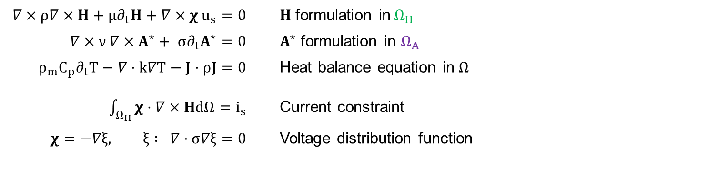





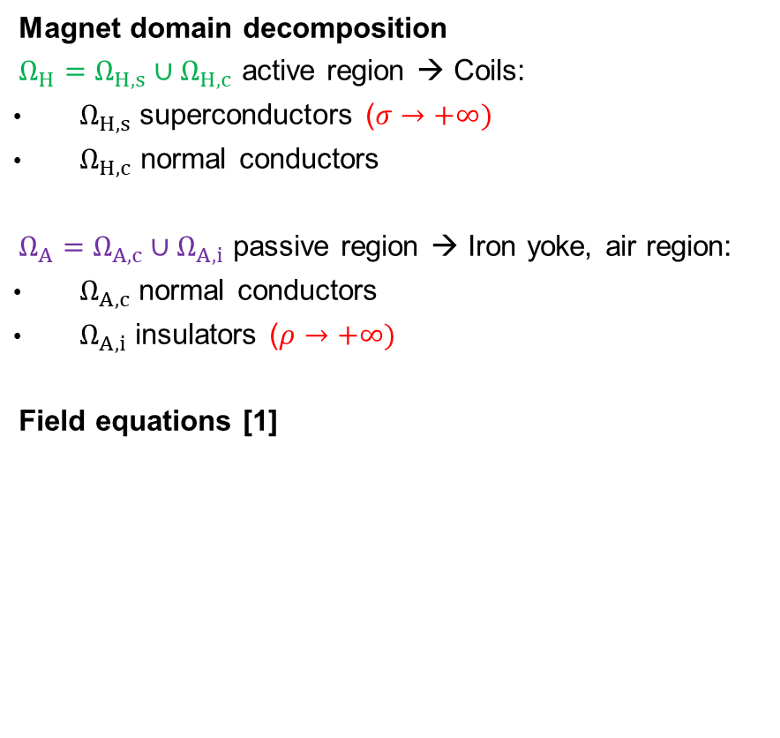








FORMULATION (EXCERPT FROM POSTER)
Magnet domain decomposition
$Ω_{H}=$ $Ω_{H,s}∪Ω_{H,c}$ active region → Coils:
$Ω_{H,s}$ superconductors ($σ→+∞)$
$Ω_{H,c}$ normal conductors
$Ω_{A}=$ $Ω_{A,c}∪Ω_{A,i}$ passive region → Iron yoke, air region:
$Ω_{A,c}$ normal conductors
$Ω_{A,i}$ insulators ($ρ→+∞)$
Field equations [1]
$$n$$
$$Ω_{A,i}$$
$$n$$
$$Ω_{A,c}$$
$$Ω_{H,c}$$
$$Γ_{HA}$$
$$Ω_{H,s}$$
$$Γ_{E}$$
$$Γ_{A}$$
$$Ω∈ℝ^{3}$$
$$−$$
$$∇×ρ∇×H+μ∂_{t}H+∇×χ u_{s}=0$$ |  | $H$ formulation in$Ω_{H}$
$$∇×ν ∇×A^{⋆}+ σ∂_{t}A^{⋆}=0$$ |  | $A^{⋆}$ formulation in $Ω_{A}$
$$ρ_{m}C_{p}∂_{t}T−∇⋅k∇T−J⋅ρJ=0$$ |  | Heat balance equation in$Ω$
$\int_{Ω_{H}}{χ}⋅∇×HdΩ=i_{s}$ |  | Current constraint
$$χ=−∇ξ, ξ : ∇⋅σ∇ξ=0$$ |  | Voltage distribution function
$$Γ_{J}$$
$$u_{s}$$
$$i_{s}$$
$$+$$
Figure: General representation of the
computational domain
[1] Bortot, L., et al. "A Coupled A–H Formulation for Magneto-Thermal Transients in High-Temperature Superconducting Magnets." IEEE Transactions on Applied Superconductivity 30.5 (2020): 1-11.

Slide 4

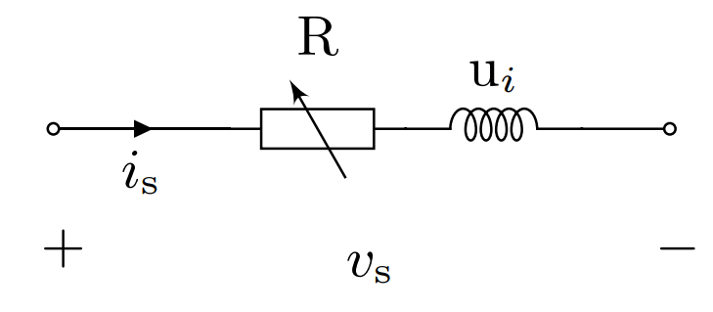


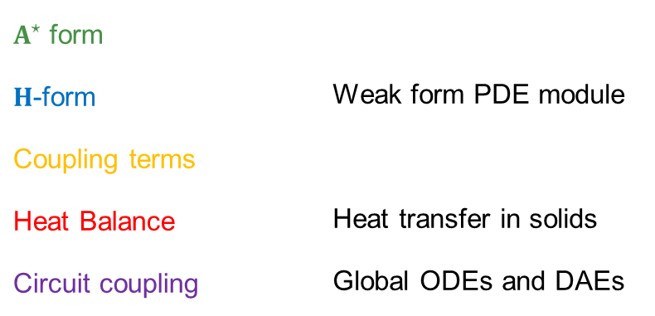




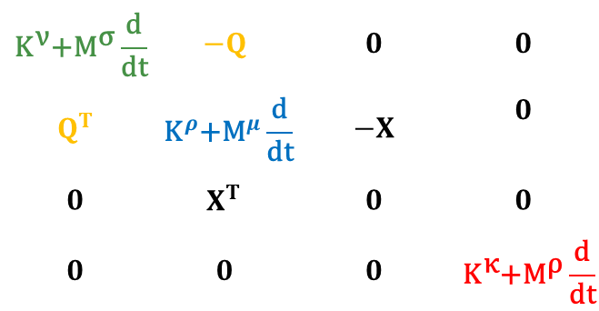


DISCRETE EQUATIONS
Discretization functions
Edge elements for $H$, $A^{⋆}$ ( 1st and 2nd order)
Nodal elements for $χ$, $T$ (1st order)
Circuit interface
External circuit connected via electric ports
FEM model → one-port component with impedance $Z_{FEM} : u_{s}=Z_{FEM} i_{s}$
$A^{⋆}$ form | Weak form PDE module
𝐇-form
Coupling terms
Heat Balance | Heat transfer in solids
Circuit coupling | Global ODEs and DAEs
$${\text{K}}^{\text{ν}}\text{+}{\text{M}}^{\text{σ}}\frac{\text{d}}{\text{d}\text{t}}$$ | $$−Q$$ | $$0$$ | $$0$$
$$Q^{T}$$ | $${\text{K}}^{ρ}\text{+}{\text{M}}^{μ}\frac{\text{d}}{\text{d}\text{t}}$$ | $$−Χ$$ | $$0$$
$$0$$ | $$Χ^{T}$$ | $$0$$ | $$0$$
$$0$$ | $$0$$ | $$0$$ | $${\text{K}}^{\text{κ}}\text{+}{\text{M}}^{\text{ρ}}\frac{\text{d}}{\text{d}\text{t}}$$
$$\text{a}$$
$$\text{h}$$
$${\text{u}}_{\text{s}}$$
$$\text{t}$$
$$0$$
$$0$$
$${\text{i}}_{\text{s}}$$
$$\text{q}\left(\text{⋅}\right)$$
$\int{\text{du} }$
$\int{\text{du} }$
$\int{\text{du} }$
$$=$$
$$\frac{d}{dt}$$

Slide 5
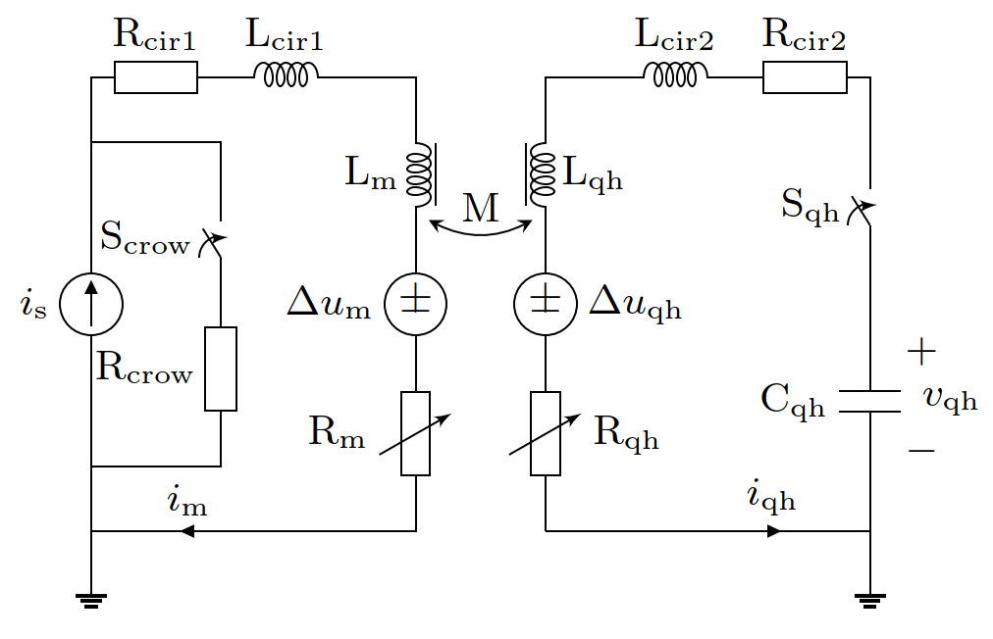
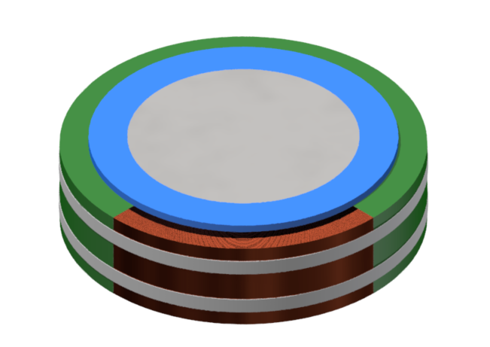
NUMERICAL EXAMPLE
HTS solenoid protected by heater strips: 2D axisymmetric model and circuitry
Iron core
Holder
B.
A.
Coil
Insulation
Heater strips
2D FEM
model
Coil supply loop
Heaters supply loop
Protection mode
A. crowbar
resistance
B. Heater
strips
Current discharged
Figure: Rendering of the HTS solenoid.
Part of the insulation is removed for illustration purposes.
0
5
10
150
t (ms)

Slide 6
NUMERICAL RESULTS (1/2)
Circuital currents
Peak temperature
Max. detection time
Induced quench
Heater strips
Figure: Current decay in the coil (left) and
current discharge in the heater strips (right)
Figure: Adiabatic hotspot temperature in the coil,
as a function of the quench detection time

Slide 7
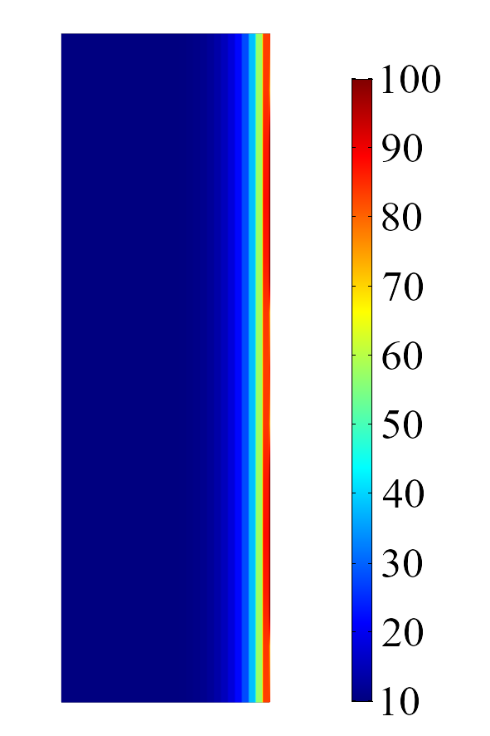

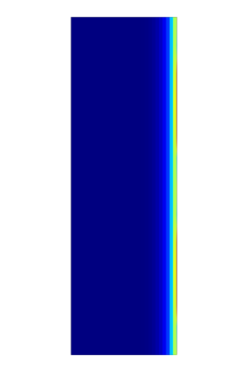
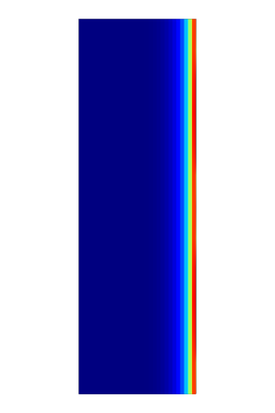
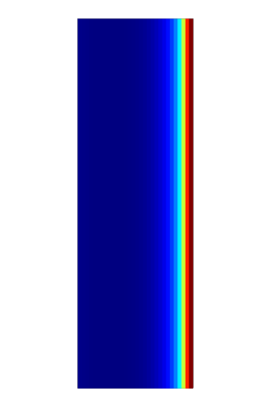
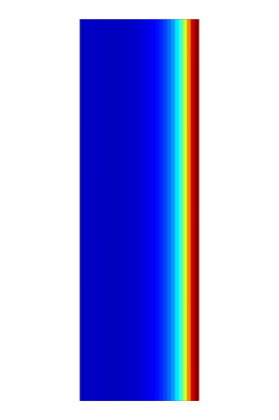
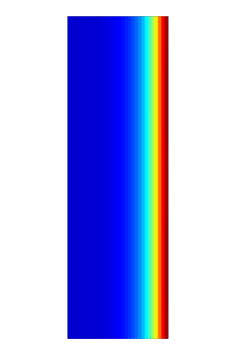
NUMERICAL RESULTS (2/2)
Heater strips
Quench
Heat diffusion
Temperature
(K)
10 ms
20 ms
30 ms
50 ms
100 ms
150 ms
Temperature distribution in the superconducting coil, as a function of time

Slide 8
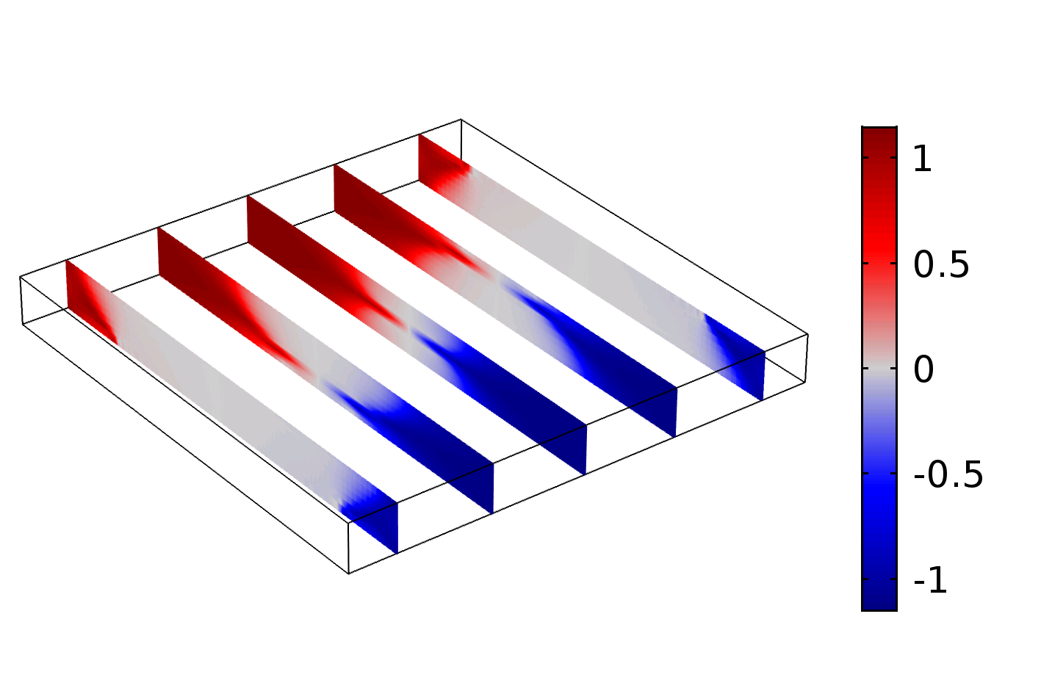
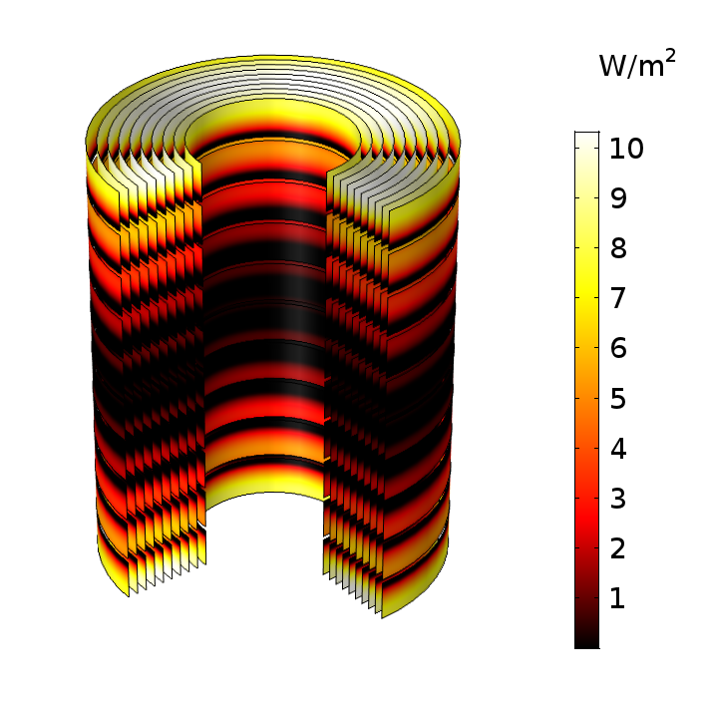
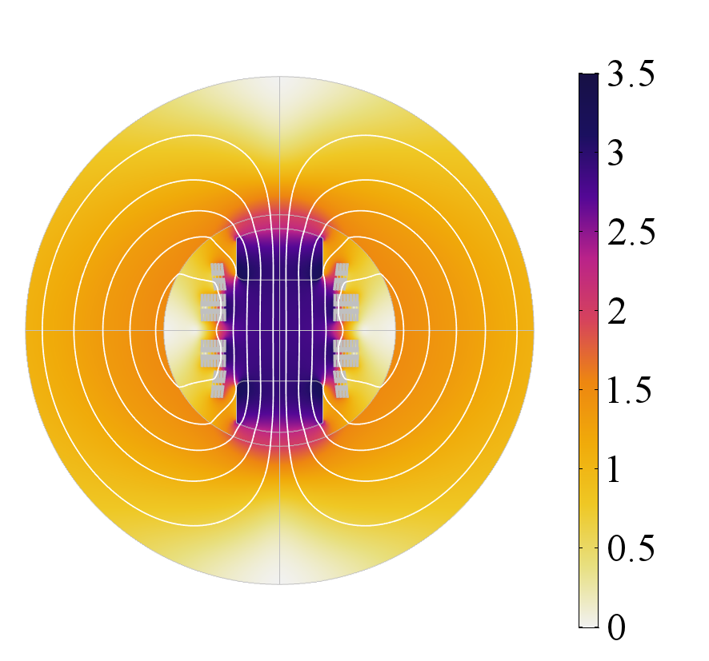


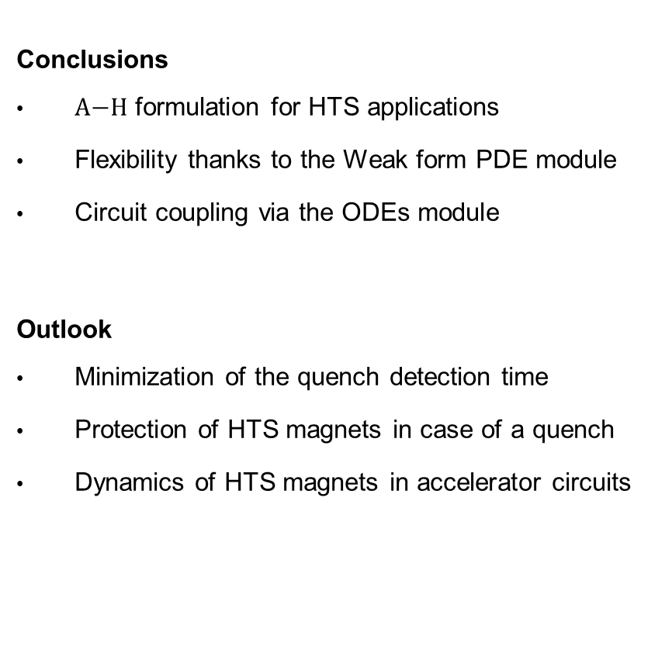
CONCLUSIONS AND OUTLOOK
Conclusions
$\text{A}\text{−}\text{H}$ formulation for HTS applications
Flexibility thanks to the Weak form PDE module
Circuit coupling via the ODEs module
Outlook
Minimization of the quench detection time
Protection of HTS magnets in case of a quench
Dynamics of HTS magnets in accelerator circuits
$$\frac{\text{W}}{{\text{m}}^{\text{2}}}$$
$$\text{T}$$
Figure:
normalized induced
current in a HTS bulk
Figure:
Ohmic loss distribution
in a HTS solenoid
Figure: magnetic flux density
in the Feather-M2
insert dipole magnet
Thank you for your attention!
Contact: lorenzo.bortot@cern.ch

