Slide 1
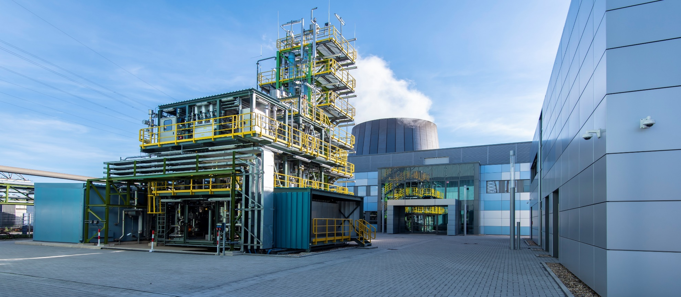

Simulation of Methanol and Urea Production from Catalytic Conversion of Steel Mill Gases
Stefan Schlüter, Fraunhofer UMSICHT, Germany
COMSOL Conference Europe, October 14-15, 2020, Online-Event

Slide 2
Carbon2Chem® – Modeling Structure
System Integration
Demand
Markets
Results
Electrolysis
Chemical Processes:
Methanol,
Ammonia / Urea
Higher Alcohols
Polycarbonate
Energy
Hydrogen
Gas Cleaning &
Conditioning
Synthesis Gas
Steel Mill
Gases

Slide 3
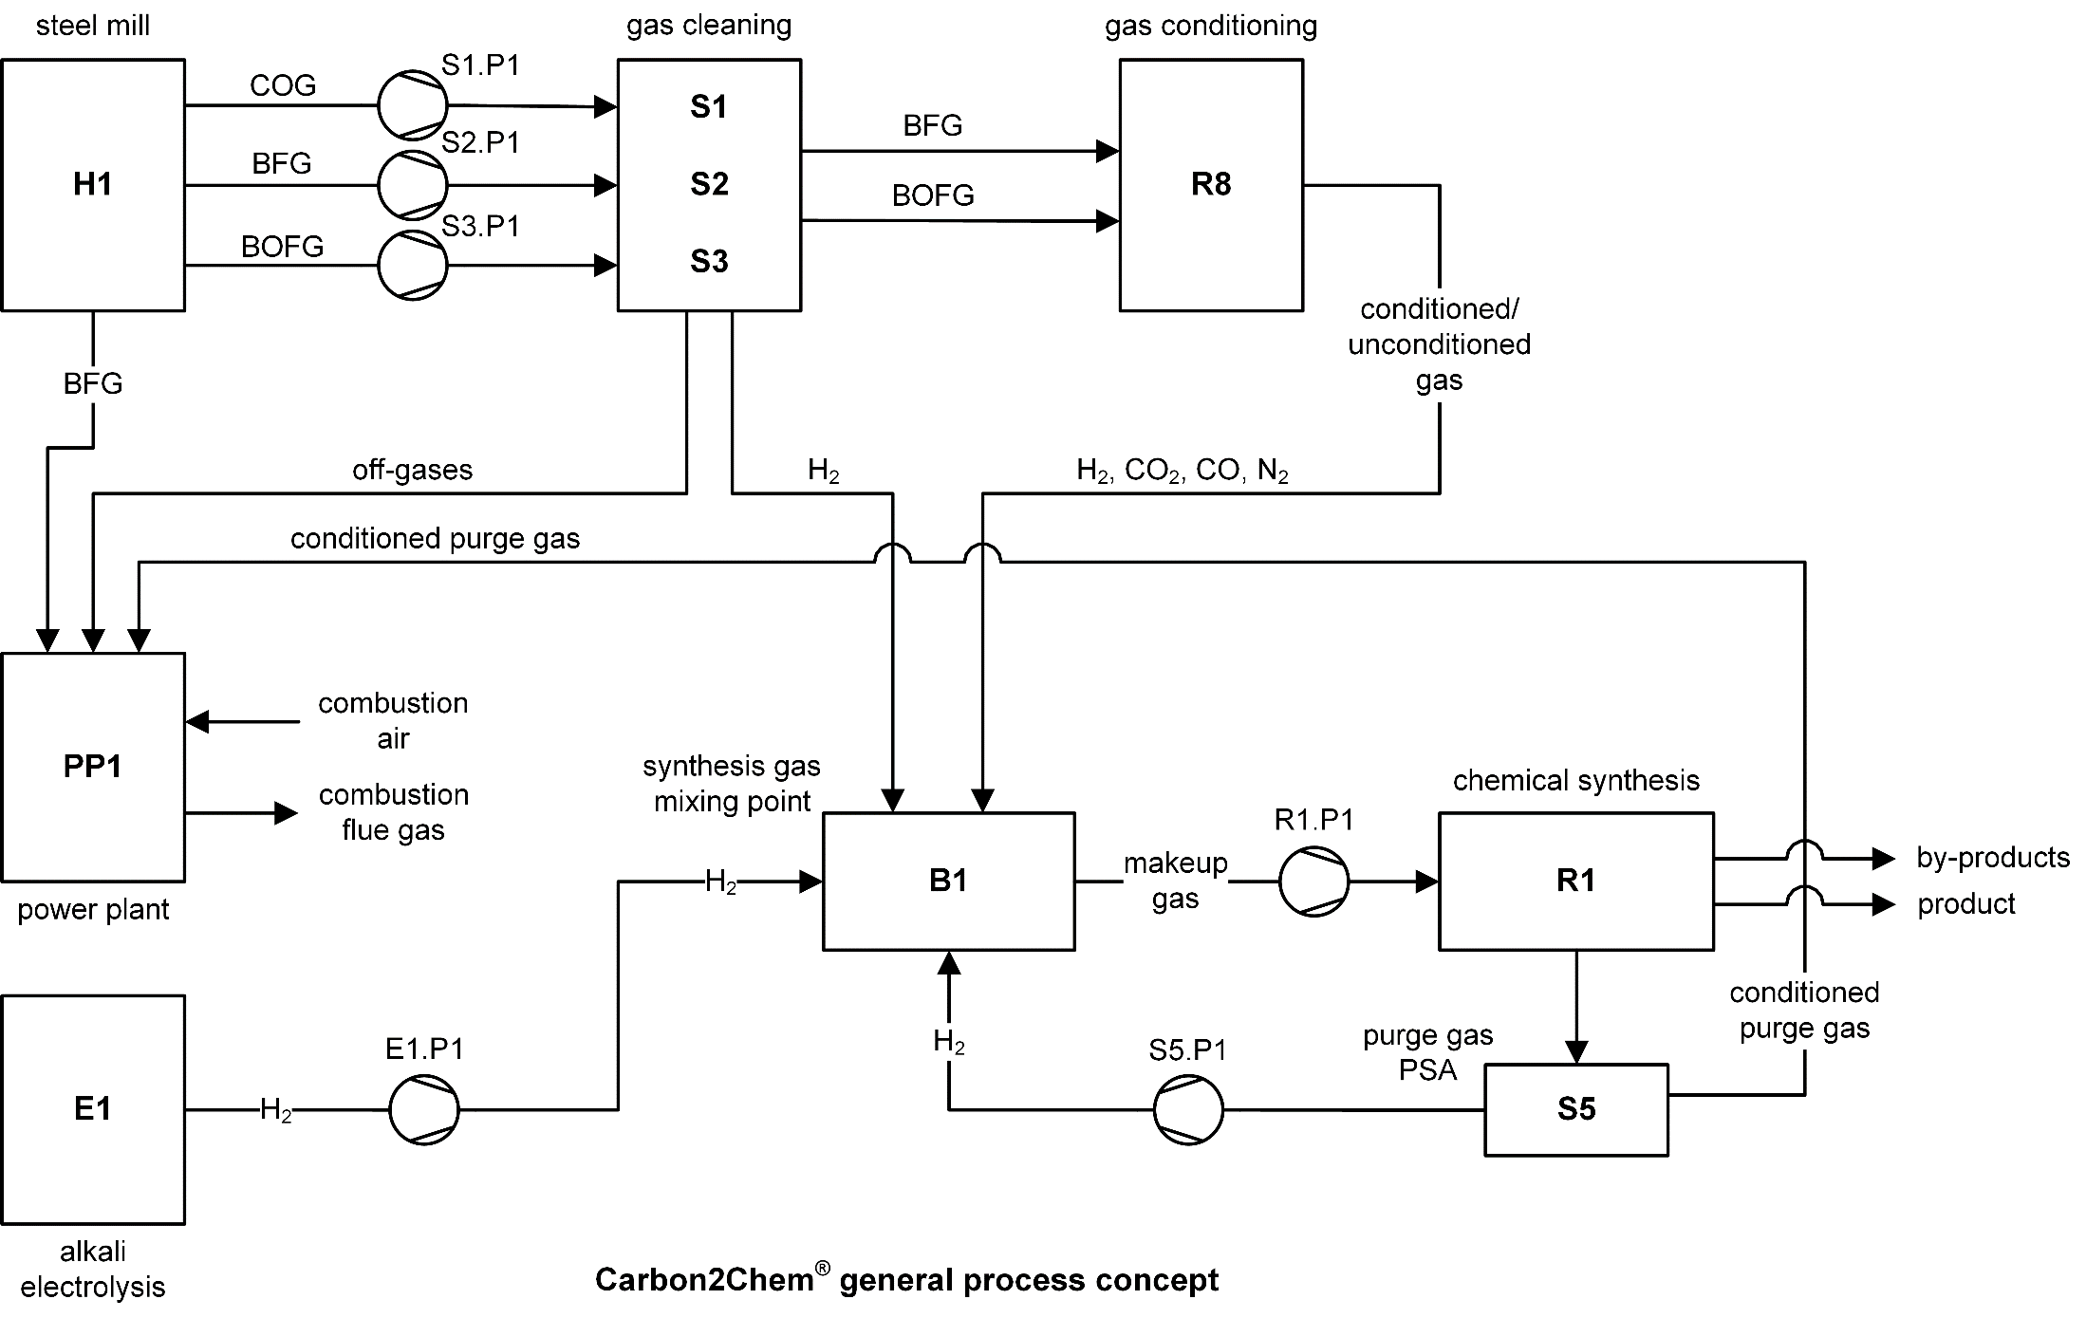
Process Concept – Methanol Synthesis

Slide 4
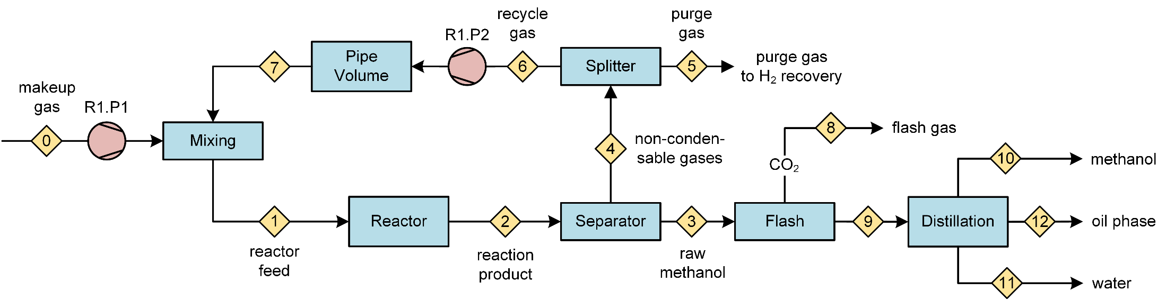
Methanol /Ammonia Synthesis Process Model
R1 = process model for methanol synthesis

Slide 5
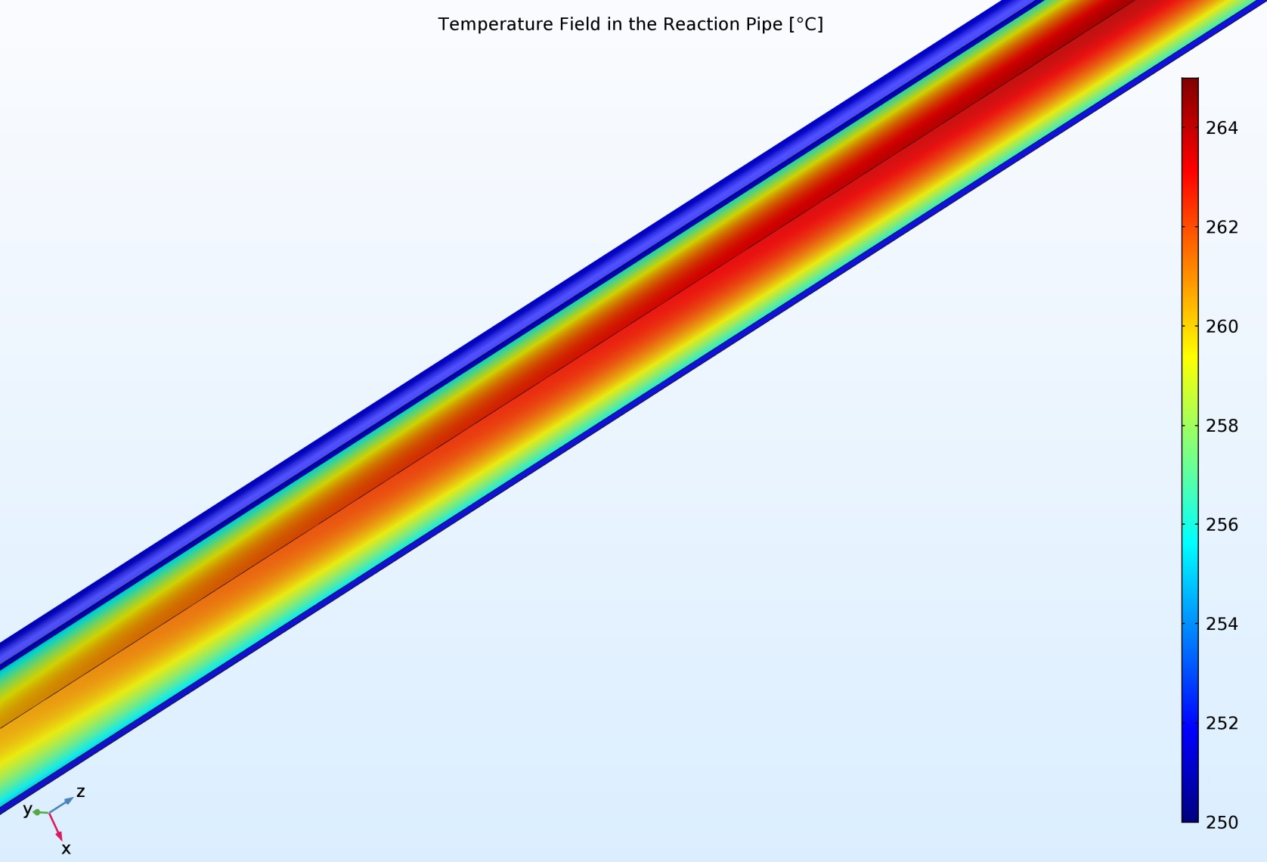
2-d Simulation of Tubular Reactor – Temperature Field
Synthesis Process Modeling
Level 1: equililibrium based modeling
Level 2: kinetically based modeling in 1-d
Level 3: kinetically based modeling in 2-d

Slide 6
Carbon2Chem® – Steel Mill Gases and Usage Scenarios
Steel mill gases, actually used by power plant
Coke oven gas (COG), H₂-rich (65%), usage for H₂-supply
Blast furnace gas (BFG), CO (25%), CO₂ (23%), N₂ (48%), carbon source
Basic oxygen furnace (BOFG), CO-rich (67%), usage in the steel mill
Time dependent courses of COG/BFG/BOFG are available from thyssenkrupp
Usage Scenarios
JUMBO: COG und BFG are used completely (1,100,000 m³/h STP)
INDUSTRIAL: BFG is used at 330,000 m³/h STP (33%)
COG: total COG is used, but no additional hydrogen source

Slide 7
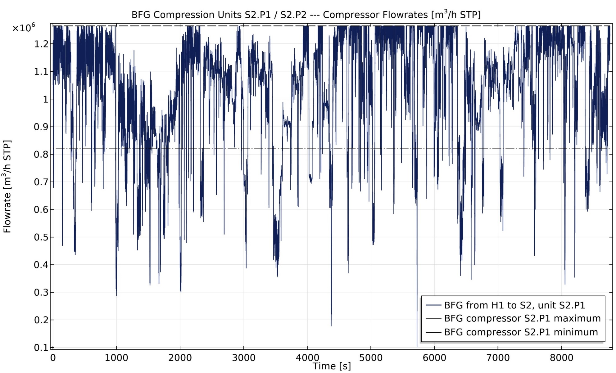
Methanol Concept 2.51 – Pumping Rate at BFG Compressor S2.P1
Production Year Simulation 1.10.2015 - 30.9.2016

Slide 8
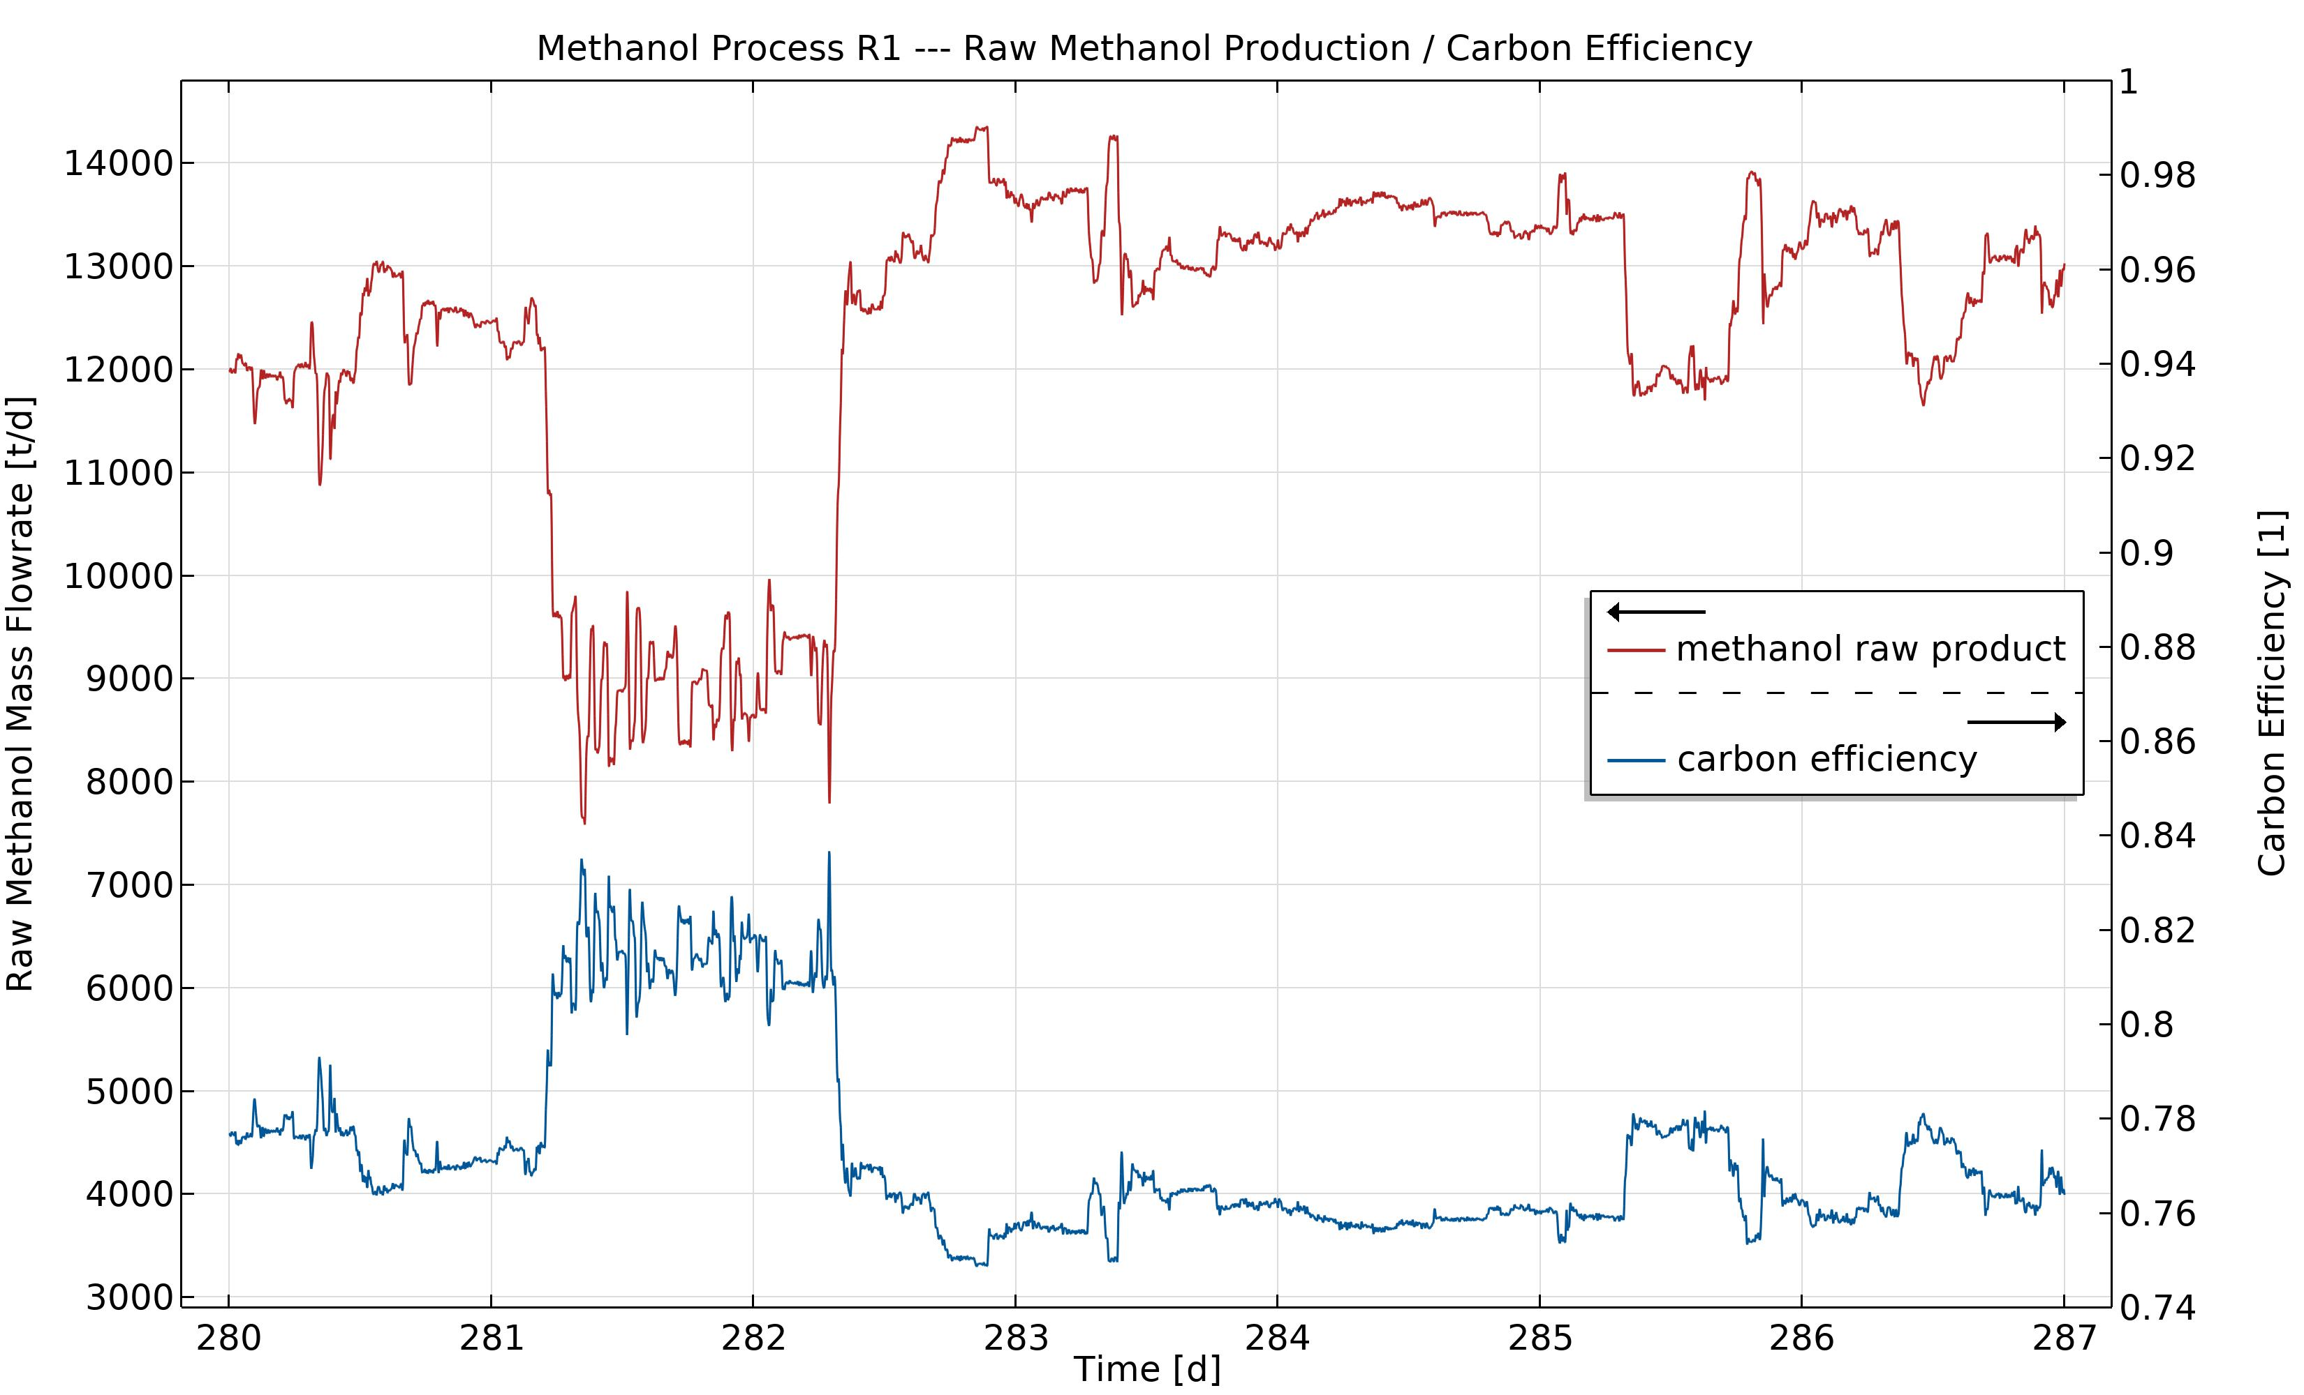
Methanol Concept 2.51 – Raw Methanol Product
Simulation 7.7.-14.7. 2016

Slide 9
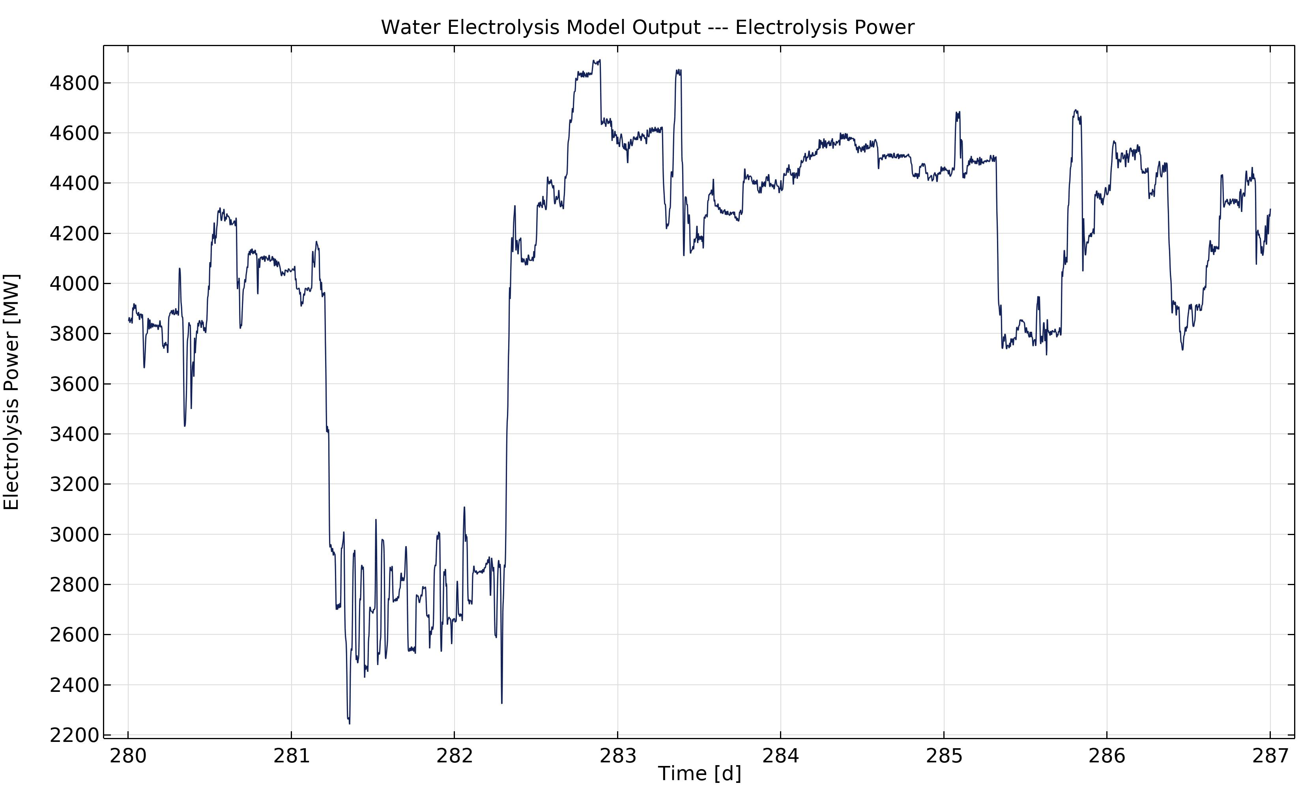
Methanol Concept 2.51 – Water Electrolysis Power Input
Simulation 7.7.-14.7. 2016

Slide 10
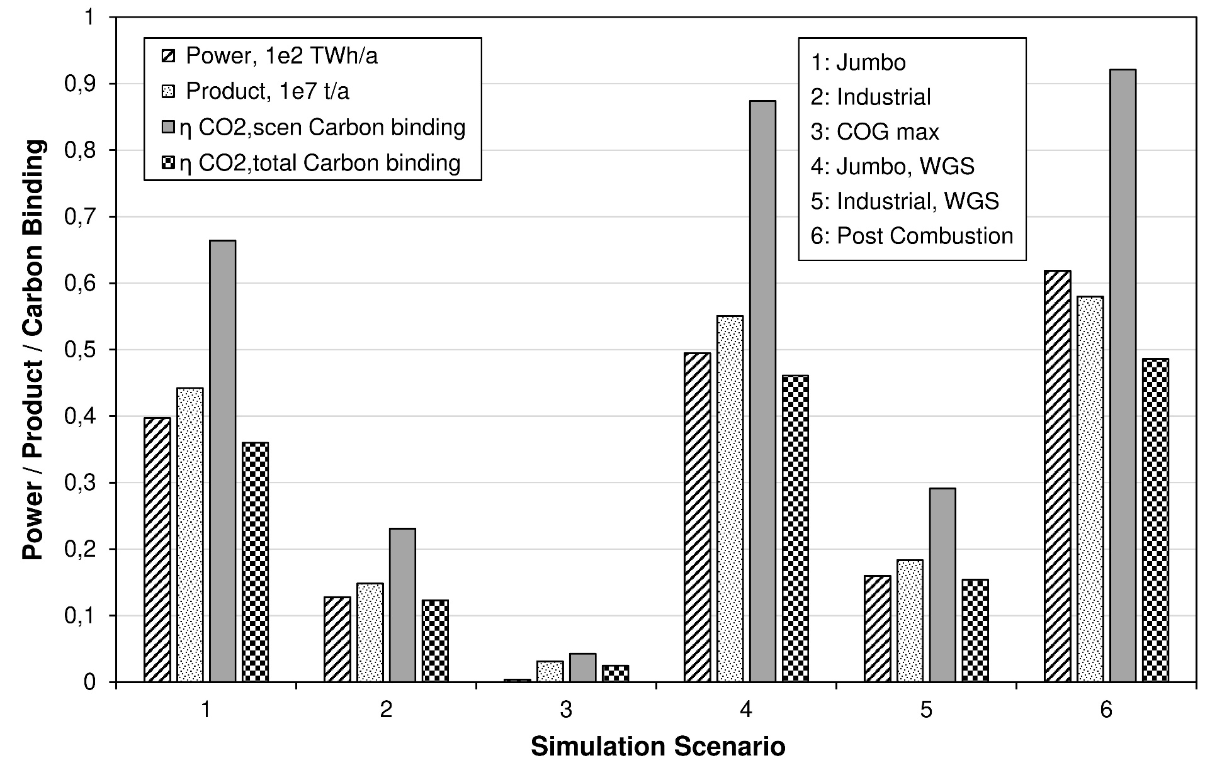
Accumulated Results – Methanol Process Simulations

Slide 11
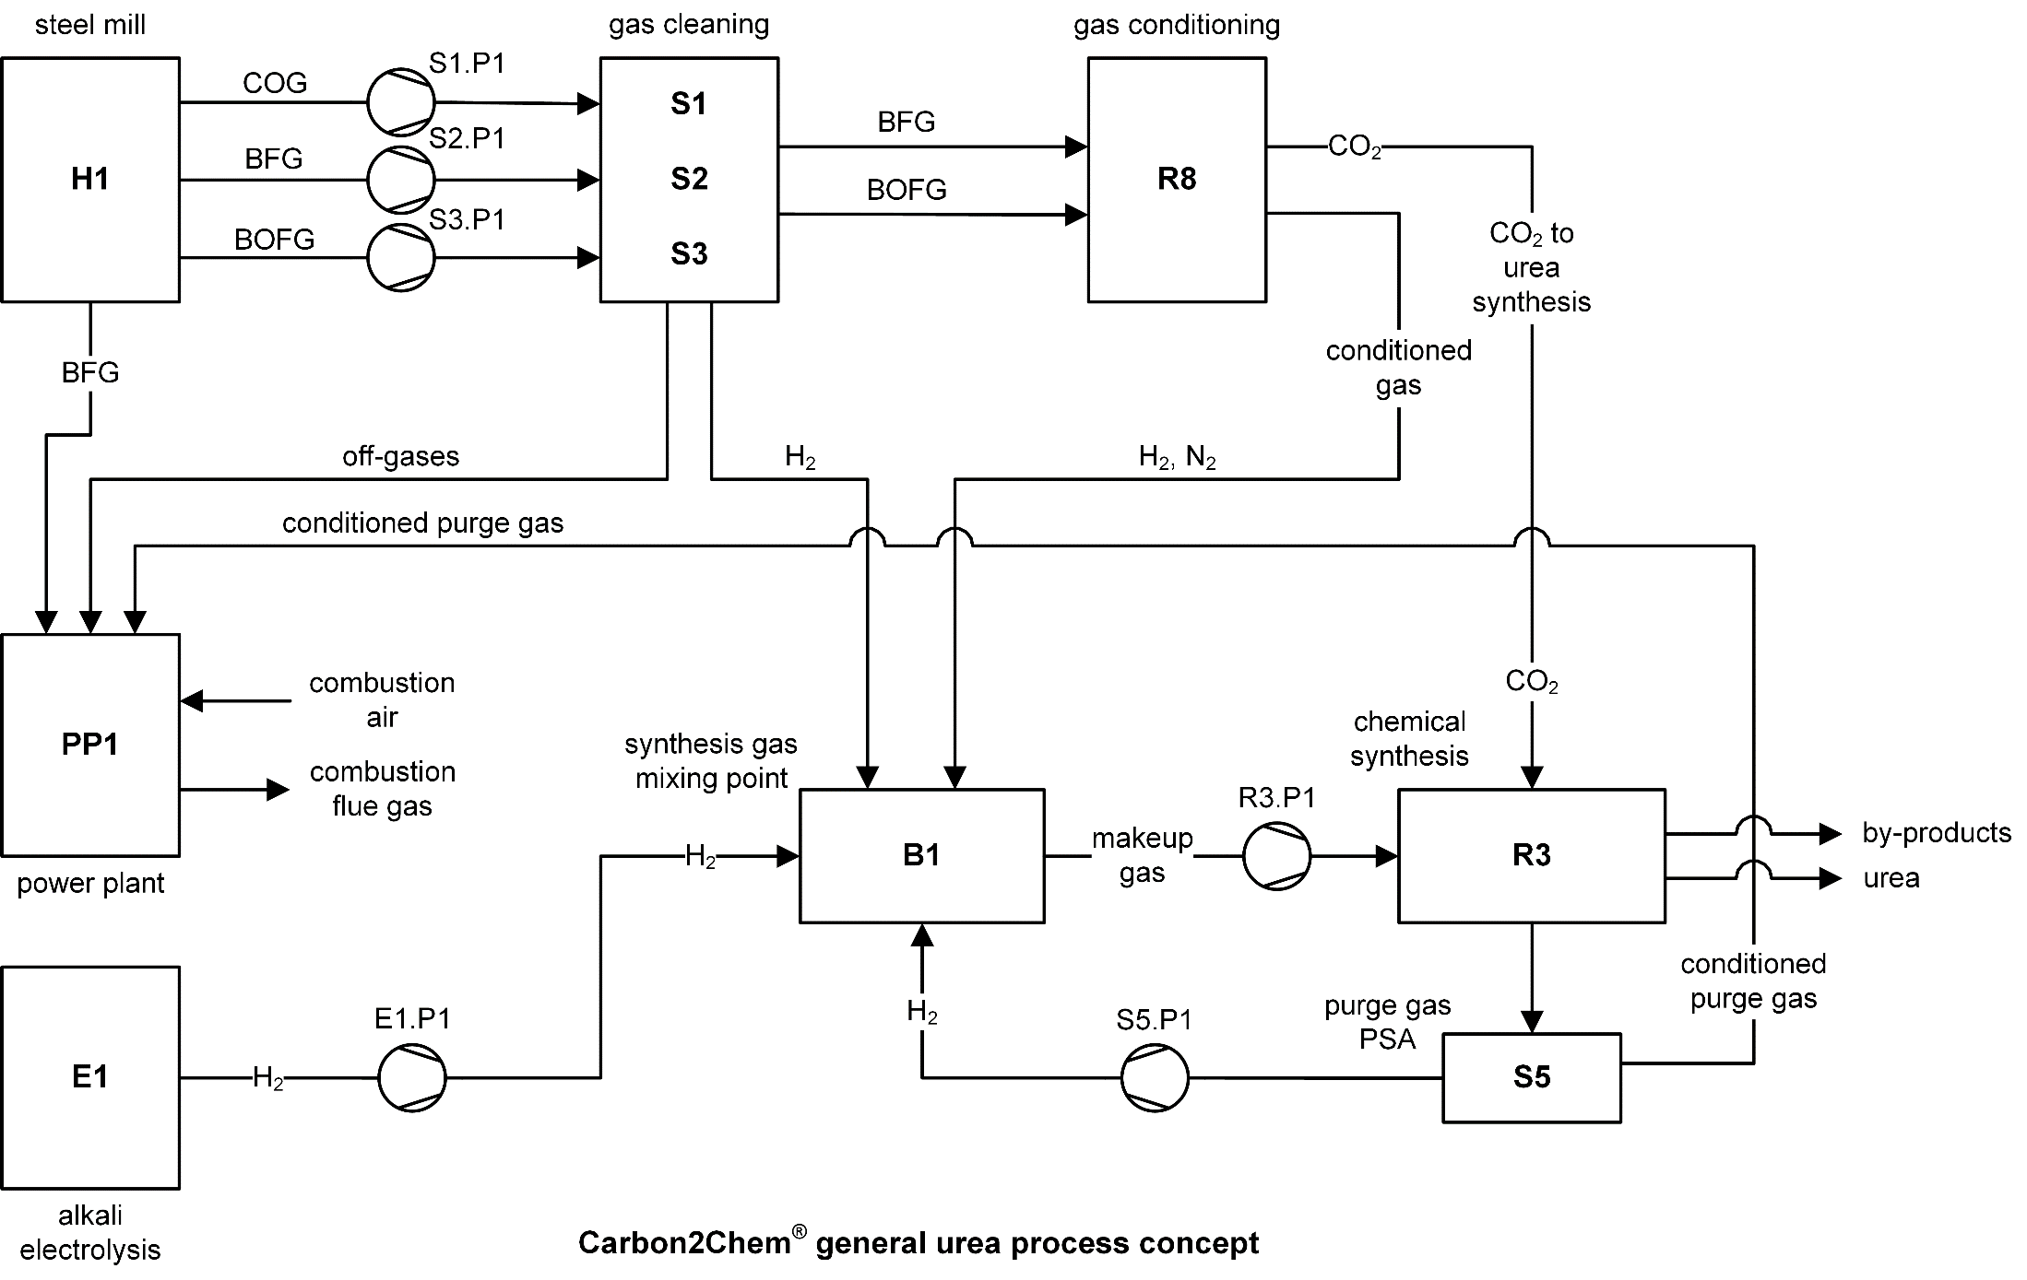
Process Concept – Ammonia and Urea Synthesis

Slide 12
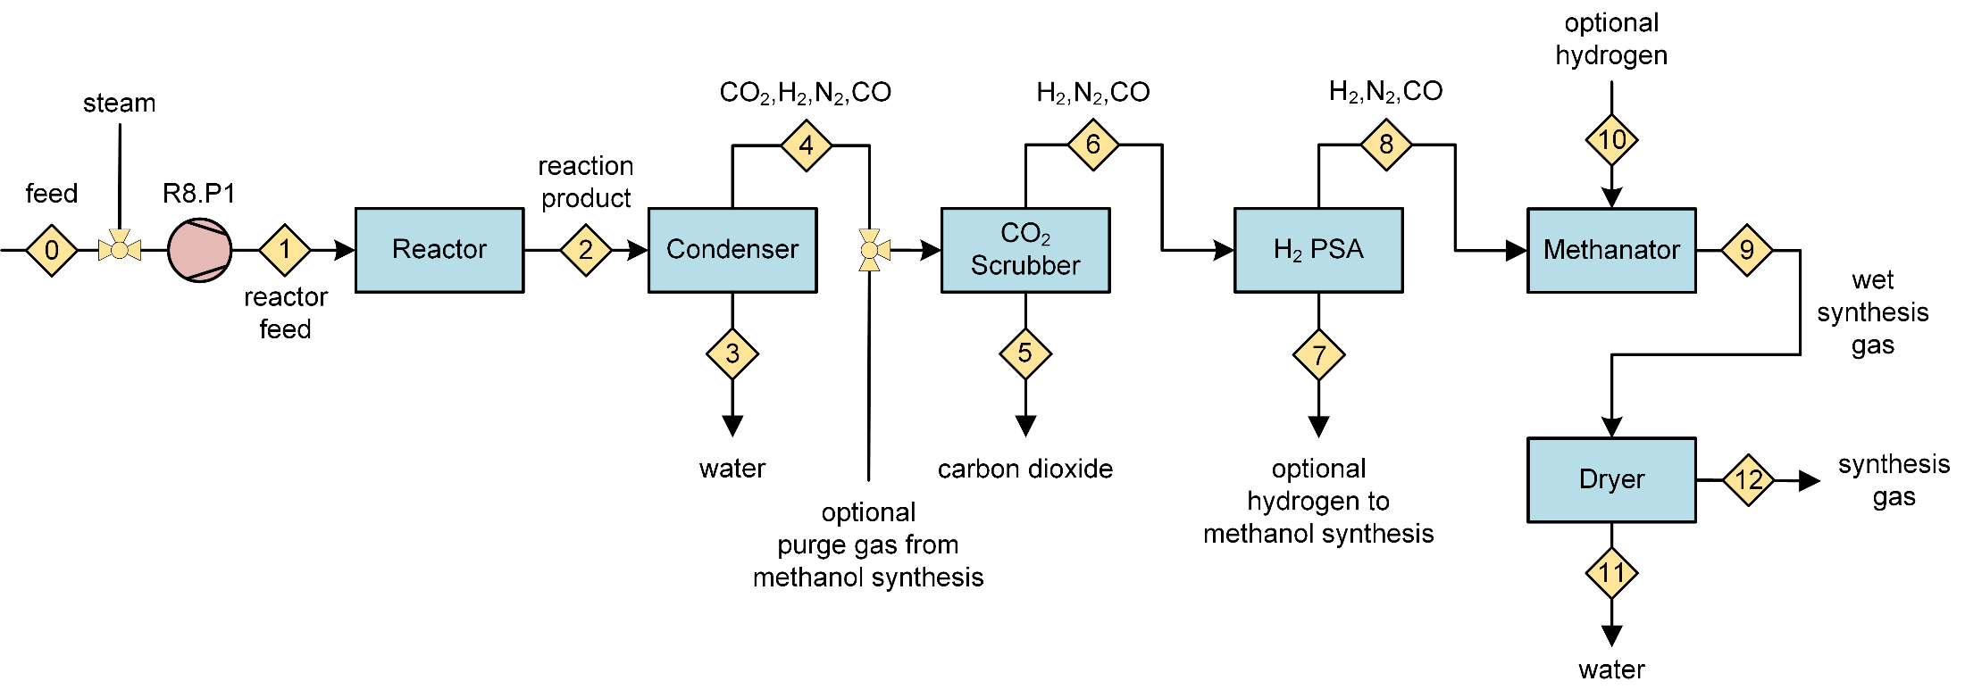
Water-Gas Shift Process
R8 = process model water-gas shift process

Slide 13
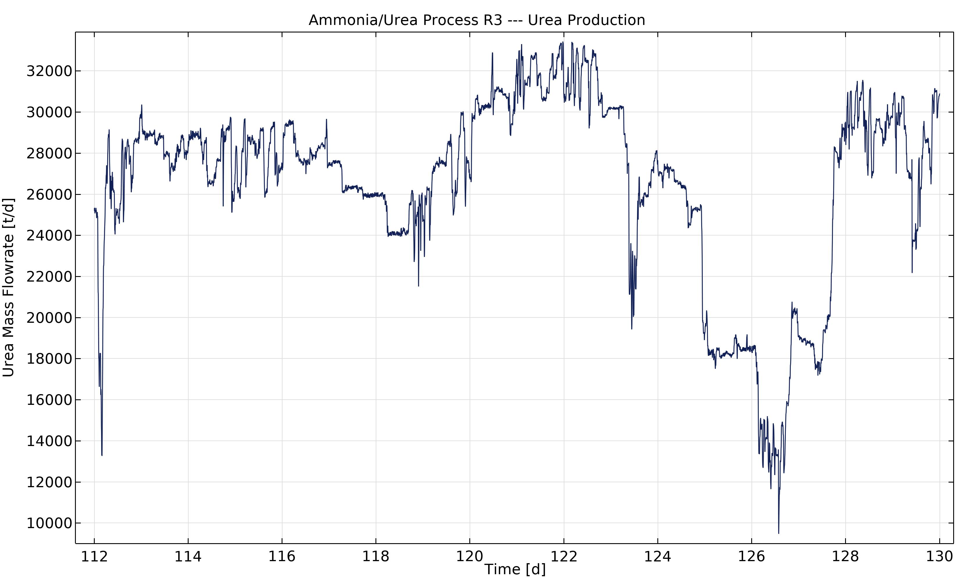
Urea Process Concept – Urea Production
Simulation 21.1.-8.2. 2016

Slide 14
Summary
Simulation models and solution by COMSOL®
Component models in different levels of physical detail
Models are coupled to a large process model, direct simultanenous time dependent solution by BDF solver
Usage of a Fujitsu simulation cluster
Results
Process concepts JUMBO, INDUSTRIAL, COG
High CO₂ recovery up to 90% with JUMBO concept
Methanol production ca. 5 Mio. t/a
Urea production ca. 10 Mio. t/a
Electrolysis power in the range 35-55 TWh/a

Slide 15

Acknowledgements
Team
Torsten Hennig (implementation)
Jürgen Grän-Heedfeld (reverse modeling)
Christian Geitner (simulation)
Thomas Bieseke (simulation cluster)
Thorsten Wack, Torsten Müller (project management)
Stefan Schlüter (model development / speaker)
Open Access Paper
http://dx.doi.org/10.1002/cite.202000068

