Slide 1
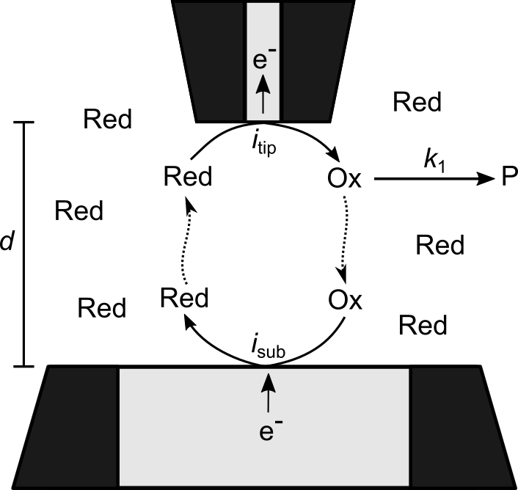
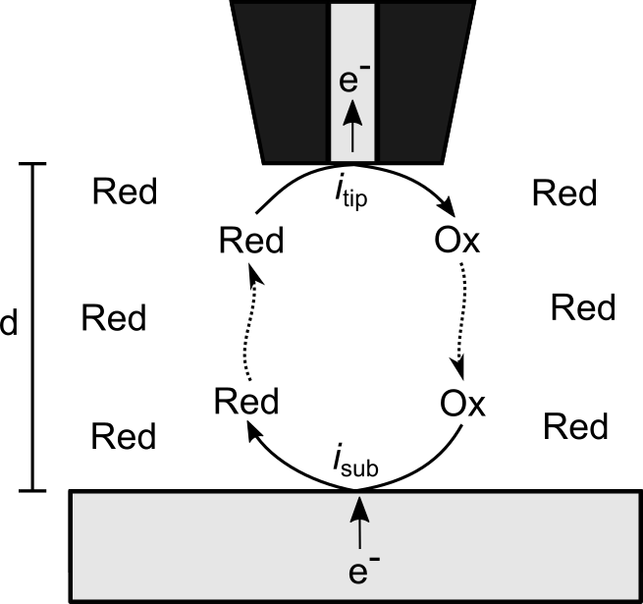

Time-Of-Flight Experiments In A Scanning Electrochemical Microscope
Sebastian Pleis, Gunther Wittstock Chemistry Department, Carl von Ossietzky University Oldenburg, D-26111 Oldenburg, Germany Contact: sebastian.pleis@uol.de
Time-Of-Flight Setup
Benchmark & Results
Tip electrode:
Red → Ox + e–
Homogeneous reaction:
Ox → P
Substrate electrode:
Ox + e– → Red
Figure 1: Time-of-flight setup
Figure 3: Comparison of simulated approach curve to literature data as benchmark experiment
Figure 4: Simulated TOF experiments for various homogeneous rate constants k₁
In a time-of-flight experiment (TOF) the collection efficiency (i_{sub} / i_{tip}) is recorded as function of the distance
The reaction mechanism and kinetic parameters can be extracted from experimental data if a simulation properly describes the relationship between i_{sub} / i _{tip} and d ^{[1-3]}
Approach curve: i_{tip} is recorded as a function of d above a large substrate electrode (r_{sub} = 250 µm)
Homogeneous reaction was switched off (k₁ = 0 s⁻¹)
The simulation agrees with the more recent literature data^{[5]} with 99% accuracy
i_{sub} / i_{tip} is decreased faster for greater k₁ because Ox is depleted by the competing homogeneous reaction
With the chosen setup a k₁ between 0.1 s⁻¹ and 100 s⁻¹ is accessible whereas a k₁ greater than 100 s⁻¹ cannot be investigated
Geometry
COMSOL Electroanalysis Interface Settings
Physics were set up using the “Electroanalysis” interface of COMSOL 5.5
Mass balance equation for the electrolyte: $\frac{∂c}{∂t}+∇\left({−D}_{i}∇c_{i}\right)=R_{i}$
Accumulation and depletion terms for the homogeneous reaction within electrolyte: $R_{Red}=0$ $R_{Ox}=−k_{1}c_{Ox}$ $R_{P}=k_{1}c_{Ox}$
A “Cyclic voltammetry” boundary condition was applied to the tip electrode and an “Electrode potential” to the substrate electrode
Further settings and mesh parameters were adapted from the “Voltammetry at a Microdisk Electrode” application
“Cyclic Voltammetry” and “Parametric Sweep” studies were used to obtain results
Figure 2: Geometry of TOF setup in COMSOL
A 2D-axisymmetrical geometry was used to save computation time
References
Conclusion & Outlook
[1] S. Bi, B. Liu, F.-R. F. Fan, A. J. Bard, J. Am. Chem. Soc. 2005, 127, 3690. [2] J. Chang, A. J. Bard, J. Am. Chem. Soc. 2014, 136, 311. [3] F. Cao, J. Kim, A. J. Bard, J. Am. Chem. Soc. 2014, 136, 18163. [4] M. V. Mirkin, F.-R. F. Fan, A. J. Bard, J. Electroanal. Chem. 1992, 328, 47. [5] A. J. Bard, M. V. Mirkin, Scanning Electrochemical Microscopy. Second Edition, CRC Press, Boca Raton, FL, 2012.
The model was used to estimate the accessible rate constants k₁ and will be expanded for more complex reaction mechanisms.
Acknowledgements
The authors would like to thank the DFG (Deutsche Forschungsgesellschaft) and the Research
Training Group 2226 Chemical Bond Activation (Carl von Ossietzky University of Oldenburg)

