Slide 1
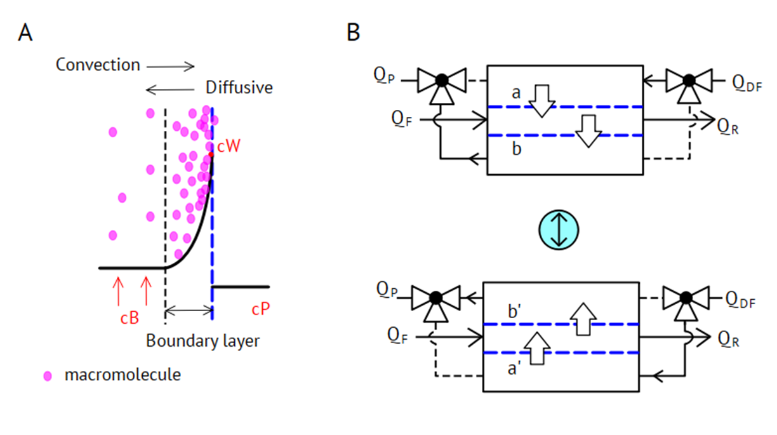
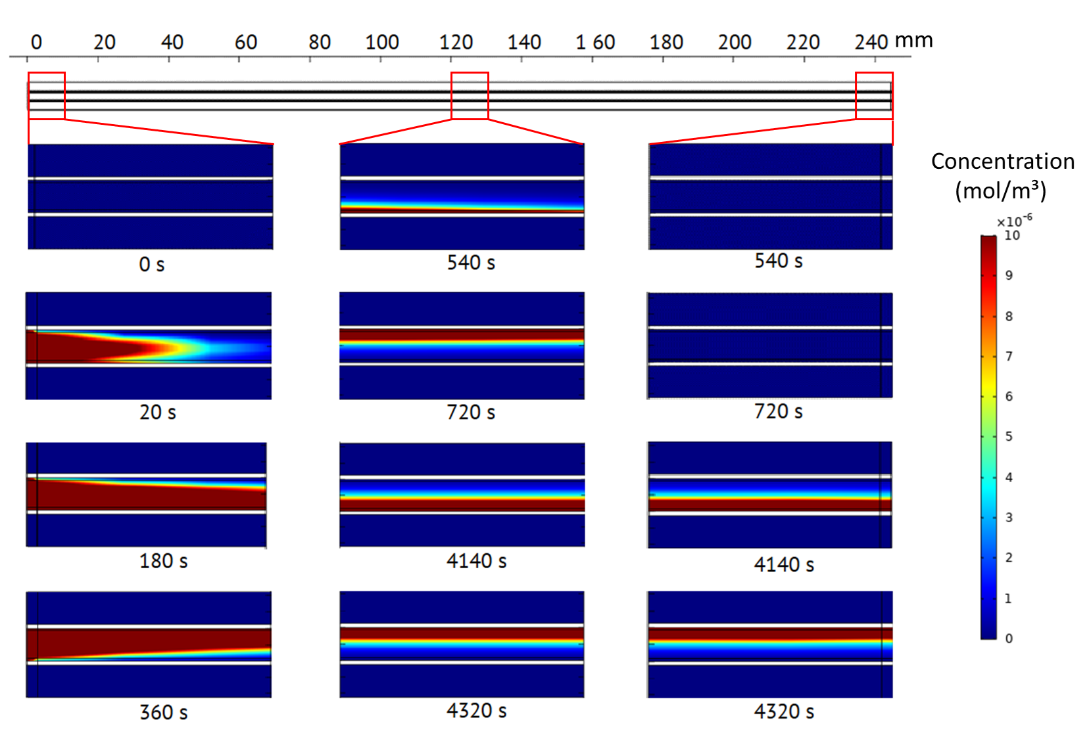
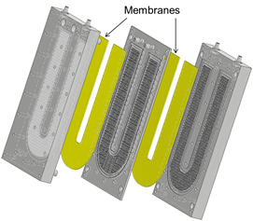
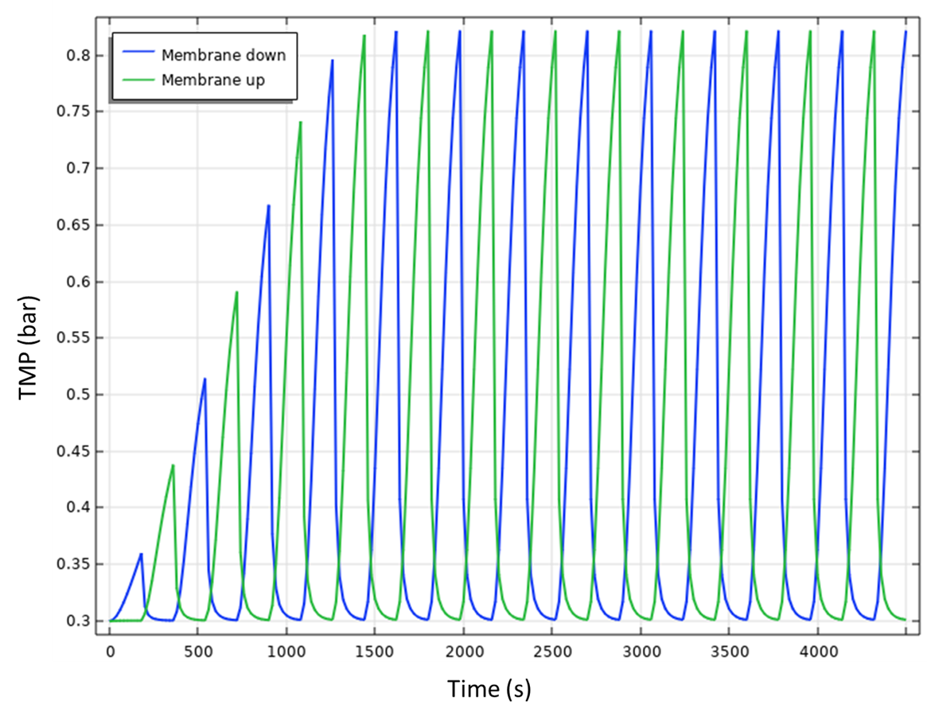
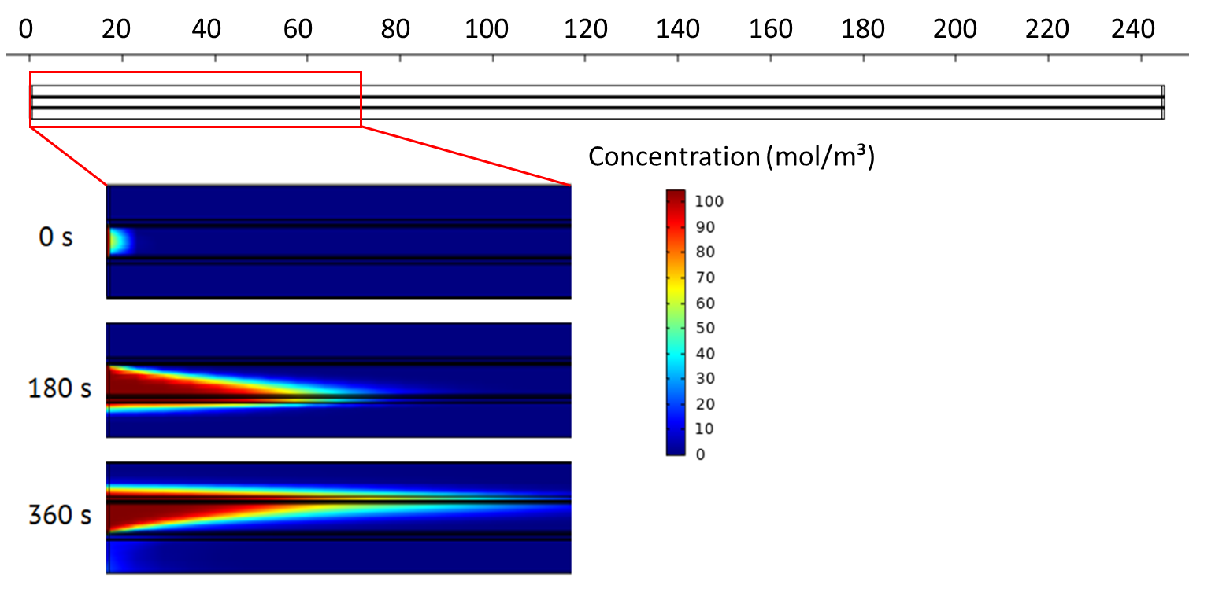
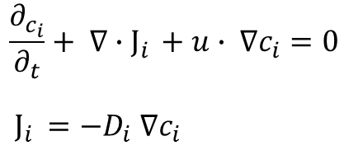
Concentration Polarization Effects in a Single Pass Membrane Module for Continuous Diafiltration
R. Tan¹, M. Franzreb¹
1. Institute of Functional Interfaces, Karlsruhe Institute of Technology, Karlsruhe, BW, Germany
INTRODUCTION: Concentration polarization (CP) of retained molecules is a common problem in membrane filtration. In our experiments we showed that this problem can be strongly reduced using an alternating direction of diafiltration buffer perfusion through the membranes as process inherent backflush^{[1]}. Here, the time course of molecule distribution within the module is simulated in order to find optimal durations of the switching cycles.
RESULTS: The time-dependent profiles of local pressure as well as concentrations of retained and permeating species are determined for different operation parameters. Although the concentration profile of the retained species in the effluent is strongly asymmetrical, its average matches the concentration in the feed, validating the accuracy of the calculation by closing the mass balance.
Figure 1. A. concentration polarization phenomenon for macromolecules at the membrane surface. B. Alternating direction of the perfusion of permeate as inherent backflush
Q _{i}: fluxes, i = F (feed), R (retentate), P (permeate), DF (DF buffer).
Figure 3. Time-dependent local BSA profile in the module. In this parameter setting, switching time is three minutes. Before alternating the direction of membrane perfusion, the protein concentration at the membrane surface reaches its maximum.
Figure 4. Time-dependent transmembrane pressure for the two membranes. The pressure increased gradually when the proteins accumulates at the surface of membrane. Alternating perfusion direction results in a sharp pressure drop. After around eight switches, the module reaches a steady state
Figure 2. Scheme of the membrane module with two adjacent membranes confining the retentate channel.
COMPUTATIONAL METHODS: A 2D multiphysics model including ‘Transport of Diluted Species’ and ‘Laminar Flow’ was developed to describe the time-dependent behavior of retained protein and permeating salt. For implementation of alternating perfusion direction through the membrane we applied a multi-step dynamic with differing boundary conditions of the steps. Concentration profiles of protein and salt are calculated in different studies, because in the first case the membranes are impermeable for the diluted species, while in the second case the species can permeate freely. The concentration profiles are determined by the following PDE.
Figure 5. Salt profiles at the inlet region of the module for two switches of perfusion direction. Salt in the feed solution is flushed into the lateral parts of module alternatively.
CONCLUSIONS: The introduction of an alternating perfusion direction in a newly designed membrane module reduces the problem of CP strongly. The simulation shows a good agreement with experimental results and clarifies the underlying phenomena of accumulation and detachment of retained species.
REFERENCES:
R. Tan, F. Hezel, M. Franzreb. Continuous single pass diafiltration with alternating permeate flow direction for high efficiency buffer exchange, Journal of Membrane Science, In Press.
Excerpt from the Proceedings of the 2020 COMSOL Conference

