Slide 1

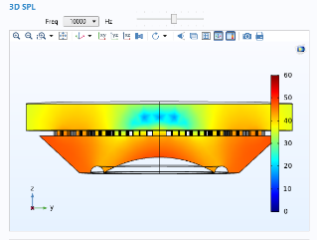
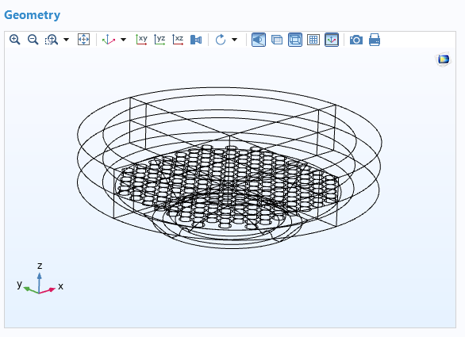
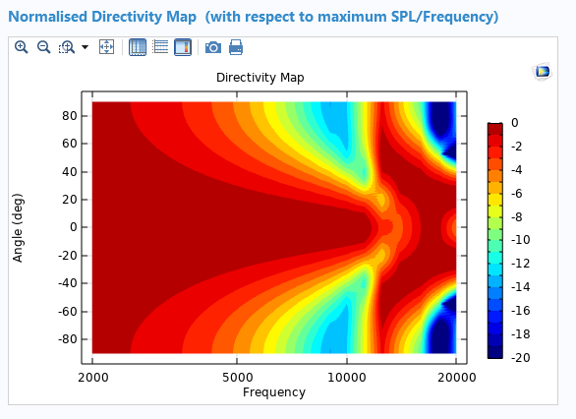
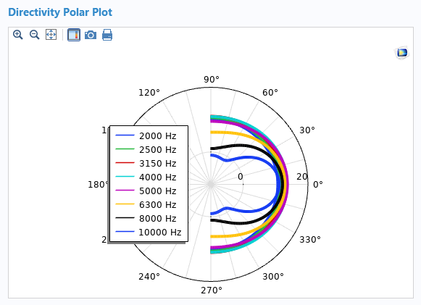
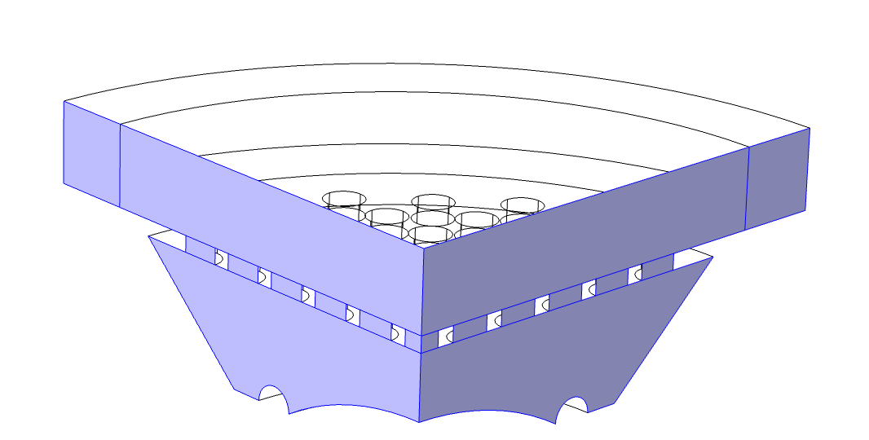
Generic Speaker Grille Apps
F. Malbos¹, M. Olsen², M. Bogdanski³
1. EPIC, HARMAN France, Paris, France
2. EPIC, HARMAN International Industries, Struer, Denmark
3. EPIC, HARMAN International Industries, Straubing, Germany
INTRODUCTION: The fidelity of an audio system in a vehicle depends on many characteristics like the number of loudspeakers, the speaker packaging as well as the position and orientation of the speakers in the vehicle. To optimize the speaker packaging, our engineering team has developed a Comsol Application to evaluate the influence of adding a speaker grille assembly to a loudspeaker. A parametric approach is used to design the 3D speaker grille.
Figure 3. Sound Pressure Level Slice
Figure 1. Speaker Grille geometry
COMPUTATIONAL METHODS: The assembly is mounted on an infinite baffle and is radiating into a semi anechoic space. The Pressure Acoustics physics interface is used in the frequency domain. To speed up the calculation time, a quarter of the geometry and symmetry conditions are applied (mirrored grille assembly geometries are considered).
Figure 4. Directivity Map
Figure 5. Directivity Polar plot
Figure 2. Symmetry Conditions
CONCLUSIONS: Based on a simple parametric geometry approach, the prediction tool has been created to investigate the influence of the speaker packaging. The use of a CAD import allows to investigate advanced designs. The application was created in close collaboration with the engineering end users. It’s uploaded to an internal Comsol application server and is accessible to all audio system engineers at HARMAN.
RESULTS: The prediction of the on axis frequency response and directivity include the main characteristics of the speaker packaging for a loudspeaker measured on an infinite baffle^{[1]}.
REFERENCES:
M. Olsen, P. Chapman, M. Bogdanski, M. Strauss, “On acoustical modeling and validation of automotive loudspeaker grilles”, AES Conference on Automotive Audio San Francisco, CA, USA (2017)
Excerpt from the Proceedings of the 2020 COMSOL Conference

