Slide 1
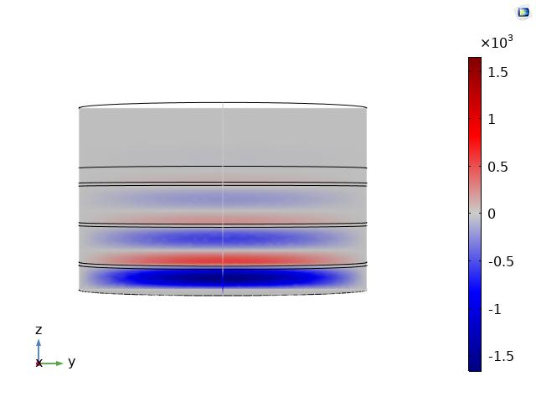
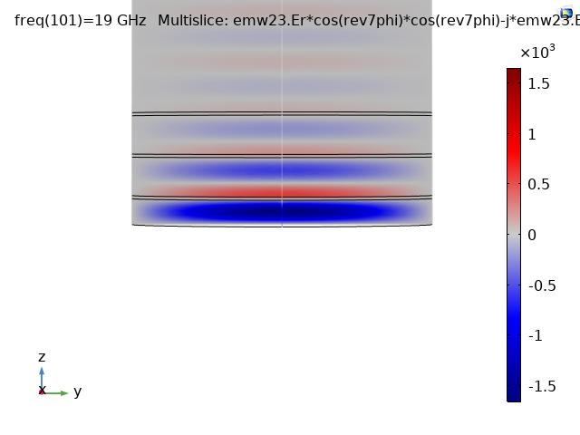
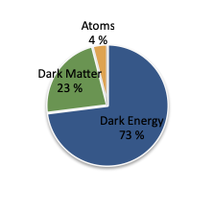
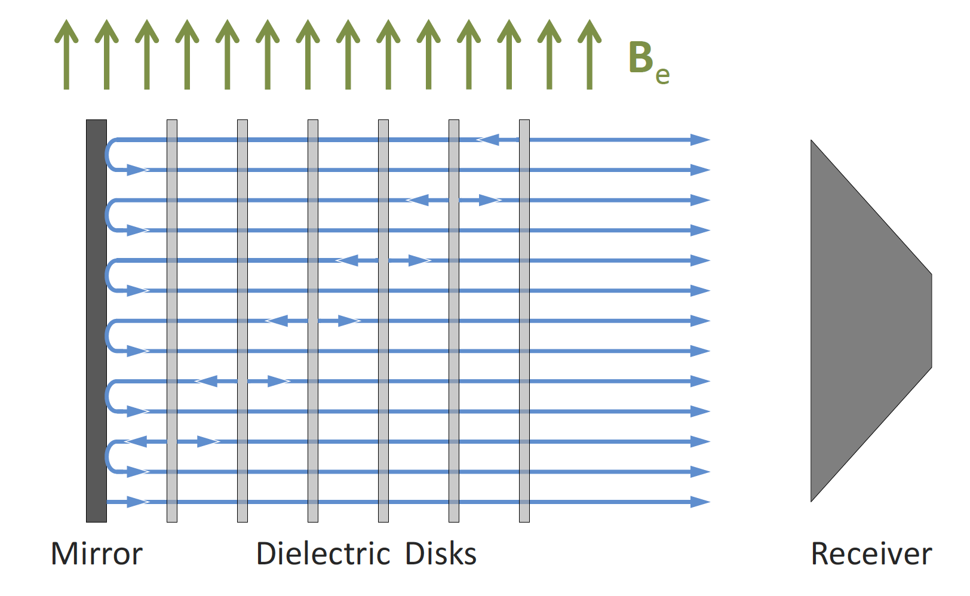
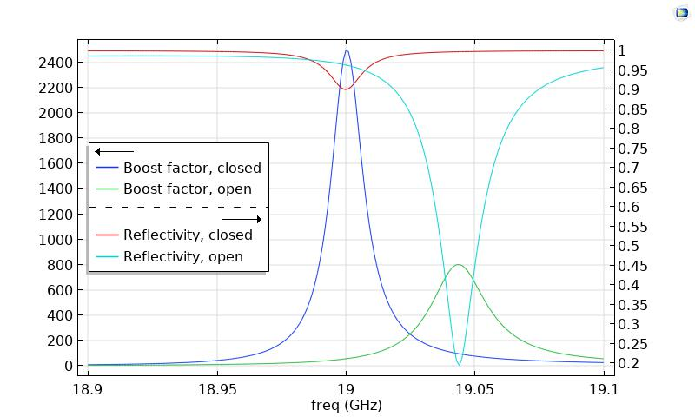
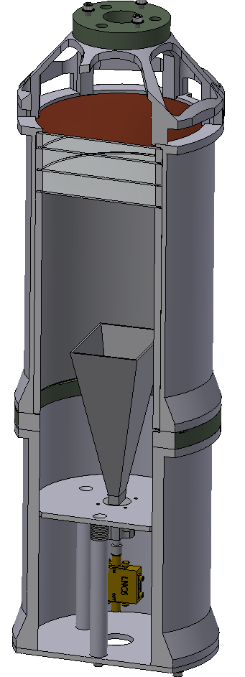
Dielectric Haloscope Simulation and the Quest for Dark Matter Axions
Xiaoyue Li¹, Chang Lee¹, Olaf Reimann¹, Derek Strom¹
1. Max Planck Institute for Physics, Munich, Germany
INTRODUCTION: An enduring puzzle in particle physics is the nature of dark matter, which makes up ~23% of the universe. Axions are a well-motivated candidate for dark matter. Dielectric haloscopes have been proposed to search for axion dark matter in the mass ranges of 40-400 µeV ^{[1]} and 0.1-10 eV ^{[2]}. A typical dielectric haloscope consists of a metal mirror and several dielectric discs placed inside a strong external magnetic field parallel to the disc surface, as shown in Fig. 2; the axion-induced electromagnetic (EM) waves are detected by the receiver. In this study, we perform simulations of a small dielectric haloscope to further our understanding of the booster behavior.
The axion-modified Maxwell equation is modeled with an external current density in the RF module. 2D Axisymmetry is used to speed up the simulation, similar to the method used in ref. [3].
RESULTS: First a full 3D simulation is compared with the 2D Axisymmetry simulation in order to confirm the validity of the latter. Fig. 4 shows an excellent agreement.
Booster
Figure 4: Comparison between the full 3D simulation and the 2D Axisymmetry simulation. The component at 19 GHz is shown.
The boost factor is defined as the ratio of the power of the axion-induced signal in the presence of the dielectric discs to that with a metal mirror. A key part of the study is to understand the correlation between the boost factor and the reflectivity, since the former is not a measurable quantity and must be inferred from the latter. The case where the booster is not surrounded by a metal tube is also simulated for comparison, as shown in Fig. 5.
Metal mirror
Dielectric discs
Receiver
Figure 1: Content of the universe
Figure 2: A sketch of the dielectric haloscope concept. Adapted from ref. [1].
METHODS: The existence of axion dark matter modifies the Maxwell equations. In the presence of a strong magnetic field and to the leading order, Ampère’s law becomes
where is the axion field, is the axion-photon coupling constant, and is the external magnetic field. The axion-induced EM waves as well as the EM response from an injected signal are simulated for the booster section of the test setup shown in Fig. 3.
(1)
Booster
mm copper mirror
Figure 5: Boost factor and reflectivity. “Closed”/“open” refers to the booster inside (without) a metal tube. In the “closed”/“open” case, the reflectivity is calculated by injecting a TE11 mode wave/Gaussian beam into the booster.
3 mm sapphire discs, each with a thickness of 1 mm
Aluminum tube
CONCLUSIONS: COMSOL is used to simulate the axion-induced signal from a small dielectric haloscope as well as its reflectivity. Further studies are needed to understand the interplay between the booster and the antenna or taper in order to compare with measurement.
Antenna; replaceable with a taper
Amplifier
Figure 3: A drawing of the test dielectric haloscope under study. Note that only the booster section is simulated.
REFERENCES:
A. Millar, et. al., JCAP 1701:061 (2017)
M. Baryakhtar, et. al., Phys. Rev. D 98, 035006 (2018)
S. Knirck, et. al. JCAP 08(2019)026
Excerpt from the Proceedings of the 2020 COMSOL Conference

