Slide 1

A User-Friendly COMSOL Multiphysics® Application to Design a Generic Induction Furnace
with COMSOL 5.5
O. Brun, J.-D. Wheeler, J.-M. Dedulle, V. Bruyere, P. Namy,
SIMTEC - (+33) 9 53 51 45 60
patrick.namy@simtecsolution.fr
jean-david.wheeler@simtecsolution.fr
1. SIMTEC, 5 rue Felix Poulat, 38000 Grenoble, France

Slide 2
Outline
Device
Model
User interface
Conclusion

Slide 3






















Our team & Our clients
Numerical Modelling Consultants
8 Members all EngD + PhD
Extensive research background
Complex problems
Various fields of expertise
Successful Track Record:
Big international compagnies
Government laboratories
Involved in Research Consortia
EU funded projects (REEcover / SHARK)
PhD projects supervision.
Discover more about our successful modelling work with clients!
www.simtecsolution.fr

Slide 4



Melt
I. Device
Crucible
Cooling system
Out flow
Inductor
Power supply circuit
$$C$$
$$U_{eff}$$
In flow
$$R$$
Induction furnace cut view

Slide 5
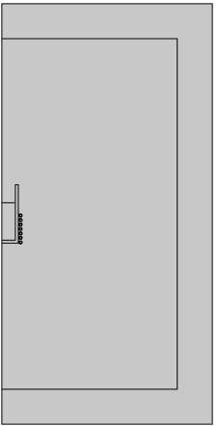
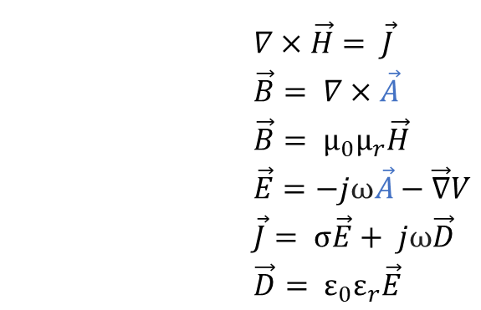
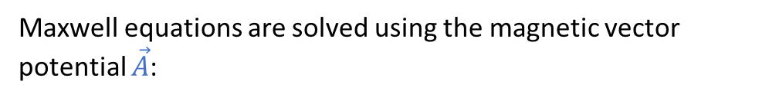
II. Model
Maxwell equations are solved using the magnetic vector potential $\vec{A}$:
$$∇×\vec{H}= \vec{J}$$
$$\vec{B}= ∇×\vec{A}$$
$$\vec{B}= µ_{0}µ_{r}\vec{H}$$
$$\vec{E}=−jω\vec{A}−\vec{∇}V$$
$$\vec{J}= σ\vec{E}+ jω\vec{D}$$
$$\vec{D}= ε_{0}ε_{r}\vec{E}$$
where $µ_{r}$ is the relative permeability, $ε_{r}$ the relative permittivity, $ω=2πf$ the pulsation, $σ$ the electrical conductivity and $\vec{J}$ the current density.
Solving domain

Slide 6
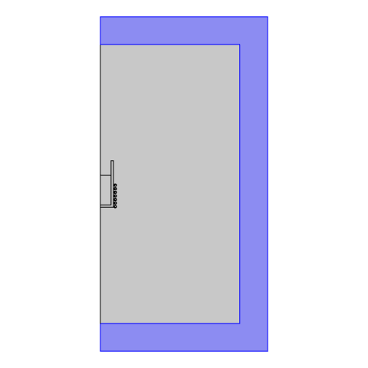
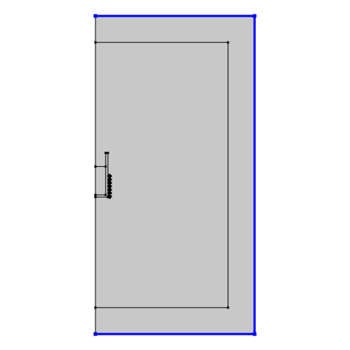
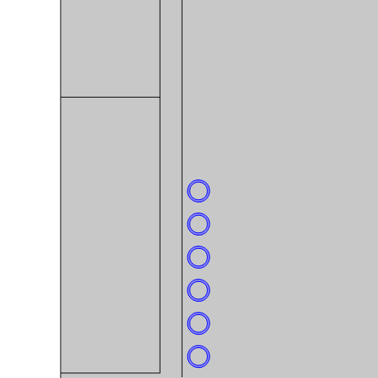
II. Model
Single conductor coil
Infinite domain
Magnetic insulation
Symmetry Axis

Slide 7

II. Model
Skin depth : $δ$
Tension
time

Slide 8
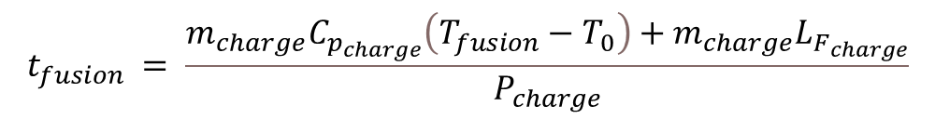
II. Model
T_{fusion}
Heat dissipated
Temperature
Liquid phase
T_{fusion}
Transition
Solid phase
Solid phase
Transition
Liquid phase
Temperature
time
<
$$t_{fusion} = \frac{m_{charge}C_{p_{charge}}\left(T_{fusion}−T_{0}\right)+m_{charge}L_{F_{charge}}}{P_{charge}}$$
<

Slide 9
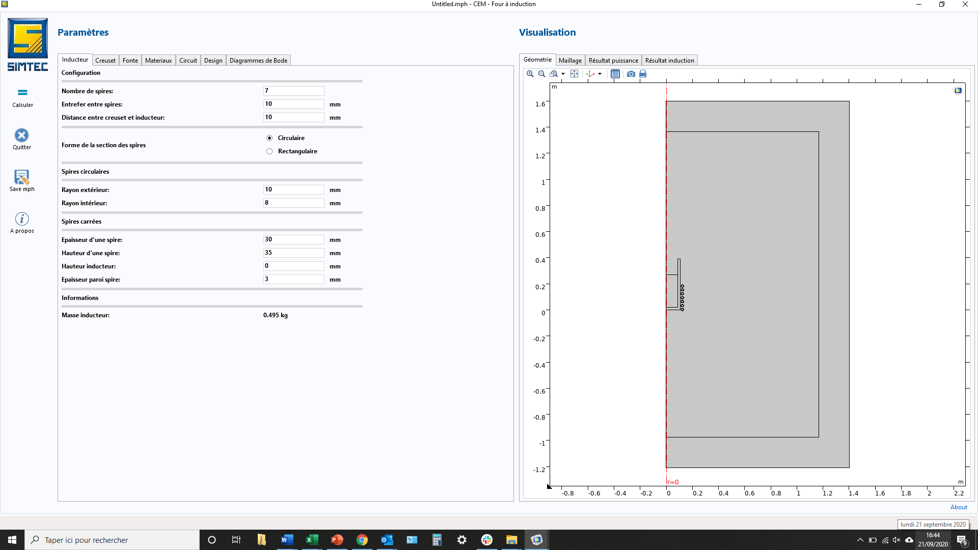
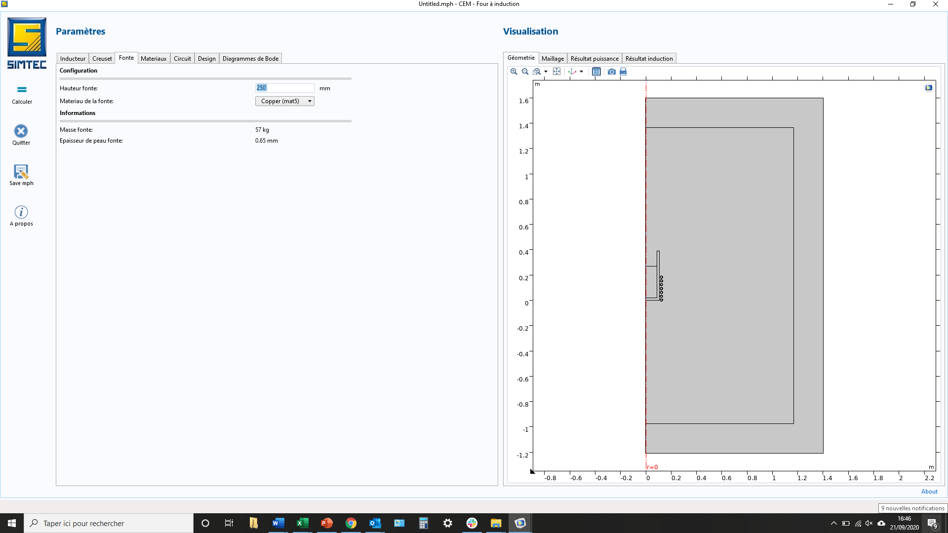

III. User interface

Slide 10
III. User interface
And also:
Design guide lines
Efficiency computation
Ideal frequency proposals + resonance frequency computation
Bode diagram
Material database

Slide 11
Conclusion
Very efficient and precise
process

Slide 12
Conclusion
Very helpful
design tools

Slide 13
Conclusion
Relevant
predictions

Slide 14
Conclusion
User friendly
interface

Slide 15

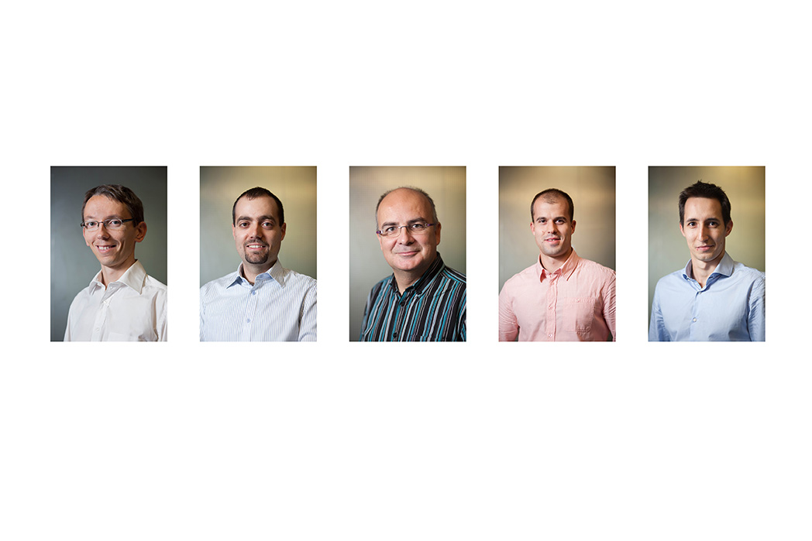
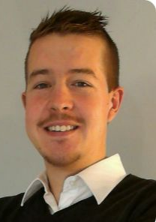
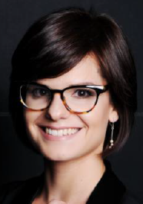

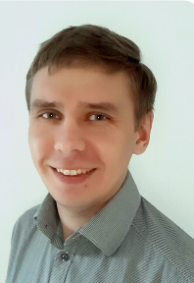
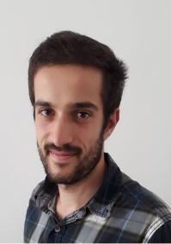
Thank you for your attention
Q&A?
SIMTEC
(+33) (0)9 53 51 45 60
Patrick.Namy@simtecsolution.fr

