Slide 1
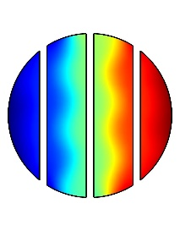
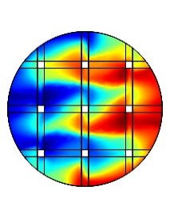
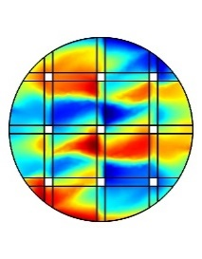
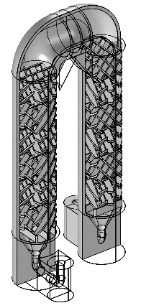
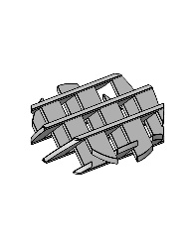
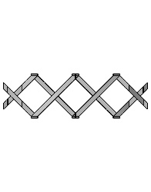
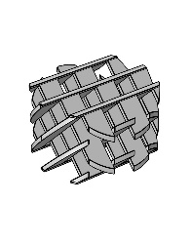
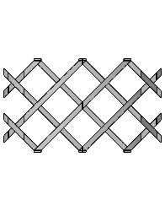
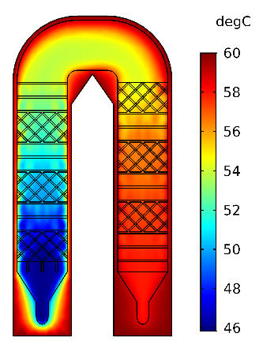
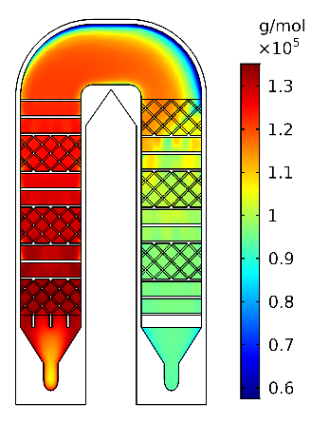
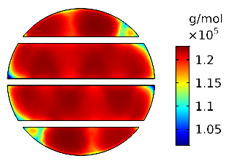
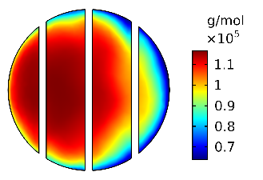
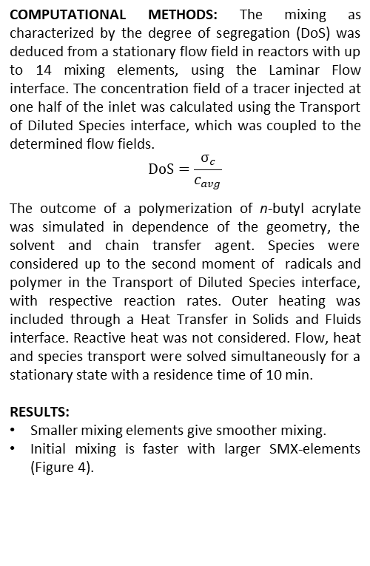
Simulation of Mixing and Polymerization in 3D-Printed
Tubular Reactors including SMX-Mixing Elements
Sören Hapke, Gerrit A. Luinstra, Kristina Zentel
1. University of Hamburg, Institute of Technical and Macromolecular Chemistry, Hamburg, Germany
INTRODUCTION: Additive manufacturing has eased the fabrication of new reactor geometries. The optimization of such geometries by CFD with simulation of the mixing of solutions and of polymerization before printing may save time, costs and effort. Such a workflow is presented here for a reactor (printed in PP) containing various SMX-Mixing elements.
Figure 5a. Fluid before mixing elements
Figure 5b. After one small element
Figure 5c. After one large element
Larger elements show better interfacial stretching.
Figure 2a. Small mixing elements
Figure 6. Conversion by simulation and experiment
Figure 7. Dispersity by Simulation and experiment
Figure 1. Cut model of typical reactor structure
Figure 2b. Large mixing elements
Trends of dispersity and conversion are well captured by the polymerization model.
COMPUTATIONAL METHODS: The mixing as characterized by the degree of segregation (DoS) was deduced from a stationary flow field in reactors with up to 14 mixing elements, using the Laminar Flow interface. The concentration field of a tracer injected at one half of the inlet was calculated using the Transport of Diluted Species interface, which was coupled to the determined flow fields.
$$DoS=\frac{σ_{c}}{c_{avg}}$$
The outcome of a polymerization of n-butyl acrylate was simulated in dependence of the geometry, the solvent and chain transfer agent. Species were considered up to the second moment of radicals and polymer in the Transport of Diluted Species interface, with respective reaction rates. Outer heating was included through a Heat Transfer in Solids and Fluids interface. Reactive heat was not considered. Flow, heat and species transport were solved simultaneously for a stationary state with a residence time of 10 min.
RESULTS:
Smaller mixing elements give smoother mixing.
Initial mixing is faster with larger SMX-elements (Figure 4).
Figure 8. Temperature in the reactor
Figure 9. Number-averaged molecular weight in the reactor
Temperature and molecular weight are uniform in mixed part of the reactor.
Larger boundary layers occur only in the upper, unmixed part of the reactor.
Figure 10a. M_{n} after 6 mixing elements
Figure 10b. M_{n} after unmixed reactor area
CONCLUSIONS:
An optimized reactor was derived by simulation of mixing and 3D-printed from PP.
A complex model for radical polymerization was able to adequately predict conversion and dispersity, and has future options.
Figure 3. Mixing by small mixing elements
Figure 4. Mixing by large mixing elements
Excerpt from the Proceedings of the 2020 COMSOL Conference

