Slide 1
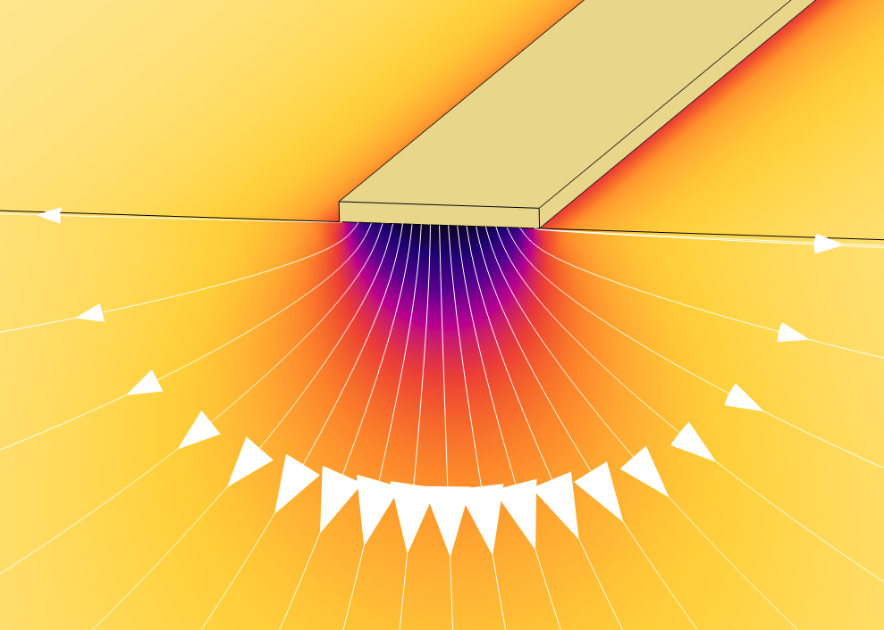
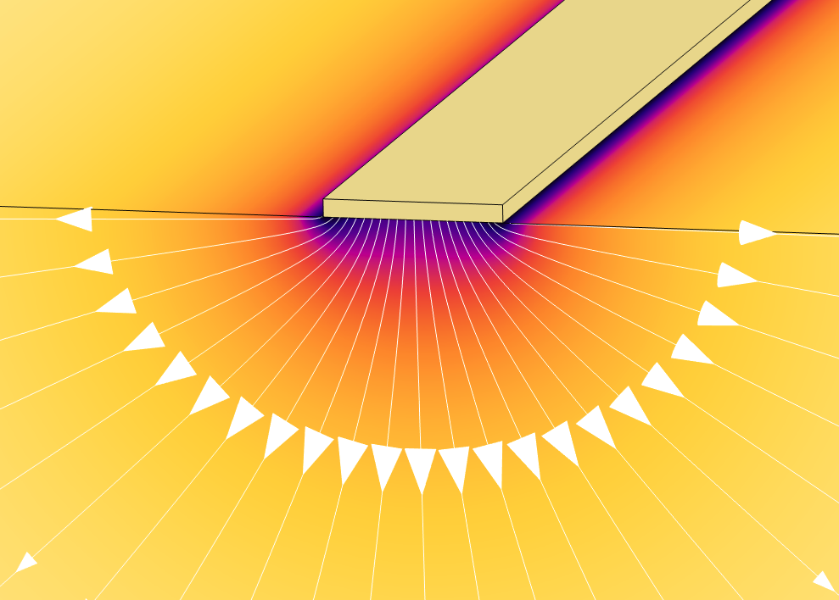
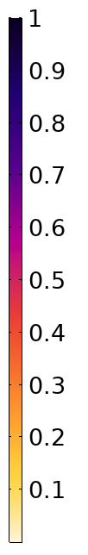





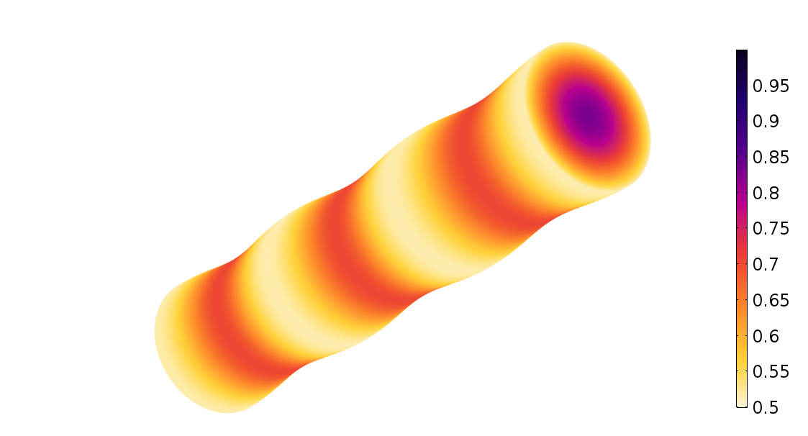
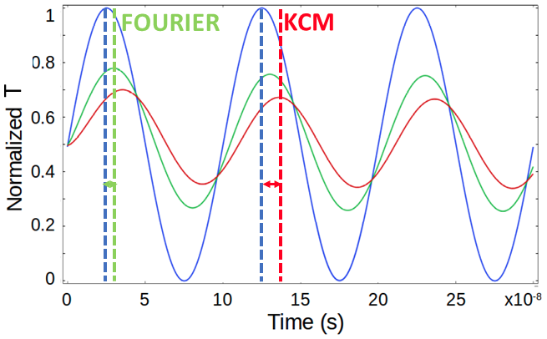



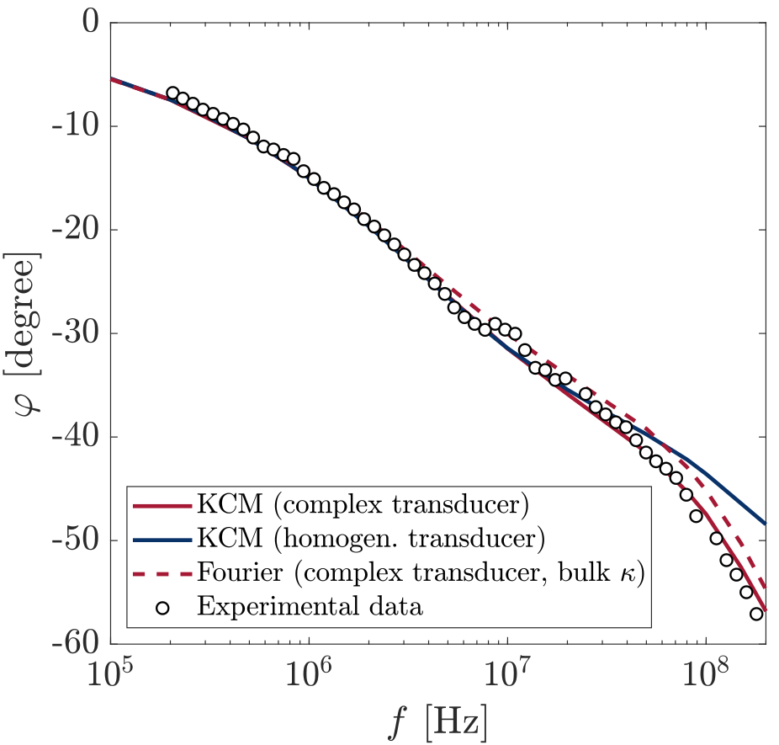
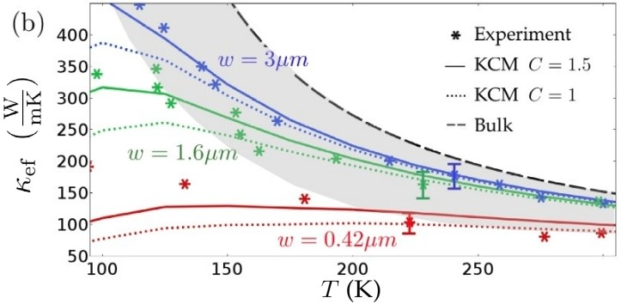
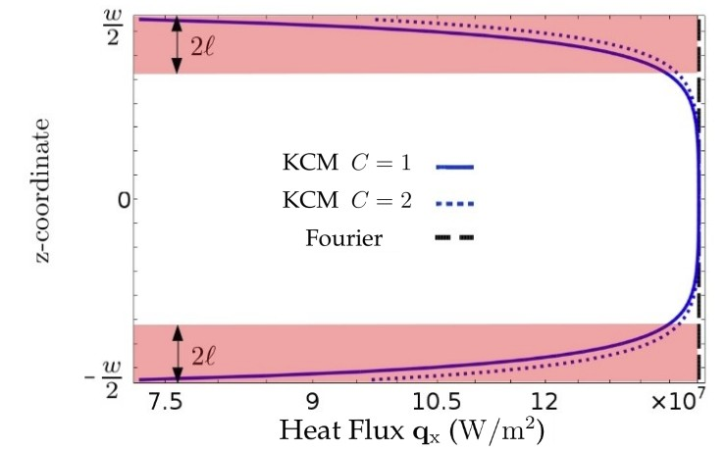

Nanoscale Heat Transport Model for Microelecronic Device Design
A. Beardo¹, L. Sendra¹, J. Camacho¹, J. Bafaluy¹, F. X. Alvarez¹,
Universitat Autònoma de Barcelona, Physics Department, Bellaterra 08193, Spain
Heat management has became a bottleneck in electronic engineering because of the large amount of energy released by current devices due to its extreme level of miniaturization [1]. This is a very important limitation to achieve, for example, terahertz clock-rates in computing and it is related to the limited success in obtaining high-performance thermoelectric devices.
We present the COMSOL implementation of the hydrodynamic heat transport equation (generalization of Fourier law) for semiconductors [2-5] with ab initio calculated parameters, along with the appropriate boundary conditions for free surfaces and interfaces.
NANO HEATERS ON TOP OF A SEMICONDUCTOR SUBSTRATE
Hydrodynamic Heat Transport (KCM)
Fourier Heat Transport
Metal-semiconductor Interface
200nm
Metal-semiconductor Interface
200nm
Metallic
Heater (𝜞)
Metallic
Heater (𝜞)
Heat Flux streamlines
Heat Flux streamlines
Silicon substrate
Silicon substrate
Normalized stationary heat flux (q) profile according to the hydrodynamic heat transport model (left) and the Fourier model (right) if a fixed energy density is introduced in the gold nanostructures. The Fourier model predicts an isotropic substrate thermal response, whereas the hydrodynamic model predicts a larger heat flux in the downward direction. This refinement of the substrate heat conduction allows accurate predictions of the resulting local temperature (T) map [2,3].
BOUNDARY CONDITIONS FOR COMPLEX NANOSCALE GEOMETRIES
FOR THERMOELECTRIC APPLICATIONS
THERMAL RESPONSE UNDER A FREQUENCY MODULATED LASER EXCITATION (UP TO 200MHz) [5]
Free Surfaces with arbitrary shape
Laser Power Density
Normalized Heat Flux
Isothermal surfaces
OR
periodic boundary
conditions
Phase lag between excitation and temperature oscillations
HEAT FLUX REDUCTION CLOSE TO THE BOUNDARIES IN Si THIN FILMS [4]
REFERENCES:
1. M.M. Waldrop. The chips are down for Moore’s law. Nature, 10.1038/530144a (2016).
2. P. Torres, et. al. Emergence of hydrodynamic heat transport in semiconductors at the nanoscale. Physical Rev. Materials 27, 076001 (2018)
3. A. Ziabari, et. al. Full-field thermal imaging of quasiballistic crosstalk reduction in nanoscale devices. Nature Communications 9, 255 (2018)
4. A. Beardo, et. al. Hydrodynamic Heat Transport in compact and holey Silicon thin Films. Physical Rev. Applied 11, 034003 (2019)
5. A. Beardo, et. al. Phonon hydrodynamics in frequency domain thermoreflectance experiments. Physical Rev. B 101, 075303 (2020)
Notes:
‹#›

