Slide 1

FINITE ELEMENT MODEL FOR MICROWAVE HEATING USED IN CHEMICAL RECYCLING OF PLASTIC WASTE MATERIAL
Alberto Frisa-Rubio
C. González-Niño, N. García-Polanco, S. Fießer,
T. García-Armingol
CIRCE
Research Centre for Energy Resources and Consumption
Zaragoza, Spain
2020

Slide 2
MAIN OBJECTIVE
Demonstrating at TRL 7 a set of innovative, cost-effective and sustainable solutions with an aim to improve the energy and resource efficiency of plastic recycling processes for materials containing at least 80% plastic.
The project is focused on following plastic containing materials:
postconsumer (after products’ end of life)
post-industrial (produced during transformation processes from raw materials to final product)

Slide 3
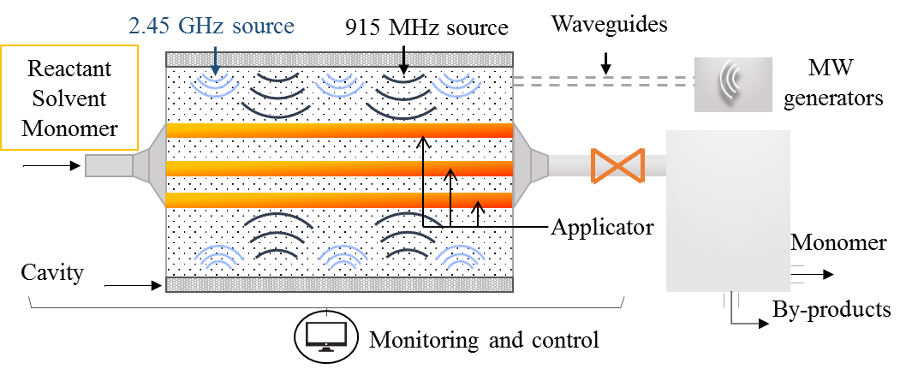
INNOVATION: CHEMICAL RECYCLING
Innovation is focused on chemical recycling processes to obtain the feedstock needed by chemical industries to synthetize new polymers, whose reintroduction at the beginning of the value chain will reduce the consumption of fossil raw materials.
Chemical Recycling assisted by Microwaves
Increasing reaction rate by more than 10 times.
Energy consumption is reduced at least a 68%.
Heating process is better controlled and more uniform, leading to higher yield and the need of smaller amount of solvents.

Slide 4
THERMAL PROBLEM
CHEMICAL DEPOLYMERIZATION (A CHEMICAL RECYCLING PROCESS)
PRELIMINAR ANALYSIS MADE IN LABORATORY (LAB SCALE) → REQUIREMENTS ARE OBTAINED:
OPERATION PRESSURE | 8-15 bar
OPERATING TEMPERATURE | up to 220 ℃
PROCESS TIME | 40 min (MAX) regardless of volume
HEATING SOURCE
POLYMER WASTE
+
SOLVENT
FILTRATION
+
DRYING
MIXING FLUID OBATAINED
RECOVERED MONOMER
MW HEATING

Slide 5
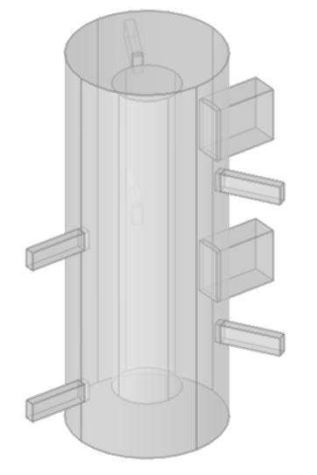
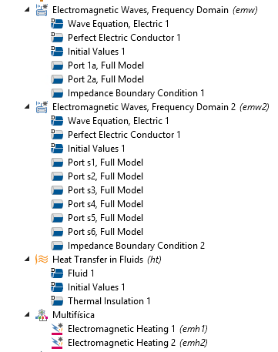
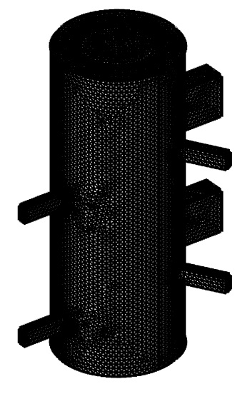
NUMERICAL SIMULATION FOR MICROWAVE HEATING SYSTEM
Process scale-up
COMSOL Multiphysics as a tool for designing:
CONTINUOS OPERATION OR BY BATCH?
SEVERAL VESSELS/APPLICATORS INSIDE OR ONLY ONE BY REACTOR?
CAVITY SHAPE INFLUENCE TO IMPROVE MICROWAVE REFLECTION?
THERMAL BEHAVIOUR.
POWER REQUIREMENTS.
MATERIAL INFLUENCE.
MODELLING
PHYSICS CONFIGURATION
MESHING
SOLVER
POST-PROCESSING
Material properties
Dielectric properties
Boundary conditions
Simplified configurations were analysed in order to select the most properly in terms of feasibility and energy distribution.
As a result, a cylindrical shape both reactor and vessel has been defined, connecting transmitting MW energy from ports to cavity connected through waveguides.
Indirect method
Stationary solver: GMRES
Time-Dependent Solver: PARDISO
Results
Electric Field
Temperature
Loss power

Slide 6
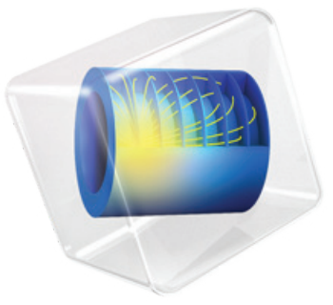
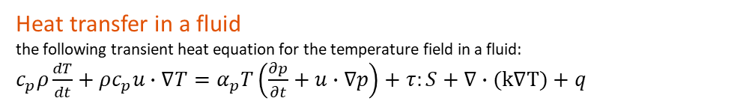
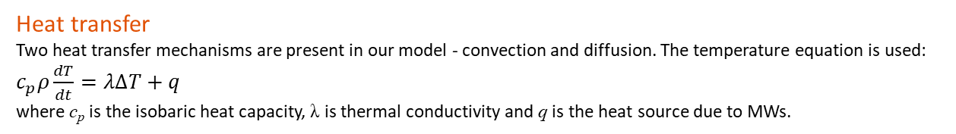
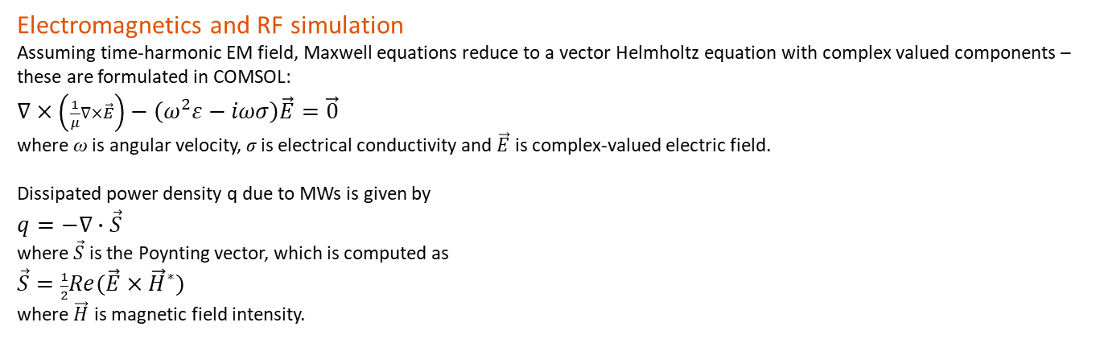
METHODOLOGY
COMSOL MODULES
COMSOL Multiphysics 5.4 | Electromagnetic Heating
RF Module | Electromagnetic waves, frequency domain
Heat Transfer Module | Heat Transfer in Fluids
GOVERNING EQUATIONS
Electromagnetics and RF simulation
Assuming time-harmonic EM field, Maxwell equations reduce to a vector Helmholtz equation with complex valued components –
these are formulated in COMSOL:
$∇×\left(\frac{1}{μ}∇×\vec{E}\right)−\left(ω^{2}ε−iωσ\right)\vec{E}=\vec{0}$
where ω is angular velocity, σ is electrical conductivity and $\vec{E}$ is complex-valued electric field.
Dissipated power density q due to MWs is given by
$q=−∇∙\vec{S}$
where $\vec{S}$ is the Poynting vector, which is computed as
$\vec{S}=\frac{1}{2}Re(\vec{E}×{\vec{H}}^{∗})$
where $\vec{H}$ is magnetic field intensity.
Heat transfer
Two heat transfer mechanisms are present in our model - convection and diffusion. The temperature equation is used:
$c_{p}ρ\frac{dT}{dt}=λ∆T+q$
where c_{p} is the isobaric heat capacity, λ is thermal conductivity and q is the heat source due to MWs.
Heat transfer in a fluid
the following transient heat equation for the temperature field in a fluid:
$c_{p}ρ\frac{dT}{dt}+ρc_{p}u∙∇T=α_{p}T\left(\frac{∂p}{∂t}+u∙∇p\right)+τ:S+∇∙(k∇T)+q$

Slide 7
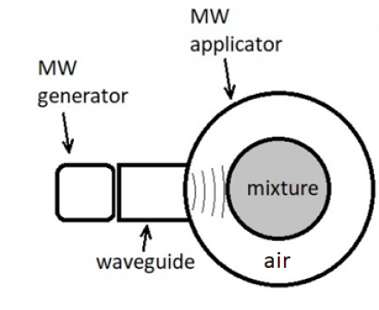
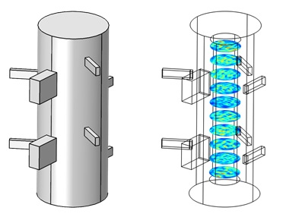
SIMULATION STRATEGIES WITH COMSOL Multiphysics
BOUNDARY CONDITIONS, MODEL SETUP & MESHING
BOUNDARY CONDITIONS Impedance boundary conditions are imposed upon all sides of the cavity and the waveguides.
Emitting ports (multi-frequency) are located at the entrance of the waveguides and configured to propagate through them in the transverse electric 10 (TE10) modes.
Schematic of the cross-section of the reactor (top). External details of the reactor (bottom). As shown, there are two types of waveguides, for the two different frequencies.
MODEL SETUP
Multi-frequency configuration: 915 MHz & 2.45 GHz ports.
Two different EM Waves physics were employed in the model builder, one per frequency
Permittivity values of the material to be heated are introduced (experimentally determined).
Material values included: termal properties and electrical properties.
MESHING CONDITIONS
Mesh size is dependant of relative permittivities of material and selected frequency on each port.

Slide 8
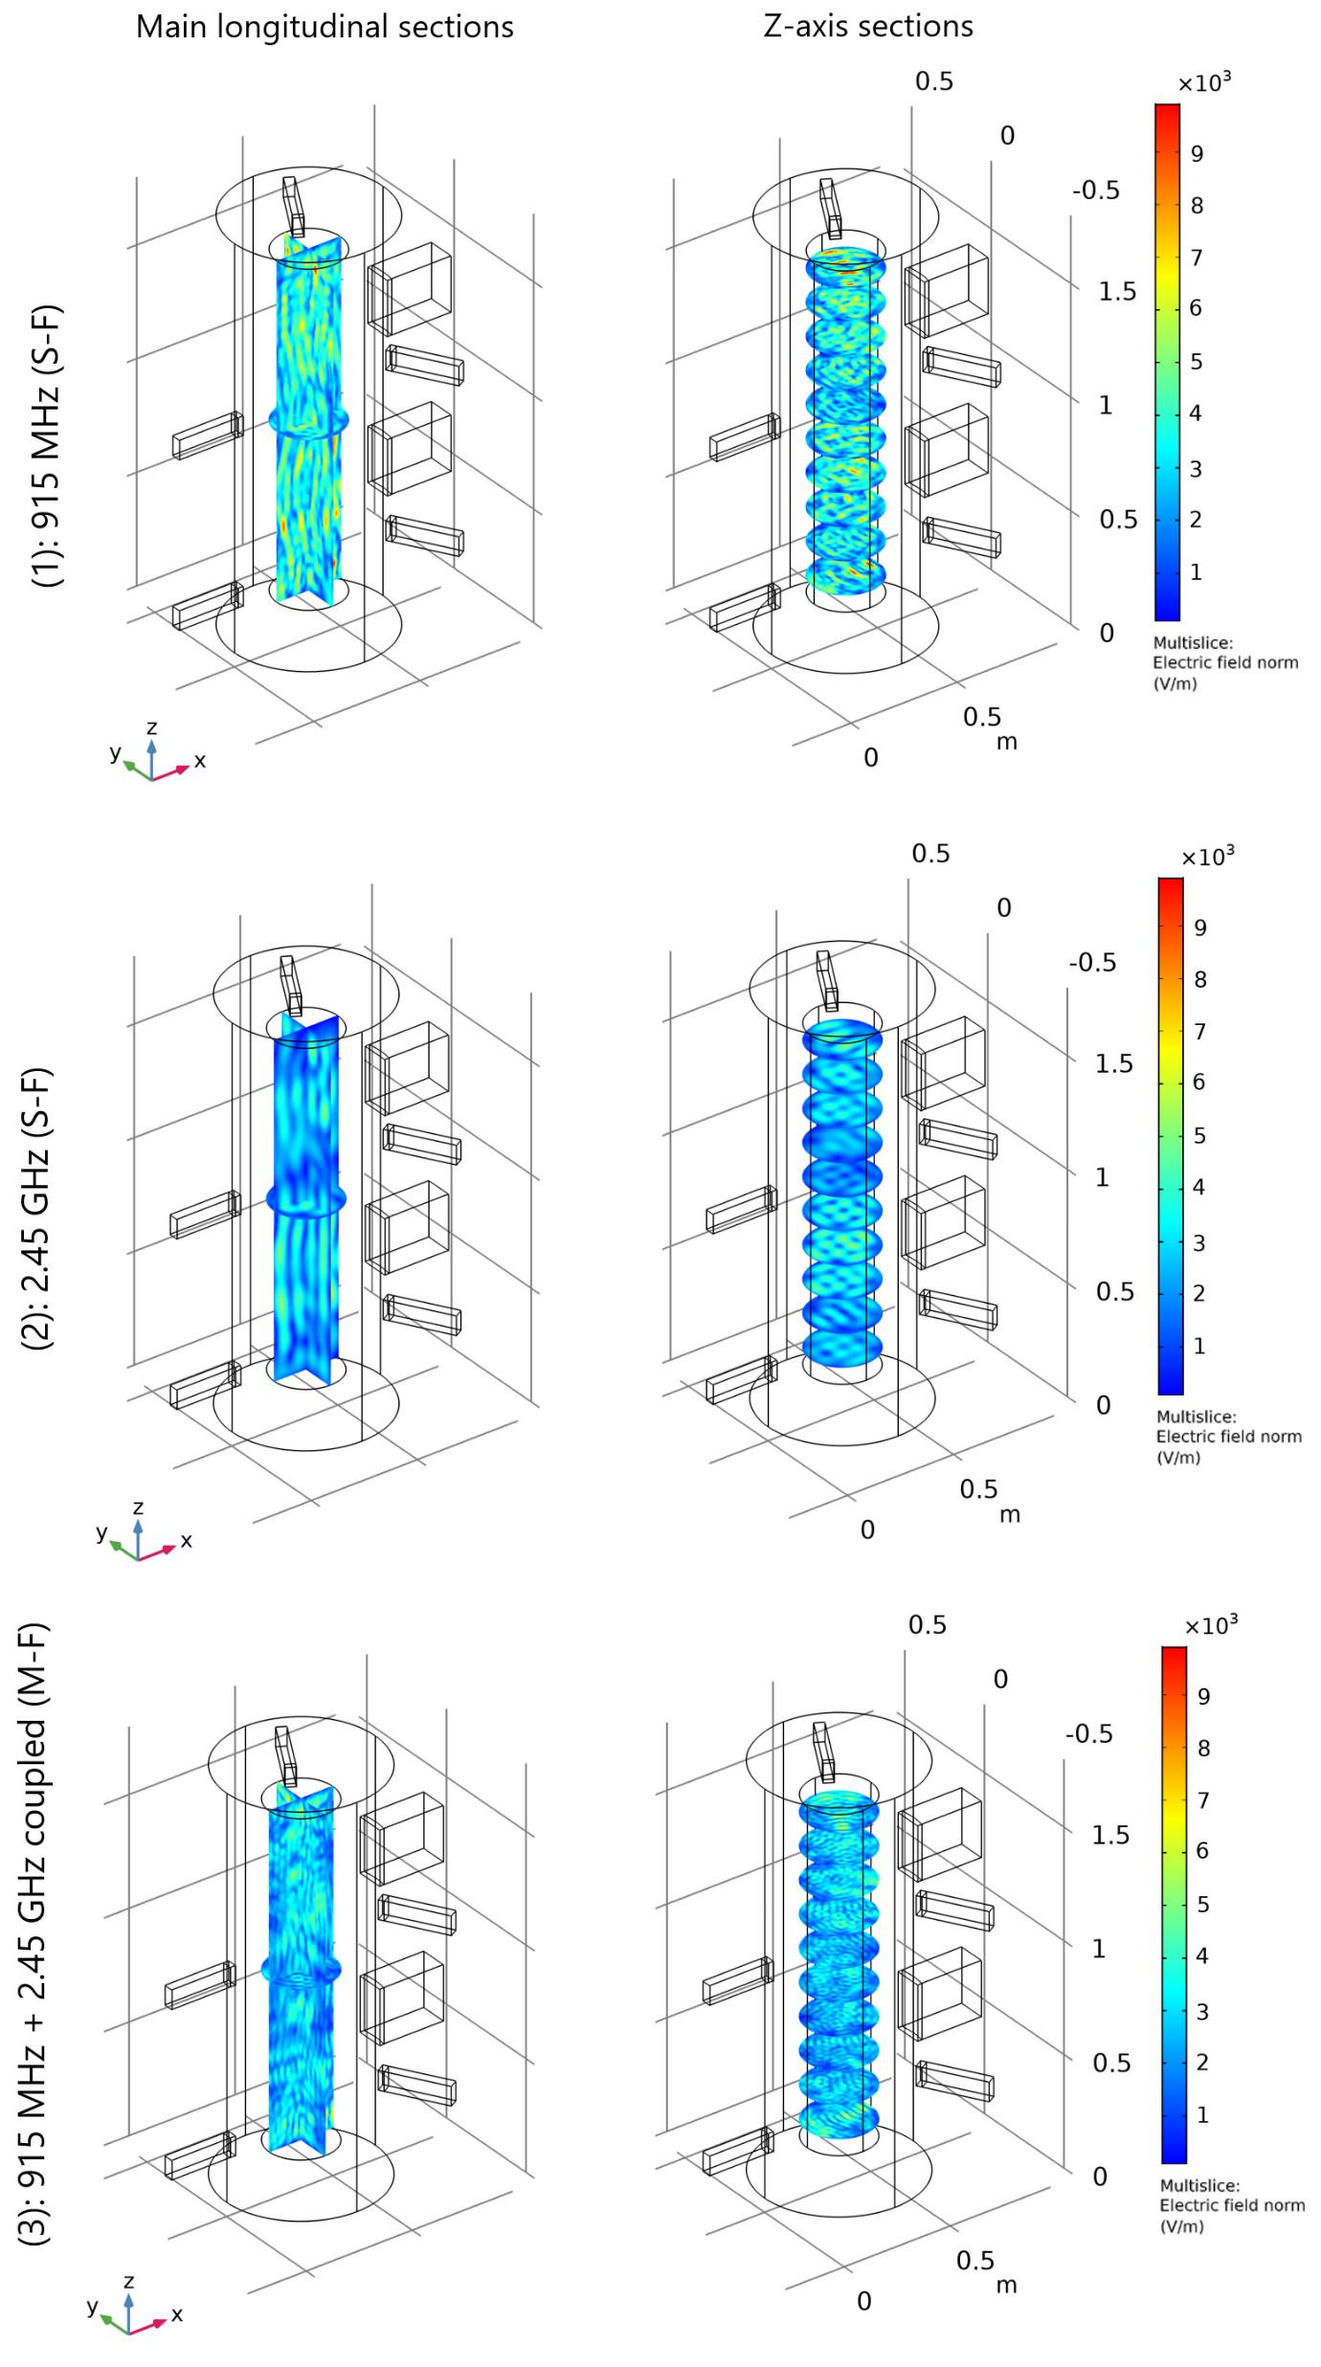
RESULTS
Radio Frequency (RF) simulation results
COMPARATIVE BETWEEN MONO-FREQUENCY OPERATION AND MULTI-FREQUENCY OPERATION.
Simulations at 915 MHz: A higher penetration depth of the energy into the material is produced inside the vessel to activate and to heat the central area. In addition, generated electric field is localized just over the areas of influence close to MW generators. | Simulations at 2.45 GHz: A more homogeneous application of the electric field is achieved and therefore, the heat transfer is expected to be more efficient. | Combining both frequencies, the reactor achieves a more homogeneous distribution along the complete vessel, both inner areas and outer areas. In addition, the electric field values are increased.

Slide 9
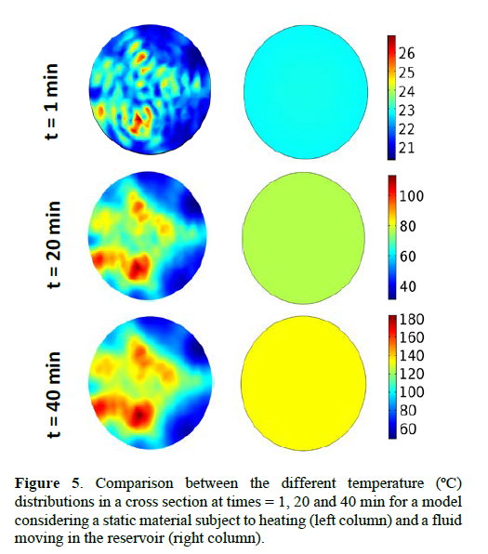
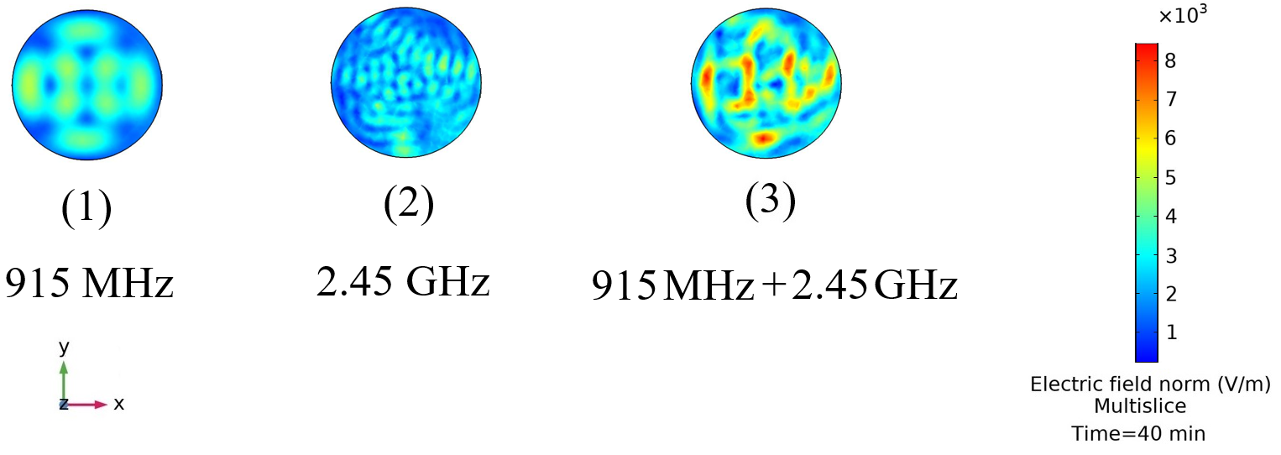
RESULTS
Comparison between the different temperature (ºC) distributions in a cross section at times = 1, 20 and 40 min for a model considering a static material subject to heating (left column) and a fluid moving in the vessel reactor (right column).
Radio Frequency (RF) simulation results
 | 915 MHz simulations: Specific hot points are found whereas, the central part is not absorbing energy from the MW source.
 | 2.45 GHz simulations: Penetration depth of the wave is lower than the obtained for 915 MHz simulations, but hot points are not observed.
 | By combining frequencies, the slice shown (3) increases nominal values of electric field norm and the hot spots that can be observed have a lower gradient with respect to nearby areas.
COMPARATIVE BETWEEN MONO-FREQUENCY OPERATION AND MULTI-FREQUENCY OPERATION.

Slide 10

CONCLUSION
A complex physical system was reduced to two different mathematical models, taking advantage in design stage and process configuration by using COMSOL Multiphysics®. The result will allow to develop a new microwave system focused on a novel industrial process.
A complete simulation methodology for depolymerization of PA by means of microwave heating simulation has been presented. Two microwave frequencies and a coupled multifrequency models were used in order to obtain the simulation results in accordance with experimental measurements (performed studies under polynSPIRE project protected under confidential document).
Then, RF simulations have been performed to analyse the thermal behaviour of the mixing fluid under different MW configuration. The results presented have revealed that combining MW frequencies is expected to be the most promising strategy to improve the homogenization of the electromagnetic field distribution achieving a more homogeneous temperature, minimizing hotspots presence. This conclusion has been extracted after performing a comprehensive sensitivity study analysis varying the frequency, number of ports and position. In addition, MW also allows a significative reduction of heating time leading to an increase of the overall efficiency of the process.
Future efforts will address the total coupling between heating and chemical process with the aim of simulating the interaction of the MW heating with the chemical reactions.
The model generated was proven a useful tool for reactor design and optimisation, being able to capture temperature changes in the reacting mixture due to the electromagnetic heating induced by the microwaves. Additionally, the framework developed for this model can be easily modified to predict the performance of other microwave-assisted reactions.

Slide 11
THANK YOU VERY MUCH FOR YOUR ATTENTION

