Slide 1
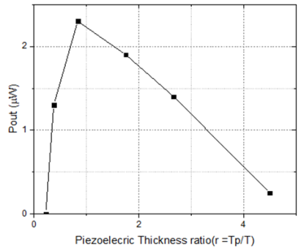
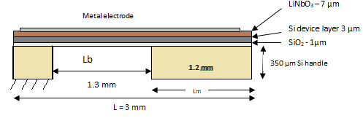


Optimization of the geometry of MEMS Piezoelectric Energy Harvester cantilevers
N. Panayanthatta¹, R. La Rosa², C. Trigona³, E. Bano¹, L. Montes¹
Institut IMEP-LaHC, Univ . Grenoble Alpes, Univ. Savoie ,Mont Blanc, CNRS, Grenoble INP*, IMEP- LaHC, 38000, GRENOBLE, FRANCE
2. STMicroelectronics, Stradale Primosole ,50, 95121 CATANIA,ITALY
3. Department of Electrical, Electronics and Computer Engineering, University of Catania, CATANIA , ITALY
1. INTRODUCTION: Here we optimize the geometry: proof mass length Lm to total length L, thickness of the piezoelectric material (Tp) to total cantilever thickness (T) for obtaining the maximum stress distribution (Smax), output voltage (Vout) and power performance (Pout) of the unimorph Cantilever beam based PEH.
3. RESULTS:
Figure 2. Maximum stress (Smax)
Figure 3. Output power (Pmax)
Figure 1. Geometry of the device
2. COMPUTATIONAL METHODS:
Physics Involved: The basic equations of motion and the equations of the electric field
2.1 Solid Mechanics
Linear Elastic Material that bends according to the stress produced.
2.2:Electromechanical coupling in Piezoelectric Material
2.3. Boundary conditions applied:
2.3.1: Mechanical:
Body Load was applied to whole system, assuming a constant force per unit volume, ie acceleration=1g.
Fixed Constraint
one end of the beam is fixed the other end can vibrate
2.3.2: Electrostatics boundary conditions
Charge Conservation
necessary to define the boundary of the piezoelectric material. The charges reside only on the surface of the metal electrode as well.
Charge Conservation, (Piezoelectric material)
To specify the spontaneous polarization inside the material on the application of strain.
Ground Specification
to define a zero reference potential, V=0.
Terminal
to obtain the output voltage from the electrode, considered as the output voltage wrt . Ground.
Figure.4. Cantilever displacement
Figure 5. Open circuit Voltage (Voc)
4. CONCLUSIONS:
The maximum output power (Pout) was obtained at the Lm/L ratio ~ 0.4.
the maximum stress developed inside the beam is near the root of the beam when the ratio r= Tp/T is close to 2.
The maximum output power (Pout) is obtained from the PEH at the maximum strain induced at the optimum ratio r as evident from the Figure (3 and 4).
This study therefore throws insight on increasing the electromechanical coupling for a given geometry and therefore the electrical outputs of the harvester.
REFERENCES:
[1]E. L. Pradeesh and S. Udhayakumar, “Effect of placement of piezoelectric material and proof mass on the performance of piezoelectric energy harvester,” Mech. Syst. Signal Process., vol. 130, pp. 664–676, Sep. 2019, doi: 10.1016/j.ymssp.2019.05.044.
[2]X. Gao, W.-H. Shih, and W. Y. Shih, “Vibration energy harvesting using piezoelectric unimorph cantilevers with unequal piezoelectric and nonpiezoelectric lengths,” Appl. Phys. Lett., vol. 97, no. 23, p. 233503, Dec. 2010, doi: 10.1063/1.3521389.
[3]H. Elbahr, T. A. Ali, A. Badawi, and S. Sedky, “Simulation of a New PZT Energy Harvester with a Lower Resonance Frequency Using COMSOL Multiphysics®,” p. 8, 2014.
[4]S. Paquin and Y. St-Amant, “Improving the performance of a piezoelectric energy harvester using a variable thickness beam,” Smart Mater. Struct., vol. 19, no. 10, p. 105020, Oct. 2010, doi: 10.1088/0964-1726/19/10/105020.
[5]R. Hosseini and M. Hamedi, “Improvements in energy harvesting capabilities by using different shapes of piezoelectric bimorphs,” J. Micromechanics Microengineering, vol. 25, no. 12, p. 125008, Dec. 2015, doi: 10.1088/0960-1317/25/12/125008.
[6] N. Panayanthatta, L. Montès., E. Bano., C. Trigona., & R. La Rosa (2019, December). Three terminal piezoelectric energy harvester based on novel MPPT design. In 2019 19th International Conference on Micro and Nanotechnology for Power Generation and Energy Conversion Applications (PowerMEMS) (pp. 1-7). IEEE.
Excerpt from the Proceedings of the 2020 COMSOL Conference

