Slide 1




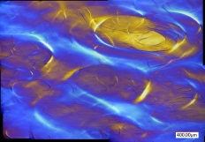
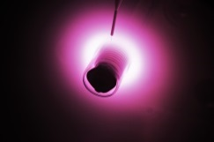
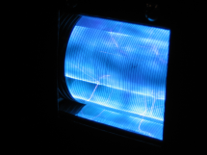
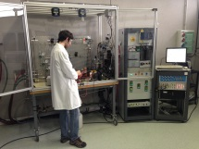
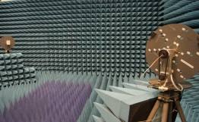

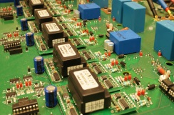

Time domain simulation of insulating dielectric materials with non-instantaneous polarization
Tianbo ZHOU¹, Pierre BIDAN¹, Lionel LAUDEBAT^{1,2}, Marie-Laure LOCATELLI¹
1 - LAPLACE, CNRS, INPT, UPS, Toulouse University, France
2 – Institut National Universitaire Champollion, Albi, France

Slide 2
Sommaire
Introduction
Debye model in time domain
The model in COMSOL
Simulation examples
Conclusions

Slide 3
Introduction
Theory of polarization
The dielectric medium is polarized under the influence of the applied field E
Debye model
The polarization cannot response instantly to an applied field.
Polarizations can be divided into instantaneous polarization and non-instantaneous polarization
Debye model traits the dipolar polarization
Polarization types of normal dielectric materials under a step­ function electric field ⁽¹⁾
Kao K 2004 Dielectric Phenomena in Solids: with Emphasis on Physical Concepts of Electronic Processes (San Diego, CA: Elsevier)

Slide 4
Introduction
Problem background in COMSOL
COMSOL | Instantaneous polarization | Non-instantaneous polarization
Frequency domain | Yes | Yes
Time domain | Yes | No
Steady state | Transient state
Yes | No
Yes | Yes
A critical factor (overvoltage/overcurrent) for the design of electric insulating devices appears in transient state
The situation in transient state in consideration of the dielectric relaxation (non-instantaneous polarization)
System under different types of signal
A method based on time domain simulation and integrating the Debye model equations in COMSOL is proposed

Slide 5
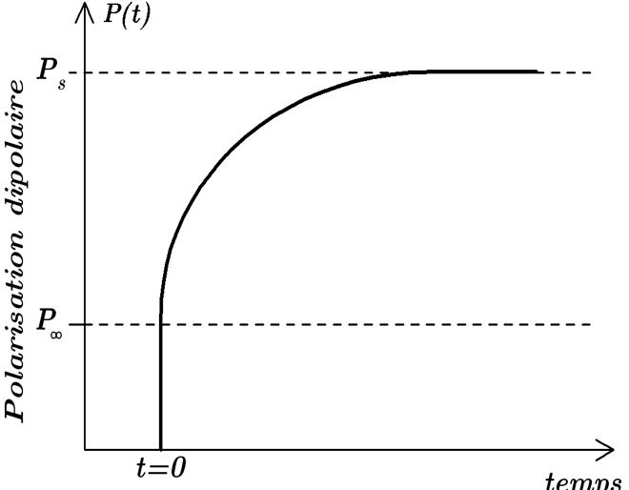
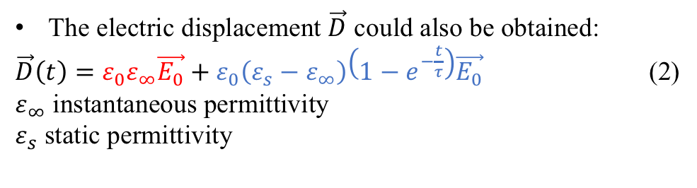
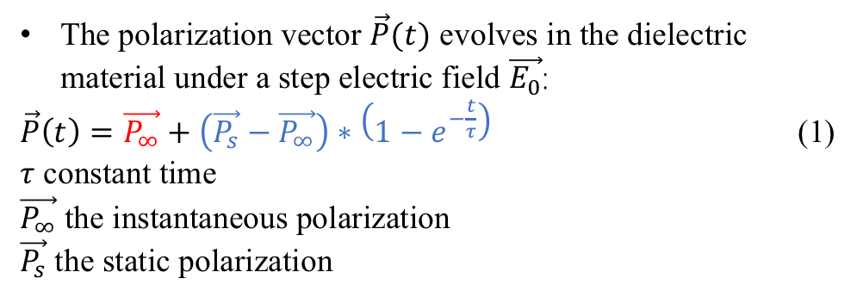
Debye model in time domain
The polarization vector $\vec{P}(t)$ evolves in the dielectric material under a step electric field $\vec{E_{0}}$:
$\vec{P}\left(t\right)=\vec{P_{∞}}+\left(\vec{P_{s}}−\vec{P_{∞}}\right)∗\left(1−e^{−\frac{t}{τ}}\right)$ (1)
$τ$ constant time
$\vec{P_{∞}}$ the instantaneous polarization
$\vec{P_{s}}$ the static polarization
Dipole polarization
The electric displacement $\vec{D}$ could also be obtained:
$\vec{D}\left(t\right)=ε_{0}ε_{∞}\vec{E_{0}}+ε_{0}\left(ε_{s}−ε_{∞}\right)\left(1−e^{−\frac{t}{τ}}\right)\vec{E_{0}}$ (2)
$ε_{∞}$ instantaneous permittivity
$ε_{s}$ static permittivity
time
Application of electric field
Dynamic polarization for a step of E

Slide 6

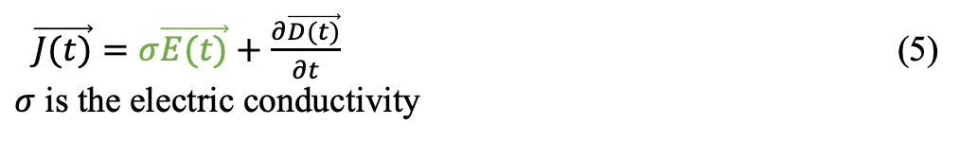


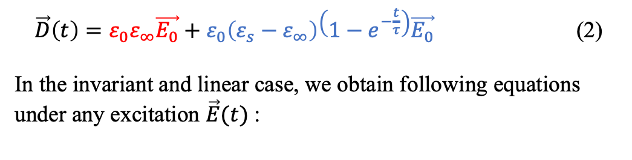



Debye model in time domain
$\vec{D}\left(t\right)=ε_{0}ε_{∞}\vec{E_{0}}+ε_{0}\left(ε_{s}−ε_{∞}\right)\left(1−e^{−\frac{t}{τ}}\right)\vec{E_{0}}$ (2)
In the invariant and linear case, we obtain following equations under any excitation $\vec{E}(t)$:
$$C_{p}$$
$$R$$
$$C_{∞}$$
$$R_{p}$$
$$\vec{D}\left(t\right)=ε_{0}ε_{∞}\vec{E}(t)$$
$+\vec{D_{\#} }\left(t\right)$ (3)
$\vec{D_{\#} }\left(t\right)+τ\frac{∂\vec{D_{\#} }}{∂t}=ε_{0} \left(ε_{s}−ε_{∞}\right)\vec{E}(t)$ (4)
The influence of the resistance of material can be introduced by coupling with general Ohm’s law
Equivalent electric circuit model
$\vec{J(t)}=σ\vec{E(t)}+\frac{∂\vec{D(t)}}{∂t}$ (5)
$σ$ is the electric conductivity

Slide 7

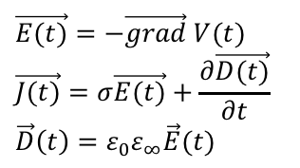


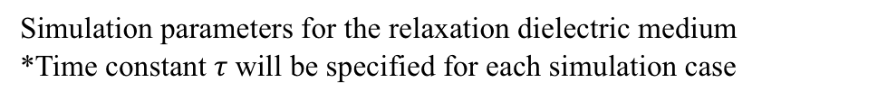
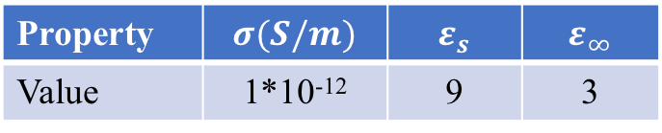

The model in COMSOL
Integration in COMSOL
$\vec{E(t)}=−\vec{grad} V(t)$
$$\vec{J(t)}=σ\vec{E(t)}+\frac{∂\vec{D(t)}}{∂t}$$
$$\vec{D}\left(t\right)=ε_{0}ε_{∞}\vec{E}(t)$$
$$+\vec{D_{\#} }\left(t\right)$$
air
$$\vec{D_{\#} }\left(t\right)+τ\frac{∂\vec{D_{\#} }}{∂t}=ε_{0} \left(ε_{s}−ε_{∞}\right)\vec{E}(t)$$
Dielectric medium
electrodes
Simulation parameters for the relaxation dielectric medium
*Time constant $τ$will be specified for each simulation case
Property | $$σ(S/m)$$ | $$ε_{s}$$ | $$ε_{∞}$$
Value | 1*10⁻¹² | 9 | 3
The parallel-plane capacitor description in COMSOL

Slide 8
Simulation examples
Steady state for a sinusoidal current excitation compared with frequency domain results
Simulation in time domain using the proposed method and simulation in frequency domain
The same electric field magnitude in steady state of 2 calculations (about 1.19kV/mm)
Electric field vs Time in time domain
Conclusion
  Same results
    Only the steady state in frequency domain calculation
    Steady state + transient state in time domain calculation by using our method
The distribution of electric field of simulation in frequency domain

Slide 9
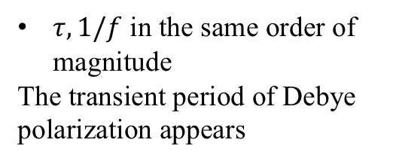
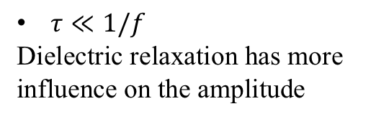
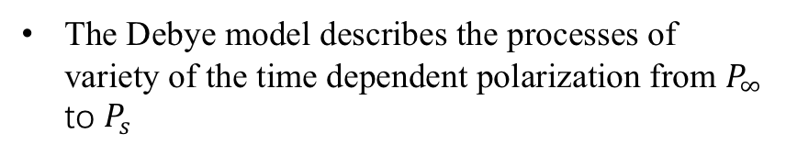

Simulation examples
Transient state results for step and sinus current excitation
Excitation of $f=$5Hz and 50Hz
$τ≪1/f$
Dielectric relaxation has more influence on the amplitude
$τ, 1/f$ in the same order of magnitude
The transient period of Debye polarization appears
Electric field vs Time under sinus (5Hz) response
Electric field vs Time under step response
The Debye model describes the processes of variety of the time dependent polarization from $P_{∞}$ to $P_{s}$
Electric field vs Time under sinus (50Hz) response

Slide 10
Conclusions
A solution for the simulation in time domain considering the non-instantaneous polarization (dielectric relaxation)
Applied for all types of excitation
Examples demonstrated in a basic geometry under different excitations
Other models such as Cole-Cole, Cole-Davidson or Havriliak-Negami can be integrated in the future

