Slide 1


COMSOL Conference
2020 Europe
ALD Vacuum Technologies
ALD Vacuum Technologies
High Tech is our Business
High Tech is our Business

Slide 2
Electron Beam Generator Simulation in COMSOL Multiphysics
Dr. Thomas Schösser, ALD Vacuum Technologies GmbH
ALD Vacuum Technologies
ALD Vacuum Technologies
High Tech is our Business
High Tech is our Business

Slide 3
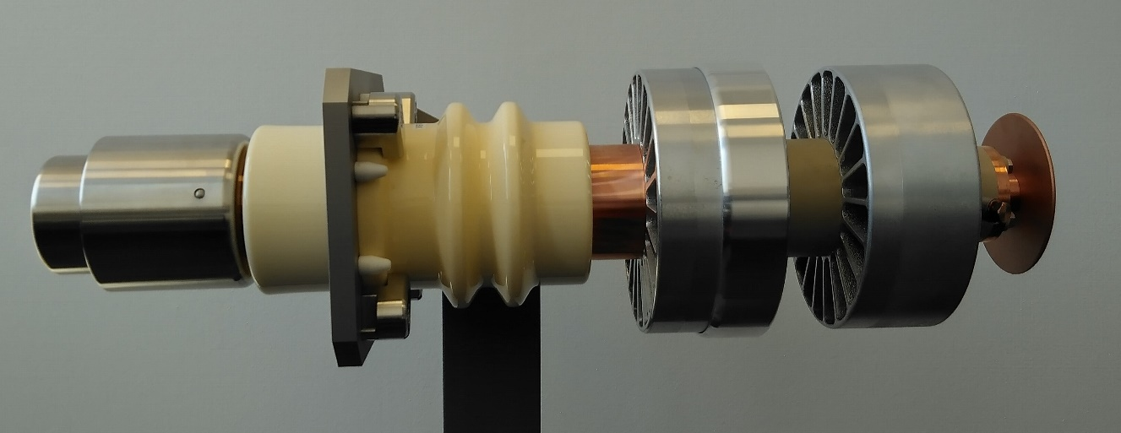
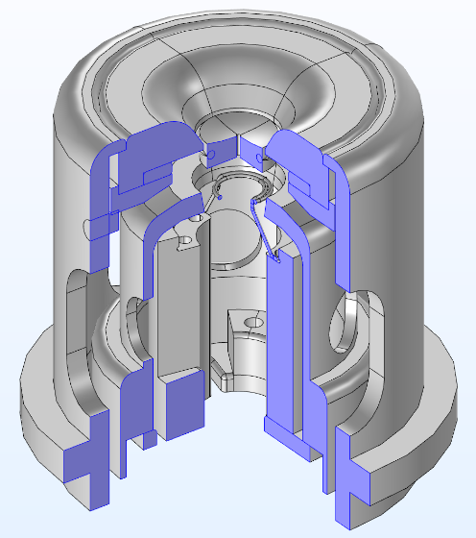

Electron Beam Generator
Electron beam
generator head
Electron beam generator

Slide 4

Simulated Physics
Currents
  Heating
    AC, some ten Amps
  Beam supply
    DC, some Amps
Voltage
  Acceleration
    some ten kilovolts
Heat
  Electron generation
    few thousand degrees celcius
Radiation
  Surface (to surface) radiation
Mechanical deformation, stress, …

Slide 5
Geometry improvements
“We have no time. We need the best results as fast as possible.”

Slide 6
Geometry improvements
“We have no time. We need the best results as fast as possible.”
This talk will focus on geometry design improvements
saving time in
  Creating model components
  Setting up simulation
  Simulate physics

Slide 7

Geometry improvements
COMSOL simulation of entire electron beam generator
  Stationary
    Heat conduction
      ~ 7 minutes
    Joule heating, heat conduction, surface to surface radiation
      ~ 5 days

Slide 8
Geometry improvements
COMSOL simulation of entire electron beam generator
  Stationary
    Heat conduction
      ~ 7 minutes
    Joule heating, heat conduction, surface to surface radiation
      ~ 5 days
conclusion
  Building and setting up the model right
  is essential for reliable and fast results

Slide 9
Import entire model
Advantages
  Ready to use 3-d-model
  Sizes are consistent with actual (physical) build
  Easy and fast way to good simulation results

Slide 10
Import entire model
Disadvantages
  Screw threads
    Unneeded faces, edges, holes, …
  Parameter definition impossible
    Radius, height, …
  Meshing is time consuming
    Errors in hidden, hard to reach faces, layers of layers deep…
  COMSOL repair tools
    > 100 errors
      very time consuming

Slide 11
Import entire model
Conclusion
  Build components
    As simple as possible
    Building only relevant features
    Reducing faces and edges
  All values are parameter (or calculated from parameters)
    Variation
    Optimization
    Series (M, L, XL)
This conclusions define the specification of the third step

Slide 12
Beam Generator Rebuild
Using technical drawings
Using parameter
  Define all values of geometries solely by parameters
Each geometry consist on exact one material

Slide 13
Beam Generator Rebuild
Primitives
  2-d
    Rectangle, Cycle
    Boundaries, constrains, revolve
  3-d
    Cylinder, box, torus, sphere
    Extrude, revolve
Combine with boolean operations

Slide 14
Beam Generator Rebuild
Conclusion
  Less time intensive than repairing CAD import
  Full control over detail depth in simulation
  Finding missing numbers in technical drawings
  Easier combining parts when using parameters

Slide 15
Combining Components
Building a complete model
  And build mesh
    And get errors
Problems
  Intersections
    Orientation
      Rotation
      Translation

Slide 16
Combining Components
Conclusion
  Unique names
  Designing components
    Setting origin right
      Mechanical contact faces at (0|0|0)
    Last step: Translate (origin)
  Unique orientation
    Like negative z-axes

Slide 17
Next steps
Materials
  ~ 10 different materials
  Some ten properties
    Thermal conductivity, heat capacity, surface radiation emission, …
Meshing
Study
  Stationary
  Multiphysics
Results
Optimization

Slide 18
Thank you

