Slide 1


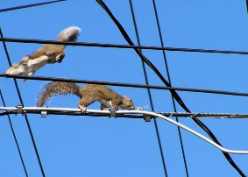

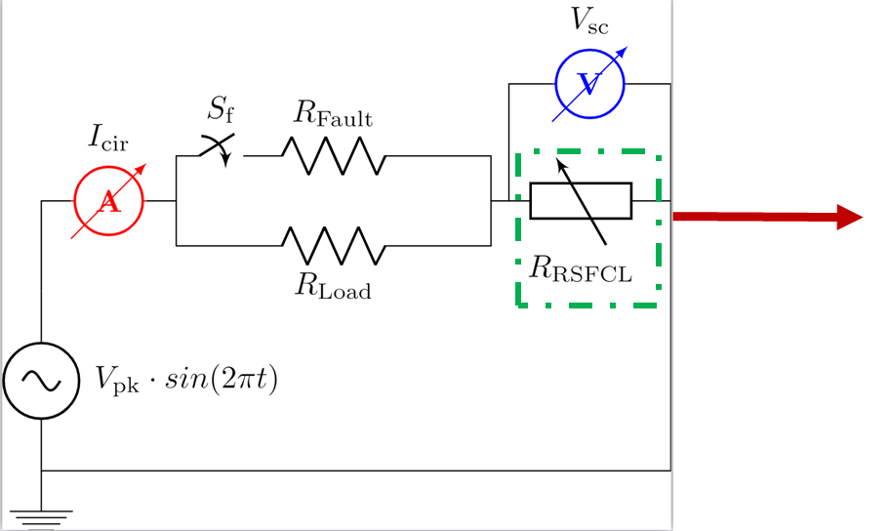
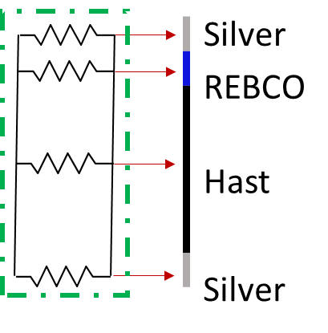
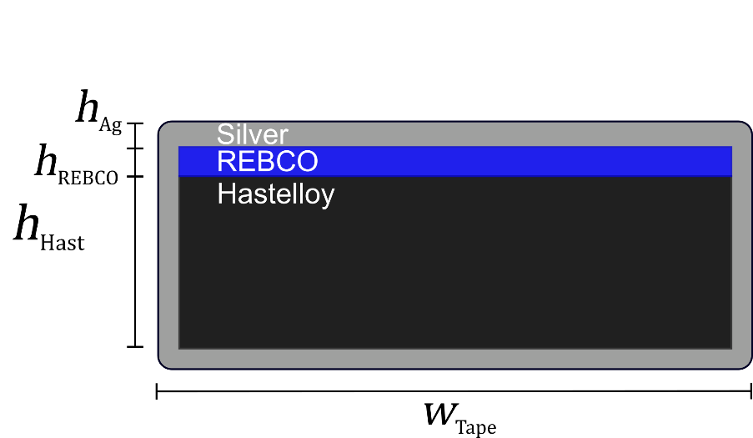
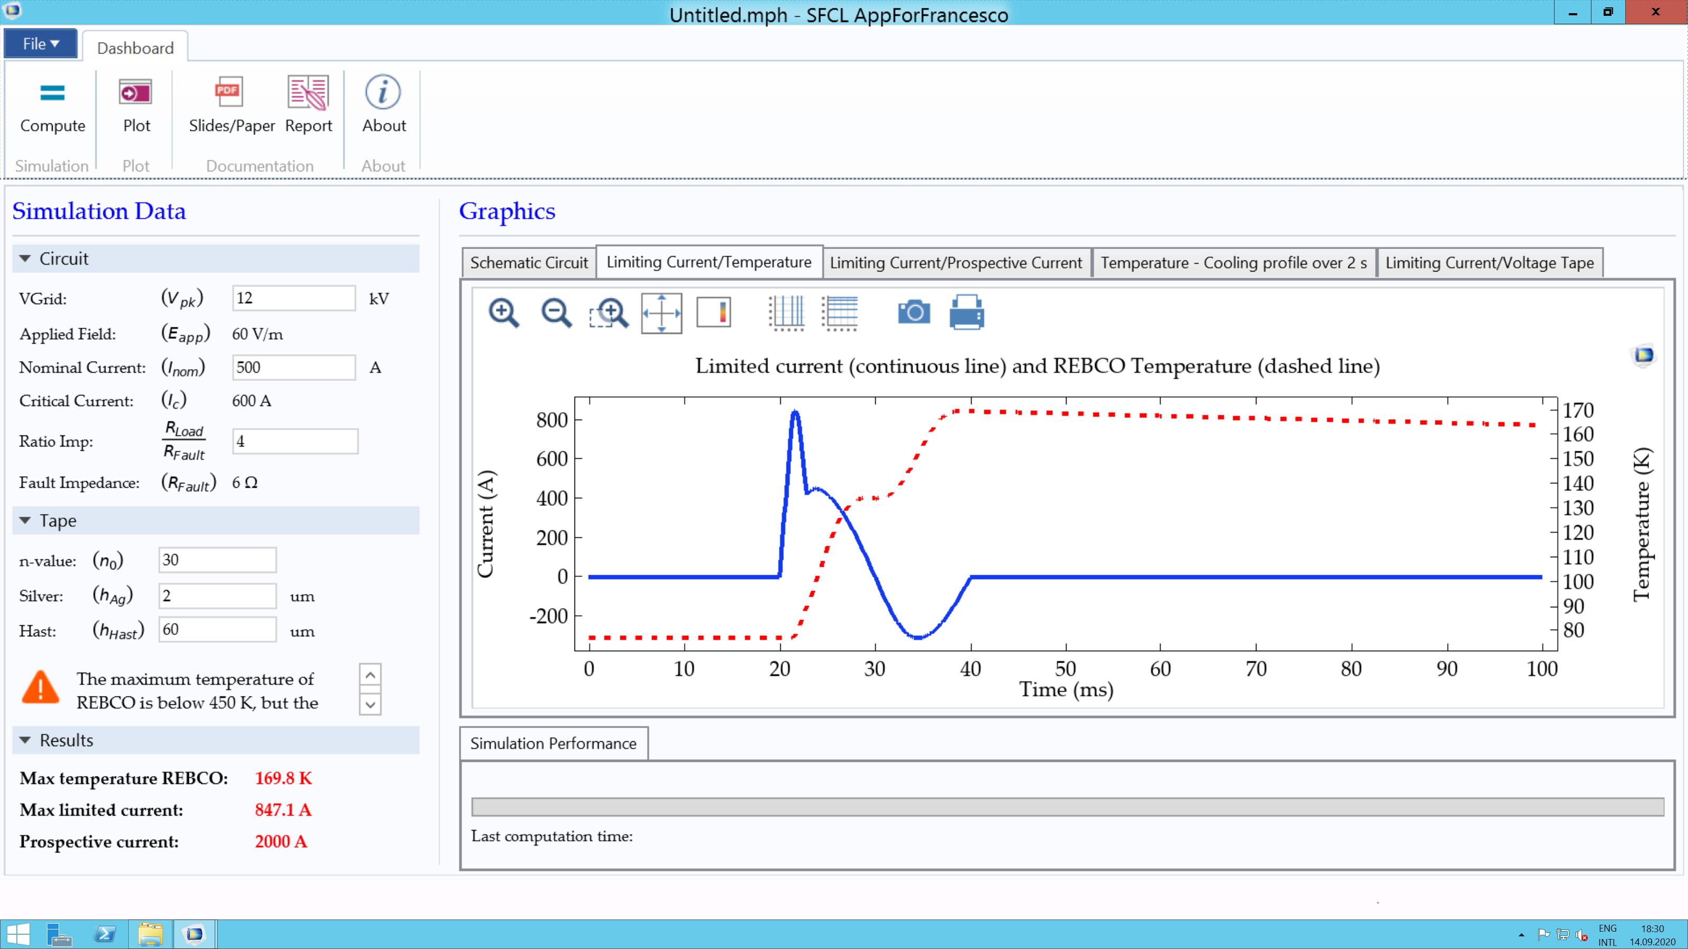
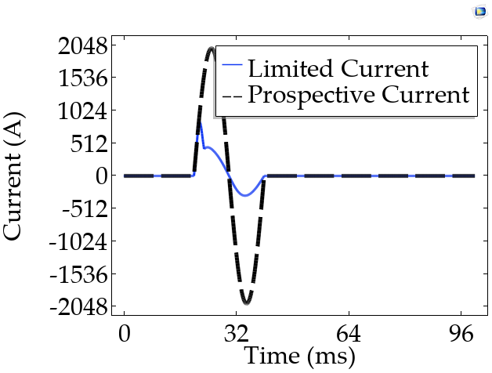
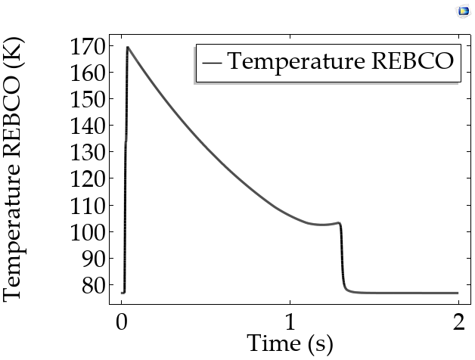
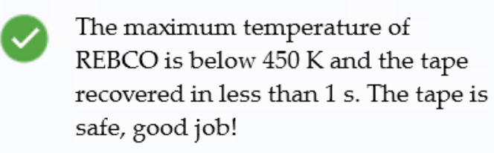
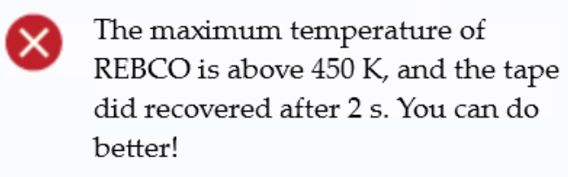


Teaching future engineers about superconductors
for power applications with an App
Nicolò Riva¹, Francesco Grilli² ,Bertrand Dutoit¹
1. SCI IC BD, Ecole Polytechnique Fédérale de Lausanne (EPFL), Lausanne, Switzerland
2. ITEP, Karlsruhe Institute for Technology (KIT), Karlsruhe, Lausanne
INTRODUCTION:
Short-circuit faults exceed the nominal current of a system (up to ten times [1]) put the system at risk
The Superconducting Fault Current Limiters (SFCL) can protect the system from damage
SFCL’s impedance is negligible under normal operation and it rapidly increases when a fault occurs (Figure 1), reducing the current flowing through it and protecting the system
GOAL:
A COMSOL App can help students learning how to deal with such complex concepts in a simplified and engaging format
By varying the circuit's design parameters and the tape, the goal is to keep the temperature of the tape below 450 K
High Imp.
Resistance
Low Imp.
METHODS:
The SFCL is modeled as a superconducting tape, constituted of silver, REBCO, and Hastelloy
A 1-D thermal model (ht) coupled with an electric circuit (ec) (parallel resistors) is solved (Figure 2)
The REBCO's resistivity is modeled with the power-law model (characterized by the n-value: the higher the n, the steeper the characteristic)
Current
Figure 1. It is impossible to avoid short-circuit currents [2,3].
Figure 2. (left) Schematic circuit and (right) representation of the tape.
Figure 3. Snapshot of the App and (right) figure of merit calculated by the App.
Figure 4. (top) Limited and prospective current and (bottom) temperature profile during cooling of the REBCO material
RESULTS:
Analyzing the plots provided (Figure 4), the students will have to adjust the parameters (Figure 3) according to simple design criteria for the tape: Is the tape safe or burnt (Figure 5)?
Figure 5. Dialog box illustrating if the tape is (left) safe or (right) burnt.
CONCLUSIONS:
The App enables students to quickly enter the world of superconductivity and simulation methods, understanding the role of superconductivity, and the design criteria of a simple but important device such as a SFCL.
What is Superconductivity?
Ask me in the chat or check
out this three minutes video!
Curious about this App any many other COMSOL models for superconducting applications?
REFERENCE
[1] Tixador P. Superconducting Fault Current Limiter
[2] Plane, Scott County (MN) Sheriff's Office Press Releases
[3] Squirrel, Yellow Blue Tech
Excerpt from the Proceedings of the 2020 COMSOL Conference

