Slide 1



A stand-alone executable app to teach about superconductors for power applications:
The Superconducting Fault Current Limiter
Nicolò Riva (EPFL)
Francesco Grilli (KIT)
Bertrand Dutoit (EPFL)

Slide 2
Motivation: Teaching (and learning) from the Students
“The questions of the students are often the source of new research. They often ask profound questions that I've thought about at times and then given up on, so to speak, for a while.”
Richard P. Feynmann

Slide 3
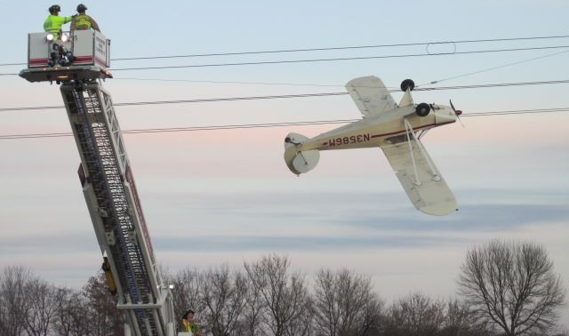
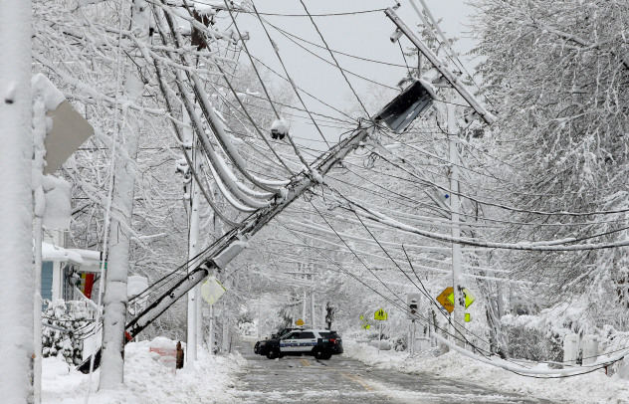
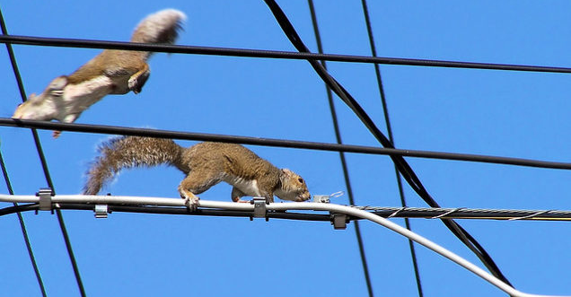
Problem: Short-circuits and faults
It is impossible to avoid faults in a power system
Faults can damage and compromise the system
Scott County (MN) Sheriff's Office Press Releases
AP Photo/Steven Senne
Yellow Blue Tech

Slide 4
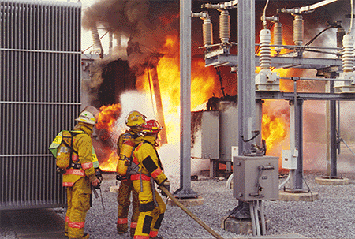
Problem: Short-circuits and faults
Yellow Blue Tech
Image © Palm Harbor Fire Department

Slide 5
Solution: Superconducting Fault Current Limiters (SFCL)
Without limiter (or low n-value)
High
With limiter
Resistance
Increasing n-value
Low
Current
Critical current
Under normal operation -> the impedance is negligible
When a fault occurs -> the impedance rises rapidly (n-value)

Slide 6
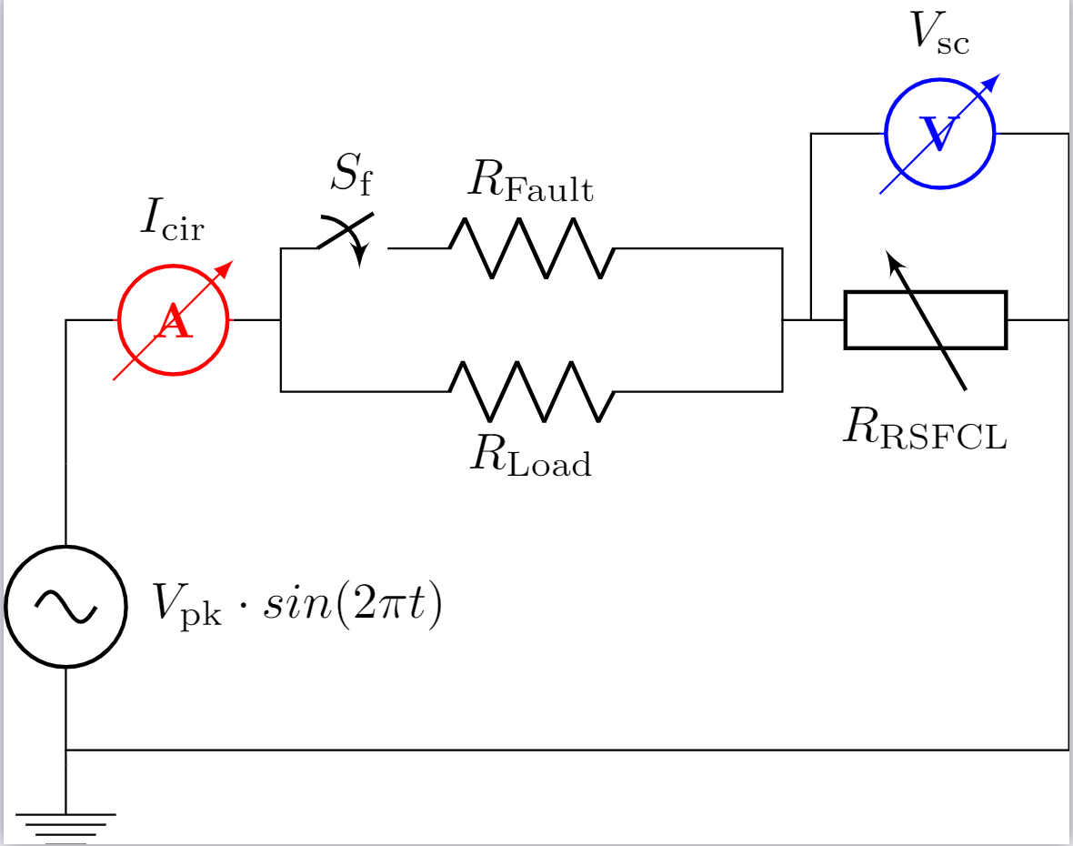


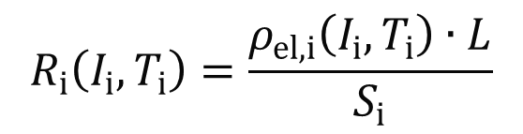
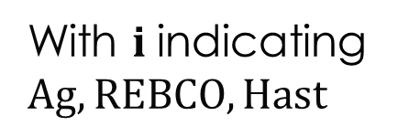
Method: 1-D FEM Model for Resistive SFCL
$$R_{Fault}$$
Fault currents
Silver
REBCO
$$R_{i}\left(I_{i},T_{i}\right)=\frac{ρ_{el,i}\left(I_{i},T_{i}\right)∙L}{S_{i}}$$
Hast
With $i$indicating $Ag, REBCO, Hast$
Silver
Circuit (ec module) + 1D Thermal Model (ht module)
$$ρ_{m,i}\left(T_{i}\right)C_{p,i}\left(T_{i}\right)\frac{∂T_{i}}{∂t}+\vec{∇}∙\left(−k\left(T_{i}\right)\vec{∇}T_{i}\right)=\frac{R_{i}\left(I_{i},T_{i}\right)∙I_{i}^{2}\left(t\right)}{L∙S_{i}} −{\left.h_{LN2}∙\text{(}T_{i}\text{−}T_{0}\text{)}\right|}_{∂Ω}$$
Heat Source
(Joule Heating)
Convection Cooling (Boundary Condition)

Slide 7
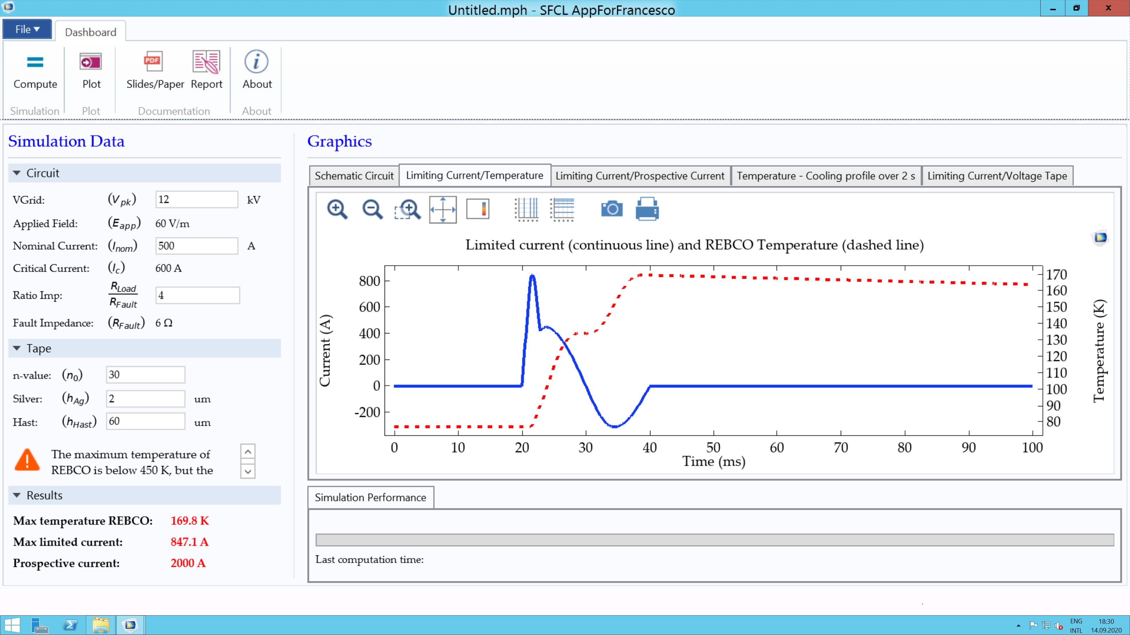
App: designing a SFCL (Is the tape safe or burnt?)

Slide 8









Test results: Initial configuration of the App
$$V_{grid}=12 kV$$
$$E_{app}=60 V/m$$
$$I_{nom}=500 A$$
$$I_{c}=600 A$$
$$Ratio=4$$
$$I_{prosp}=2000 A$$
$$n_{0}=30$$
$$h_{silver}=2 μm$$
$$h_{Hast}=50 μm$$

Slide 9
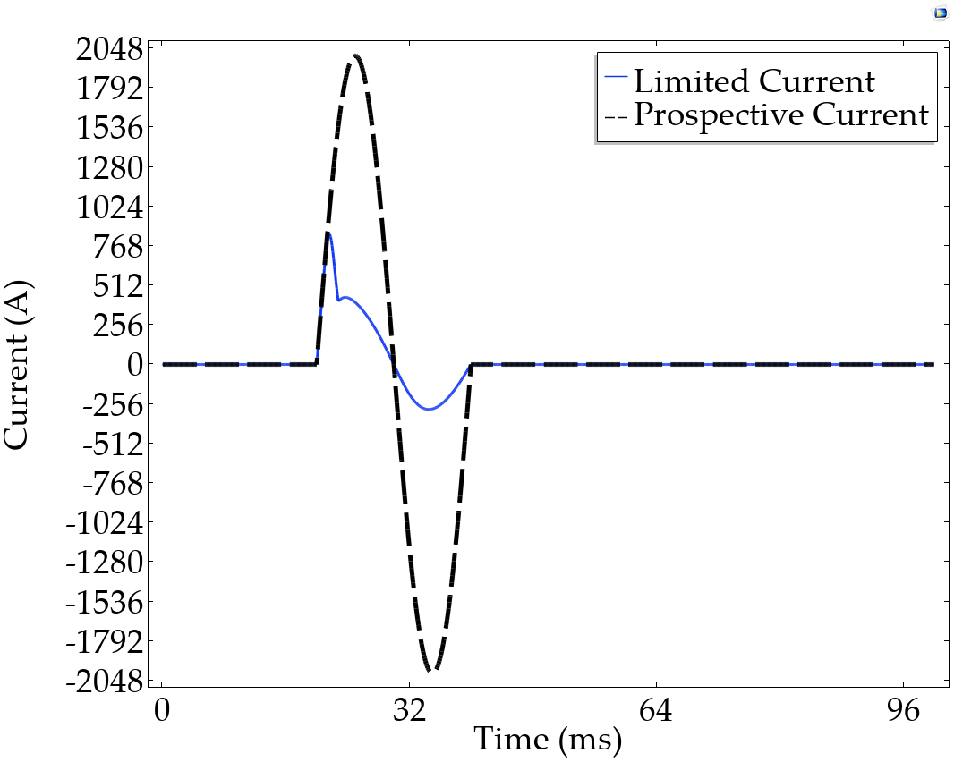
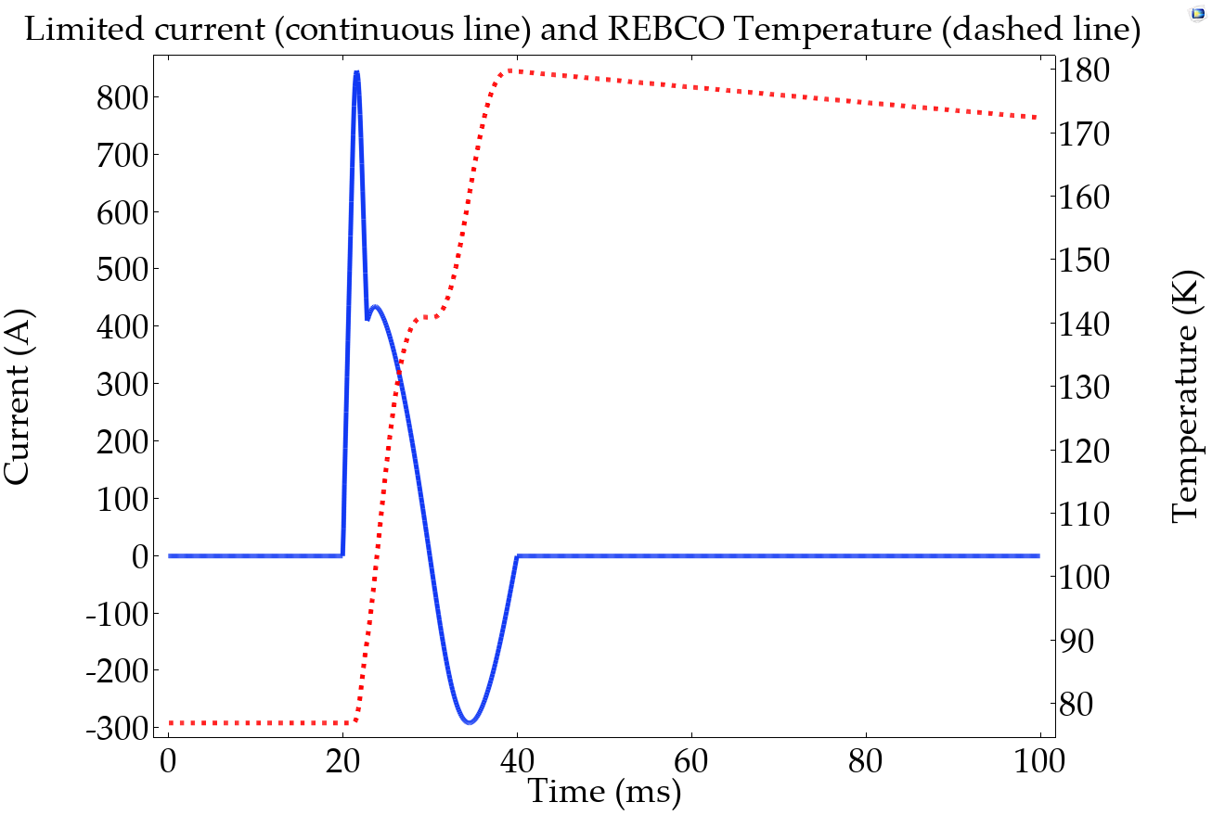
Test results: Initial configuration of the App
The limitation kind of works, the limited current is smaller than 2000 A…

Slide 10



Test results: Lower n-value of the power-law
$$V_{grid}=12 kV$$
$$E_{app}=60 V/m$$
$$I_{nom}=500 A$$
$$I_{c}=600 A$$
$$Ratio=4$$
$$I_{prosp}=2000 A$$
$$n_{0}=5$$
$$h_{silver}=2 μm$$
$$h_{Hast}=50 μm$$
How important is a sharp transition of the resistivity characteristic?

Slide 11
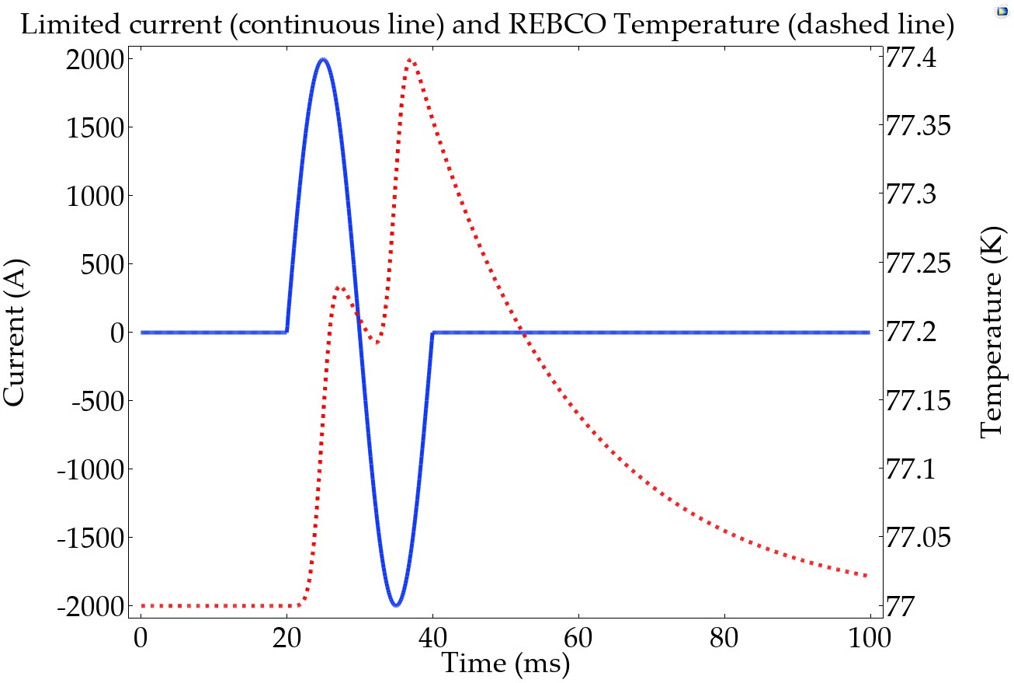
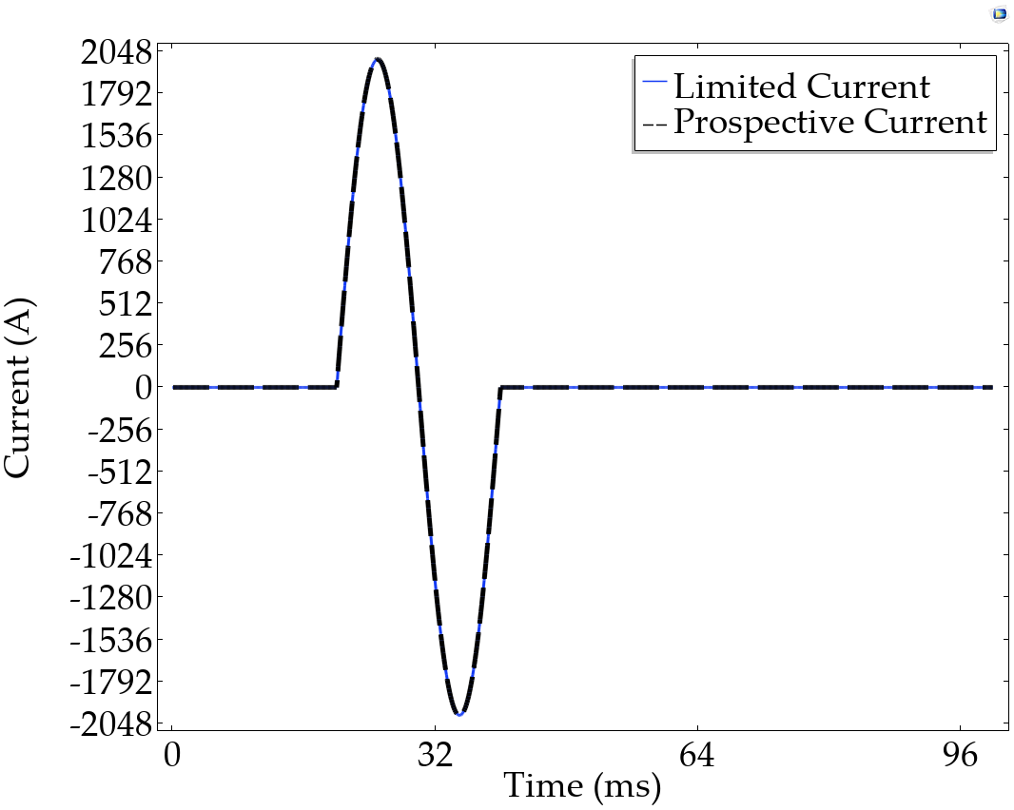
Test results: Lower n-value of the power-law
With a low n0, there is no current limitation!

Slide 12





Test results: Higher fault
$$V_{grid}=40 kV$$
$$E_{app}=200 V/m$$
$$I_{nom}=500 A$$
$$I_{c}=600 A$$
$$Ratio=10$$
$$I_{prosp}=5000 A$$
$$n_{0}=30$$
$$h_{silver}=2 μm$$
$$h_{Hast}=50 μm$$
We want to test the tape for higher faults…
Normally the fault ranges between 2 to 10 times the nominal load

Slide 13
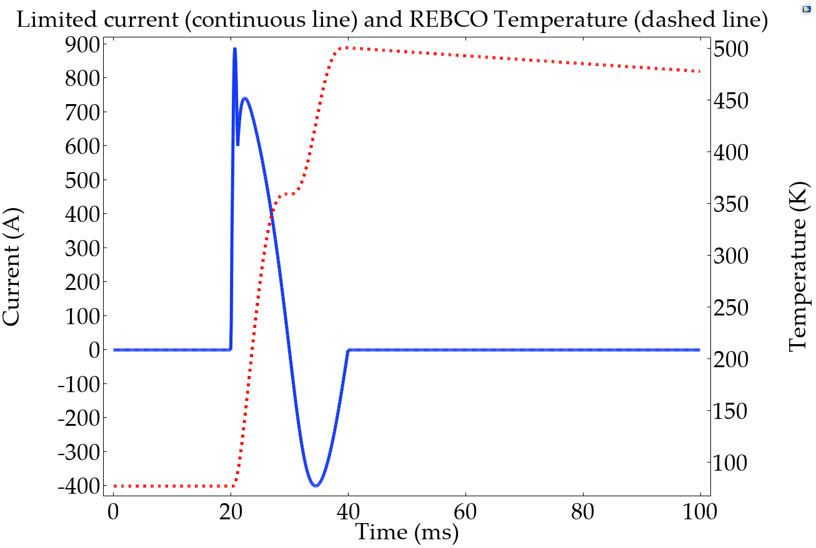
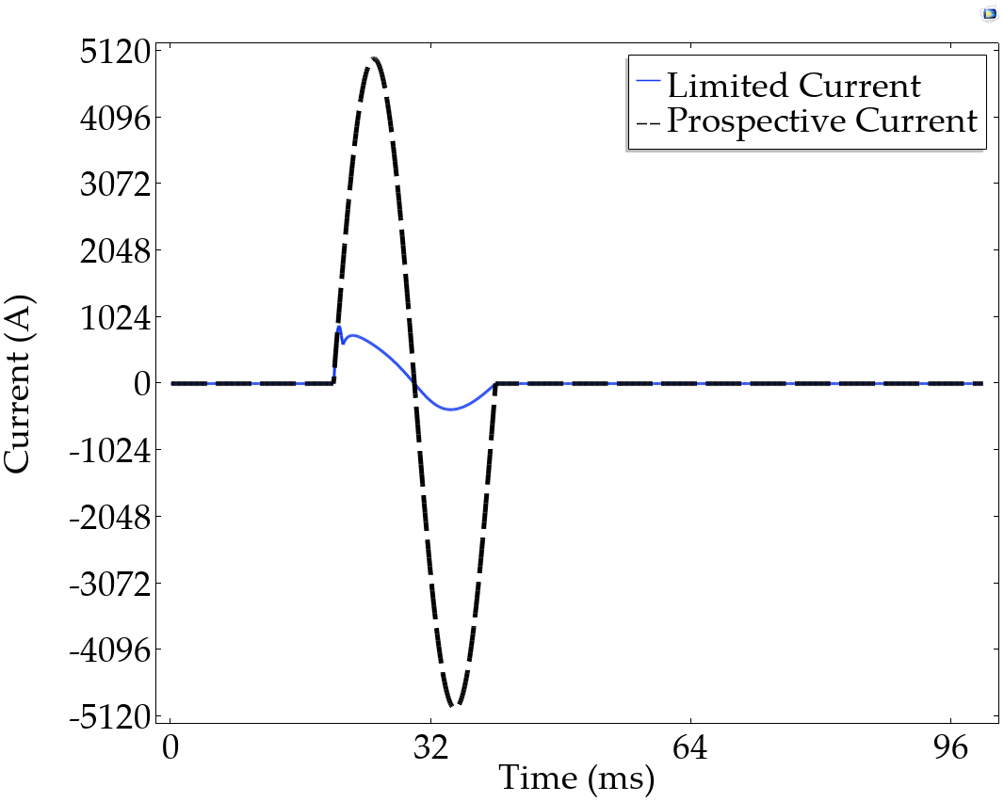
Test results: Higher fault
The current is limited and the non-linearity works well, but the tape is burnt (above 450 K)!

Slide 14


CONCLUSIONS:
The App enables students to quickly enter the world of superconductivity and simulation methods, understanding the role of superconductivity, and the design criteria of a simple but important device such as a SFCL.
Superconductivity in three minutes
HTS Modeling Website
What is Superconductivity?
Ask me in the chat or check
out this three minutes video!
Curious about the App and many other COMSOL models for superconducting applications?

Slide 15
Special Thanks!
We want to thank Ivar Kjelberg (CSEM SA) for having provided feedback and the executable App, and Sven Friedel (COMSOL Switzerland) for his collaboration;
Swiss Federal Office of Energy SFOE under grant agreement SI/500193-02;
REFERENCE
[1] Tixador P. Superconducting Fault Current Limiter
[2] Downed power lines, AP Photo/Steven Senne
[3] Plane, Scott County (MN) Sheriff's Office Press Releases
[4] Squirrel, Yellow Blue Tech

