Slide 1


Cooling Process Optimization Through A Three-phases Thermo-hydraulic Model
with COMSOL 5.5
J.-D. Wheeler¹, M. Pautard², T. Gilloux², P. Namy¹, C. Coulouarn²,
SIMTEC - (+33) 9 53 51 45 60
patrick.namy@simtecsolution.fr
jean-david.wheeler@simtecsolution.fr
christophe.coulouarn@thalesgroup.com
1. SIMTEC, 5 rue Félix Poulat, 38000 Grenoble, France
2. THALES

Slide 2
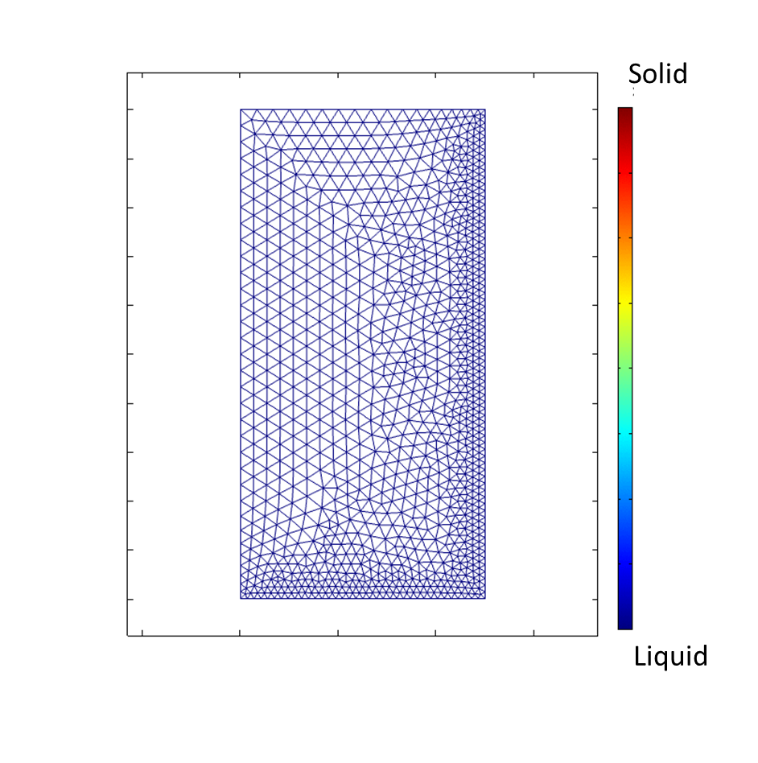
Outline
Device
Liquid-solid phase change
User interface
Conclusion

Slide 3






















Our team & Our clients
Numerical Modelling Consultants
8 Members all EngD + PhD
Extensive research background
Complex problems
Various fields of expertise
Successful Track Record:
Big international compagnies
Government laboratories
Involved in Research Consortia
EU funded projects (REEcover / SHARK)
PhD projects supervision.
Discover more about our successful modelling work with clients!
www.simtecsolution.fr

Slide 4
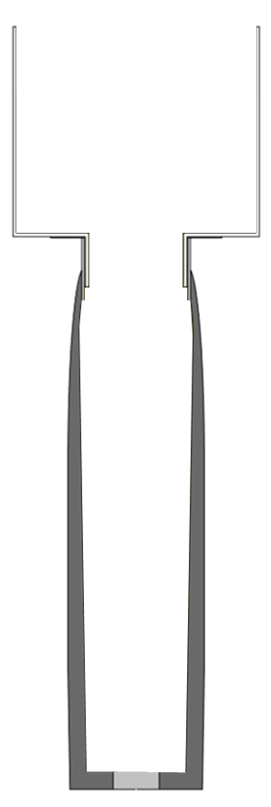

I. Device
Production of the new ammunition bodies with melt casting:
Good solidification quality
Minimum amount of experimental tests
Exploring more cooling methods
→ COMSOL numerical model and application!
Cooling fluid
Filling phase
Cooling phase
Filling phase
Cooling phase
Revolution axis
Cooling fluid
Cast iron ammunition body
Aluminium part
Cooling fluid
Plastic accessories
Explosive formulation
Ammunition body with the production accessories

Slide 5
II. Liquid solid phase change
Heat of transformation
Density variation
Heat flow due to convection
Zero motion in solids
Liquid phase
Solid phase

Slide 6
II. Liquid solid phase change
T_{fusion}
Heat dissipated
Temperature
Liquid phase
T_{fusion}
Transition
Solid phase
Solid phase
Transition
Liquid phase
Temperature
time
Modified heat capacity method

Slide 7

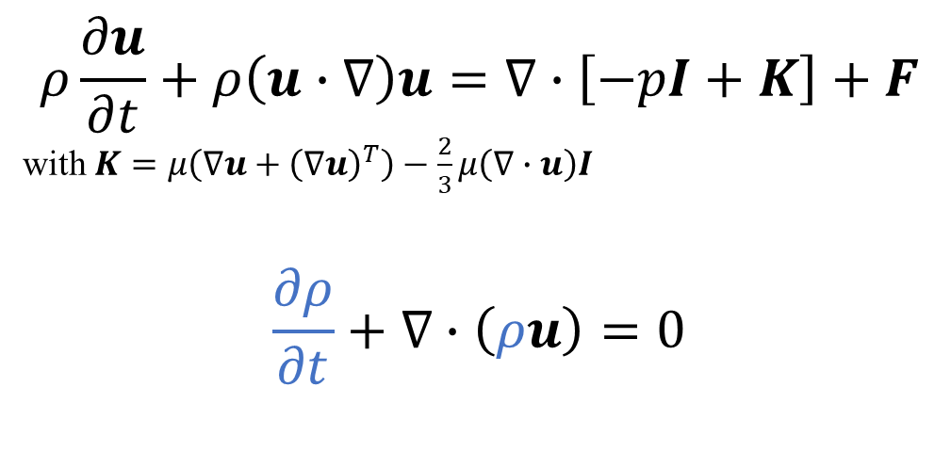
II. Liquid solid phase change
$$ρ\frac{∂u}{∂t}+ρ\left(u∙∇\right)u=∇∙\left[−pI+K\right]+F$$
with $K=μ\left(∇u+{\left(∇u\right)}^{T}\right)−\frac{2}{3}μ\left(∇∙u\right)I$
$$\frac{∂ρ}{∂t}+∇∙\left(ρu\right)=0$$
Motion conservation
$$ρ∇∙(u)=0$$
Mass conservation
accounting
for moderate density variations
Weakly compressible Navier-Stokes Equation

Slide 8
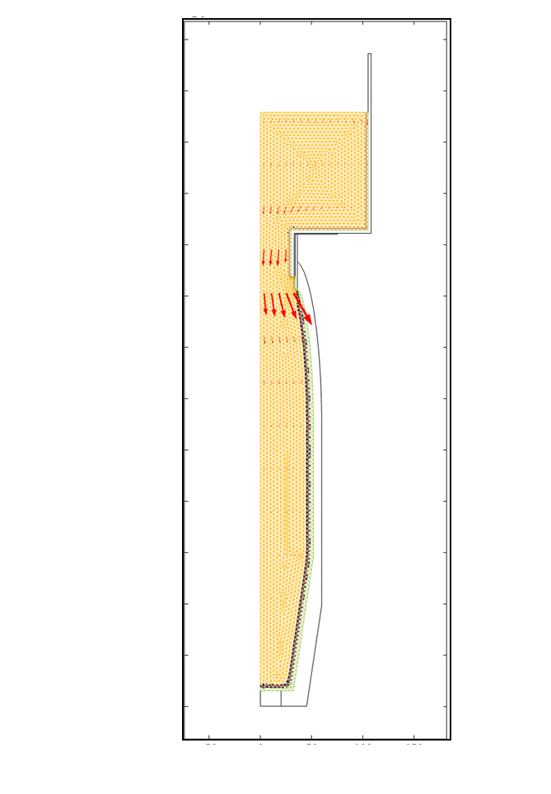
II. Liquid solid phase change
Heat of transformation
Density variation
Heat flow due to convection
Zero motion in solids
and also :
Parametrizable geometry
Optional process components
Parametrizable process options
…
Better targeted tests
Faster development
More reliable products
Process simulation result

Slide 9
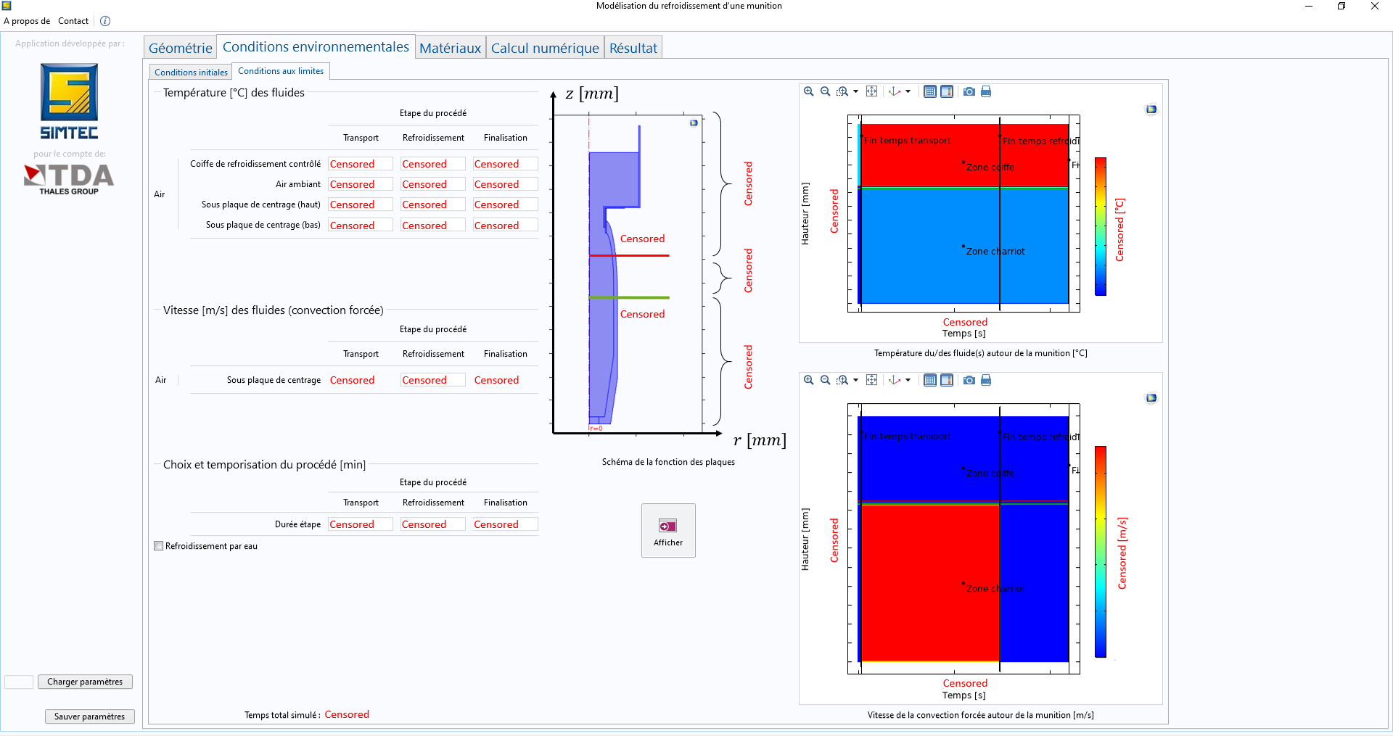
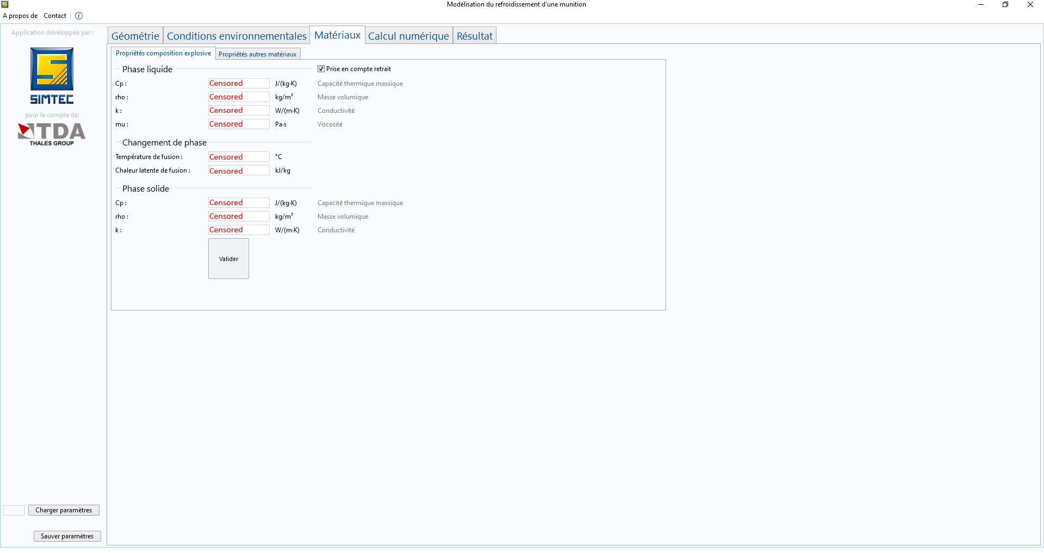
III. User interface

Slide 10
Conclusion
Complex
process
Revolution axis

Slide 11

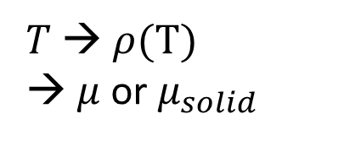



Conclusion
$$dr, dz$$
Moving mesh
Complex
equation system
Heat transfer
$$u$$
$$dr, dz$$
$$u_{free surface}$$
$T$ → $ρ(T)$
→ $μ$ or $μ_{solid}$
Navier-Stokes

Slide 12
Conclusion
Relevant
predictions
Process simulation result

Slide 13
Conclusion
User friendly
interface

Slide 14

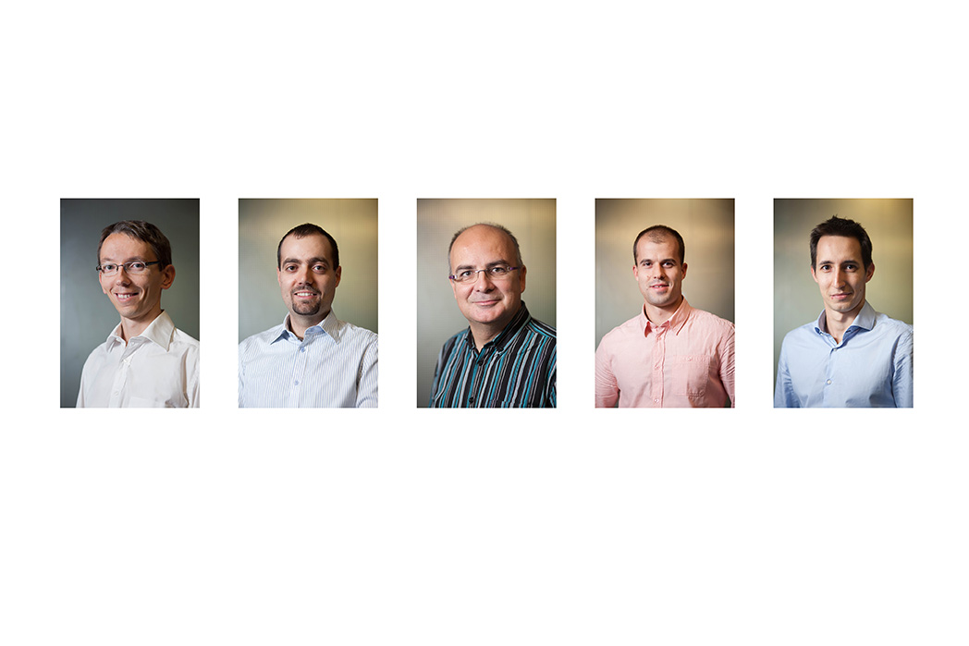





Thank you for your attention
Q&A?
SIMTEC
(+33) (0)9 53 51 45 60
Patrick.Namy@simtecsolution.fr

