Slide 1

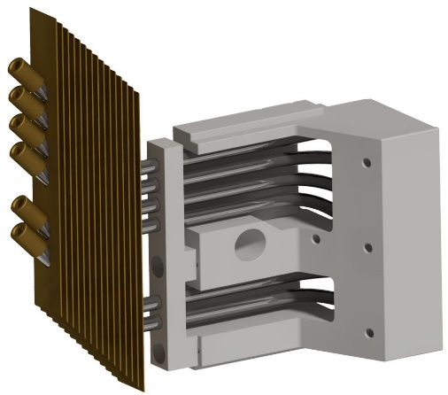
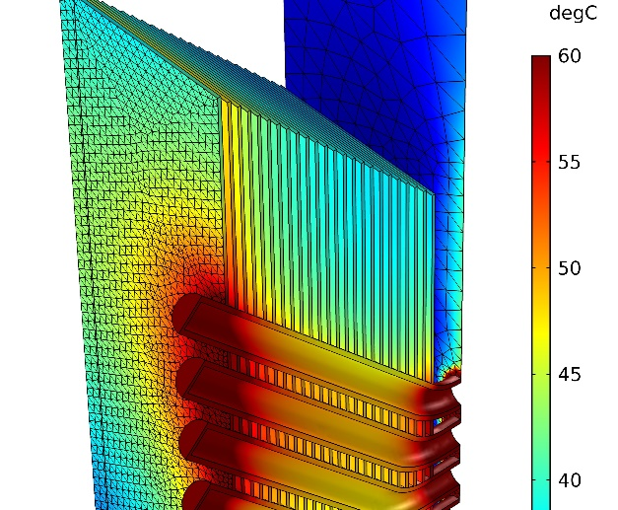
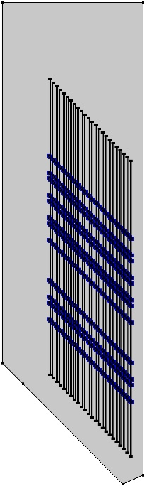
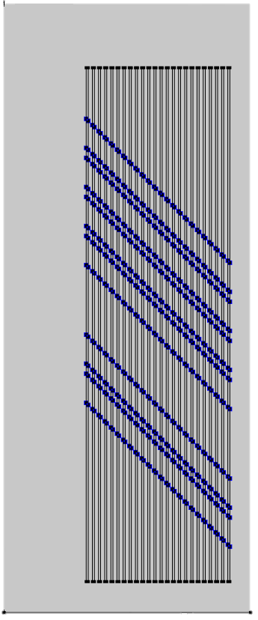
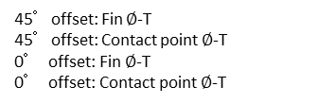
Simulative Development of a Convectively Cooled Heat
Sink for a Heat Pipe Mould-Element
V. Hüttemann¹, M. Lührmann¹, S. Kartelmeyer¹, L. Fromme¹, E. Moritzer², C. Jaroschek¹
1. Faculty of Engineering and Mathematics, Bielefeld University of Applied Sciences, Bielefeld, Germany
2. Faculty of Engineering, University of Paderborn, Paderborn, Germany
INTRODUCTION: The Bielefeld University of Applied Sciences has developed an injection mold in which a lateral slide is tempered by heat pipes instead of conventional cooling channels. The heat sink is to be convectively cooled by a fan which flows against a cooling fin package. In order to reduce the number of correction loops at the real heat sink, the optimum number and distance of the fins is investigated with COMSOL.
RESULTS: For evaluation, the average temperature of the 2D cooling fins and the contact points between the fins and the heatpipes are displayed over their distance to each other for the 0°and 45°configuration. In addition, the temperature distribution within the 3D contour with a cooling fin distance of 2 mm is used to compare the simulations.
45°offset: Fin $∅$-T
45°offset: Contact point $∅$-T
0° offset: Fin $∅$-T
0° offset: Contact point $∅$-T
Figure 1. Lateral slide with convective cooling
COMPUTATIONAL METHODS: The multiphysics coupling of nonisothermal flow is used and thus the laminar flow is combined with the heat transfer interface. To optimize simulation time a parametric sweep is used to change geometric variables. The power of the heatpipes is assumed to be constant and has been identified from experimental measurements of the heatpipes within the desired temperature range. The optimal parameters of the 2D simulations are evaluated in a 3D simulation afterwards.
Figure 3. Temperature evaluation
Flow region
Cooling fins
Heatpipe power
entrys
(Contact points)
Figure 4. 3D temperature distribution
CONCLUSIONS: The results show a minimum temperature level for a 2 mm distance and a slight variance in temperature between the 2D and 3D geometries. This may be caused by the strong simplifications. Moreover, no ideal laminar airflow can be created in reality. Nevertheless, a prototype with a cooling fin distance of 2 mm will be produced and tested on basis of the COMSOL simulations.
Figure 2. 45°and 0°offset geometry for a 2 mm fin-distance
Excerpt from the Proceedings of the 2020 COMSOL Conference

