Slide 1

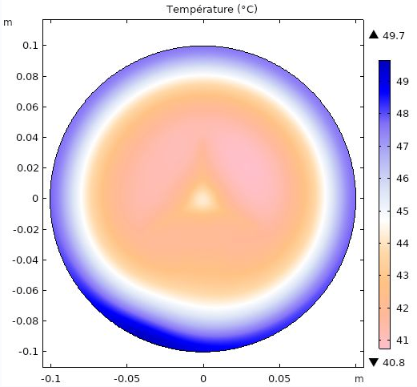
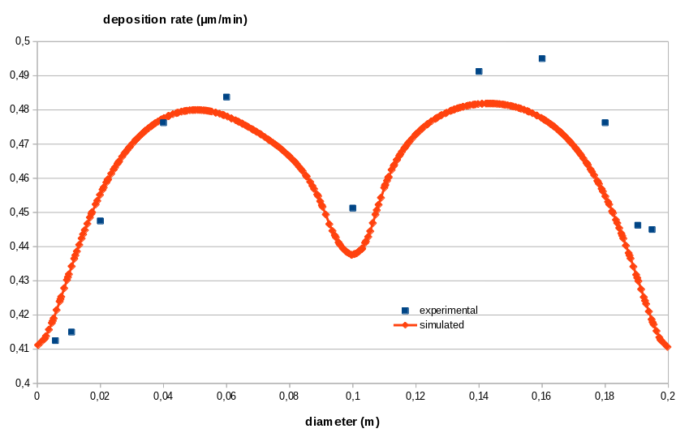
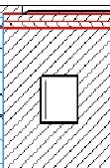
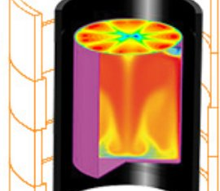
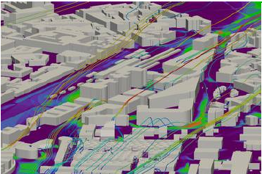
Thermal study of wafer cooling and heat resistance fitting
Rouch Hervé, Boilot Fabrice
INOPRO IAO, 38250, Villard de Lans
INTRODUCTION: Unwanted temperature gradients at the surface of a silicon wafer during a deposition process ocurr. A simple 3D model solving only for conductive heat transfer was built based on experimental data fitting in order to be able to later perform mechanical design optimisation. The goal is to improve the wafer’s surface thermal homogeneity.
RESULTS: Equivalent fitted thermal resistance parameters :
Mechanical contacts : 7,04.10⁻⁴ m².K/W
0,15mm gaps : 1,59.10⁻³ m².K/W
0,25mm gaps : 4,63.10⁻³ m².K/W
0,45mm gaps : 0,25 m².K/W
0,5mm gaps : 0,28 m².K/W
Incident process heat flux BC
3D mechanical design
Losses
Figure 3. Wafer
surface temperature
Convective cooling flux BC
Figure 1. Schematic diagram of the model
COMPUTATIONAL METHODS: Solving for and modeling every heat transfer mode in tight gaps (up to 150µm) and mechanical contacts is challenging.
Solving Navier-Stokes equations in the cooling system is computing intensive for experimental fitting with parametric sweeping.
Thus the model was geometrically and physically simplified : every type of mechanical gap was replaced by a coincidence and we only solved for conductive heat transfer. Every type of gap and contact was assigned a surface thermal resistance parameter.
The coupling between fluid mechanics and heat transfer was neglected and a convective heat flux was assumed with constant convective heat transfer coefficient and a linearly varying temperature between inlet and outlet of the cooling loop with in and out temperature based on experimental data.
A DOE method was used to find the 5 thermal resistance parameters : second order and more interactions between parameters were neglected and the influence of each one of the 5 parameters was investigated within several level ranges using parametric sweeps. The values in m².K/W have to be physically coherent between themselves and meaningful.
Figure 5. Experimental (blue) and simulated (orange) deposition rate
CONCLUSIONS: A simple 3D model of a deposition device was built. A linear law was fitted with respect to temperature for the deposition rate. It shows good agreement with experimental data and will allow a geometrical design optimisation in order to improve the wafer surface deposition rate homogeneity.
Heat transfer module has been used to solve heat conduction in solids and through the mechanical contacts.
For more than 20 years, INOPRO IAO provides modelings and studies for design assistance :
R&D : Design simulation models
Industries : Optimize efficiency and yields
Construction and urban planning Anticipate airflow comfort
Environnement & energy : Specify equipments
Wafer surface (green)
Mechanical contacts (red)
Cooling loop with fixed temperature depending on position and constant heat transfer coefficient
Mechanical gaps (blue)
Figure 2. Partial cut view of 3D model geometry
Excerpt from the Proceedings of the 2020 COMSOL Conference
Notes:
<number>

