Slide 1
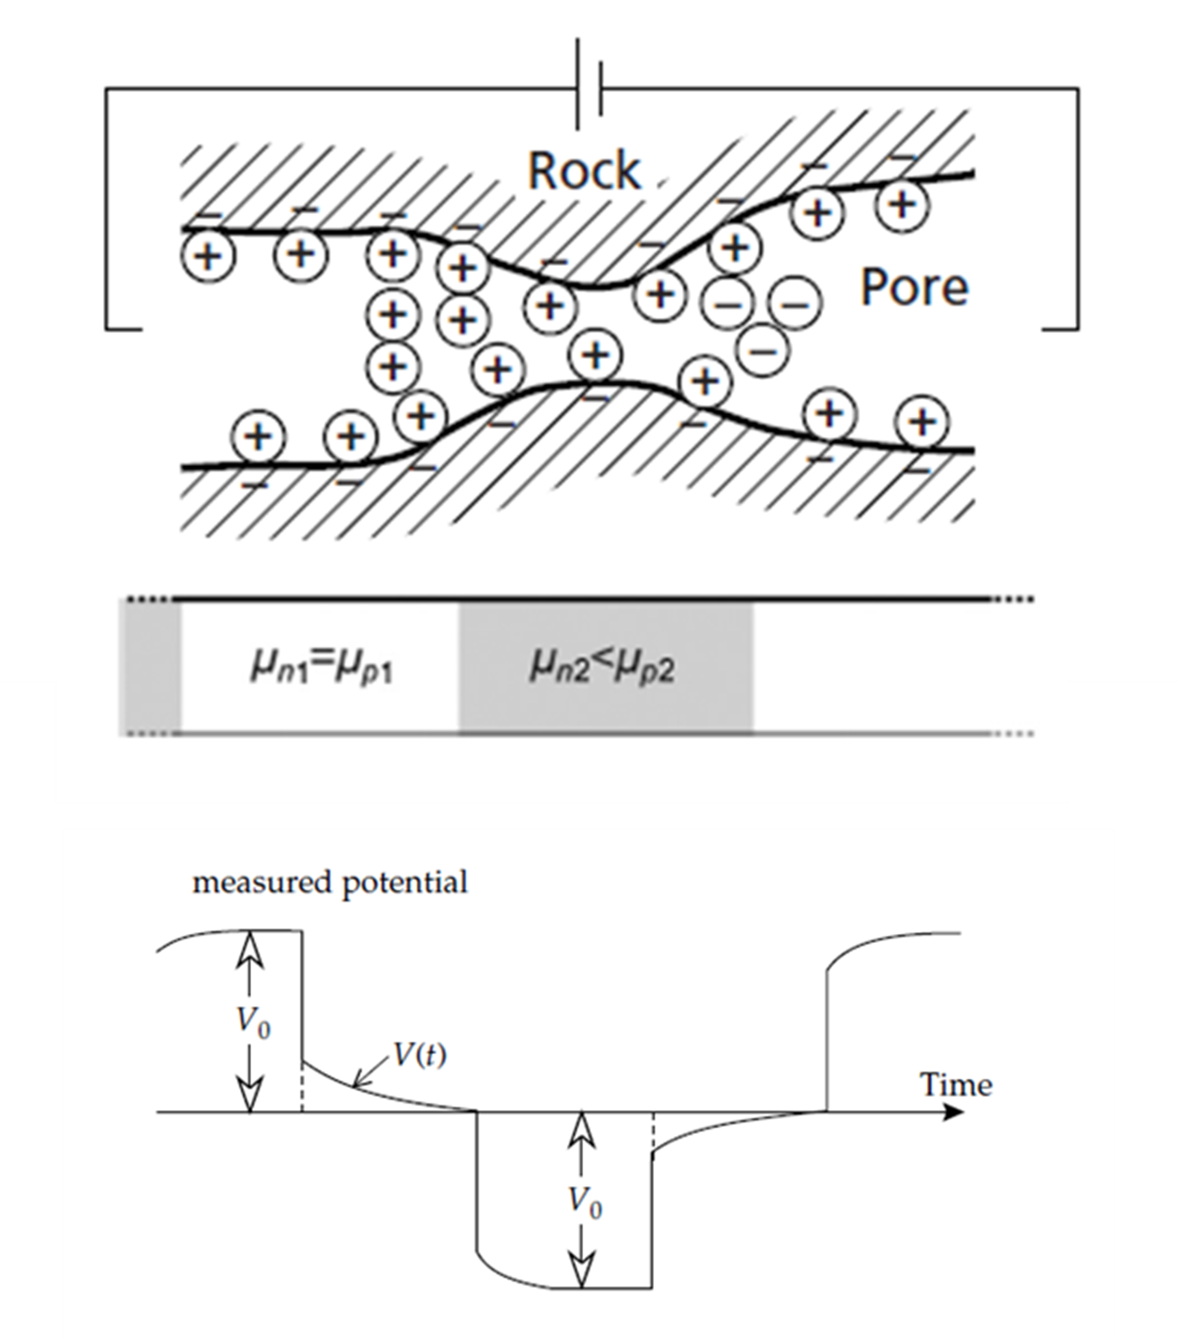
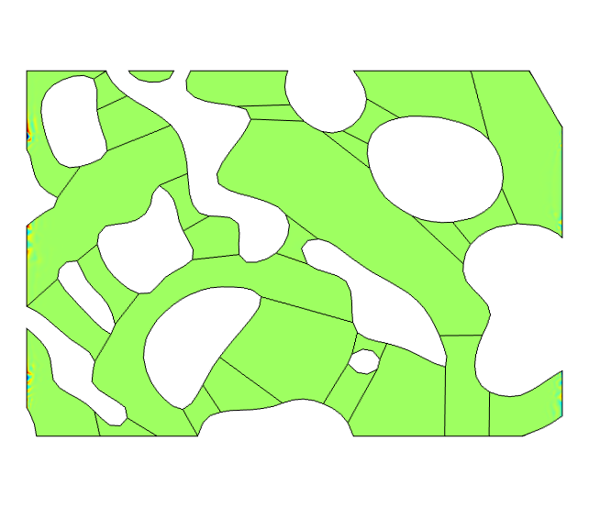
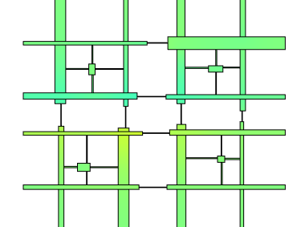
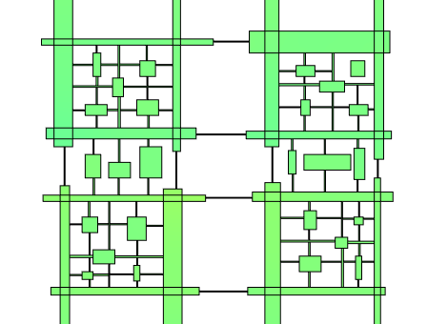




Numerical Modelling of the Membrane Polarization Effect for
Realistic Shapes of the Pore Space
N. Resay¹, A. Hördt²
Institute for Geophysics and Extraterrestrial Physics, Braunschweig University of Technology, Braunschweig, Germany
INTRODUCTION: The Spectral Induced Polarization (SIP) is a promising electrical method, which can be used to predict the saturated hydraulic conductivity of consolidated and unconsolidated porous media. It is important to investigate how the SIP response is affected by the shape and distribution of the pore sizes.
One type of polarization called membrane polarization occurs when pore space narrows to within several boundary layer thicknesses, where upon application of an electrical potential, an ion-selective membrane is created causing surplus and deficiency of both cations and anions at each ends of pore throat. Upon removal of electrical potential, discharging is measured in time or frequency domain (Figure 1).
COMPUTATIONAL METHODS: The governing equations for charge transport in pore space according to Marshall and Madden (1959) are the continuity equations for the concentrations of cations and anions and Poisson’s equation for the potential U (Equations 1-3). These partial differential equations (PDEs) are coupled and solved using equation-based modeling in COMSOL Multiphysics to numerically model more realistic pore structures.
$iωc_{p}=D_{p}∆c_{p}+∇\left[μ_{p}c_{p0}∇u\right]$ (1)
$iωc_{n}=D_{n}∆c_{n}+∇\left[μ_{n}c_{n0}∇u\right]$ (2)
$∆u=\frac{F}{ε}\left(c_{n}−c_{p}\right)$ (3)
$c_{p}$, $c_{n}$: cation and anion concentrations,
$D_{p}$, $D_{n}$: diffusion coefficients,
$μ_{p}$, $μ_{n}$: ion mobilities,
𝑢: electrical potential,
$F$: Faraday’s constant,
$ε$: permittivity.
Figure 1. Membrane polarization effect.
RESULTS: The pore size distribution, porosity, and the specific surface area of a specific sandstone sample is measured by mercury porosimetry. The membrane polarization effect is numerically modelled for realistic shapes of pore space (Figures 2,3,5) correspond to the sandstone sample and their spectral behavior is compared with those of laboratory results.
Figure 5. Realistic pore space geometry.
Figure 2. Network 2,
φ=21.5%, $S_{pore}=$3.36 $1/{µm}$
Figure 3. Network 3,
φ=21.5%, $S_{pore}=$3.36 $1/{µm}$
Figure 6. Spectral behavior of the realistic pore space.
CONCLUSIONS: With COMSOL Multiphysics the effect of the shape and distribution of the pore sizes on the membrane polarization effect could be investigated.
A spectral response prediction or a comparison between the numerically modelled and in laboratory measured membrane polarization is possible.
f [Hz]
REFERENCES:
Marshall, D.J. and Madden, Induced polarization, a study of its causes. Geophysics, Vol. 24, No. 4; T.K. 1959.
Bücker, M. And Hördt, A. Analytical modelling of membrane polarization with explicit parametrization of pore radii and the electrical double layer. Geophysical Journal International, P. 804-813; 2013.
Figure 4. Spectral response of the modelled Networks 2&3 compared to the Sandstone sample BE1.
Excerpt from the Proceedings of the 2020 COMSOL Conference

