Slide 1
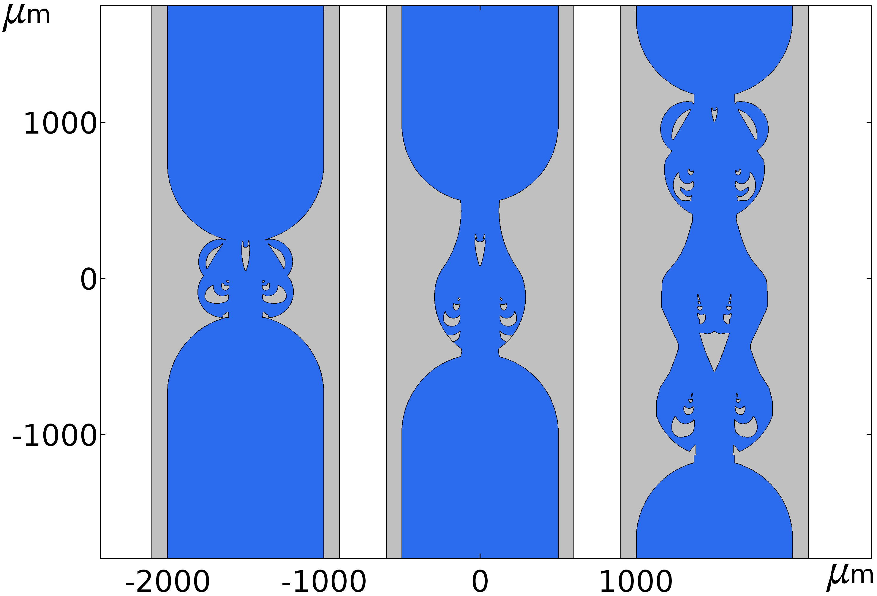



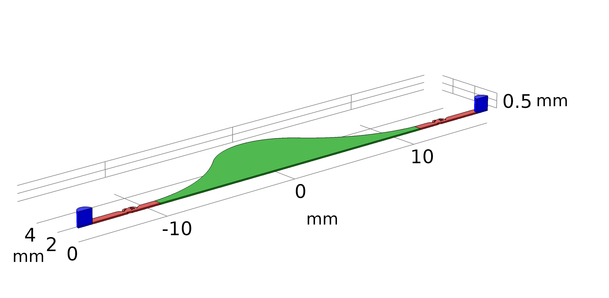


Three-dimensional time resolved fluid mechanics simulation of an
EWOD-driven micropump
S. Bohm^{1,2}, L. Dittrich², E. Runge¹
¹Group “Theoretical Physics I”, Technische Universität Ilmenau, Germany
²5microns GmbH, Ilmenau, Germany

Slide 2
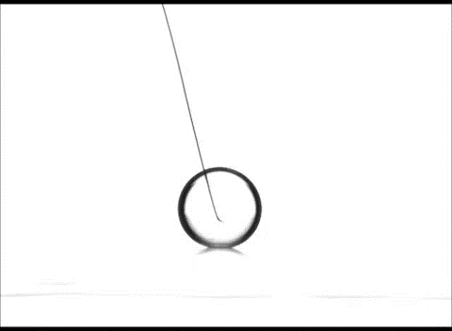
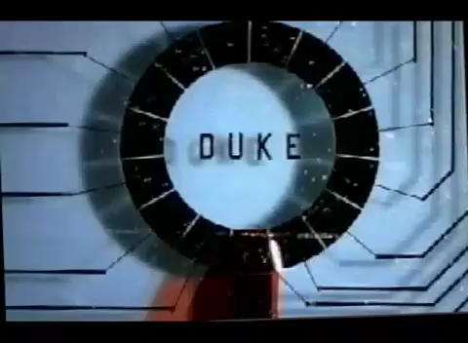
Fundamentals – Electrowetting on dielectrics (EWOD)
„Classical“ EWOD experiment:
droplet on superhydrophobic surface
[1] GVD Corporation, http://www.gvdcorp.com/about-gvd
Microfluidic application:
Moving of droplets on hydrophobic surfaces
[2] Duke Microfluidics Lab, http://microfluidics.ee.duke.edu/
Adjustable lenses, optical switches, displays, micropumps … and many more
2

Slide 3
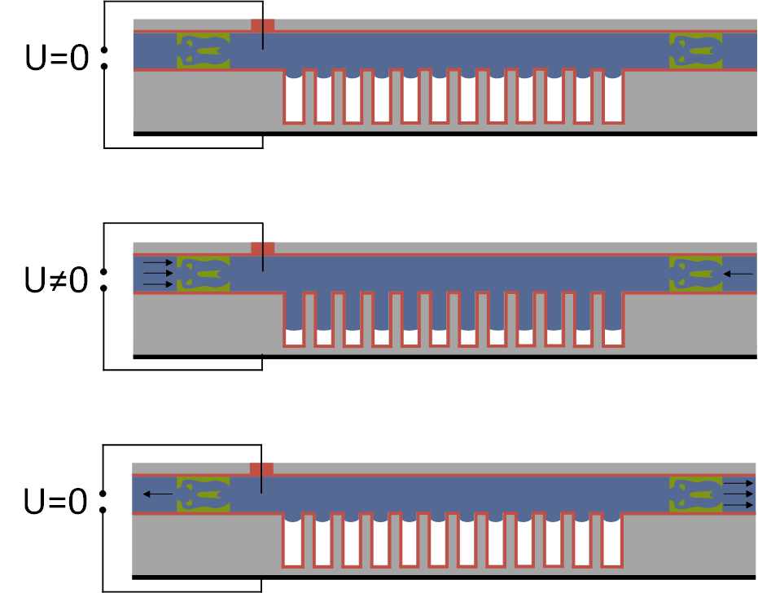
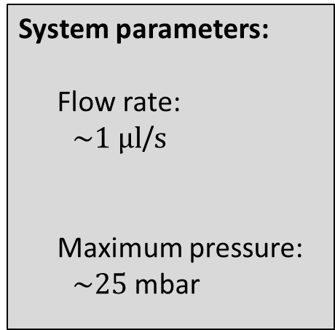
Motivation and objective
Idea:
With the help of the EWOD-effect and the use of topological optimized Tesla-valves, a pump can be manufactured that does not require any moving components
[3] L. Dittrich et. al, DE Pat., 112011104467B4
Initial state
System parameters:
  Flow rate:
  $\sim 1 µl$/$s$
  Maximum pressure:
  $\sim 25$mbar
Liquid-air interfaces are deflected and the fluid volume inside the cavities is increased
Initial state is restored
Liquid
Dielectrics
Passive valves
Resulting volume stroke is rectified using passive Tesla-valves
3

Slide 4
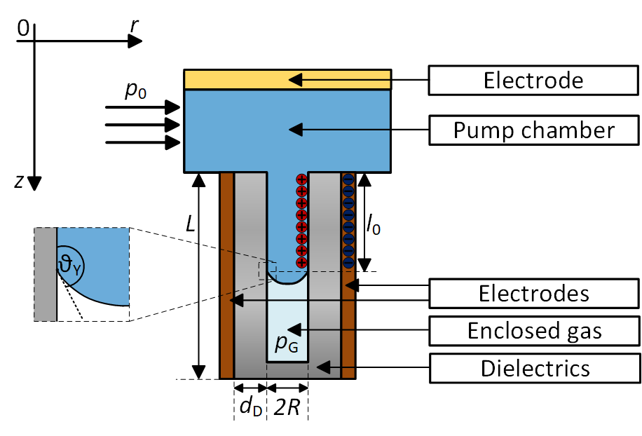



Analytical model of the multiphase flow inside a single microcavity
Assumptions:
Cylindrical shaped cavities
Liquid is incompressible
The deflection of the interface is regarded as quasi-static and is assumed to follow the external applied voltage instantaneously.
Young-Lippmann eq.:
$$\cos{θ\left(U\right)=\cos{θ_{Y}+\frac{1}{2}\frac{ε_{0}ε_{r}U^{2}}{dγ_{lv}}}}$$
$p_{in}\left(l(t),U\left(t\right)\right)=p_{L}(U=0)−p_{L}\left(U\left(t\right)\right)+p_{G}\left(l\left(t\right)\right)−p_{0}$
$l\left(t\right)=L\left(l_{o}\left(U=0\right)−\frac{V_{res}\left(t\right)}{N⋅A} \right)$
$l_{0}\left(U\left(t\right)\right)=L\left(1−\frac{p_{at}}{p_{0}+p_{L}\left(U\left(t\right)\right)}\right)$
$p_{L}\left(U\left(t\right)\right)=\frac{2γ_{lv}\cos{θ\left(U\left(t\right)\right)}}{R}$
$V_{res}(t)=\int_{0}^{t}{\left(\int{u\left(t\right)⋅ndA_{1}+\int{u\left(t\right)⋅ndA_{2}}}\right)dt}$
[4] Matsumoto, H., Colgate, J., Preliminary investigation of micropumping based on electrical control of interfacial tension (1990)
4

Slide 5
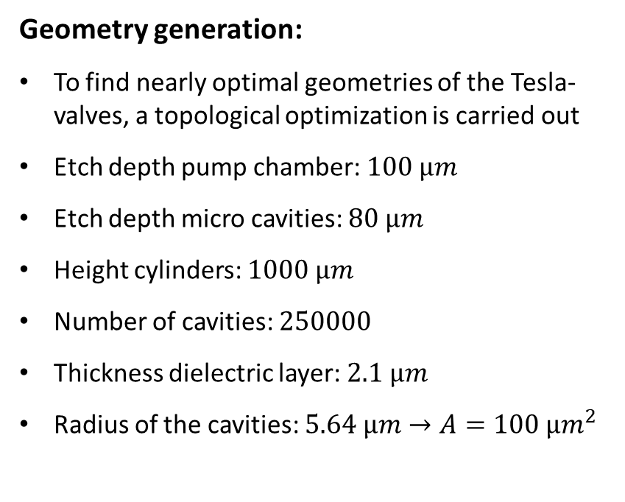
Simulation – Geometry
Geometry generation:
To find nearly optimal geometries of the Tesla-valves, a topological optimization is carried out
Etch depth pump chamber: $100 µm$
Etch depth micro cavities: $80 µm$
Height cylinders: $1000 µm$
Number of cavities: $250000$
Thickness dielectric layer: $2.1 µm$
Radius of the cavities: $5.64 µm→A=100 µm^{2}$
5

Slide 6
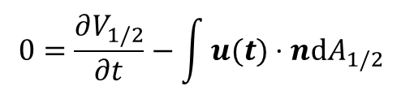
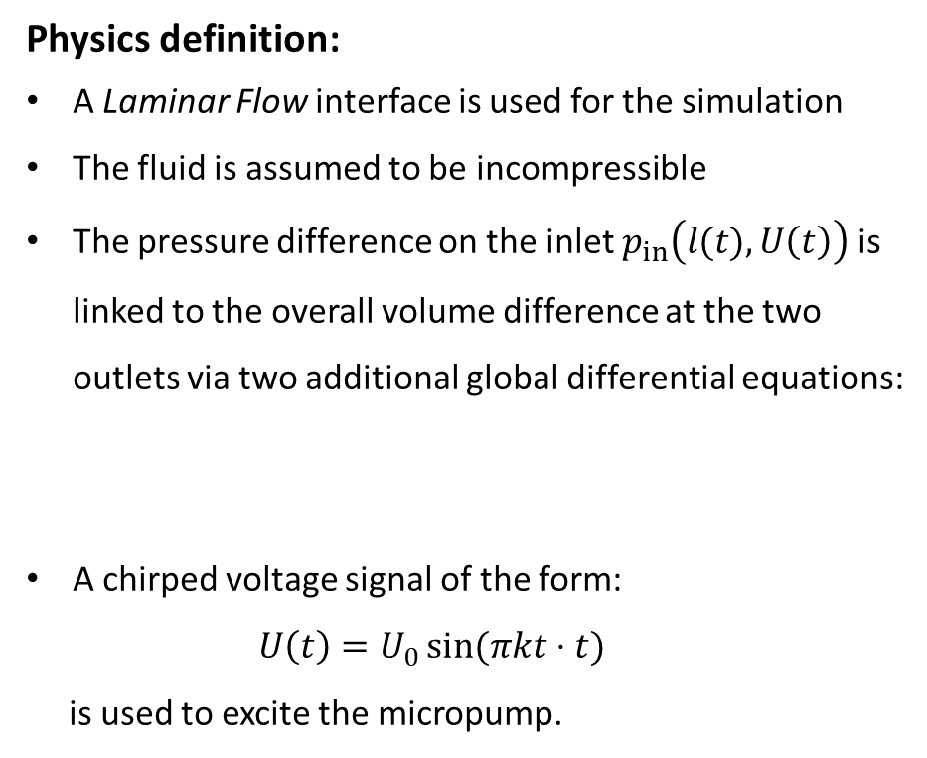
Simulation – Physics
Physics definition:
A Laminar Flow interface is used for the simulation
The fluid is assumed to be incompressible
The pressure difference on the inlet $p_{in}\left(l(t),U\left(t\right)\right)$ is linked to the overall volume difference at the two outlets via two additional global differential equations:
A chirped voltage signal of the form:
$U\left(t\right)=U_{0}\sin{(πkt⋅t)}$
is used to excite the micropump.
$$0=\frac{∂V_{1/2}}{∂t}−\int{u(t)⋅ndA_{1/2}}$$
6

Slide 7
Analysis of the results
1. Step:
  During the simulation, the relevant parameters are evaluated using global probes and accumulated in a single probe table.
  The results are exported, and the final evaluation is carried out in Matlab.
  Simulations are done on the Massively Parallel Compute Cluster (MaPaCC) of the Technische Universität Ilmenau:
    2x Intel® Xeon® CPU E5-2650 v4 at 2.20 GHz
    2 sockets with 12 cores in total
    simulation takes between 72 and 150 hours
    requires on average about 6 GB of memory
7

Slide 8
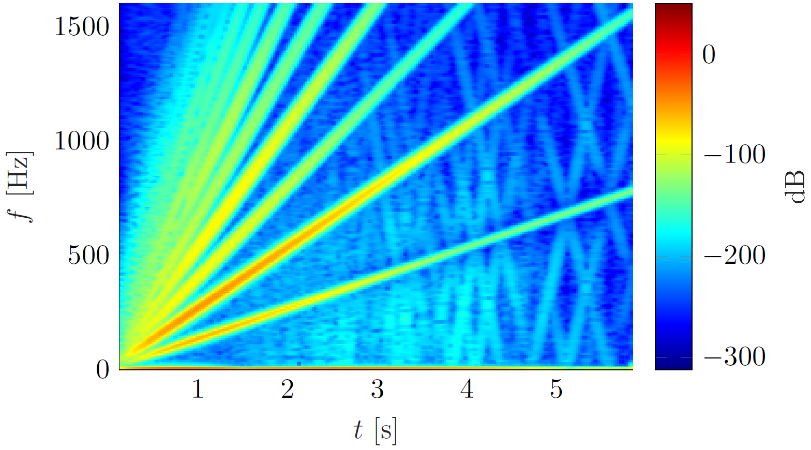
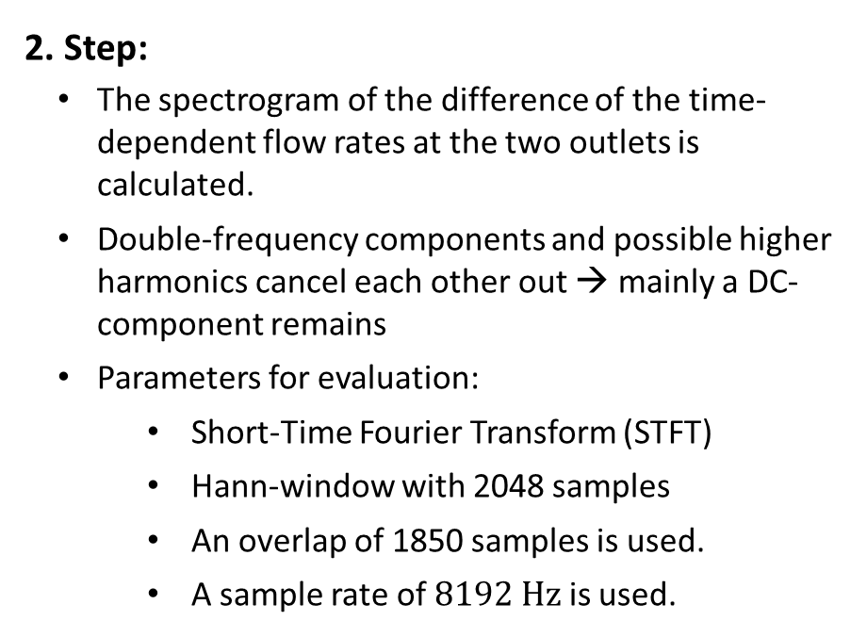
Analysis of the results
2. Step:
  The spectrogram of the difference of the time-dependent flow rates at the two outlets is calculated.
  Double-frequency components and possible higher harmonics cancel each other out → mainly a DC-component remains
  Parameters for evaluation:
    Short-Time Fourier Transform (STFT)
    Hann-window with 2048 samples
    An overlap of 1850 samples is used.
    A sample rate of $8192 Hz$ is used.
7

Slide 9
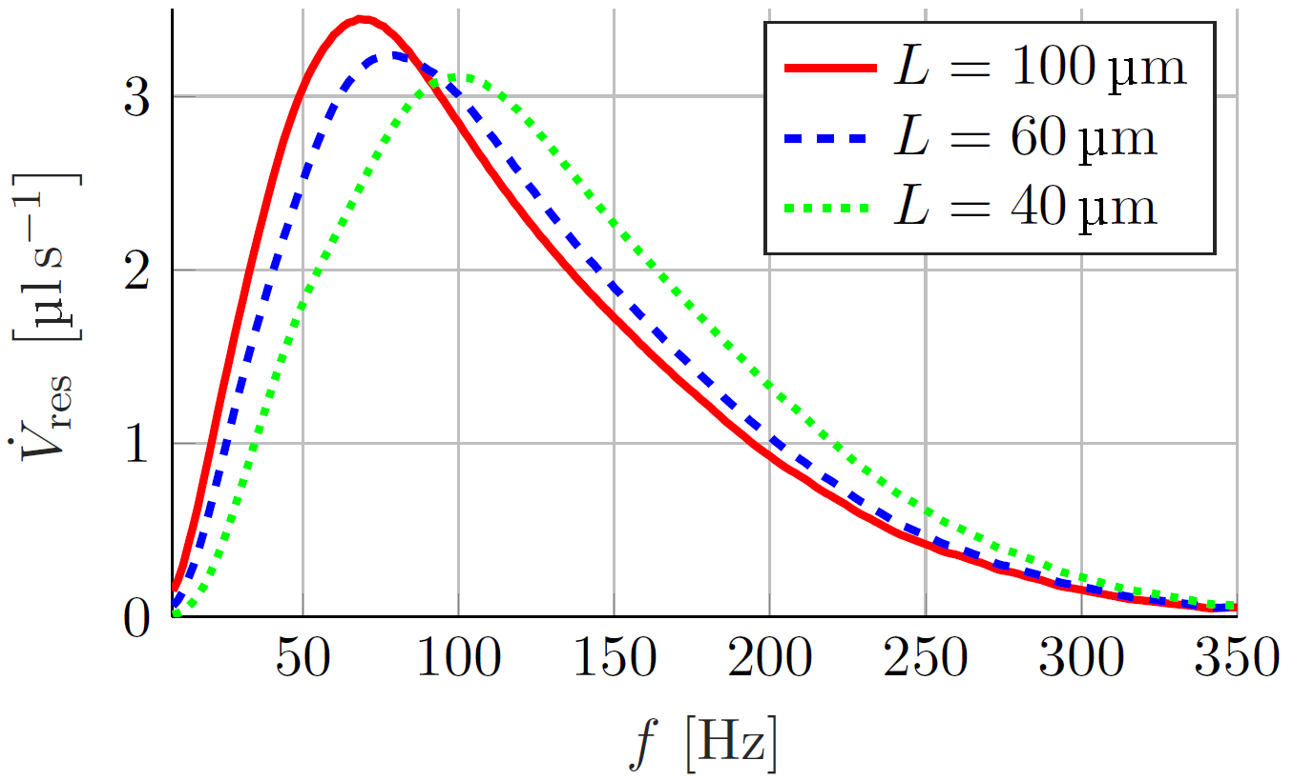
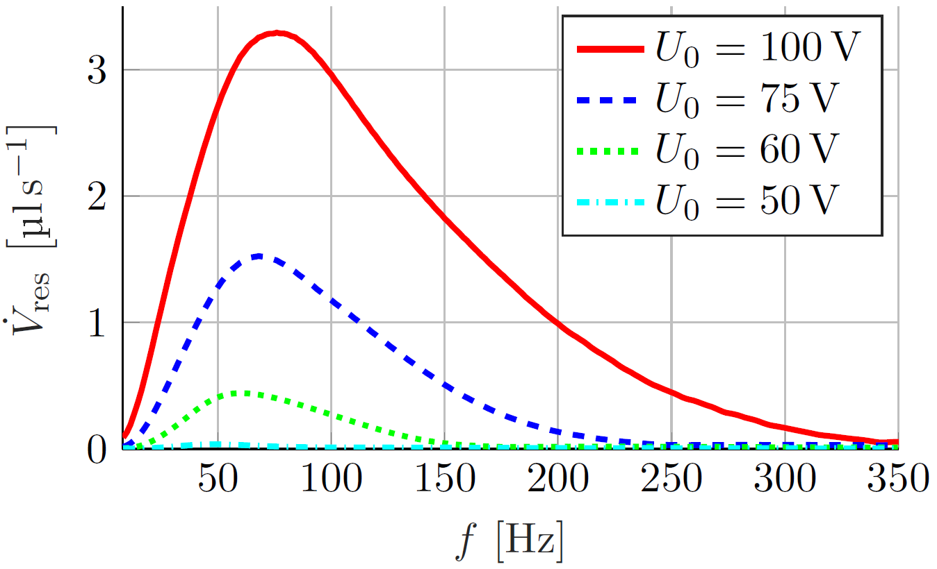
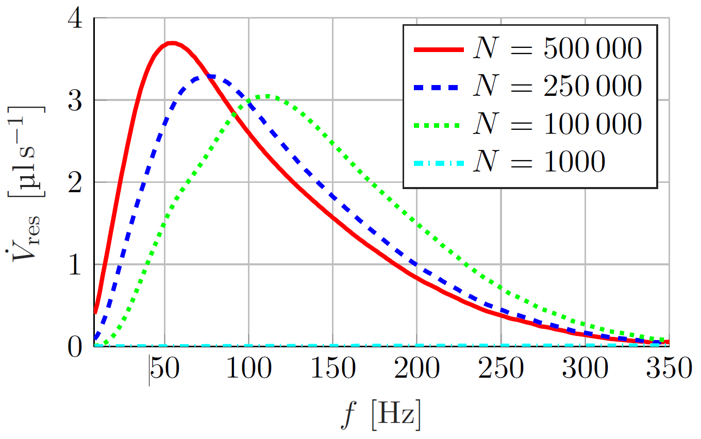
Parametric studies
Dependence of the frequency-dependent flowrate on the etch depth of the microcavities.
Dependence of the frequency-dependent flowrate on the amplitude of the applied voltage curve.
Dependence of the frequency-dependent flowrate on the total number of microcavities.
Dependence of the frequency-dependent flowrate on the etch depth of the microcavities.
Dependence of the frequency-dependent flowrate on the amplitude of the applied voltage curve.
Dependence of the frequency-dependent flowrate on the total number of microcavities.
High voltages: quadratic dependence of the contact angle on the voltage amplitude becomes visible
Low voltages: the flow rate vanishes due to the low diodicity of the Tesla-vales
Maximum flow rate decreases due the decreased maximum deflection of the interface
Resonance frequency is increased due to the increased stiffness of the cavities
High number of cavities: weak dependence of the resulting flow rate
Low number of cavities: the flow rate vanishes due to the limited volume stroke
8

Slide 10
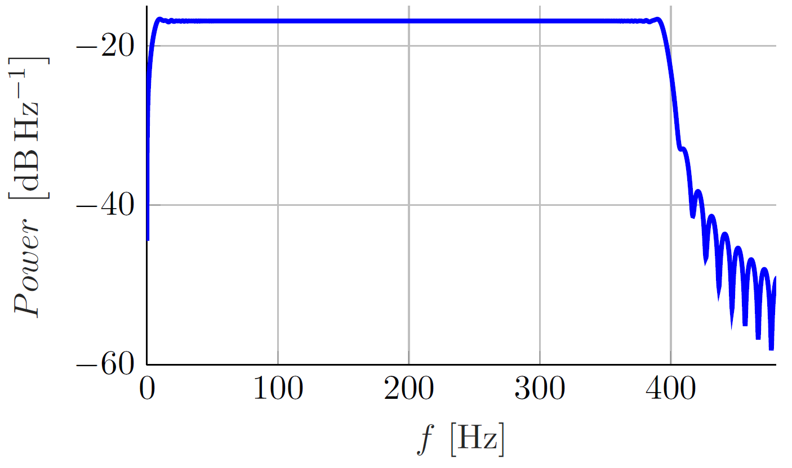
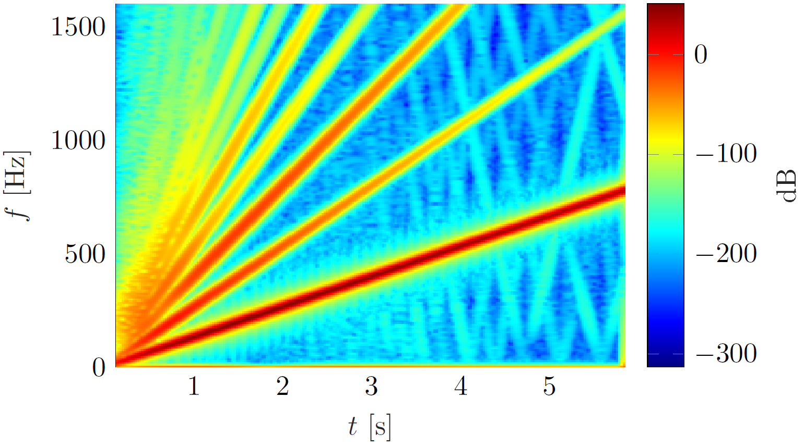
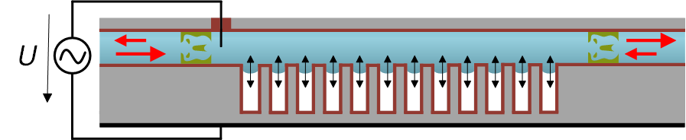
Summary
9

Slide 11
Thank you for your attention!
10

