Slide 1



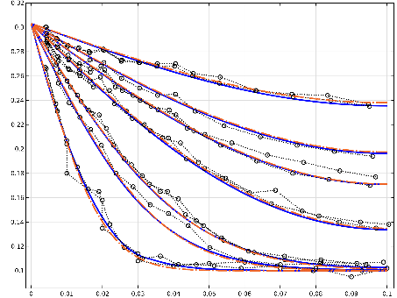
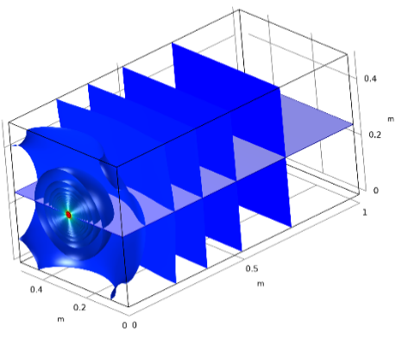
An alternative equation-based model in COMSOL Multiphysics® for bentonite re-saturation
M. Kröhn¹, L. Fromme²
¹GRS gGmbH, Brunswick, Germany
²Faculty of Engineering and Mathematics, Bielefeld University of Applied Sciences, Bielefeld, Germany
BACKGROUND
Bentonite is a versatile clayey material that is, among other things, envisaged in designs for radioactive waste repositories as a geotechnical protection of the waste canisters against groundwater. The water uptake dynamics of bentonite are therefore of considerable interest.
Following a completely different approach for the hydraulics of the re-saturation, an alternative concept was developed, with the experimental 1D code VIPER, including a new balance equation and backed up by laboratory experiments.
GOALS
- enhance the inherent limited range of possible applications of code VIPER by transferring the underlying differential equations to COMSOL
- validate the new COMSOL model by means of
* code comparison with VIPER
* matching experimental data
* checking plausibility with 2D- and 3D-models
RESULTS
code comparison and matching experimental data
3D-model for demonstration
Figure 2. Numerical results from the 1D COMSOL-model (blue), experimental results (black), numerical results from VIPER (dash-dotted orange )
COMPUTATIONAL METHODS
Balance equation
is a function of → non-linear PDE
Realization in COMSOL
Equation-based model - coefficient form of the PDE node - using the previous solution operator
partial density of the vapour
vapour saturation density
dry density of the bentonite
Water content at full saturation
Apparent vapour diffusion coefficient
time
Figure 3. Calculated water content distribution in a 3D-rod with pointwise injection after 75 years
CONCLUSIONS AND OUTLOOK
- Successful transfer of the mathematical model for isothermal bentonite re-saturation to COMSOL
- First applications of this concept to higher dimensional water uptake problems
- Further work envisaged * refinement of isothermal formulations * advancing to non-isothermal problems
ACKNOWLEDGEMENTS
Funding of this work under contract no. 02 E 11647 by the German Federal Ministry for Economic Affairs and Energy (BMWi) is gratefully acknowledged.
Experimental set-up
Lab test with a compacted bentonite sample; wetting from one side with water
compacted bentonite
liner
water
REFERENCES:
COMSOL, Mechanical Modeling of Bentonite Clay. Application library, Application ID: 80101, as of September 2020, https://www.comsol.com/model/mechanical-modeling-of-bentonite-clay-80101
Frei, W., Using the Previous Solution Operator in Transient Modeling. COMSOL Blog, 2015, https://www.comsol.com/blogs/using-the-previous-solution-operator-in-transient-modeling/
Figure 1. Sketch of the test principle
Excerpt from the Proceedings of the 2020 COMSOL Conference

