Slide 1



Challenges of DC insulating systems for airborne applications
D. Anagnostou, C. Willich, J. Kallo
COMSOL 2020 Europe

Slide 2

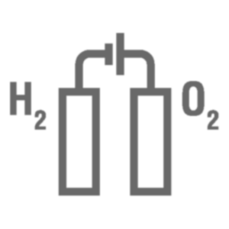

Electrification of Aircrafts
Aircraft electrification is progressing rapidly
Application in propulsion & subsystems (e.g. hydraulic, pneumatic)
Increased power demand leads to higher voltages of the powertrain.
Voltage level predicted to reach 3 kV DC in the near future

Slide 3
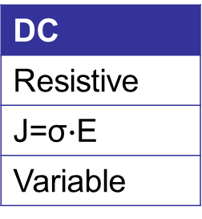
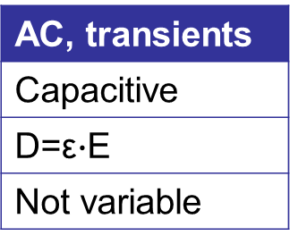
Electric Field Distribution
|E| has different characteristics for AC and DC voltages
Variable operating conditions of the system:
mixture of AC and DC field distribution or shift from one to the other
fast and big temperature variations
AC, transients
Capacitive
D=ε$∙$E
Not variable
DC
Resistive
J=σ$∙$E
Variable

Slide 4
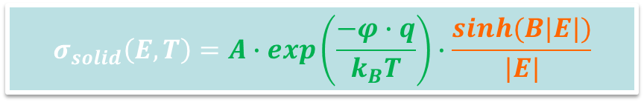
Electrical Conductivity of Insulators
$$σ_{solid}\left(E,T\right)=A∙exp\left(\frac{−φ∙q}{k_{B}T}\right)∙\frac{sinh⁡(B|E|)}{|E|}$$
Depends on:
Temperature
Pollutants – large molecules/particles
Radioactivity
High energy particles
Electric field strength
σ_{air} ≈ 10⁻¹⁴…10⁻¹⁵ S/m
[1]
Temperature
Dependence
El. Field
Dependence
[1]. Qin, S. & Boggs, S., “Design considerations for high voltage DC components“, IEEE Electrical Insulation Magazine, 2012, 28, 36-44

Slide 5
Simulation Model
For the simulation was used:
Electric Currents (ec) interface from AC/DC Module
Heat Transfer in Solids (ht) interface from Heat Transfer Module
A Time Dependent study
The model parameters were:
R_{duct} =8,45mm
R_{cond} =5,25mm
Thickness_{ins}=1,2 mm
Voltage = 1000V DC
Shield
Duct
Air
Cu
Insulator

Slide 6
Electric Field Dependence
The |E| is low
→ does not affect the value
of σ_{ins}
The electrical conductivity of a solid insulator becomes a F(T)
NFD: No Field Dependence

Slide 7
Thermal Gradient vs |E| Distribution
Small thermal gradient across insulator leads to:
linear change of field strength within the insulator
more uniform field distribution within the insulator
* A: 0,98eV activation energy, B: 0,56eV activation energy
Temperature difference between the inner and the outer side of the insulator of a shielded cable

Slide 8
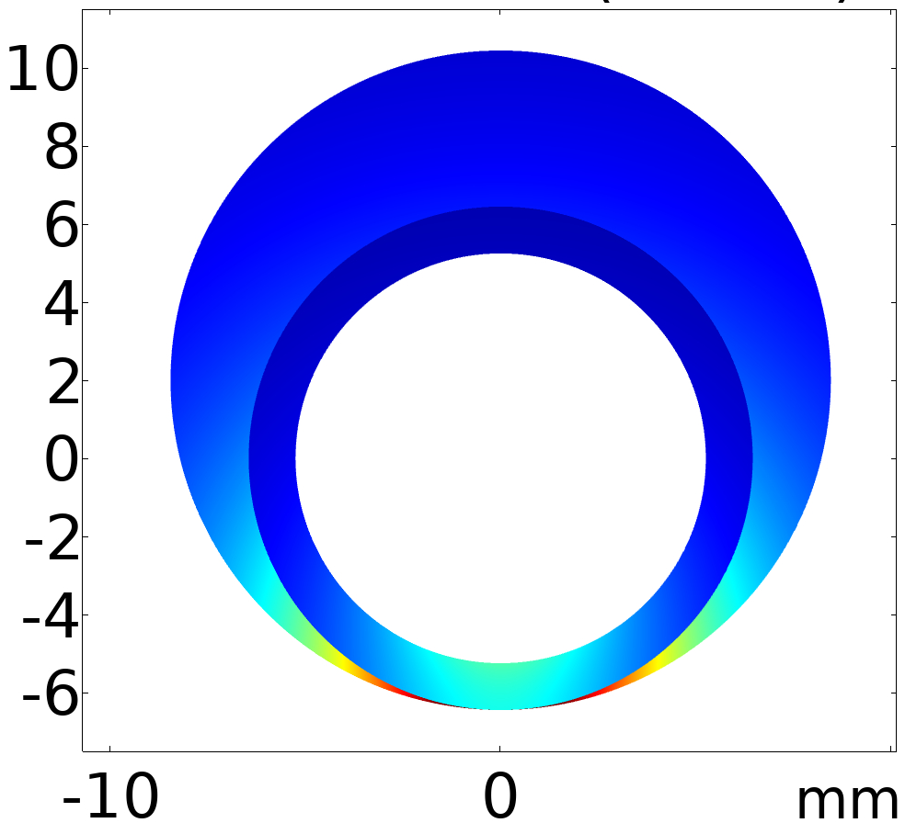
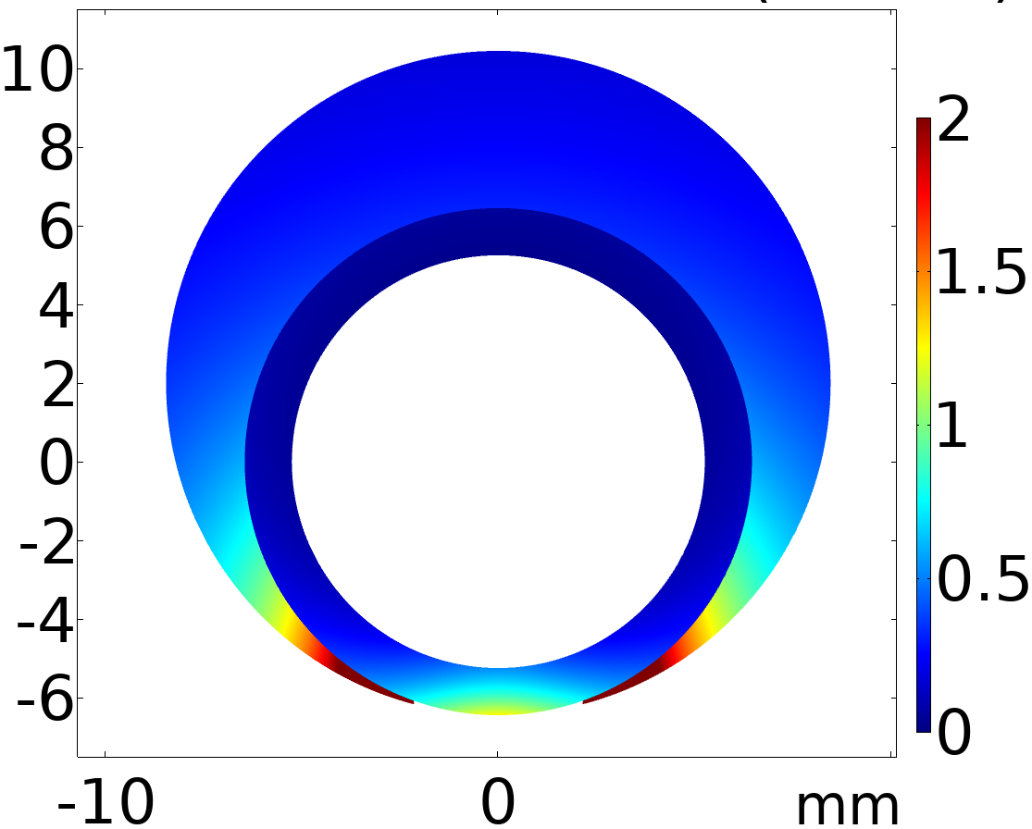
Unshielded Cable in Duct
Air 70°C
σ_{air} = 3x10⁻¹⁵ S/m
Insulator
at 0sec
after 20.000sec
Duct
0V
Cu
1000 V
80°C
The distribution of |E| changes over time in the insulator and the air

Slide 9

Radial |E| Distribution
ins.
air
According to the operating and ambient conditions, the |E| distribution can vary significantly
* A: 0,98eV activation energy, B: 0,56eV activation energy

Slide 10

Summary
The |E| distribution around a cable under DC voltage was simulated and investigated
The comparison was done for:
A shielded and an unshielded cable
Two different types of the insulating material
Two different values of σ_{air}
Different conductor and air temperatures
The risk for partial discharges can be reduced by:
Using proper insulating materials
Improving the thermal design of the system
This research was funded by the German Federal Ministry for Economic Affairs and Energy under the grant number 20Y1701B

Slide 11
THANK YOU
for your
ATTENTION !

