Slide 1
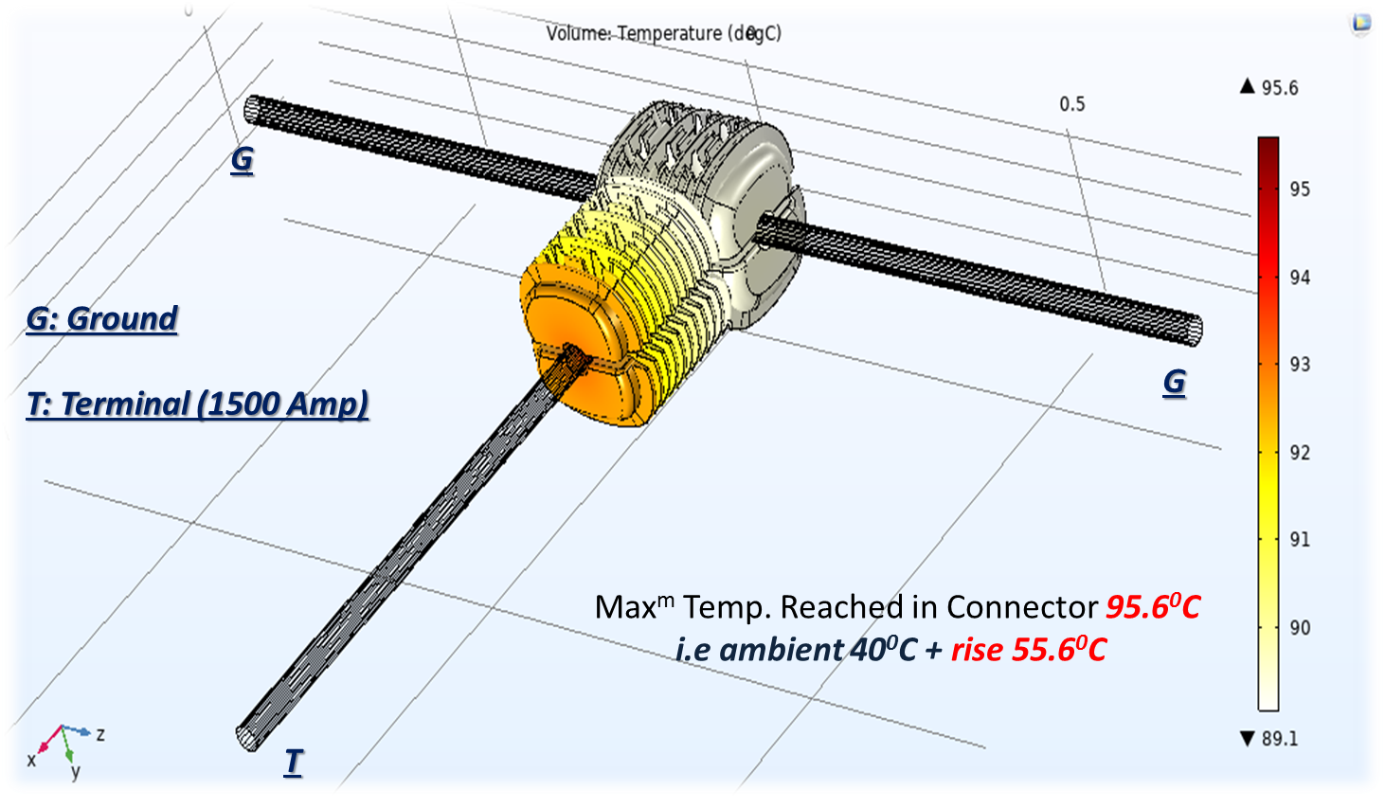
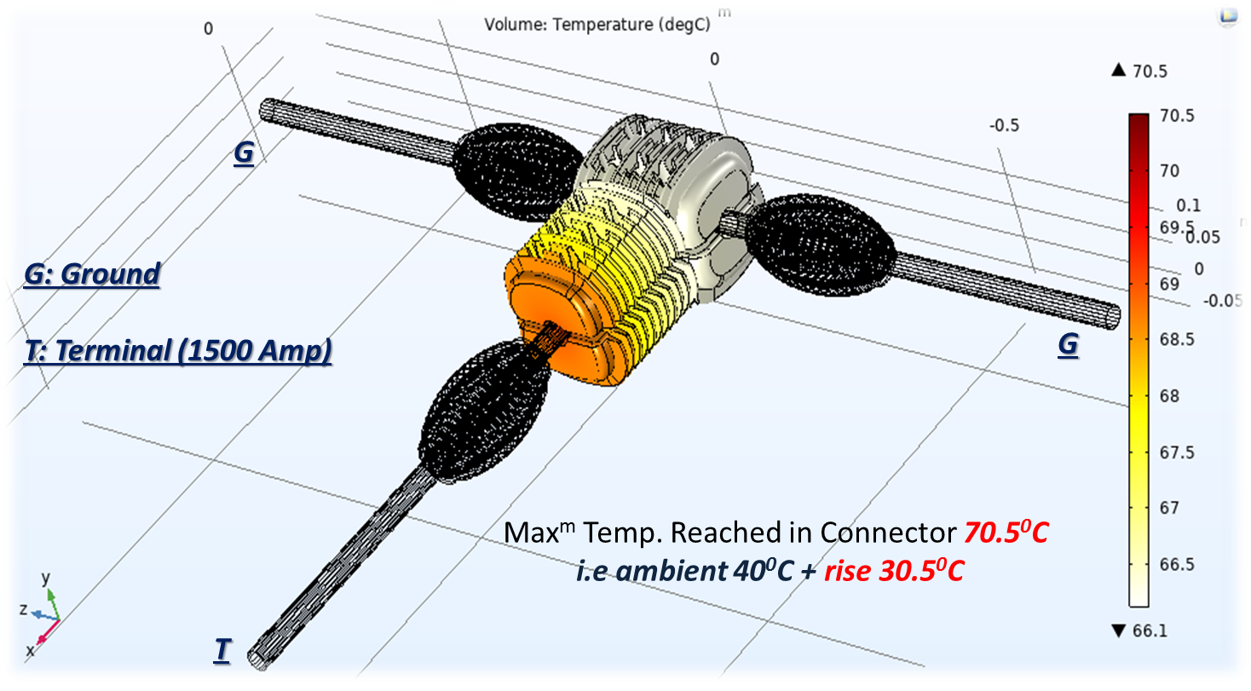
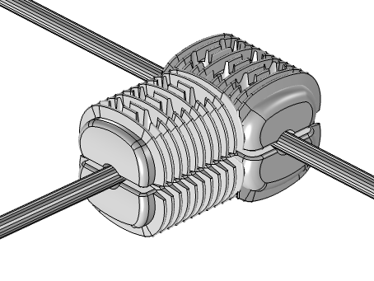
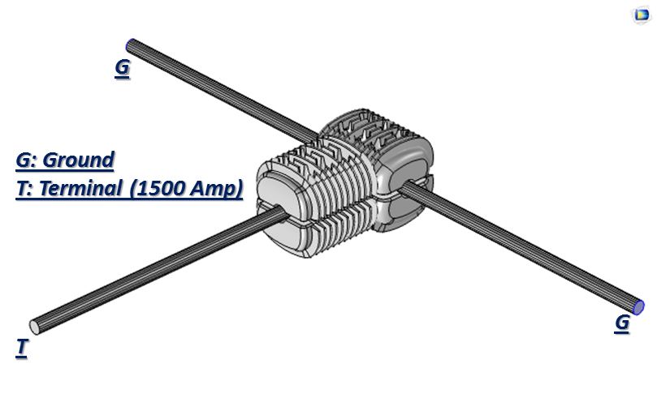
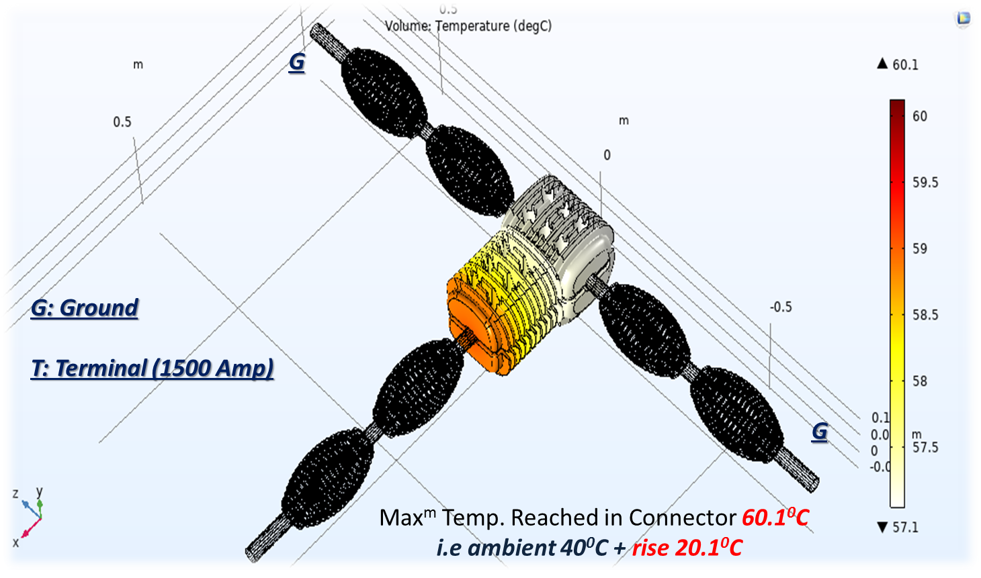
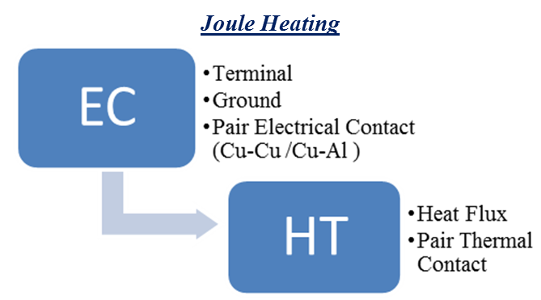
Temperature Rise Simulation Of Electric Power Connector
Abhijnan Chowdhuri, Raghav. R. Upasani, Ishant. Jain
1.M&P CoE, Raychem Innovation Centre, Raychem RPG Pvt Ltd, Vadodara, GJ, India
INTRODUCTION: In modern days one of the biggest challenges is to have a special connector for very high current power supply which shouldn’t exceed the rating temperature of 90°C at full load. This main challenge it to design special connectors of aluminum (Al). In this study, a new approach is defined to design a unique connector made of Al which will not exceed the rating temperature and dissipate the heat very fast due to its well-organized fins and shape. The thermal analysis via comsol gave a clear picture that the fins ratio for both the side should be maintained in a specific ration which gives the maximum heat dissipation power and the practical experiments showed that there are no large potential difference drop when the connectors are attached with any HTLS conductor.
Figure 4. T-connector with no heat sink in conduction path
Figure 1. Twin Connector for HTLS
TEMPERATURE RISE SIMULATION: 1500 A current was applied as per IS 5561 to analyze temperature distribution within the connector, as the connector will get heated due to passage of electric current.
Figure 5. T-connector with one heat sink in conduction path
Figure 2. BC’s for HTLS Connector
Figure 6. T-connector with two heat sink in conduction path
T –Connector with | Max Temp (⁰C) | Temp Rise (⁰C)
No heat sink | 95.6 | 55.6
One heat sink | 70.5 | 30.5
Two heat sink | 60.1 | 20.1
Figure 3. COMSOLTM Physics and Multiphysics used for simulation
Table 1. Temperatures of connector with different arrangement
RESULTS:
Temperature distribution was analyzed for the connector and was compared with IS 5561 standard. Accordingly, heat sinks were placed at terminal and ground ends of the connector to study its effects on the temperature distribution of the connector.
CONCLUSIONS:
Multiple iterations were carried out in designing of T- Connector based on simulation results in order to increase optimum surface area of connector.
Fast heat dissipation and high mechanical strength of the heat sink played a decisive factor in reducing the maximum temperature of the T-connector.

