Slide 1


Slide 2

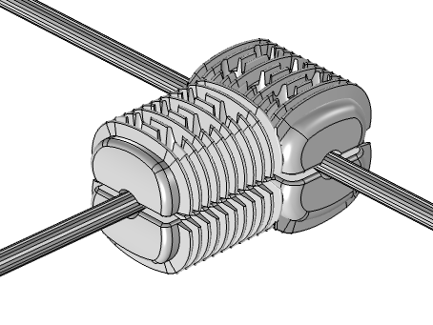
Temperature Rise Simulation Of Electric Power Connector
Prepared by: Abhijnan Chowdhuri
Raghav Upasani
Ishant Jain
2

Slide 3

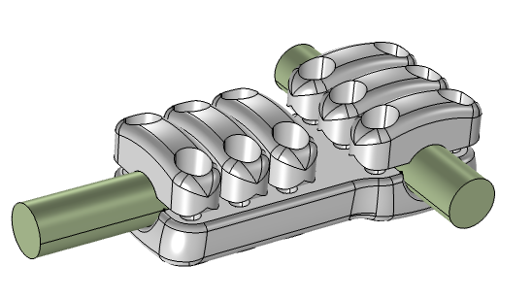
Background
For 220/400 KV line, ACSR Zebra (Ø 28.62 mm) and ACSR Moose (Ø 31.77 mm) conductors are been used having current carrying capacity of 1000 Amps each
Increase in demand for Electrical Power Generation & Transmission, there exist a few hindrances
High cost to install new Power lines
Difficulty in acquiring Tower sites – Right of way (ROW)
Large time involved in constructing new Power lines
Therefore, High Temperature Low Sag (HTLS) conductors, having high ampacity, which can deliver large power without any change in existing tower design are been used.
Hence there is need to design connector for HTLS conductor having permissible temperature as per IS 5561
Fig 1. 3 keeper connector for ACSR Zebra & ACSR Moose
Fig 2. Twin Connector for HTLS
3

Slide 4
Problem Definition
Design of the connector should be such that the maximum allowed temperature should be less than 85⁰C including the ambient temperature at 1600 A as per standard IS 5561.
Moreover, the connectors that are being used for HTLS cables should be made up of IS 5561 (AL - 4600 & A6 grade) or equivalent grade of aluminium as per standard IS 617.
Need for FEA
Helps to study response of the system based on loading condition in real world situation
To determine the correctness and efficiency of a design before the system is actually constructed
Reduces lead time and cost to product
4

Slide 5
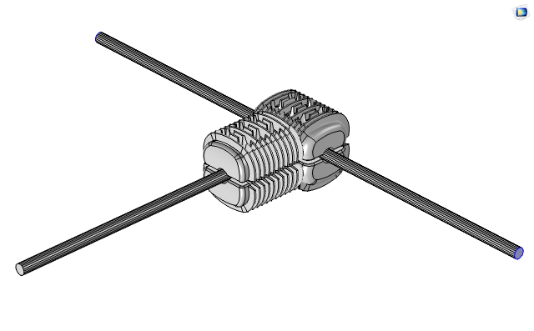
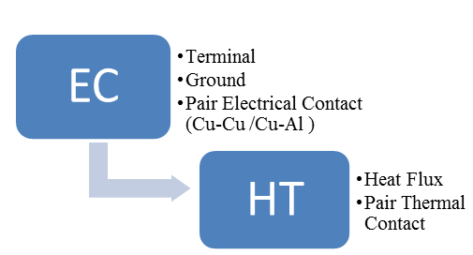
Temperature Rise Simulation as per IS 5561
A. Geometry
C. Physics & Multiphysics Used
G
Joule Heating
G: Ground
T: Terminal (1600 Amp)
G
T
B. Material Properties
HTLS Conductor (Al-Zr) Properties
Property | Value | Unit
Electrical Conductivity | 1.38x10⁷ | S/m
Relative Permittivity | 1 | 1
Thermal Conductivity | 169 | W/m-K
Density | 2517 | Kg/m
Heat Capacity at constant Pressure | 943 | J/Kg-K
Connector (Al) Properties
Property | Value | Unit
Electrical Conductivity | 3.5x10⁷ | S/m
Relative Permittivity | 1 | 1
Thermal Conductivity | 219 | W/m-K
Density | 2705 | Kg/m
Heat Capacity at constant Pressure | 960 | J/Kg-K
5

Slide 6
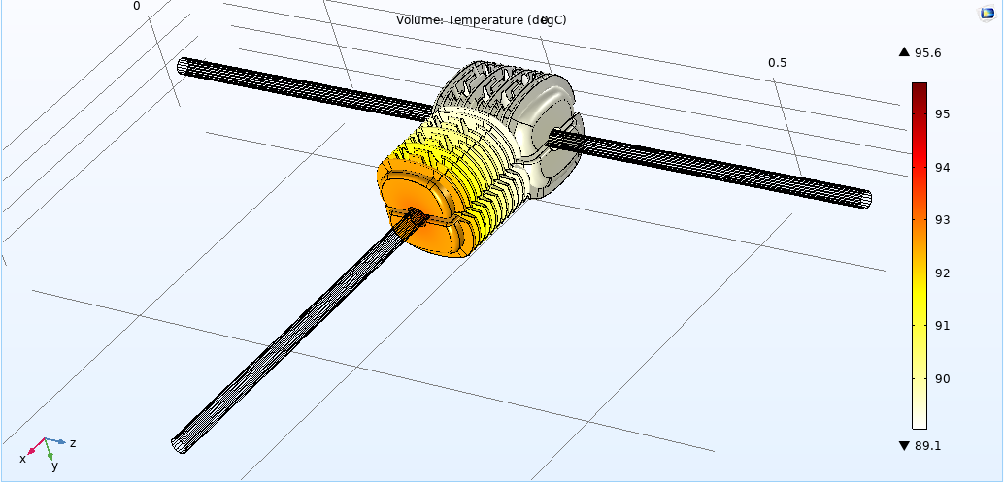
Temperature Rise Simulation as per IS 5561
D.1 Result - T-connector with no heat sink in conduction path
G
G: Ground
T: Terminal (1500 Amp)
G
Max^{m} Temp. Reached in Connector 95.6⁰C
i.e ambient 40⁰C + rise 55.6⁰C
T
6

Slide 7
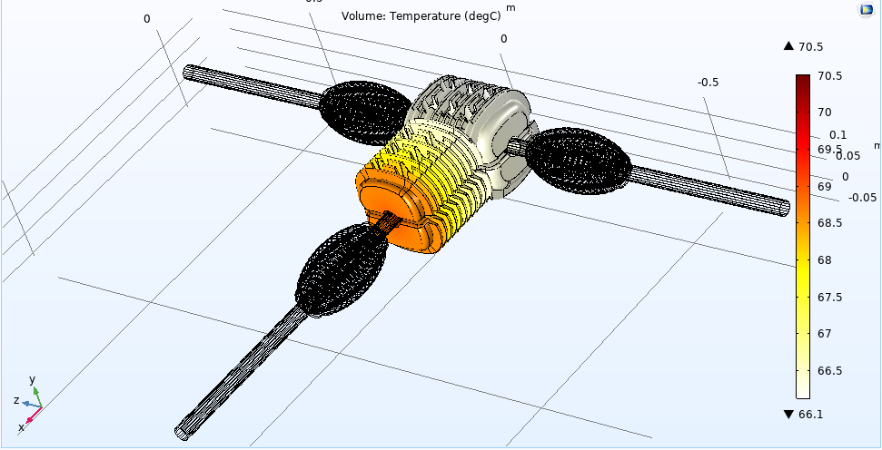
Temperature Rise Simulation as per IS 5561
D.2 Result - T-connector with one heat sink in conduction path
G
G: Ground
T: Terminal (1500 Amp)
G
Max^{m} Temp. Reached in Connector 70.5⁰C
i.e ambient 40⁰C + rise 30.5⁰C
T
7

Slide 8
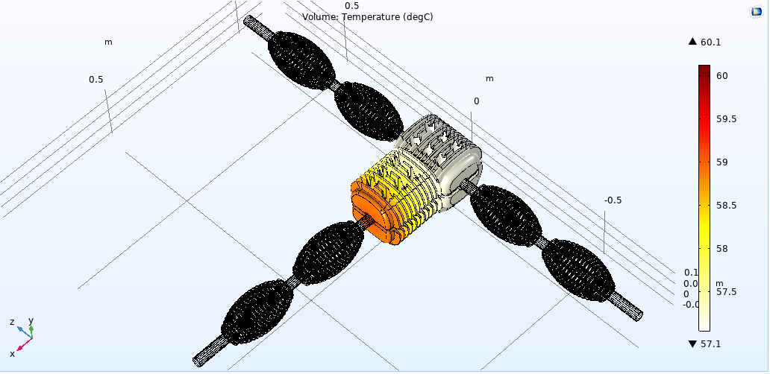
Temperature Rise Simulation as per IS 5561
D.3 Result - T-connector with two heat sink in conduction path
G
G: Ground
T: Terminal (1500 Amp)
G
8

Slide 9
Conclusion
Multiple iterations were carried out in designing of T- Connector based on simulation results in order to increase optimum surface area of connector.
Current requirement was high, hence heat sink were incorporated along with the connector to reduce the temperature rise as shown below.
Fast heat dissipation and high mechanical strength of the heat sink played a decisive factor in reducing the maximum temperature of the T-connector.
T-Connector With | Max Temperature (⁰C) | Temperature Rise (⁰C)
No heat sink | 95.6 | 55.6
One heat sink | 70.5 | 30.5
Two heat sink | 60.1 | 20.1
Future Work
Prototyping, Real life testing & Validation needs to be done.
9

Slide 10

THANK YOU

Slide 11
Questions?

