Slide 1
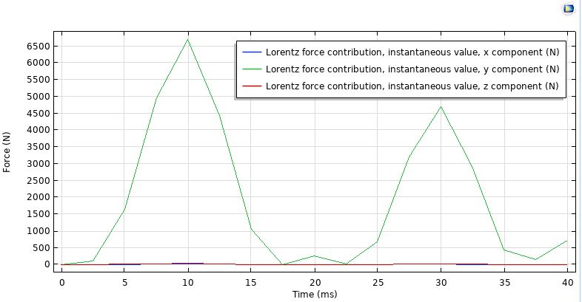
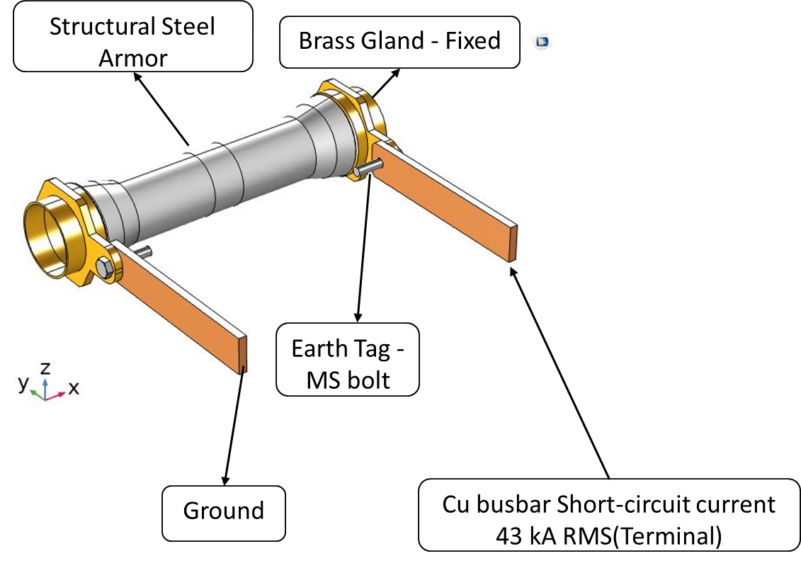
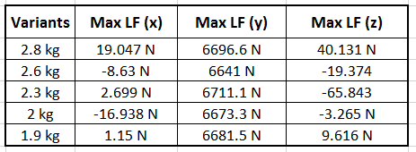
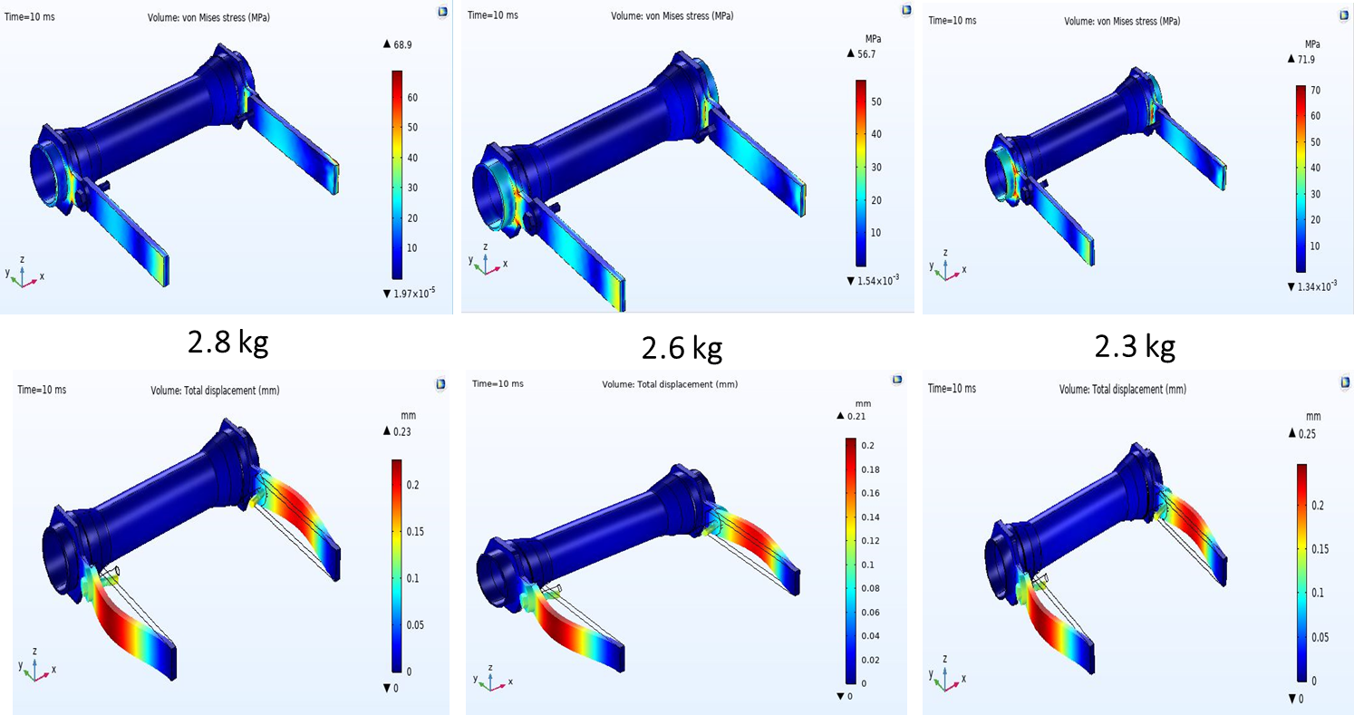
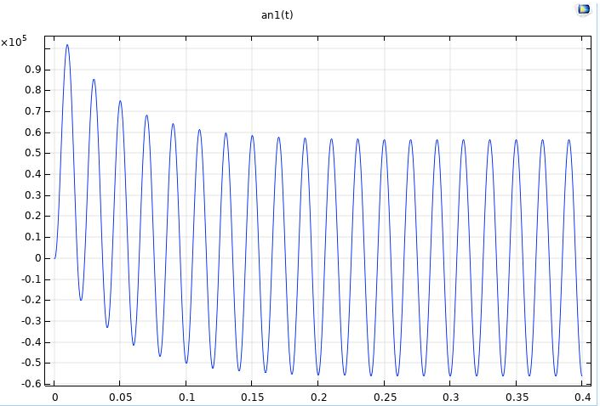
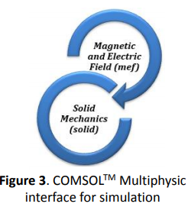
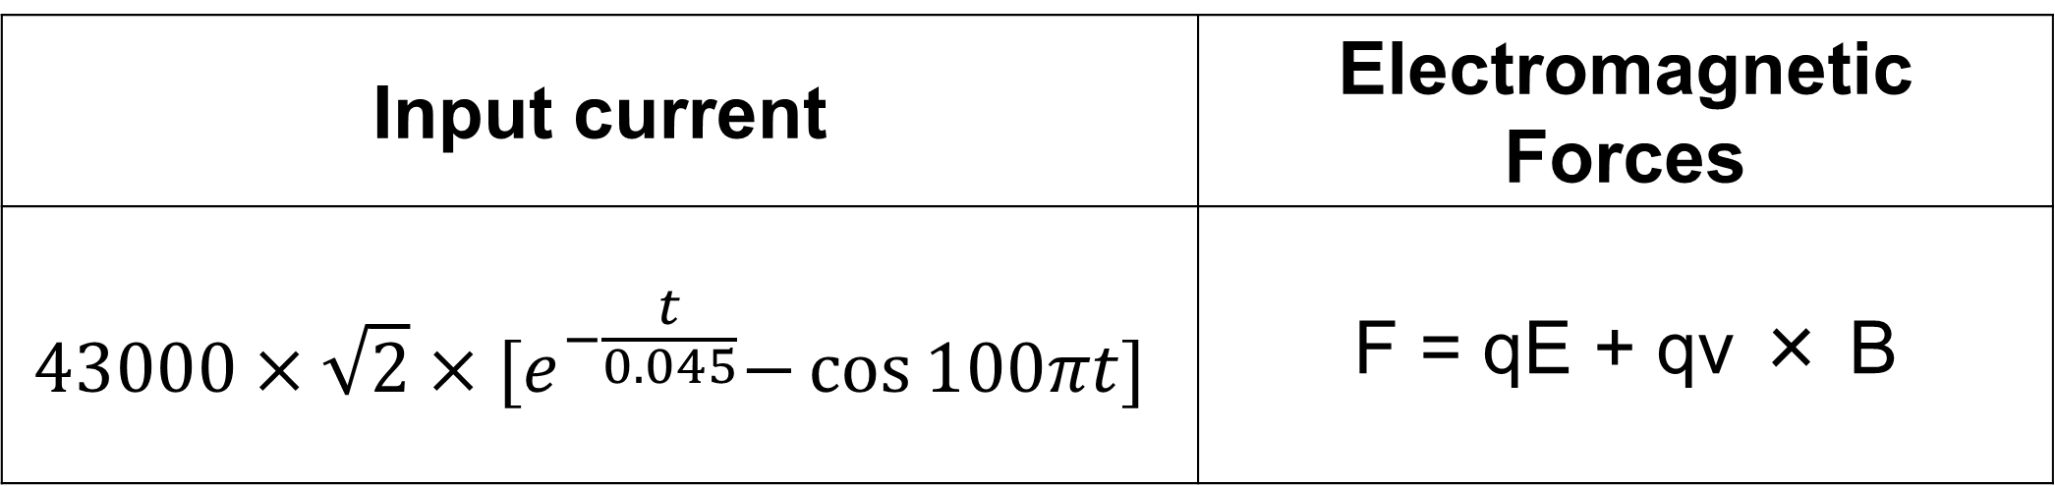
Cable Gland – SC Analysis
Nitin Pandey, Hamza Saiger, Ishant Jain
Raychem Innovation Centre, Raychem RPG Ltd, Vadodara, GJ, India
INTRODUCTION: Cable gland is a strain relieving device, designed to attach and secure the end of an electrical cable to the equipment. In the event of short-circuit, large current shall pass through cable’s armour to the ground, keeping cable gland and equipment safe. Current weight of industrial single seal cast integral earth lug (CIEL) cable gland is reduced by altering the wall thickness and cross section area of earth tag, in the design. Short-circuit analysis of Cable gland is performed using ComsolTM Multiphysics as per IEC 62444 standard. By incorporating MEF (Magnetic & Electric Field) module, a decaying short-circuit wave is applied having maximum initial peak at 10 milli-second to obtain the induced electromagnetic force. Further, the obtained Lorentz forces are given as body load using SM (Solid Mechanics) module to find out the induced stresses in the gland. Hence, the cost of cable gland is reduced by optimizing its weight with the FOS (Factor of Safety) greater than 2.
RESULTS:
The Lorentz force results are obtained due to flow of short circuit current as shown in Fig 4.
The maximum forces are induced in the y direction.
These values are the most important values in terms of checking the stresses induced further.
Air
Figure 4. Lorentz forces- Cable Gland 2.8kg
Table 2 . Induced Lorentz Forces- All variants
NUMERICAL MODEL (3D, Frequency Transient)
Model simulates the cable gland induced to Lorentz forces due to short circuit current.
Magnetic Electric fields (mef) and solid mechanics (solid) interfaces are coupled to obtain the finite element solution for volumetric electromagnetic forces.
A decaying waveform is applied to terminal with initial peak of 107.5 kA & max force at 10 ms as shown in Fig 2.
Figure 1. SC Model of Cable Gland
Figure 5. Stress & Deformation Comparison
CONCLUSIONS:
For a short time current withstand test as per IEC 62444, results are within the limit for 3 variants.
Lower versions of 2kg and 1.9kg were not safe as high von mises stresses were induced in the busbar and armor.
The variant with 2.3kg weight is safe but has low FOS >2.
Hence, 2.6kg weight cable gland is selected based on analysis.
Manufacturing & Testing time along with cost are reduced to obtain optimized product at the design stage.
Input current | Electromagnetic Forces
$$43000×\sqrt{2}×{[e}^{−\frac{t}{0.045}}−\cos{100πt]}$$ | F = qE + qv × B
Table 1. Model Equations
REFERENCES:
IEC 62444 Standard
COMSOL AC/DC Module Users Guide
Figure 2. Terminal Boundary Condition
Excerpt from the Proceedings of the 2020 COMSOL Conference

