Slide 1


Slide 2



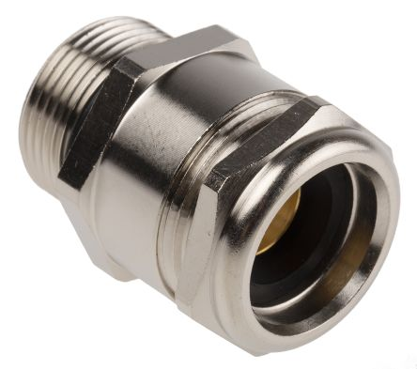
Cable Gland - SC Analysis
Nitin Pandey, Hamza Saiger, Ishant Jain, Pawan Wavare
Materials & Processing,
Raychem Innovation Centre (RIC),
Raychem RPG Pvt. Ltd., Vadodara, Gujarat
2

Slide 3

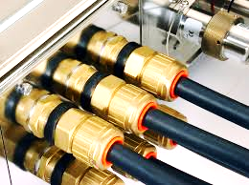
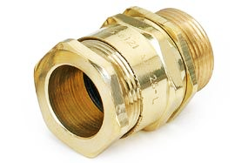
Corp. R&D
Scope & Background
Device to attach and secure - end of cable to equipment
Short-circuit current shall pass through cable’s armour to ground, keeping gland and equipment safe
Current weight of industrial cable gland reduced - altering wall thickness and c/s area of earth tag, in the design.
Short-circuit analysis of Cable gland - ComsolTM Multiphysics as per IEC 62444, to optimize weight of the Cable gland
5 variants - designed in terms of weight
Cable - 3 core Cu XLPE cable with nominal area of 300 mm²
3

Slide 4
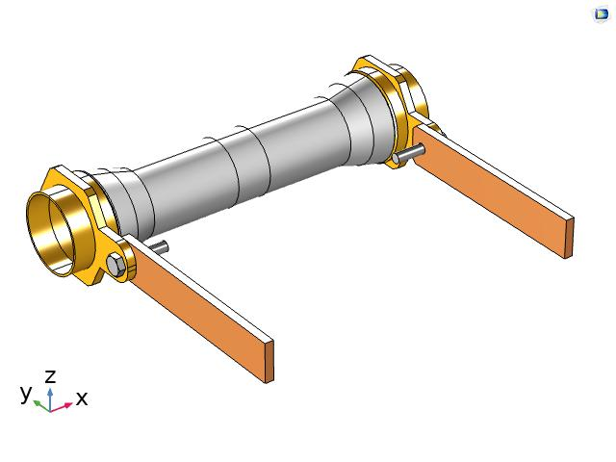
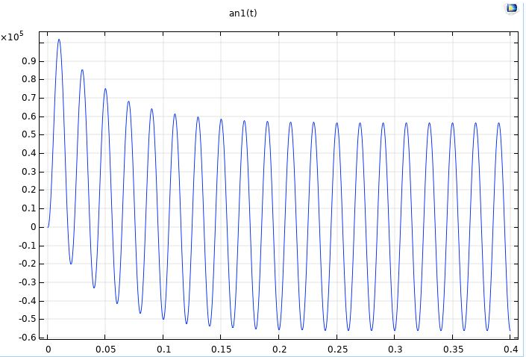
Corp. R&D
Modelling & Boundary conditions
Structural Steel Armor
Brass Gland - Fixed
Air
Decaying waveform to terminal having initial peak of 107.5 kA and max force at 10 ms
Ground
Earth Tag - MS bolt
Cu busbar Short-circuit current 43 kA r.m.s (Terminal)
Electromagnetic Forces as body load
4

Slide 5
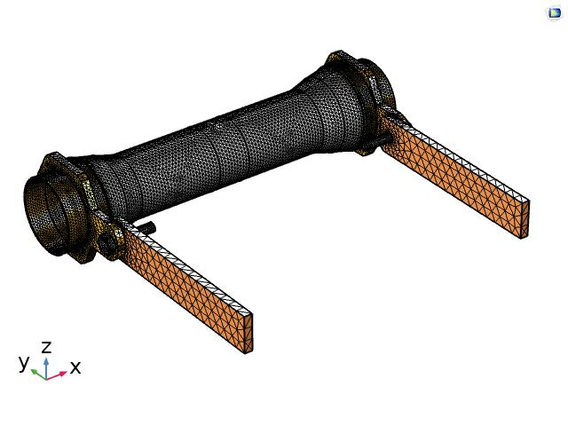
Corp. R&D
Mesh
Mesh Statistics
Tetrahedral elements - 957732
Triangles - 8727
Edge elements - 6501
Vertex elements - 224
Average element quality- 0.723
5

Slide 6
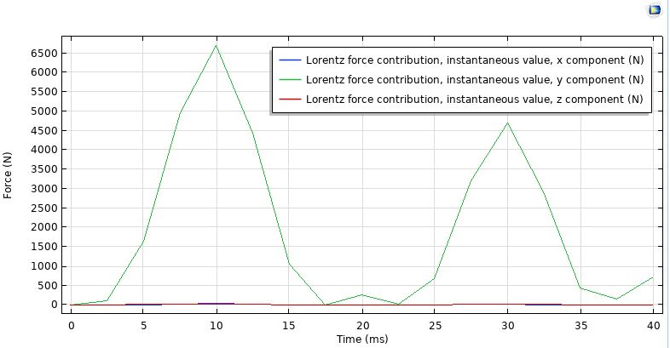
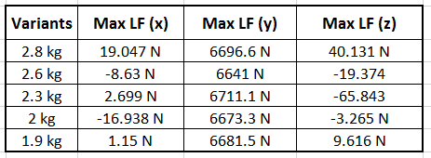
Corp. R&D
Results - Lorentz force
2.8 kg - LF Graph
Induced Lorentz Force
6

Slide 7
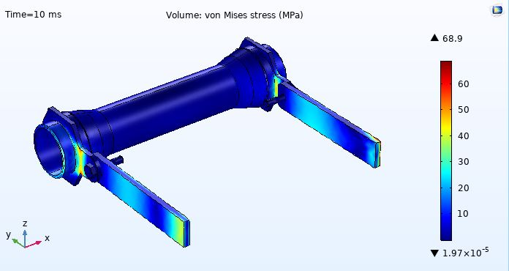
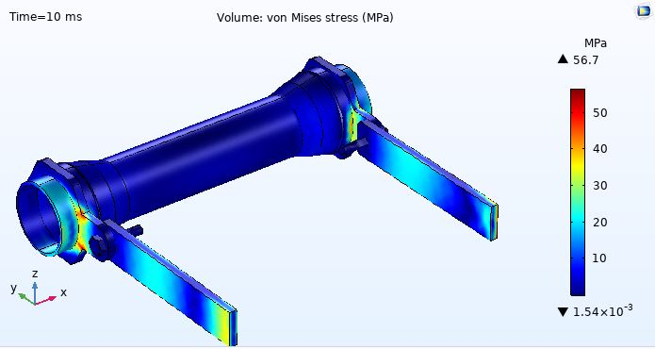
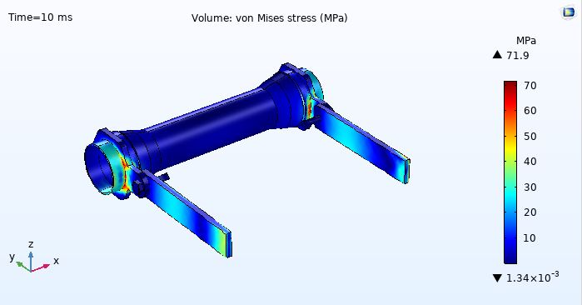
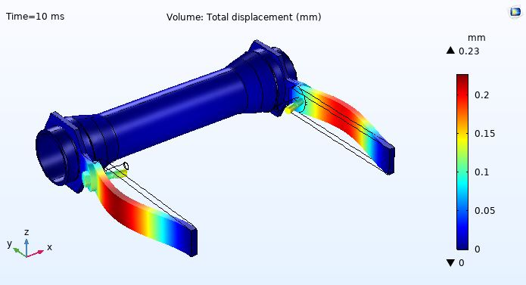
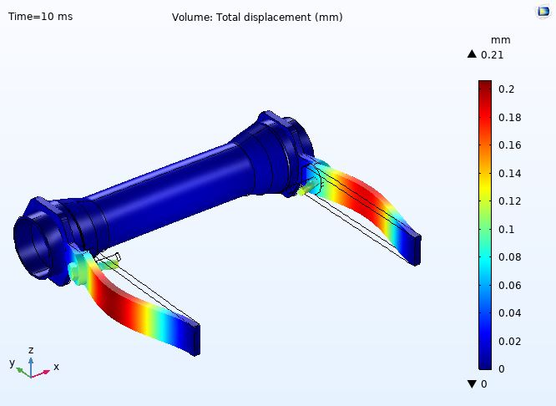
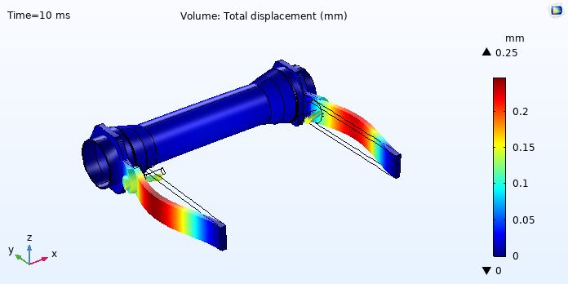
Corp. R&D
Results - Stress & Displacement plot at 10 ms
2.8 kg
2.6 kg
2.3 kg
7

Slide 8
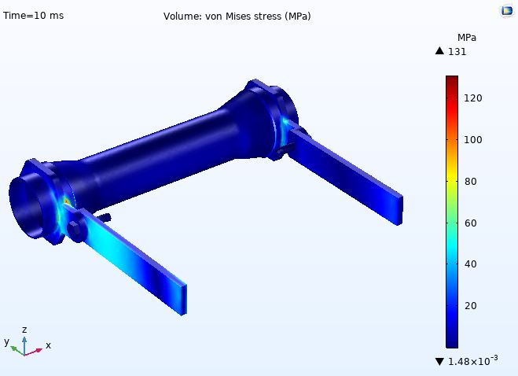
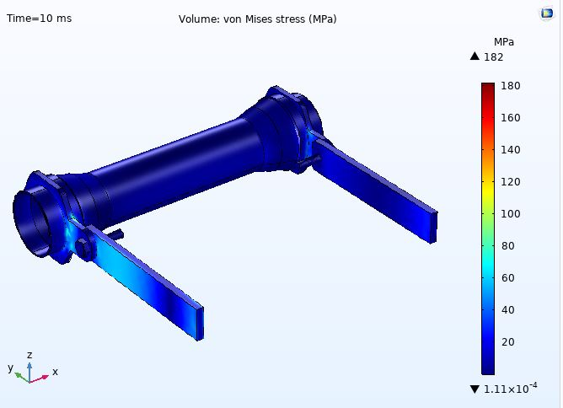
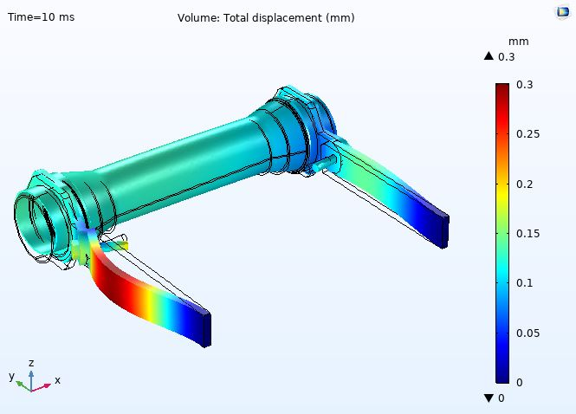
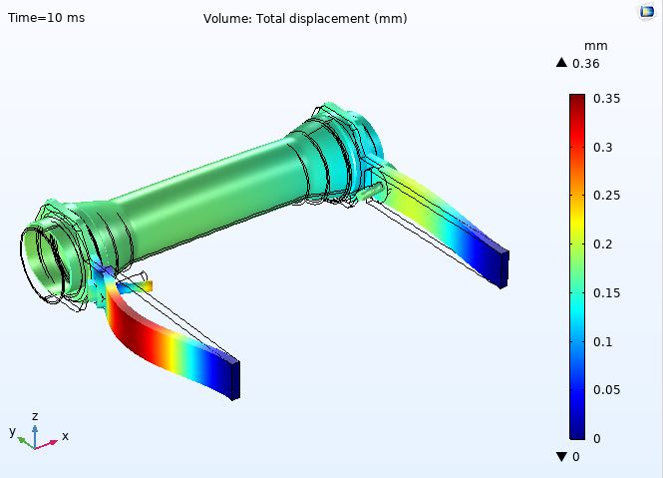
Corp. R&D
Results - Stress & Displacement plot at 10 ms
2 kg
1.9 kg
8

Slide 9
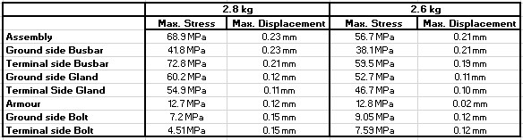
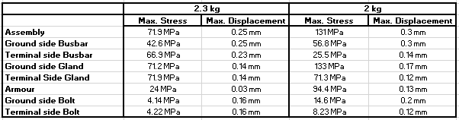
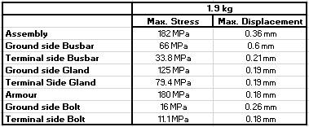
Corp. R&D
Results - Component wise Stress & Displacement
Max. Stress & Displacement - 1.9 kg
Safest Variant - 2.6 kg
9

Slide 10
Corp. R&D
Conclusion
Lorentz force - Highest in y direction. Least induced Lorentz Force in y direction - 2.6 kg variant leading to lesser mechanical stress
1.9 & 2 kg variant - Not Safe as high stresses observed on the ground side gland & Armour
2.3 kg variant - Safer than 1.9 & 2 kg variants but stress on the gland is high (FOS < 2)
Manufacturing individual glands and testing - Cost ↑. FEA - To select correct variant with optimum weight and performance
2.6 kg variant - Stress & Displacement are lesser as compared to other variants.Hence, it is selected with FOS > 2 - 300 grams weight reduced
* Assuming yield strength of Brass as 135 MPa, Copper as 250 MPa and Structural Steel as 240 MPa
10

Slide 11

THANK YOU

