Slide 1

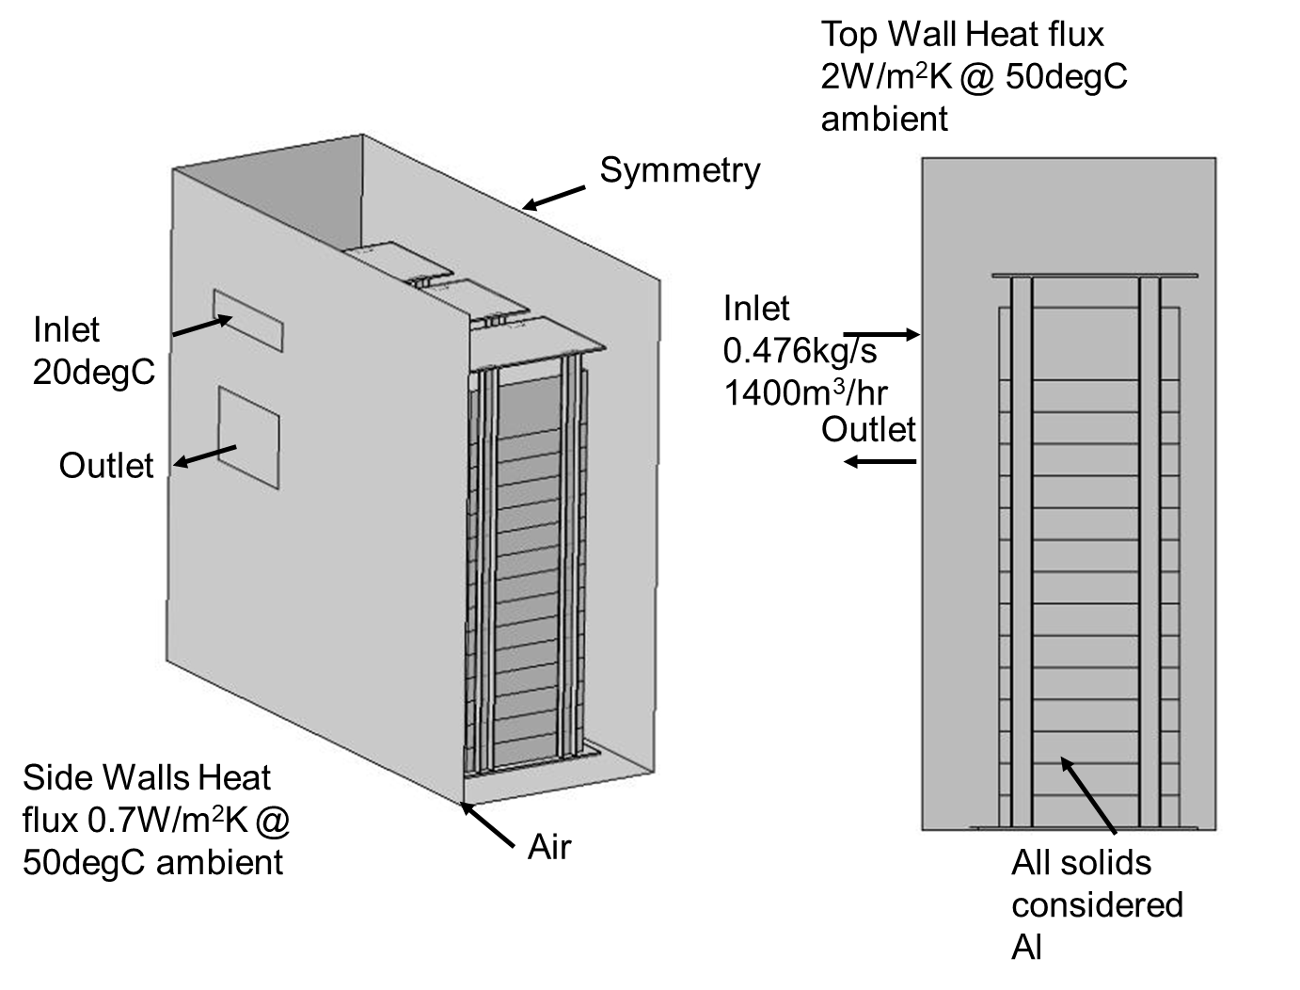
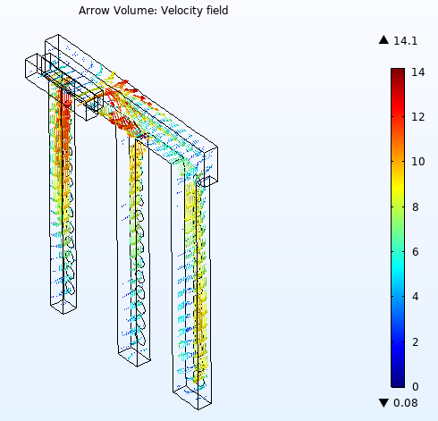
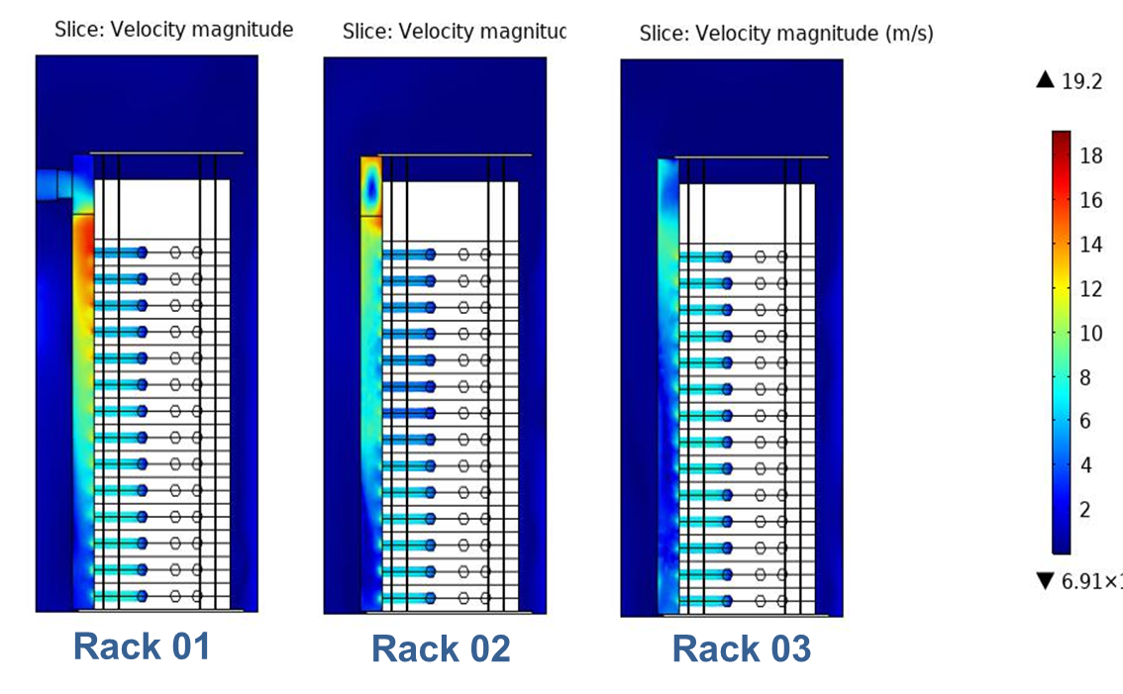
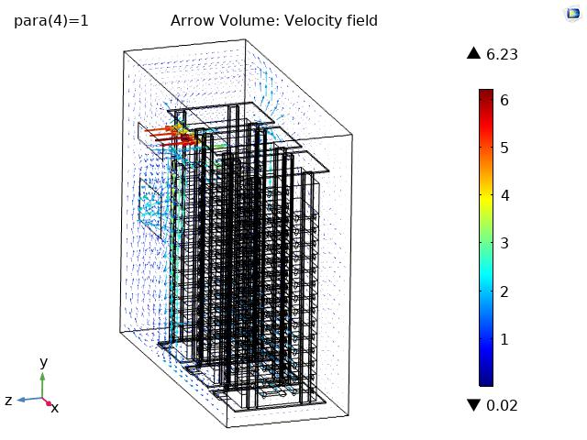
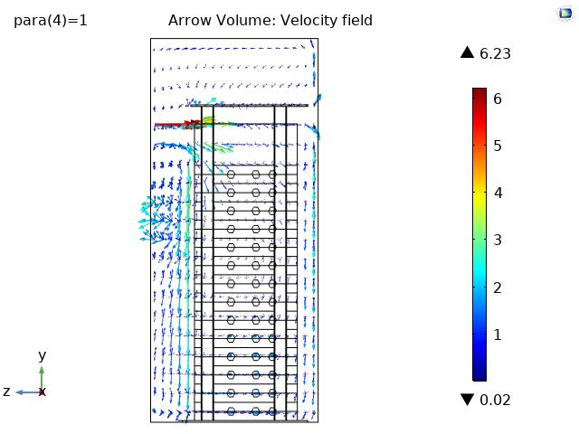
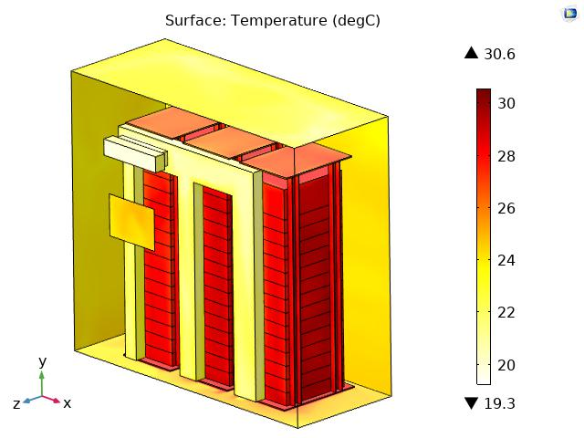
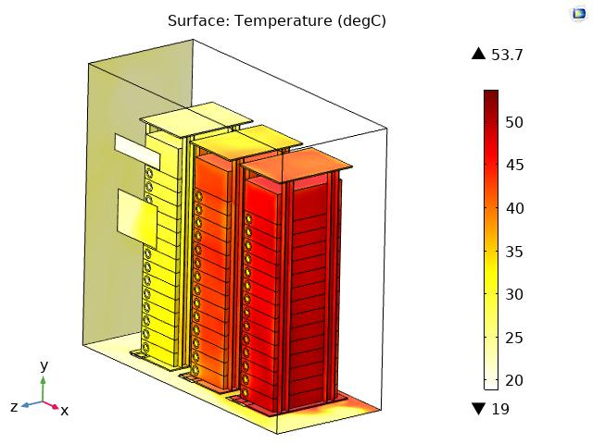
Thermal Design & Analysis of BTM
H. S. Saiger, I. Jain
Raychem Innovation Centre, Raychem RPG Ltd, Vadodara, GJ, India
INTRODUCTION:
DUCT DESIGN:
BTM is a battery storage unit deployed in solar power plants for storing electric charge in DC to AC convertor systems. As it is important to assess the thermal reliability along with efficiency of the system, a model (Fig 1) is developed in COMSOL® including a coupled CFD-thermal interface to determine the temperature rise in the system for design verification.
The airflow pattern indicate recirculation & intermixing of hot and cold air.
The temperature is higher and non-uniform.
Hence a duct was designed to overcome the above concerns.
A series of simulations were carried out to finalize duct dimensions for equal mass flow rates in each limb.
Figure 4. Duct Design & Analysis
IMPROVISED MODEL:
Figure 1. Baseline Model of BTM
NUMERICAL MODEL (3D, Stationery):
Model simulates the airflow patterns in the battery cabinet from AC cabinet.
Turbulent flow (spf) and heat transfer (ht) interfaces are coupled to obtain the finite element solution for flow pattern & temperature profiles.
Figure 5. Velocity profile in duct limbs
PRELIMINARY RESULTS:
Figure 2. Velocity vectors
Figure 6. Temperature Profile
CONCLUSIONS:
Figure 3. Temperature profile
Reduction & Uniformity in temperature profile obtained with a simplified solution.
Desired cooling of batteries & ambient air achieved.
Analysis helped to identify reliable and efficient solution.
Excerpt from the Proceedings of the 2020 COMSOL Conference

