Slide 1


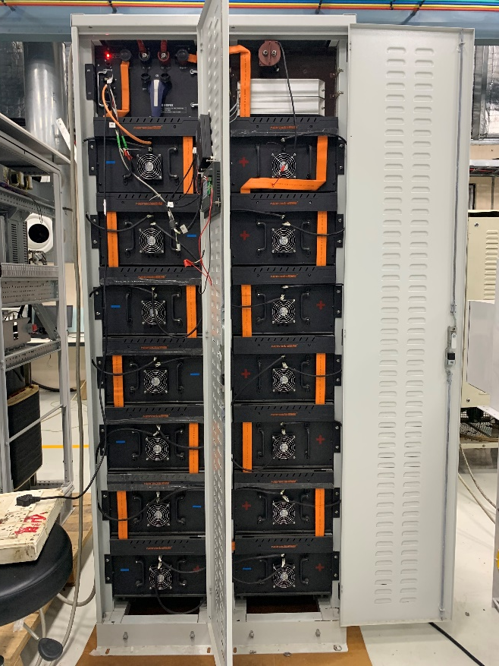
Thermal Design & Analysis of BTM
Hamza Saiger, Ishant Jain
Raychem RPG (P) Ltd.
Halol, Gujarat

Slide 2
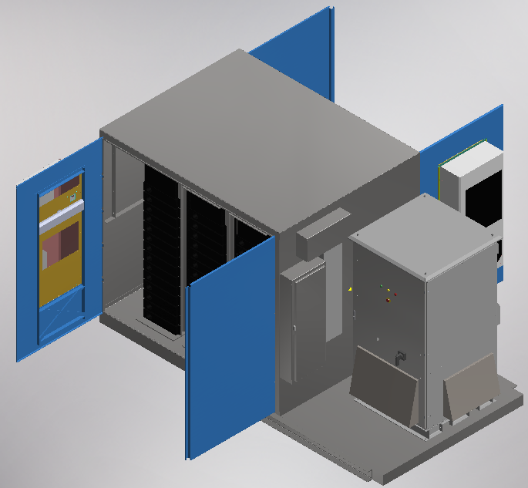
Introduction
BTM : Battery Energy Storage System.
Important system in DC to AC conversion from solar power plants.
Capturing and storing electric charge in special batteries.
Such systems are used at the utility customer level.
Result in significant savings to businesses through smart grid.
Improve energy security by optimizing energy supply and demand.
BTM
Panel AC
Convertor System
Battery rack

Slide 3
Purpose & Scope
Battery & fan heat generation.
Temp Rise in the system.
Thermal aspect important in design.
Adding more cooling capacity → Inefficient design.
Re-circulation and inter-mixing of hot-cold air to be avoided.
Reliable + Efficient Design → Performance & Cost optimized end product.
Testing each configuration- Time consuming/Expensive.
Pursue cooling solutions from COMSOL® analysis.
>37°C High risk of damage May negate battery warranty
32-37°C Risk of damage & downtime
27.1-32°C Longer periods may compromise battery life
25.1-27°C Fans may require more power reducing efficiency
25°C Ideal temperature Reliable & Efficient
18-24.9°C Reliable operation Temp Drop → Efficiency drop
<18°C Inefficient Costly make-up

Slide 4
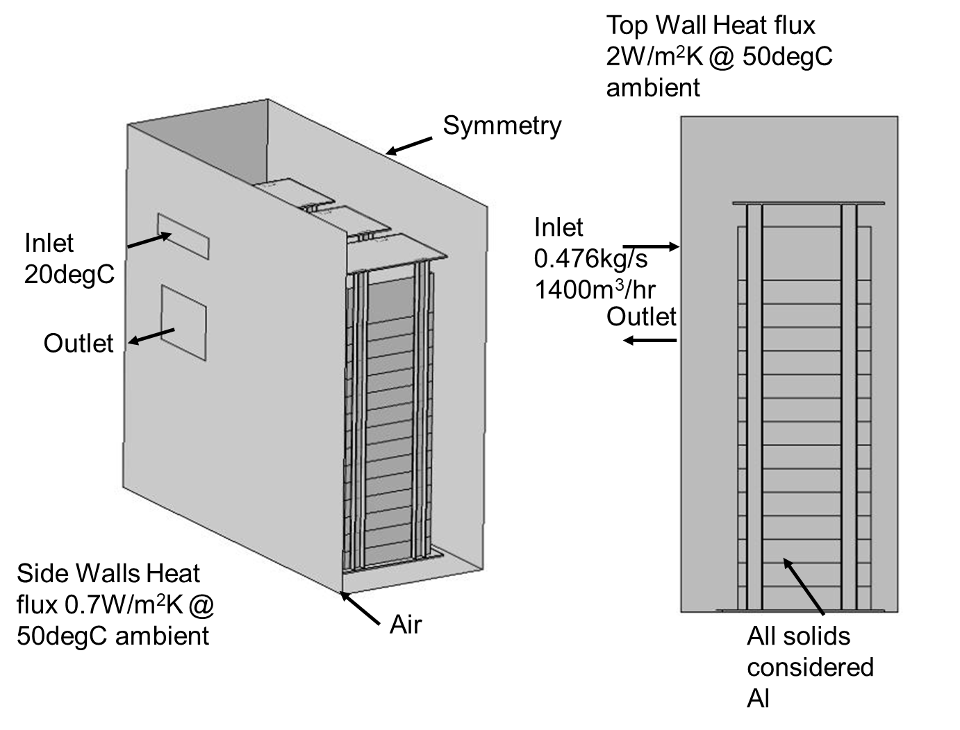
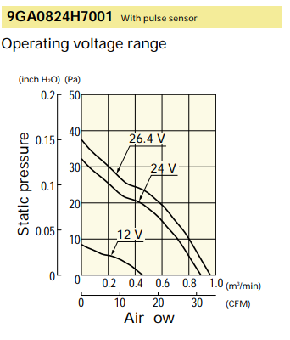
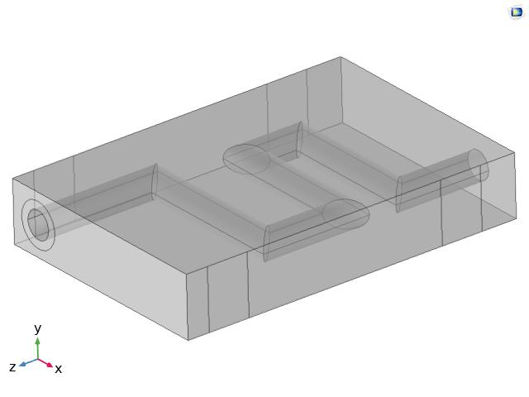
Baseline Model
Main Model
Physics: CFD + Heat Transfer
Multiphysics: Non-isothermal flow
Model: Union Model
Solver: Stationery, One Way Initialization NITF
Battery Model

Slide 5
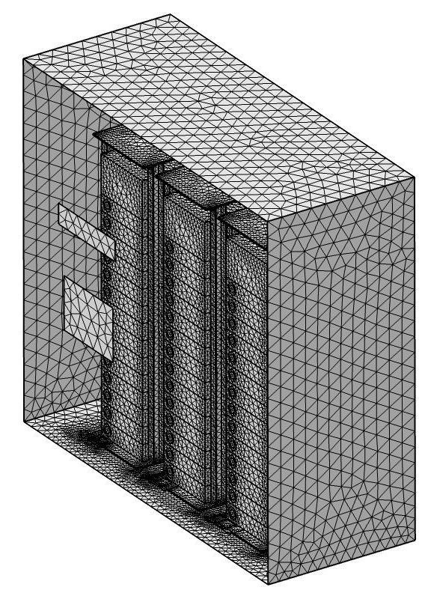
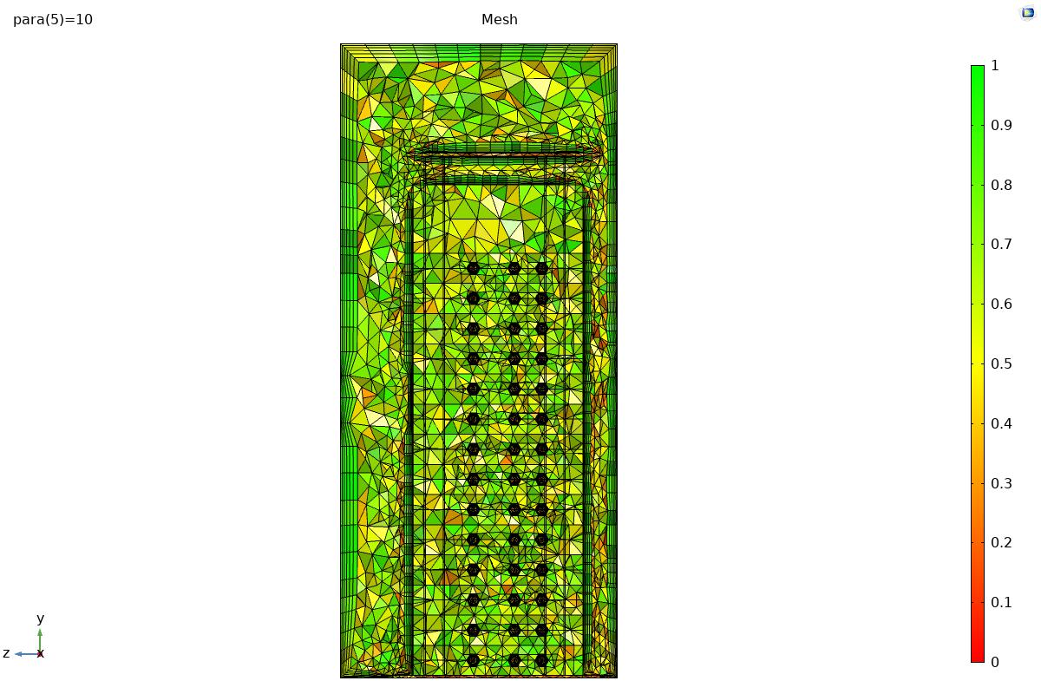
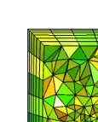
Baseline Model Mesh
BL height of 3.9mm for
y+ layer >30
Structured Tet Mesh
Mesh Quality

Slide 6
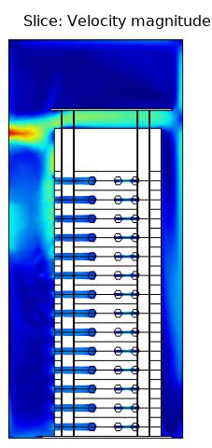
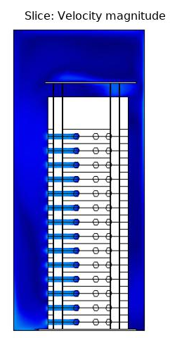
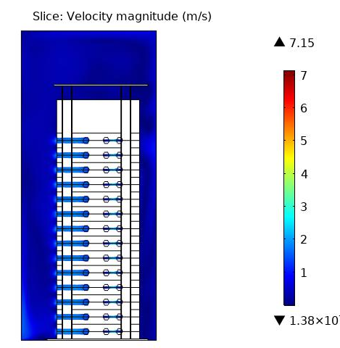
Baseline Model Results
Velocity Profiles
Rack 01
Rack 02
Rack 03
2nd and 3rd racks → Low velocities (flow rate)
Inefficient & unreliable design

Slide 7
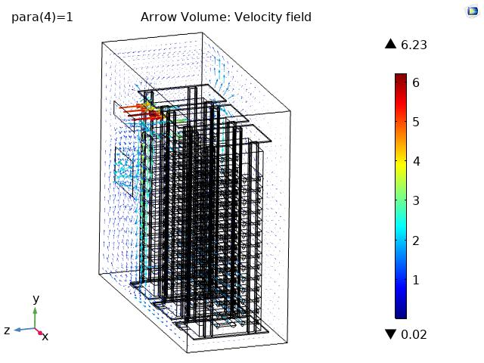
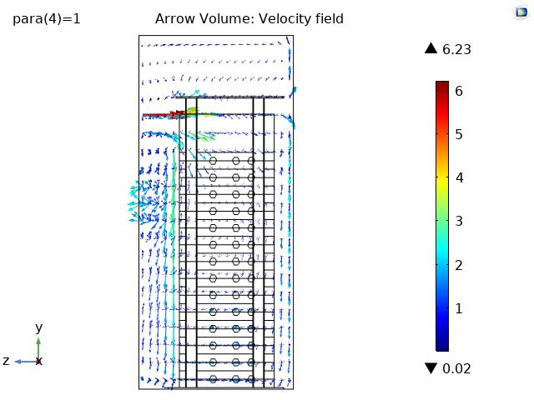
Baseline Model Results
Velocity Vectors
Recirculation observed near inlet outlet interface
Hence flow separation of hot-cold air at different temp is necessary.

Slide 8
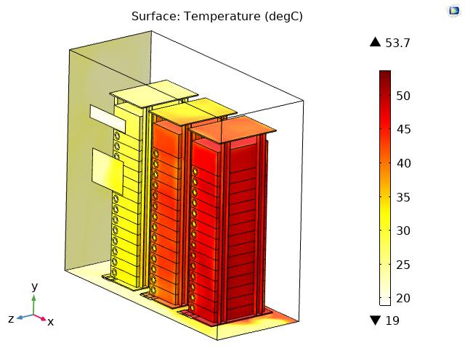
Baseline Model Results
Temperature Profile
Unequal temperature distribution.
Higher temperatures observed due to less airflow in the region.

Slide 9
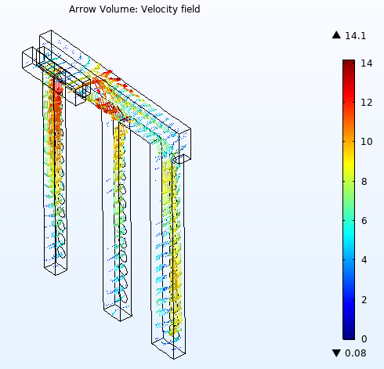
Duct Design
Negate the recirculation & intermixing of hot & cold air → a duct was designed.
Duct with unequal c/s limbs → account for equal mass flow rate

Slide 10
Duct Parametric Design
DoE – Limb C/S
It was noted that there was lower mass flow rate in center limb, hence c/s areas needed to be re-designed.
A series of iterations were carried out as shown below:
Length (mm) | Mass Flow (kg/s)
120 | 0.124
180 | 0.09
240 | 0.167
Length (mm) | Mass Flow (kg/s)
120 | 0.124
200 | 0.109
220 | 0.155
Length (mm) | Mass Flow (kg/s)
120 | 0.124
200 | 0.11
200 | 0.154
Length (mm) | Mass Flow (kg/s)
120 | 0.124
220 | 0.124
180 | 0.14
Length (mm) | Mass Flow (kg/s)
150 | 0.148
220 | 0.127
150 | 0.112
Length (mm) | Mass Flow (kg/s)
130 | 0.133
220 | 0.125
170 | 0.13
Final iteration

Slide 11
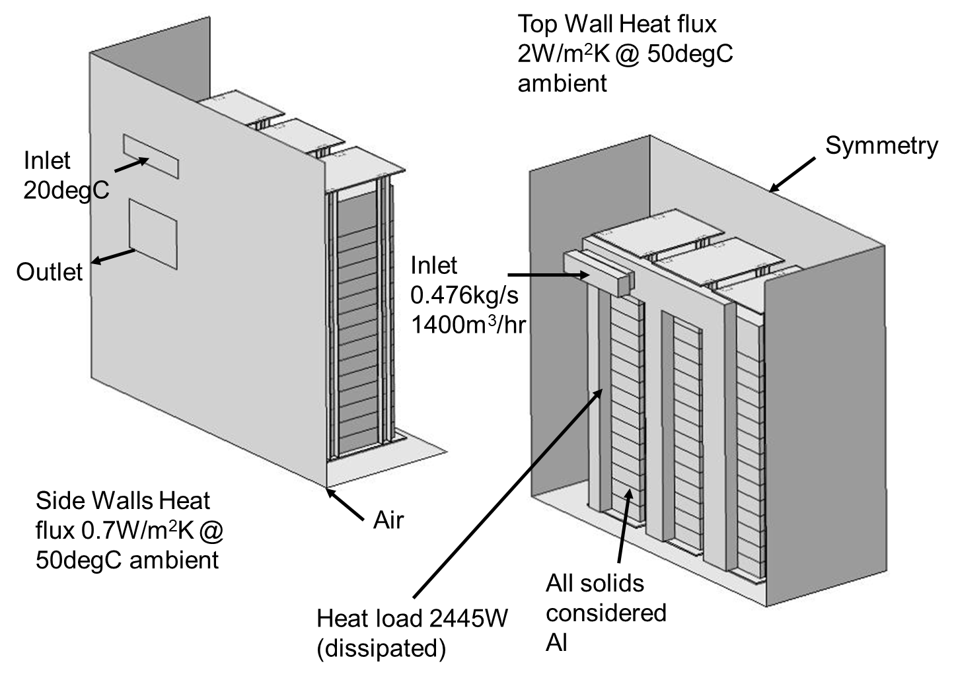
Improvised Model with Duct

Slide 12
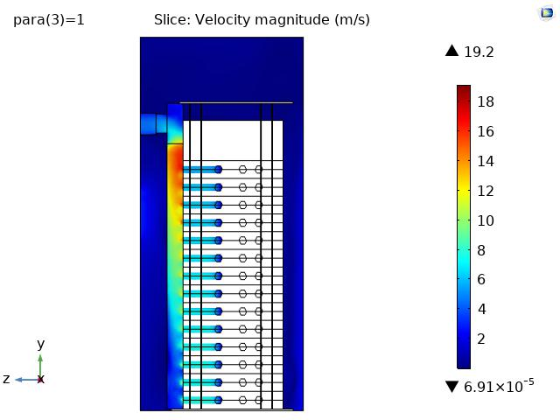
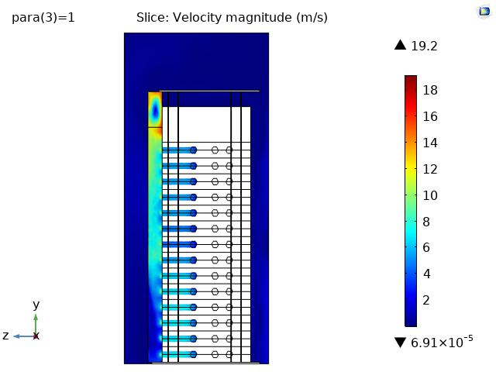
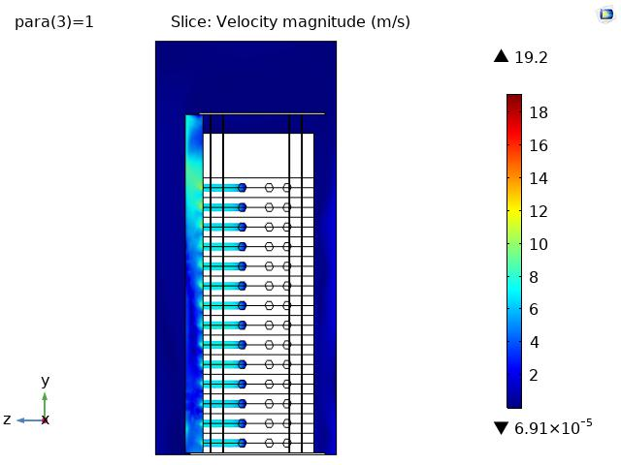
Improvised Model with Duct Results
Velocity Profiles
Rack 01
Rack 02
Rack 03
Almost equal distribution between racks.
No inter-mixing of hot & cold air

Slide 13
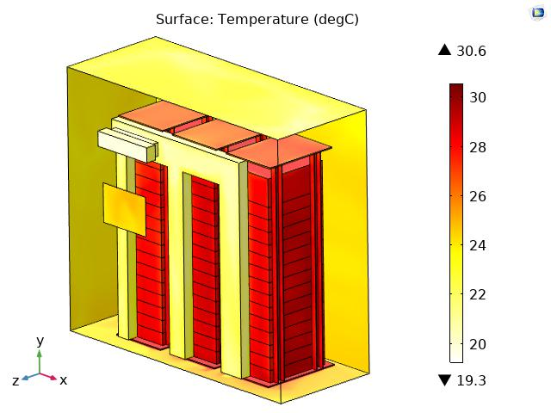
Improvised Model with Duct Results
Temperature Profile
Reduction in temperature from previous case.
Uniformity in temperature profile in all batteries.
Temperature of batteries @ 28.7°C
Temperature of ambient air in the cabinet @ 24°C

Slide 14
Conclusion & Future Scope
The ducting system & cabinet designed on the basis of extensive CFD simulations of cell layout and airflow pattern.
Desired cooling of batteries & ambient air achieved.
Analysis helped to identify reliable and efficient solution.
Verified methodology & analysis can be extrapolated to
    Identify failure points if any at design stage
    Improve product performance
    Reduce number of test iterations
    Reduce design & testing cost
    Develop reliable design.

Slide 15

Q&A

