Slide 1
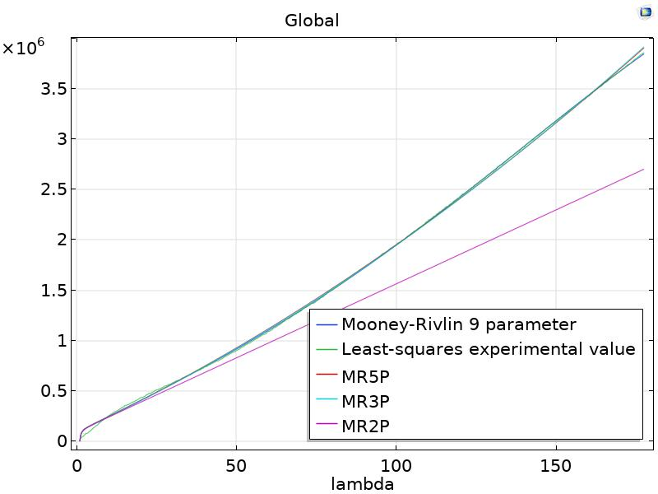
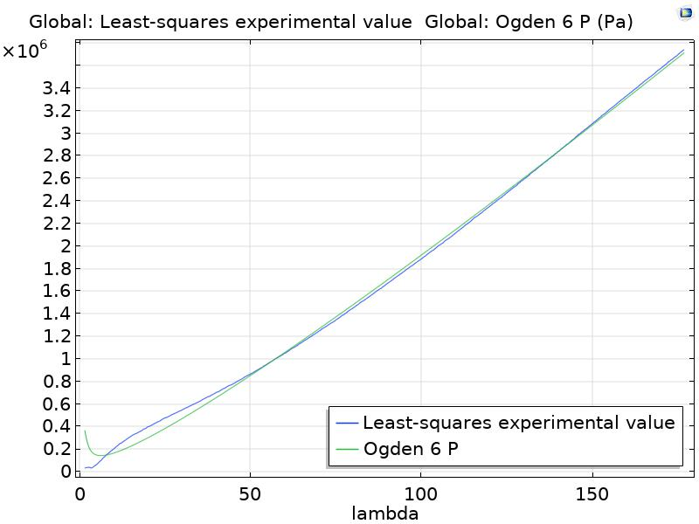
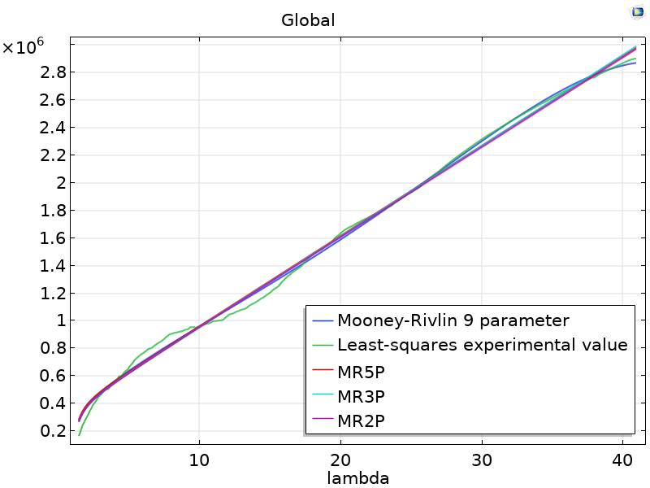
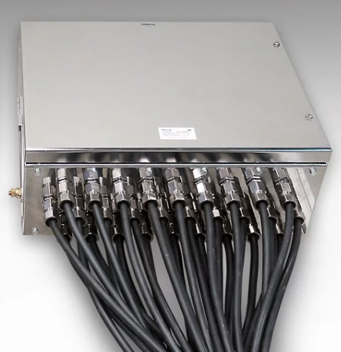
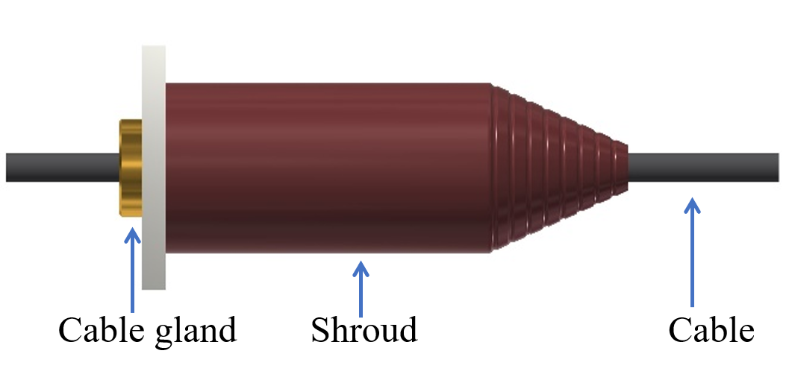
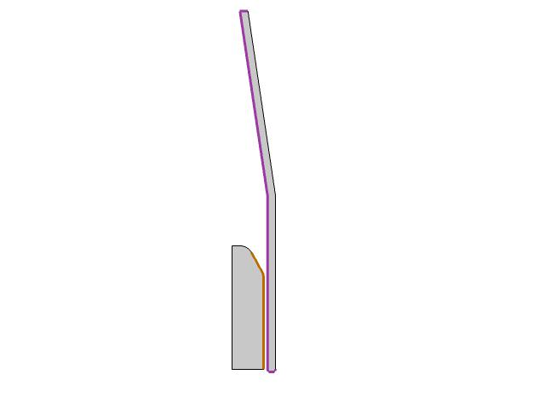
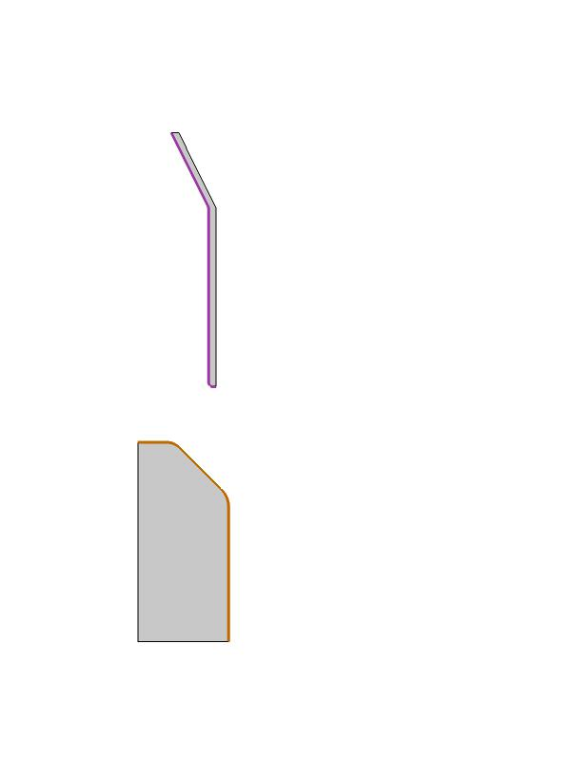
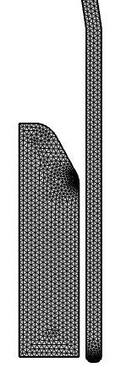
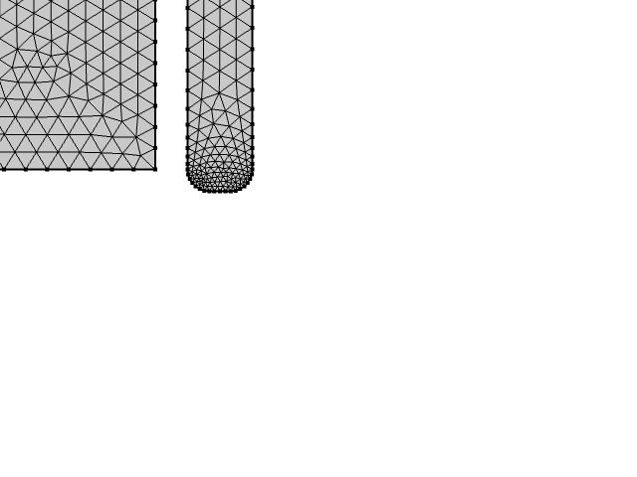
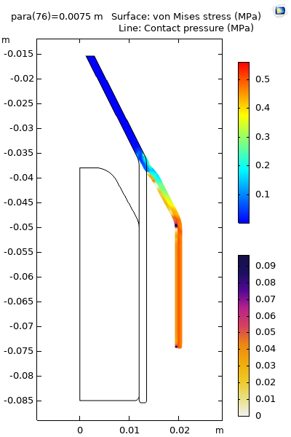
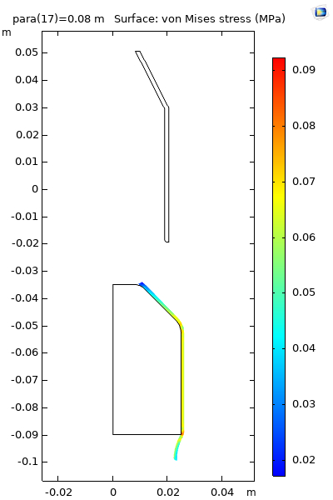
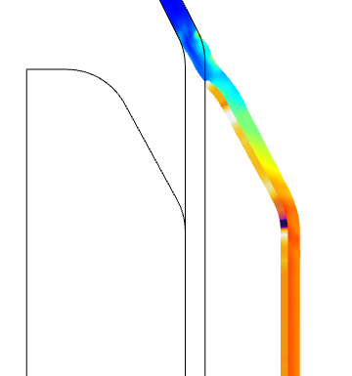
Non-linear analysis of shroud expansion
Ganesh Bhoye¹, Ishant. Jain²
1,2. Raychem Innovation Centre, Raychem RPG Pvt Ltd, Vadodara, GJ, India
INTRODUCTION: Shroud is used to provide protection against dirt or foreign substance gathering on cable gland assembly. Mostly they provide mechanical impact resistance and serve as additional protection. The existing shroud is made up of Polyvinylchloride which is inherently a self-extinguishing fire-retardant material however having limited elasticity which prohibit the expansion and variability .
Figure 2. Curve Fitting Uniaxial Tensile test data
Figure 3. Curve Fitting Biaxial Tensile test data
HYPER-ELASTIC STUDY FOR SHROUD EXPANSION: Direct Expansion and Sliding expansion are two different Phenomenon have been studied. Figure 4, Figure 5 and Figure 6 show the Boundary conditions for Direct expansion, Sliding expansion and Mesh generation resp.
Cable gland
Figure 1. Cable Gland and Shroud Assembly
In current work, various design of shrouds ( fig-1) made up of Hyper-elastic material-based are designed and analyzed to study the non-linear expansion behavior. Least square regression model is fitted with various hyperelastic models available in literature using optimization module of COMSOL In-house setup was designed and developed to extract biaxial stress strain curve.
Fixed Constraint
Prescribed displacement
OPTIMIZATION FOR CURVE FITTING:
The different material models have been established for hyper-elastic materials. Theses material model’s equations have been used for Analysis in order to find a best fit model for a shroud material compositions. In Optimization study, Curve fitting is done on experimental stress strain data for material composition collected from UTM. In current study, curve fitting is done for different material models like
Contact
Contact
Prescribed displacement
Fixed Constraint
Figure 4. Direct Expansion
Figure 5. Sliding Expansion
Figure 6. Mesh Generation
1. Arruda Boyce | 2. Yeoh
3. Mooney Rivlin 9- parameter | 4. MR-5 Parameter
5. MR-3 Parameter | 6. MR-2 Parameter
7. Ogden 6-parameter model | 8. Ogden 8-parameter
Total squared error for each model has been determined and model with least total squared error has been found. Figure 2 shows curve fitting of MR-2 parameter, MR-3 parameter, MR-5 parameter, MR-9 parameter and Ogden 6 parameter with Experimental data for uniaxial stress-strain curve. It is clear from the graphs that Mooney Rivlin 9 parameter material model has least square error and matches the experimental Uniaxial stress strain curve. While A special fixture has been developed in order to carry the biaxial tensile testing. Figure 3 shows biaxial tensile test data and curve fitting for same with MR9 parameter model being best fit model for experimental data. Material Constants have been determined for MR 9 parameter material model which are input to next Hyper-elastic study.
Figure 7. FEA for Direct Expansion
Figure 8. FEA for Sliding Expansion
CONCLUSIONS:
From Fig 7 & Fig 8 Though Sliding Expansion is more practical approach, Maximum radial expansion can be observed in Direct expansion variant.
Shroud can be expanded by 15 mm diametrically Hence single size of the shroud can be used for more than Three Cable glands.
Optimum Thickness has been determined & selected.
REFERENCES:
Michael Rackl, “Curve Fitting for Ogden, Yeoh and Polynomial Models” 8th September 2017.
Nomesh Kumar, V. Venkateswara Rao, “Hyperelastic Mooney-Rivlin Model: Determination and Physical Interpretation of Material Constants”, MIT International Journal of Mechanical Engineering, Vol. 6, No. 1, January 2016, pp. 43-46
Walter Frei, “Curve fitting of Experimental data with COMSOL Multiphysics” 9th Mrch 2015, COMSOL Blog.
Table 1. Static Force Calculation for simulation
Figure 4. Input Waveform

