Slide 1


Slide 2
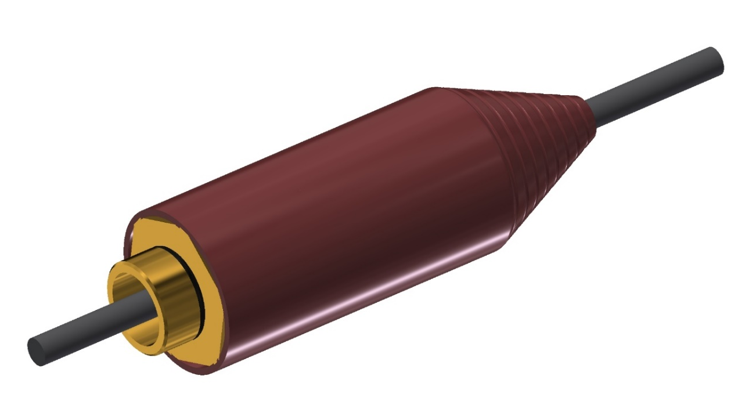
Non-linear Analysis
of
Shroud expansion
Ganesh Bhoye, Dr. Sunita Mohapatra, Ishant Jain
Raychem Innovation Centre,
Raychem RPG Pvt. Ltd., Halol, Gujarat-389350
2

Slide 3
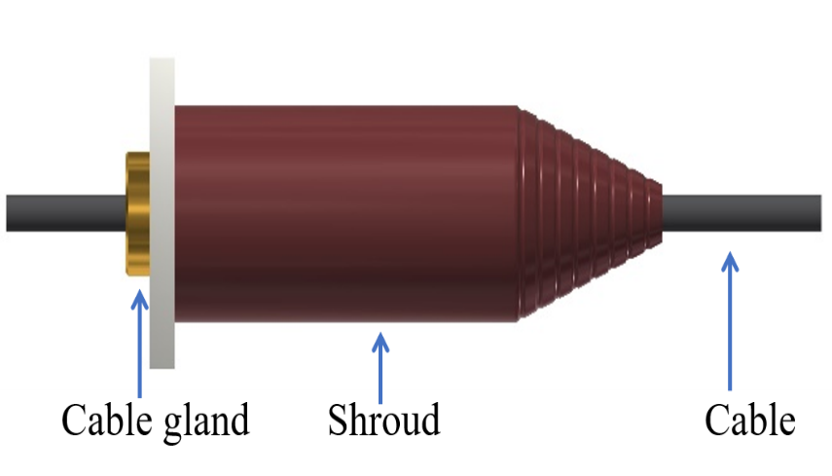
Shroud for Cable Gland
Shroud give additional ingress protection to cable gland assembly.
Existing Shroud is made up of PVC which have limited elasticity which prohibit the expansion and variability.
New shroud is made up of the Fire retardant and Halogen free material.
Need for FEA Analysis
To select Optimised elasticity for Shroud based on material composition.
To Reduce Tooling cost and tooling Time.
3

Slide 4
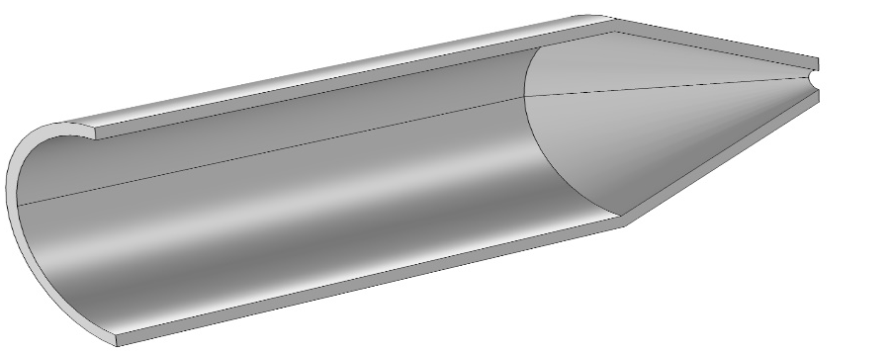
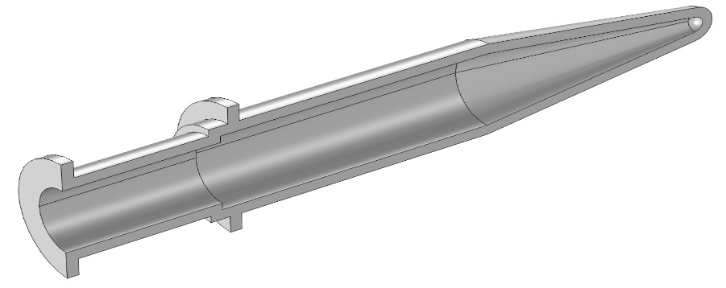
Problem Definition
To determine expansion of shroud design using Hyper-elastic Material Module.
For Verification and optimization of the design.
To incorporate modularity in the design.
To optimize thickness of the Shroud for effective material utilization
Optimization (Curve fitting)
Error Estimation-total squared error
Model selection
Material constants estimation
Input of material constants to the actual geometry
Solid Mechanics (Hyper-elastic simulation)
Application of the boundary conditions
Meshing
Analyze and postprocessing
Results
Physical Phenomenon:
Sliding expansion
Direct expansion
Fig. Sectional View of the shroud design
4

Slide 5
Optimization study for Curve fitting
Material behavior to be predicted.
Curve fitted to stress strain curve data from UTM after processing.
Following material models were used,
Arruda Boyce
Yeoh
Mooney Rivlin 9- parameter,
MR-5 Parameter,
MR-3 Parameter
MR-2 Parameter
Ogden 6 and 8 parameter model
Uniaxial tensile testing data
Total squared error-
Model with least squared error is selected.
best fit model is used i.e. Mooney Rivlin 9 parameter model fits best for this data.
Determination of parameters i.e. Material constants like C01, C10, C11, C12, C02, C20, C21, C03, C30.
Biaxial tensile testing data
Mooney Rivlin 9 parameter model fits best for selected material composition.
5

Slide 6
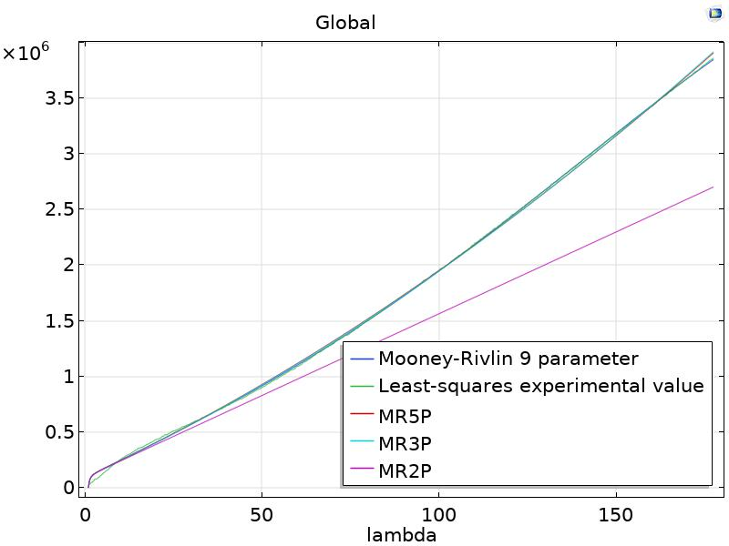
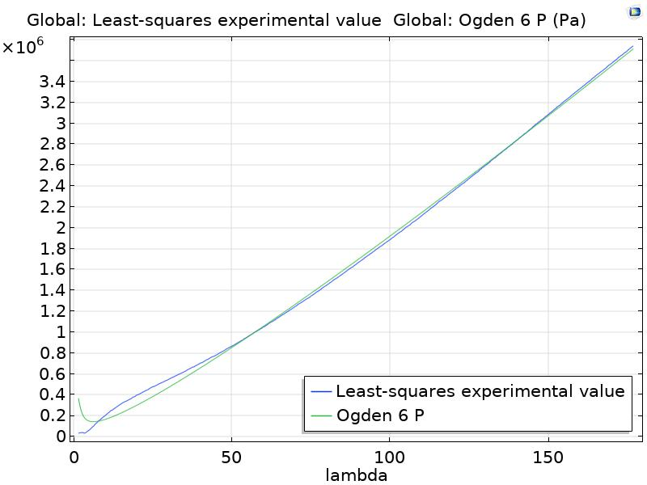
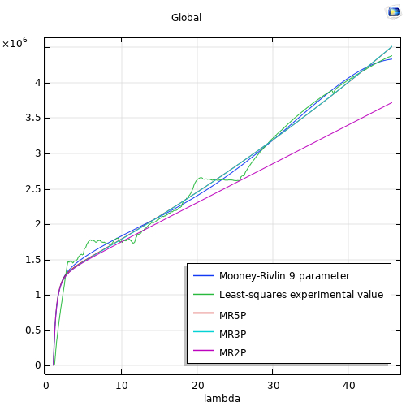
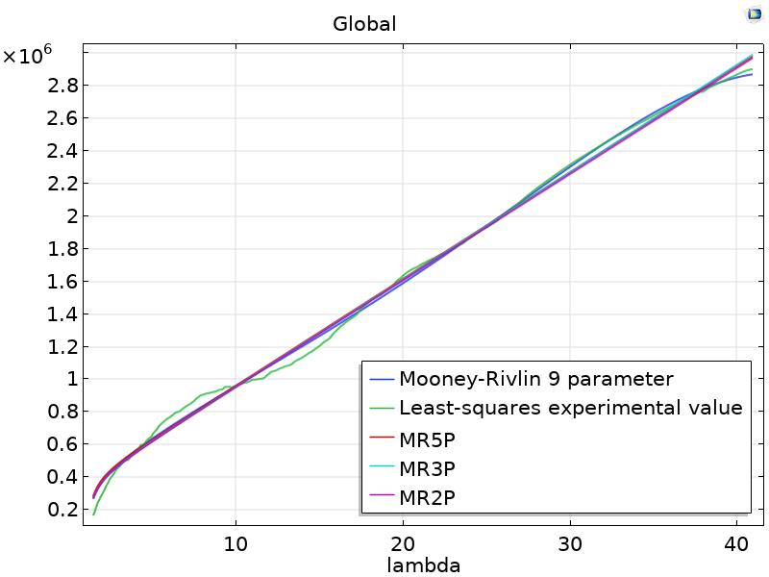
Optimization study for Curve fitting
Curve fitting for uniaxial testing data
Curve fitting for uniaxial testing data
Curve fitting for Biaxial testing data
Curve fitting for Biaxial testing data
More realistic material behavior can be predicted from Biaxial Tensile test Data
6

Slide 7
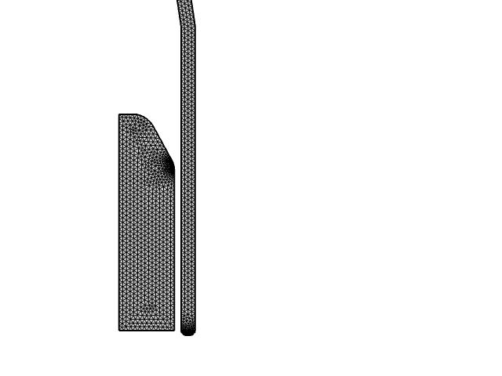
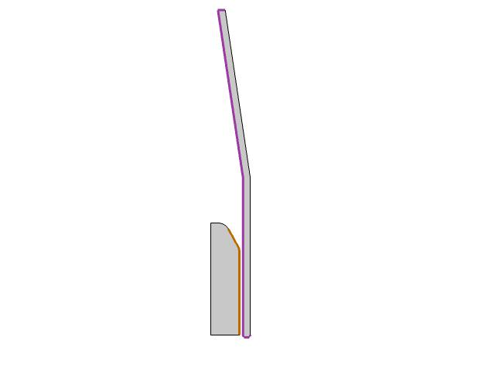
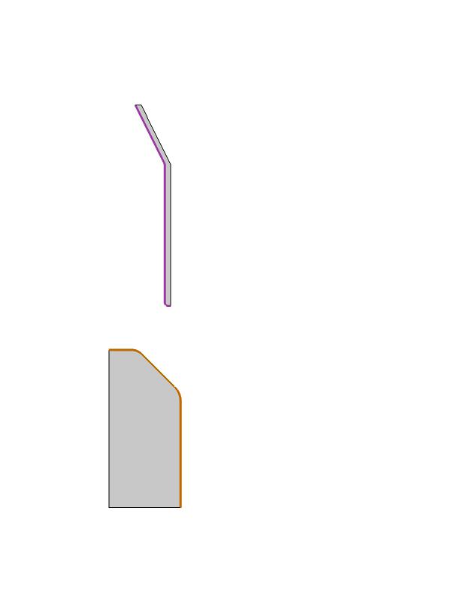
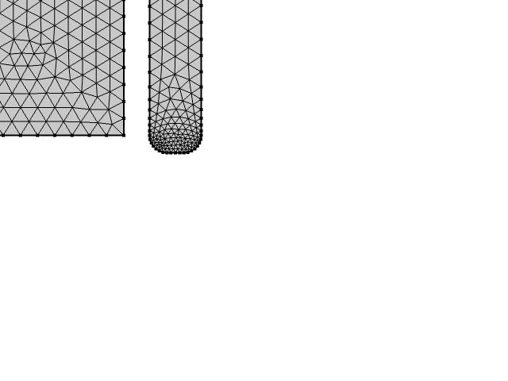
FEA –Hyper-Elastic Study
Expansion Phenomenon- Boundary conditions and Meshing
Direct Expansion
Sliding expansion
Fixed Constraint
Prescribed displacement
Contact
Contact
Prescribed displacement
Fixed Constraint
Direct Expansion
Sliding Expansion
Mesh Generation
Expansion with two types have been determined to find maximum deformations and critical points in design and to optimize thickness.
7

Slide 8
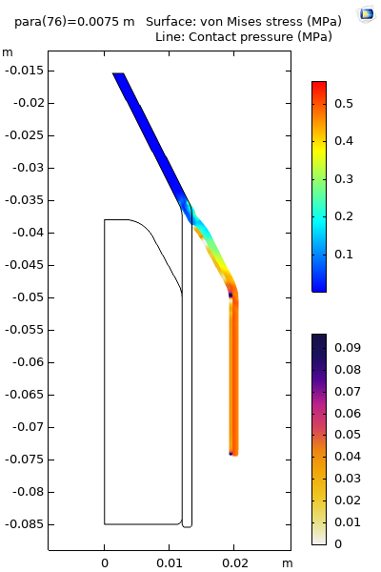
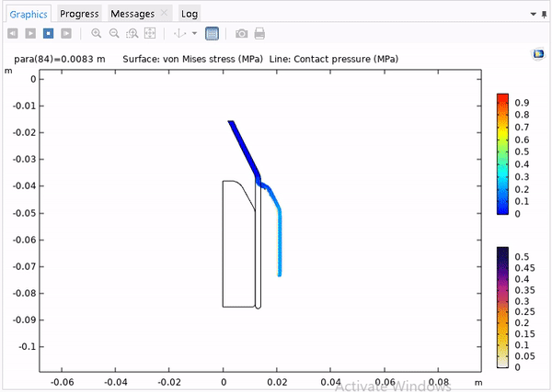
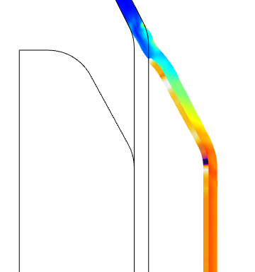
FEA –Hyper-Elastic Study
Direct Expansion
Maximum Expansion and critical points can be observed in this type of expansion.
8

Slide 9
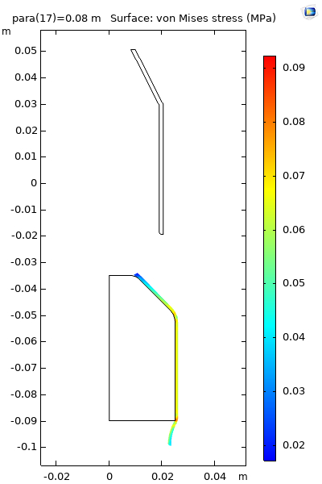
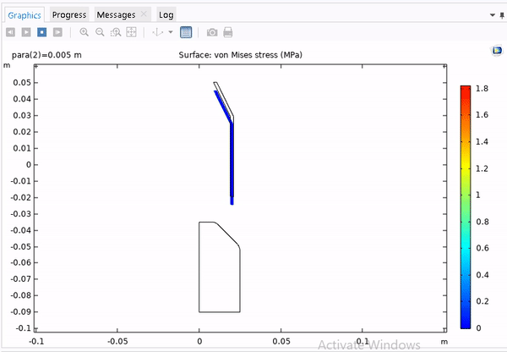
FEA –Hyper-Elastic Study
Sliding expansion
Sliding Expansion is more practical approach similar installation of shroud
9

Slide 10
Concluding Remarks
Though Sliding Expansion is more practical approach, Maximum radial expansion can be observed in Direct expansion variant.
It was clear from the results that minimum expansion of 7.5 mm can be achieved failure (tearing of shroud) i.e Shroud can be expanded by 15 mm diametrically.
Hence single size of the shroud can be used for more than 3 Cable glands.
Effect of thickness of the shroud has also been determined and optimum thickness has been selected for product.
Application of Optimization and Hyper-elastic module in Design phase of the product can reduce tooling cost and tooling time significantly.

Slide 11

THANK YOU
11

Slide 12
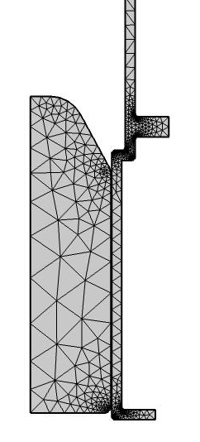
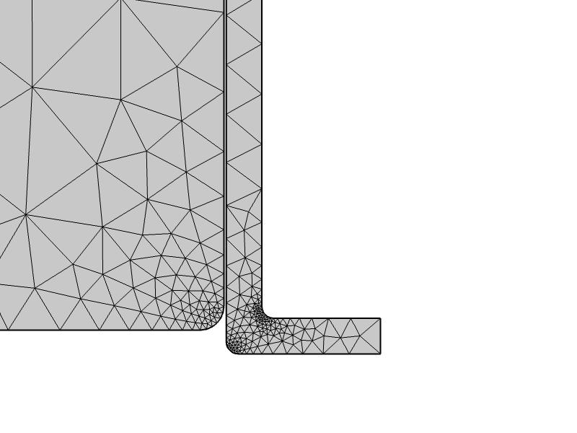
Meshing
12

Slide 13
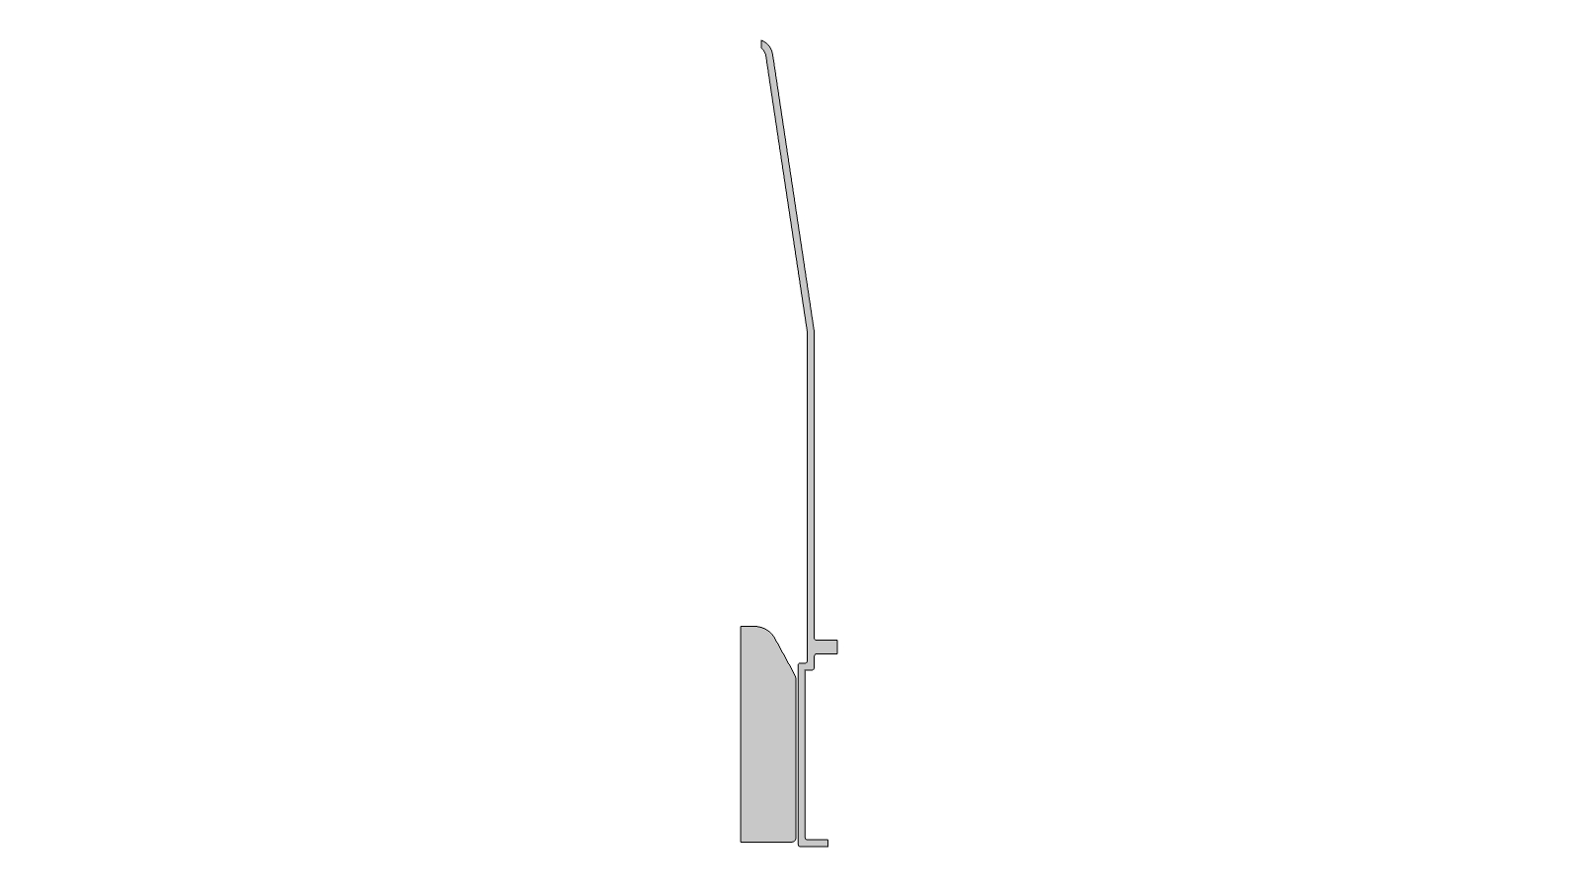
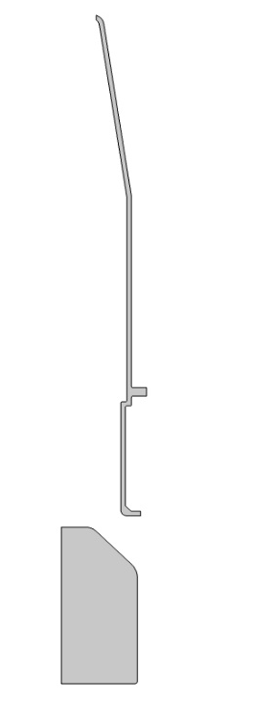
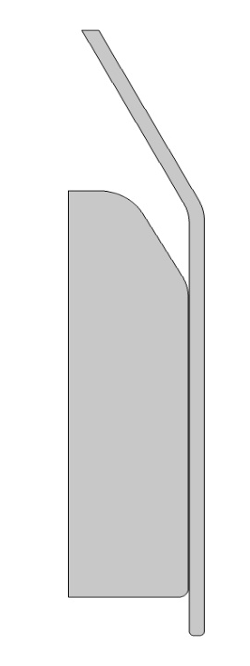
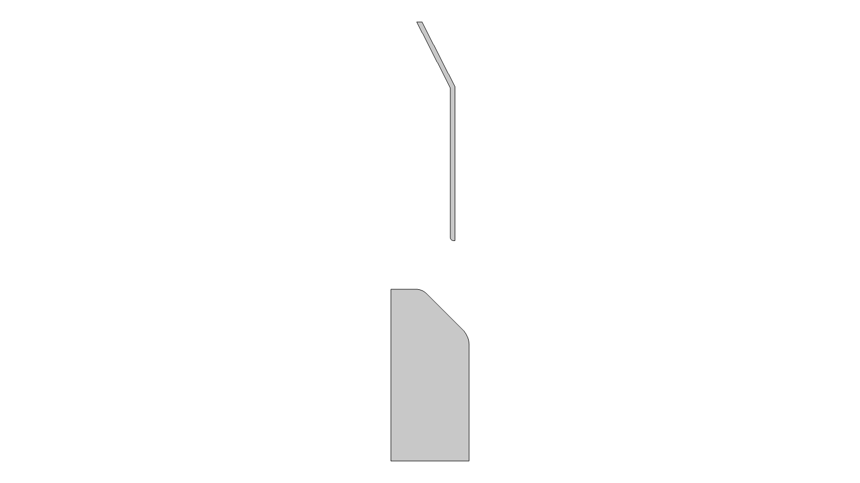
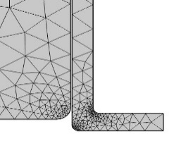
FEA –Hyper-Elastic Study
Expansion Phenomenon
Direct Expansion
Sliding expansion
13

