Slide 1
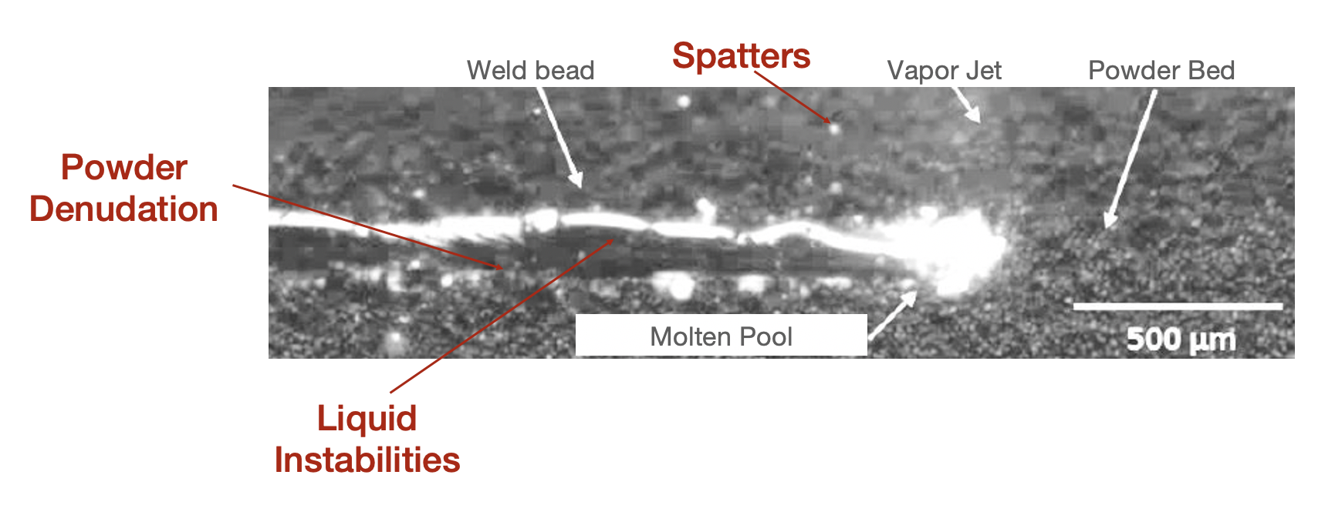
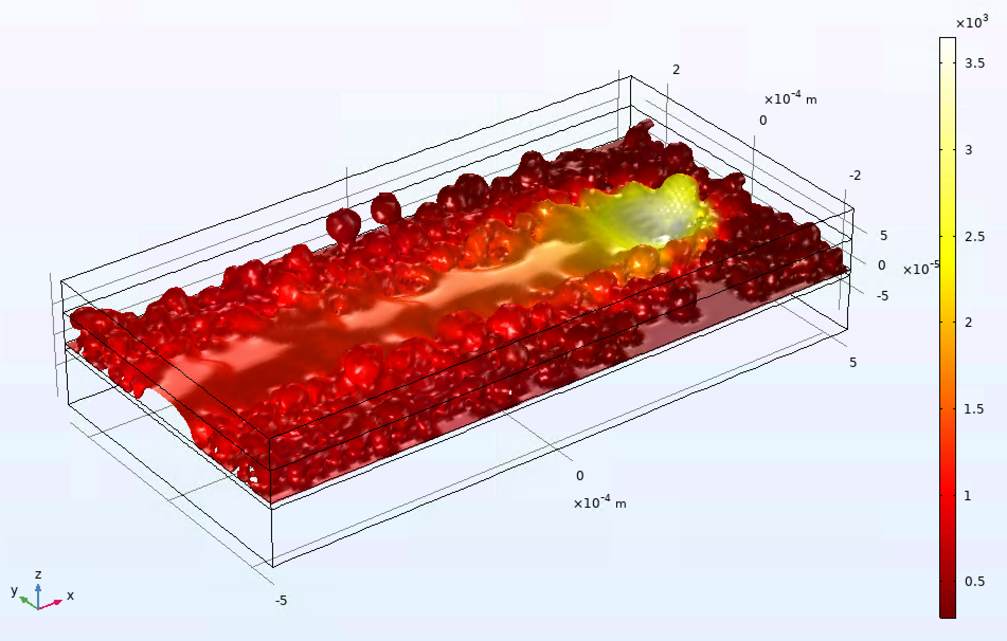
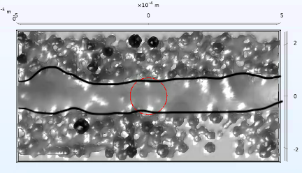
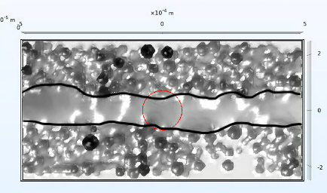
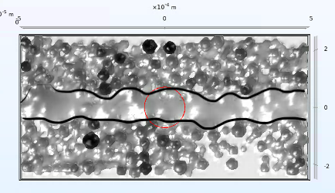
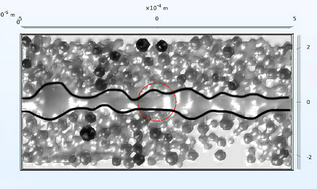
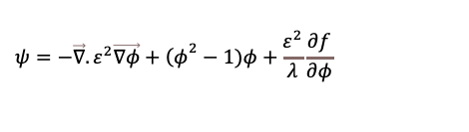


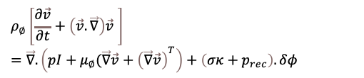

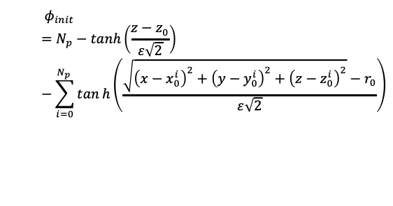
Powder Consideration For Additive Manufacturing Simulation
M. Dal¹, Y. Mayi¹, K. Marchais², P. Peyre¹
1. Laboratoire Procédés et Ingénierie en Mécanique et Matériaux (PIMM) – UMR 8006, Arts et Metiers Institute of Technology, CNRS, CNAM, PIMM, HESAM Université, F-75013 Paris, France
2. Arts et Metiers Institute of Technology, University of Bordeaux, CNRS, Bordeaux INP, INRAE, I2M Bordeaux, Talence F-33400, France
INTRODUCTION: Laser Powder Bed Fusion (or Selective Layer Melting) is one of the metallic 3D printing method. Industries are currently trying to master and improve this accurate process.
Baser on the selective and sequential melting of powder layers by laser, some defects remains present and annoying (Figure 1):
Aggregates on powder bed (downfall of spatters)
Lack of feeding material (denudation of powder)
Unstable built (flow instabilities)
As shown in the figure 1, these defects occurs at the size of the molten pool, i.e. the mesoscale.
To improve the process understanding at this scale, a multiphysical simulation of single track is proposed.
Figure 2. External geometry (left) and internal powder description (right Φ_{init})
RESULTS: The results of the simulation are shown in figure 3 in terms of temperature field during laser irradiation, for 0.4 m/s and in figure 4 for scanning speed from 0.4 to 1 m/s. Some track instabilities appears at high velocities and balling effect at 1 m/s.
Figure 1. LPBF single-track high-speed imaging
COMPUTATIONAL METHODS: At the scale of the molten pool, sensitive phenomena are: 1-heat transfers, 2-fluid flows and 3-free boundary tracking.
Figure 3. Thermal field at the interface (v = 0.4 m/s).
1-heat transfers
0.4 m/s
0.6 m/s
$$ρ_{∅}{c_{p}}_{∅}^{eq}\frac{∂T}{∂t}+ρ_{∅}{c_{p}}_{∅}\vec{v}.\vec{∇T}=\vec{∇}.\left(λ_{∅} \vec{∇T}\right)+S.δ∅$$
2-fluid flows
$$ρ_{∅}\left[\frac{∂\vec{v}}{∂t}+\left(\vec{v}.\vec{∇}\right)\vec{v} \right]=\vec{∇}.\left(pI+μ_{∅}(\vec{∇}\vec{v}+{\left(\vec{∇}\vec{v}\right)}^{T}\right)+\left(σκ+p_{rec}\right).δφ$$
0.8 m/s
1 m/s
$$\vec{∇.}\vec{v}=0$$
Table 1. Title of the table
3-free boundary tracking
Figure 4. Effect of scanning speed on track shapes.
$$\frac{∂φ}{∂t}+\vec{v}.\vec{∇φ}=\vec{∇}.\frac{γλ}{ε^{2}}\vec{∇ψ}$$
Scanning speed (m/s) | Length (µm) | Width (µm) | Thickness (µm)
0.4 | 220 | 78 | 40
0.6 | 170 | 57 | 30
0.8 | 168 | 55 | 24
1 | 175 | 51 | 20
$$ψ=−\vec{∇}.ε^{2}\vec{∇φ}+{\left(φ\right.}^{2}−1)φ+\frac{ε^{2}}{λ}\frac{∂f}{∂φ}$$
Initial Phase field solution coming from DEM simulation* :
$$φ_{init}=N_{p}−\tanh\left(\frac{z−z_{0}}{ε\sqrt{2}}\right)−\sum_{i=0}^{N_{p} }{tanh\left(\frac{\sqrt{{\left(x−x_{0}^{i}\right)}^{2}+{\left(y−y_{0}^{i}\right)}^{2}+{\left(z−z_{0}^{i}\right)}^{2}}−r_{0}}{ε\sqrt{2}}\right)}$$
CONCLUSIONS: Lost of track regularity with the velocity is well described with this model but the assumption on gas flows does not allow to observe spatters and denudation.
Some current and future works are thus about vapor ejection due to vaporization with Phase field method.
* Java Programming
Excerpt from the Proceedings of the 2020 COMSOL Conference

