Slide 1
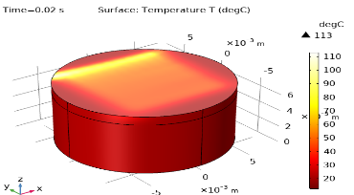
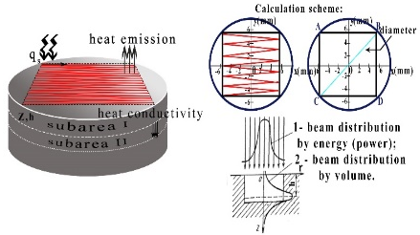
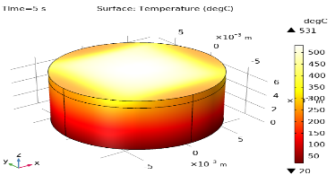

Thermophysical model of electron-beam treatment of titanium alloy VT-1
A. E. Lapina¹, N. N. Smirnyagina¹
1. Institute of Physical Materials Science SB RAS, 6 Sakhyanova Str., Ulan-Ude, Republic of Buryatia,670047, Russia.
INTRODUCTION: The investigation is aimed at developing a thermophysical model of electron beam boriding of titanium alloy VT-1. Features of introducing of the focused electron beam into titanium alloy VT-1 were investigated. The stages of constructing a mathematical model of thermal fields arising in the sample during electron beam processing are considered. Numerical calculations made it possible to show that the temperature-time conditions of heating and cooling of the titanium alloy VT-1 affect the nature of structural transformations.
RESULTS: The temperature distribution over the surface and deep into the sample in the direction of electron beam motion was determined. As a result of one passage of the electron beam on the surface of the sample, a temperature of 113 ºC is reached (Fig.2).
Figure 2. Temperature distribution after one pass of the electron beam over the surface of the sample.
After 5 seconds after the start of the treatment process, the maximum temperature reaches 531 ºC. After completion of the electron beam processing process, the temperature is 688 ºC. Maximum temperatures are reached on the surface in the central part of the sample, which is associated with the trajectory of the electron beam. At the same time, temperatures in the heat exposure zone can reach 2000-2500 ºC, which indicates high heating and cooling rates in the electron beam exposure zone of the order of 10⁶.
Figure 1. Scheme of calculations
COMPUTATIONAL METHODS: When modeling the electron beam processing process using the COMSOL Multiphysics software complex, a number of parameters must be taken into account:
Selects the dimension of the model.
A three dimensional model of the electron-beam exposure process on the sample surface is constructed.
The choice of physics and type of research.
We consider a time-dependent process - Time Dependent. To study temperature changes, the thermal conductivity module in solids is used - Heat Transfer in Solids (ht). Electron beam exposure time t = 60 s. The motion of the electron beam along the x and y-axis is specified using the Analytic and Interpolation functions. Using the Deposited Beam Power section of the Heat Transfer in Solids module, the effect of the electron beam on the sample is described.
Defining geometry and global variables.
The sample is a cylindrical plate with a diameter of 15 mm and a height of 7 mm. The power of the electron beam P=U⋅I=20000⋅0.001=200 W. Electron beam diameter 1 mm.
Addition of materials.
A sample of titanium alloy VT-1 was selected for the study and its main thermophysical properties were set. The initial alloy VT-1 was a mixture of two modifications of titanium α- and β-Ti.
Generation of a grid.
Before starting the study, a mesh for specimen partitioning is set. The mesh selected in the model is triangular mesh size - fine.
a b
Figure 3. Temperature distribution over the surface and volume of the sample after: 5 seconds of electron-beam processing (a), after processing of the sample with an electron beam (b).
CONCLUSIONS: As a result of computer modeling, a three-dimensional model of temperature change was built in the Comsol Multiphysics environment due to the effect of a moving focused electron beam source. Peculiarities of electron beam introduction into titanium alloy VT-1 are considered.
Note:
All abstracts, papers, posters, and presentations must comply with, and are subject to, our Copyright Notice:
www.comsol.com/conference/copyright-notice
REFERENCES:
A. E. Lapina, N. N. Smirnyagina, D. E. Dasheev, "Simulation of thermal processes in the treatment of titanium alloy VT-1 electron beam in a vacuum", Vestnik BSU. Chemistry. Physics, No. 2-3, p. 55-63, 2018.
Excerpt from the Proceedings of the 2020 COMSOL Conference

