Slide 1

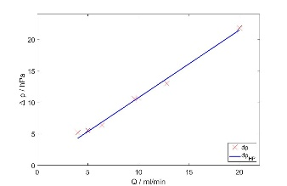
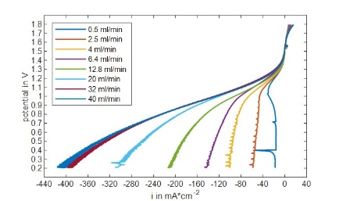
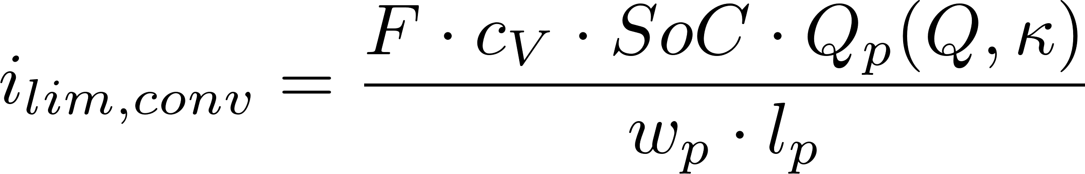
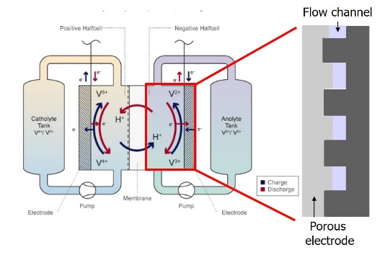
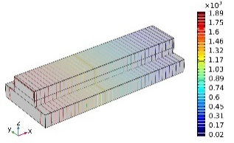
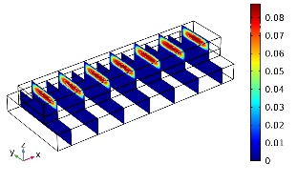
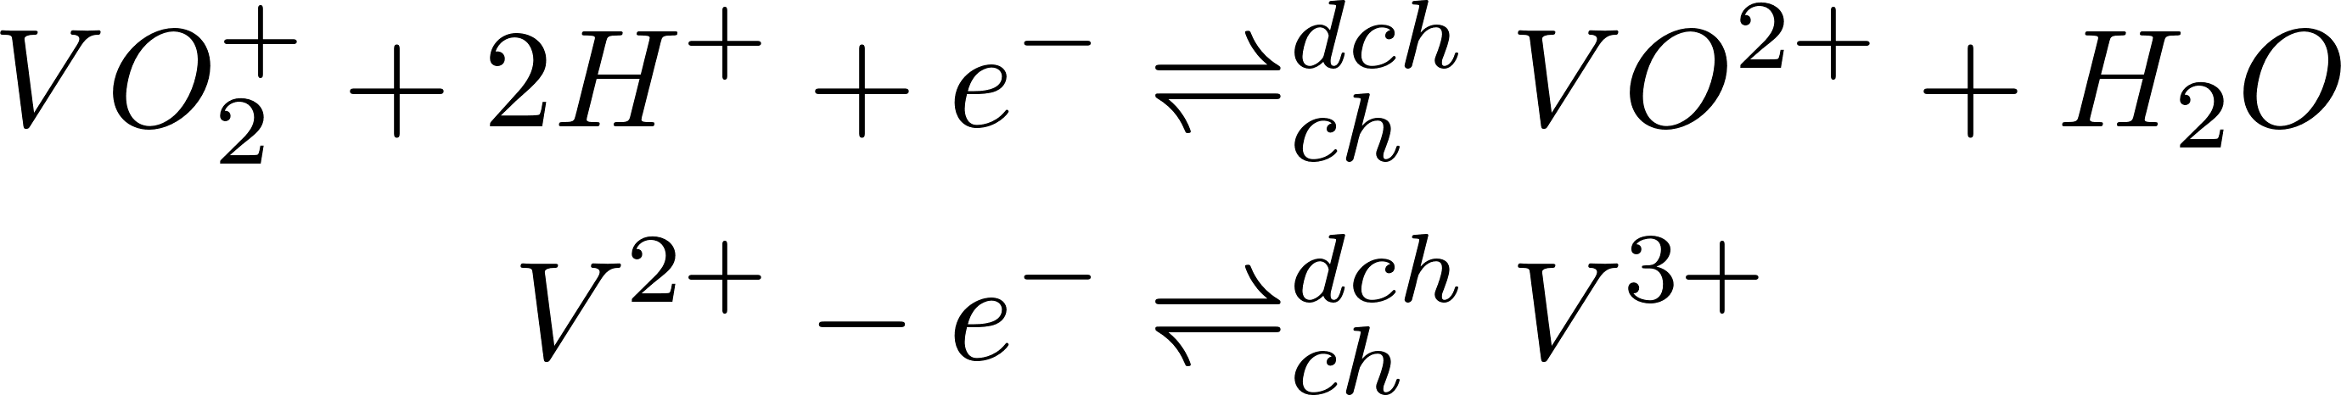
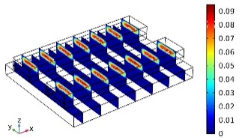
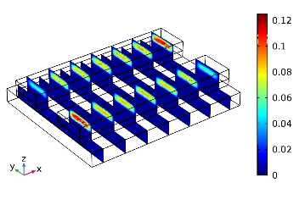
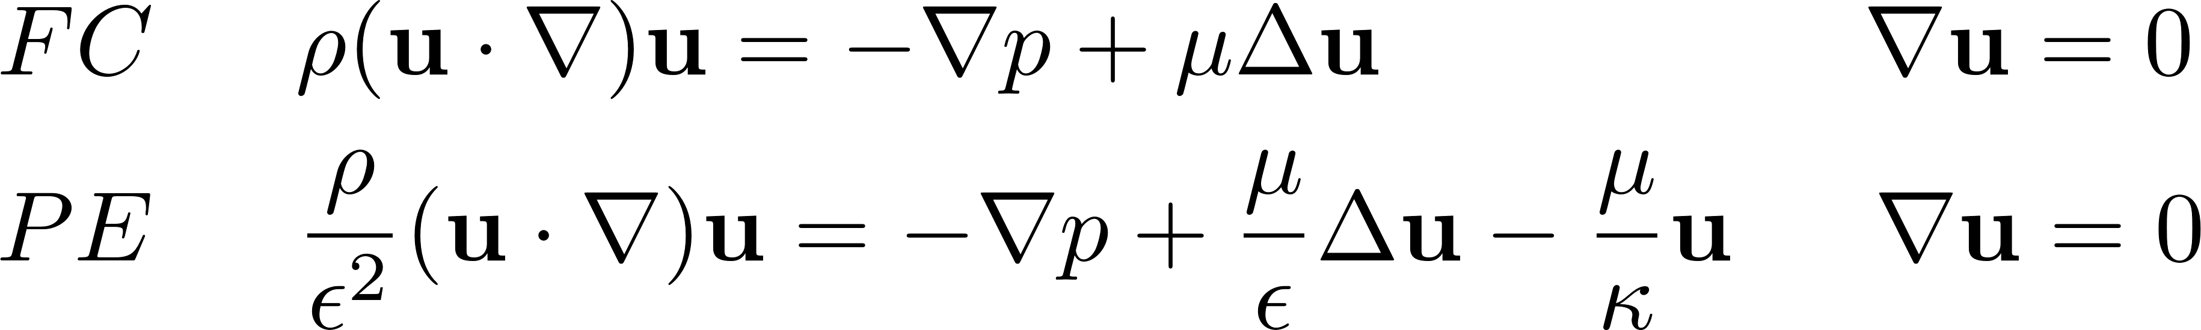
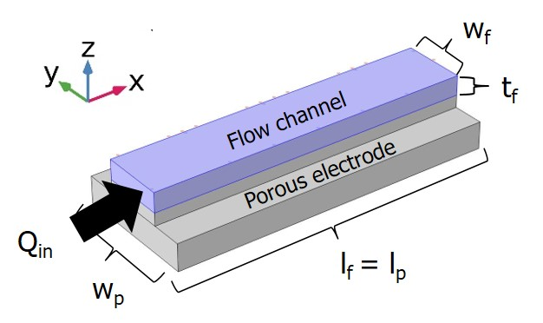
Fluid Flow Patterns And Limiting Current Densities In Vanadium Redox Flow Batteries T. Struckmann, J. Boettcher, P. Kuhn, S. Ressel
Hamburg University of Applied Sciences, Heinrich Blasius Institute for Physical Technologies, Hamburg, Germany
INTRODUCTION: All vanadium redox flow batteries (VRFB) typically consist of planar cells with flow-by fluid flow design [1]. Their limiting current densities are determined by electrolyte convection in porous electrodes [2]. The key parameters flow channel depth and hydraulic permeability κ of the porous electrode depend on electrode compression and are difficult to measure directly. In this study both parameters are determined from experimental VRFB cell data by analytical approximations. Parametrized models and parameters are validated in order to enable simulations of alternative cell designs such as interdigitated fluid flow [1] or tubular cells [3].
The effective hydraulic permeability of the electrode is fitted by an analytical 1D approximation for the porous electrode flow rate Q_{p} [2] and the convection part of the experimental limiting current densities.
Model and parameter validation
Δp_{sim} = 18.3 hPa i_{lim,sim} = 288 mA/cm²
Δp_{exp} = 21.9 hPa i_{lim,exp} = 317 mA/cm²
Validation results are slightly below experimental values.
Simulations
Simulations for different flow designs can be performed using the model and the parameters from experiment.
Figure 3. Pressure drops and current densities for flow rates Q
Figure 1. Flow-by fluid flow in VRFB
Figure 4. Pressure drop and velocity distribution (u / m/s) @20 ml/min
EXPERIMENTAL: A planar VRFB cell with 20 parallel flow channels (w_{f} = 0.10 cm, w_{p} = 0.20 cm, l_{f} = 5.0 cm) is used to measure pressure drops and polarization curves for cell flow rates Q = 0.5 ml/min - 40 ml/min with vanadium concentration 1.6 mol/l at SoC = 90%.
COMPUTATIONAL METHODS: Stationary studies in the COMSOL free and porous media flow module were performed using Navier-Stokes equations for the flow
channel (fc) free flow and Brinkmann-Darcy equations for the porous electrode (pe) flow. Periodical boundary conditions were used for the porous electrode cut planes.
Figure 5. Fluid velocity in parallel (left) and interdigitated flow designs
CONCLUSIONS: Analytical approximations can be used to parametrize fluid flow models from experimental cell data. Simulation results are within 10-20% deviations consistent with experimental values. Future work will concentrate on experiments and simulations for tubular cell designs [3] as well as on electrochemical 3D simulations using the COMSOL batteries and fuel cell module.
Outlet
Inlet
Figure 2. Base configuration – single flow channel
REFERENCES:
L. F. Arenas et l., Redox flow batteries for energy storage: Their promise, achievements and challenges, Current Opinion in Electrochemistry 16 (2019), 117-126.
X. Ke et al., A simple analytical model of coupled single flow channel over porous electrode in VRFB with serpentine flow channel, Journal of Power Sources 288 (2015) 308-313
S. Ressel et al., Performance of a vanadium redox flow battery with tubular cell design, Journal of Power Sources 355 (2017) 199-205.
RESULTS:
Parametrization by experimental data
The effective flow channel depth t_{f} is fitted from Hagen-Poiseuille pressure drop estimates to experimental values.
Excerpt from the Proceedings of the 2020 COMSOL Conference

