Slide 1

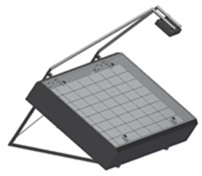
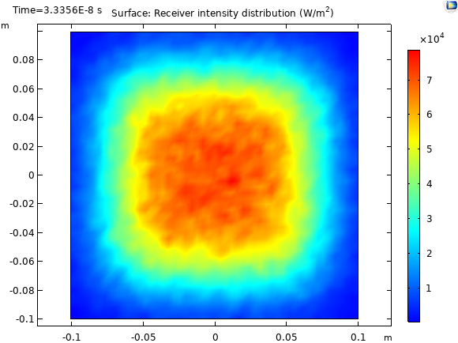
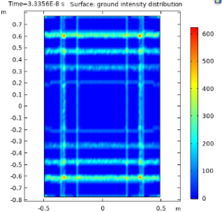
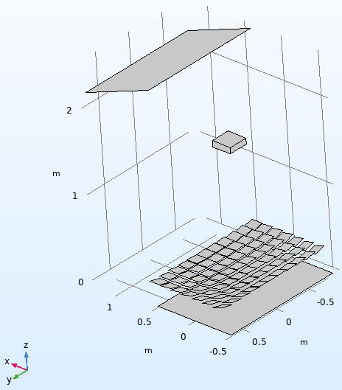
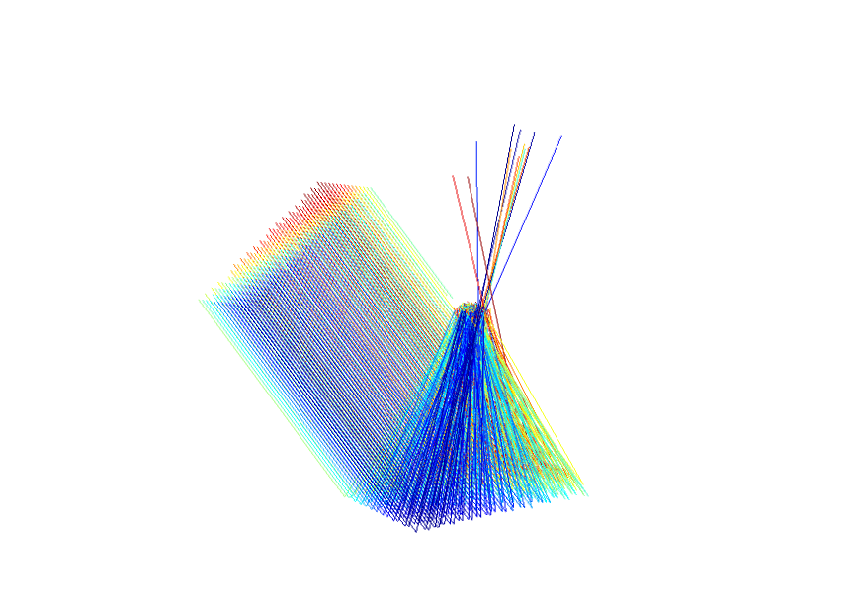
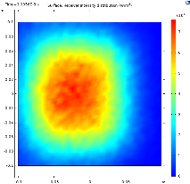
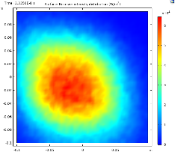

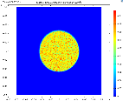
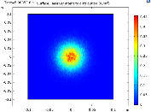
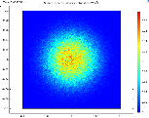
Multi-Mirror Array Calculations With Optical Error
J. Goettsche ¹, S. Alexopoulos ¹, A. Duemmler¹ , S.K. Maddineni²
Solar-Institut Jülich, FH Aachen, Juelich, Germany
2. FH Aachen, Juelich, Germany
INTRODUCTION: In the framework of the Greek-German co-operation project “Solar Collectors with Static Concentrators” (SCoSCo) a novel concentrating mirror array collector (MAC) design was established. It is based on a mirror array unit that was introduced earlier [1] but was modified from flat to focussing.
GEOMETRY: Figure 1. shows the geometric configu-ration of the MAC. All mirrors are pre-oriented and can be tracked in a coupled mode by two drives.
RESULTS: The intercept factor (fraction of emitted rays that hit the receiver) and intensity distribution on the receiver were calculated for numerous parameter sets and angles of incidence. Near-optimal results were found with this parameter set.
Receiver size | Mirror facets | Concentration factor | Focal length | Optical error | Intercept (100,000 rays)
20 cm x 20 cm | 14 cm x 14 cm 7 x 11, gap: 1 mm | 38.2 | 1.4 m | 7 mrad | 88.3 %
Figure 5. Receiver intensity distribution at normal incidence (300,000 rays)
Figure 6. Intensity distribution of rays that pass between the mirror gaps
Figure 1. Sketch of the Mirror Array Collector (MAC)
EVALUATION: The intercept data of a range of incidence angles in x and y directions were used to calculate incidence angle modifiers (IAM) as input for the solar-thermal performance calculations using the Matlab/Simulink toolbox CARNOT [2].
An off-centre shift of the intensity distribution was found at oblique angles of incidence, which can be corrected by the MAC control algorithm.
IMPLEMENTATION: The mirror array was programmed using the COMSOL application builder so that the number and size of mirrors and the gaps between them could be varied easily (Fig. 2).
Figure 3. Optimal tube positions for different incidence angles
Figure 7. Intensity distributions for 30° f(left) and 30 °/40 ° (right)
CONCLUSIONS: Raytracing simulations were performed with respect to a novel concentrating solar collector design. The results confirm the feasibility of a coupled movement of the mirror facets using only two mechanical drives with acceptable optical losses. Good results can be obtained even when optical errors of ± 7 mrad are present.
Figure 2. Complete setup of the COMSOL raytracing model inclu-ding ray source, mirror array, receiver box and virtual background surface,
Figure 3. Reflected rays for 30° incidence angle
COMSOL MODELING (GEOMETRIC OPTICS MODULE):
The optical error and the solar cone angle of ±4.65 mrad were programmed together as part of the reflection condition on the mirror surfaces.
Acknowledgements
This project was co-funded by the German Federal Ministry of Education and Research (BMBF) and the Hellenic Secretariat for Research and Technology (SCOSCO project) in the framework of the Greek-German co-operation.
REFERENCES:
[1] Sauerborn, M. et al. 2008. Test of a Mini-Mirror Array for Solar Concentrating Systems, EUROSUN 2008, Lisbon, Portugal.
[2] CARNOT Toolbox Ver. 7.0 for MATLAB/Simulink R2018b, Solar-Institut Juelich
Figure 4. Test of the reflection condition using a single 1mm² mirror left: solar cone only, centre: ± 1 mrad optical error with normal distribution, right: combination of both

