Slide 1



Implications of Sorption on Carbon Dioxide Sequestration in Gas Shales
Karthi Arunachalam
K.Arunachalam@ed.ac.uk

Slide 2
Agenda
Introduction
Adsorption Characterization
Numerical Simulation
Sensitivity Analysis
Conclusion

Slide 3
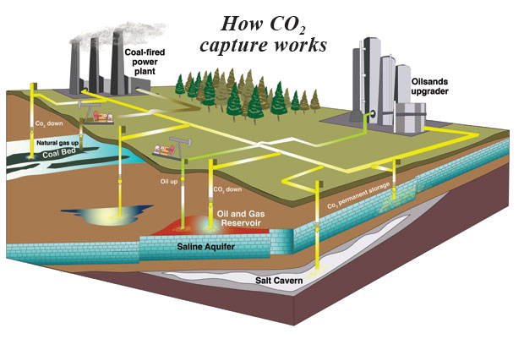
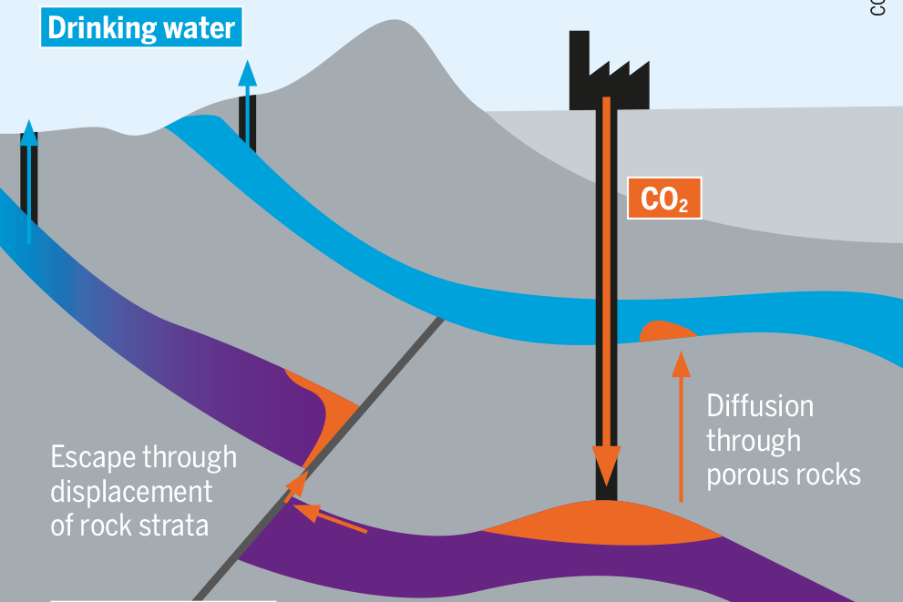
Introduction
Carbon Capture and Storage

Slide 4
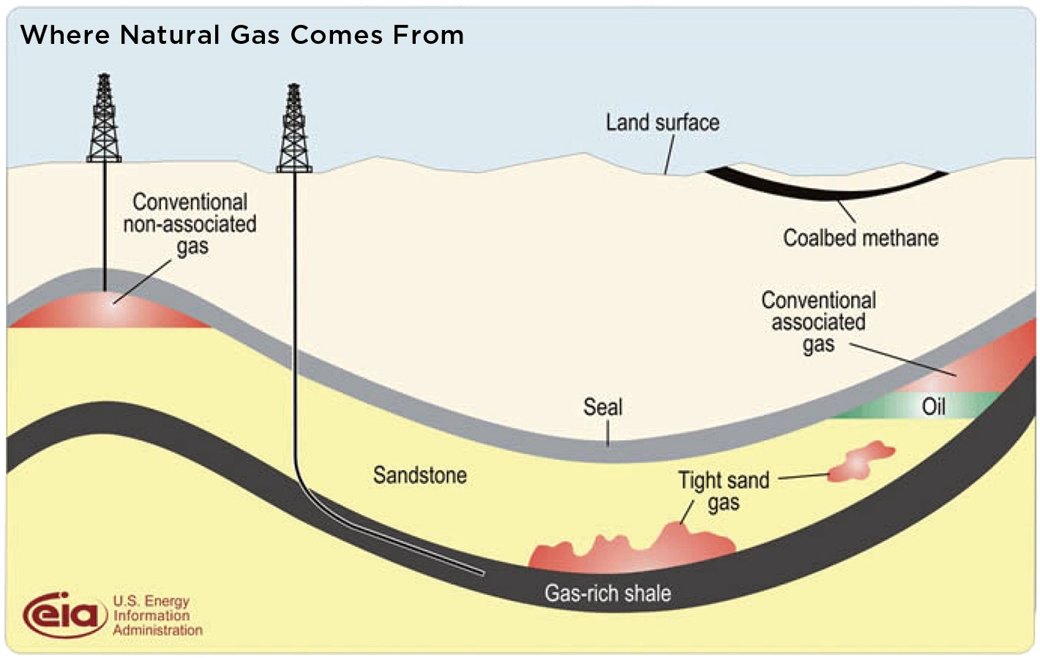
Introduction
What are Gas Shales?

Slide 5
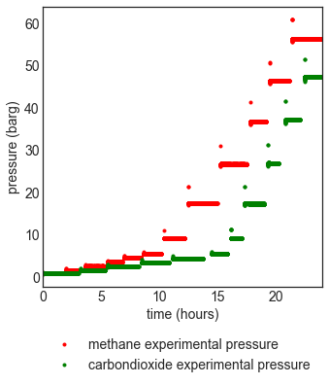
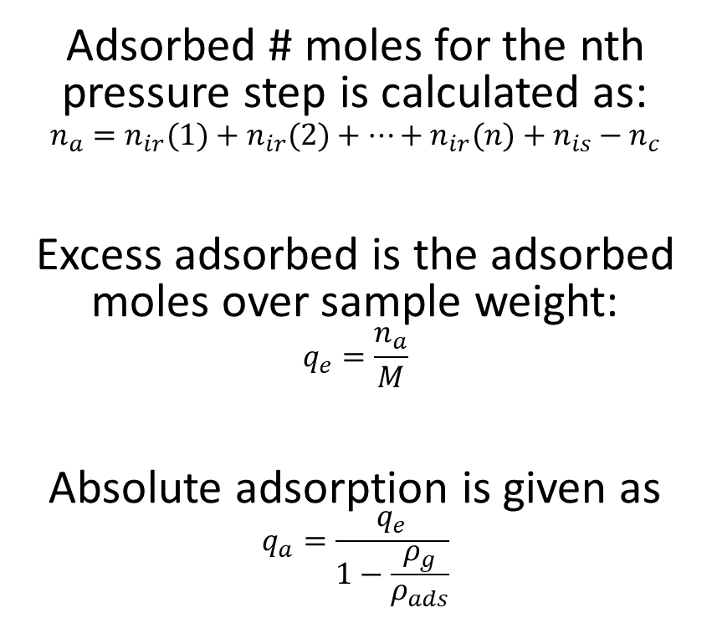
Adsorption Characterization
Adsorbed # moles for the nth pressure step is calculated as:
$$n_{a}=n_{ir}(1)+n_{ir}(2)+…+n_{ir}(n)+n_{is}−n_{c}$$
Excess adsorbed is the adsorbed moles over sample weight:
$$q_{e}=\frac{n_{a}}{M}$$
Absolute adsorption is given as
$$q_{a}=\frac{q_{e}}{1−\frac{ρ_{g}}{ρ_{ads}}}$$

Slide 6
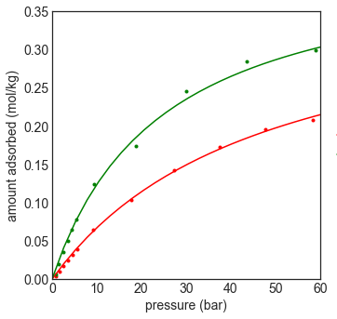
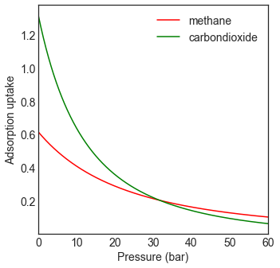
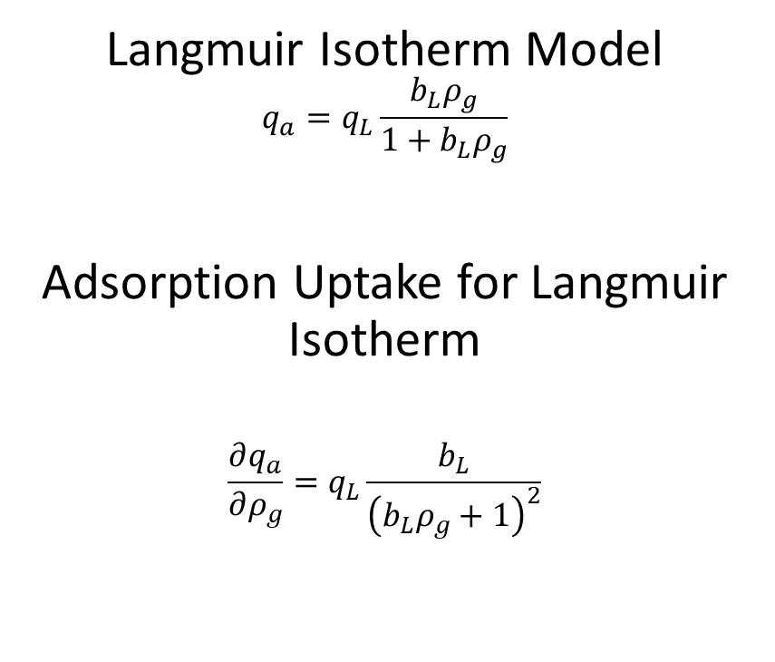
Adsorption Characterization
Langmuir Isotherm Model
$$q_{a}=q_{L}\frac{b_{L}ρ_{g}}{1+b_{L}ρ_{g}}$$
Adsorption Uptake for Langmuir Isotherm
$$\frac{∂q_{a}}{∂ρ_{g}}=q_{L}\frac{b_{L}}{{\left(b_{L}ρ_{g}+1\right)}^{2}}$$

Slide 7
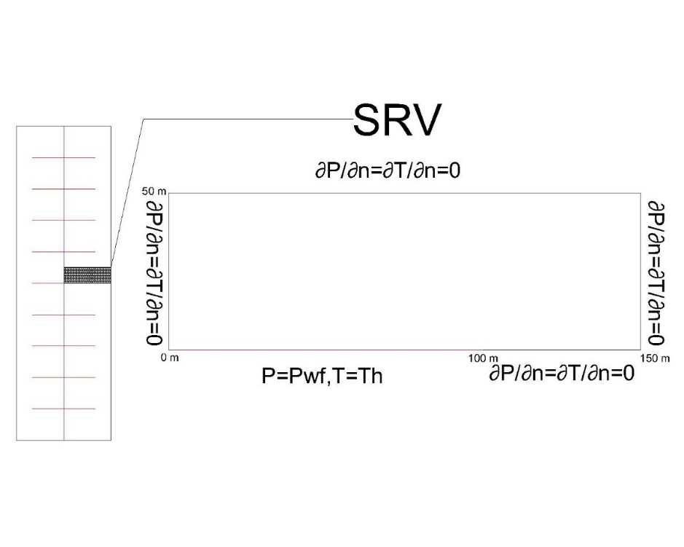
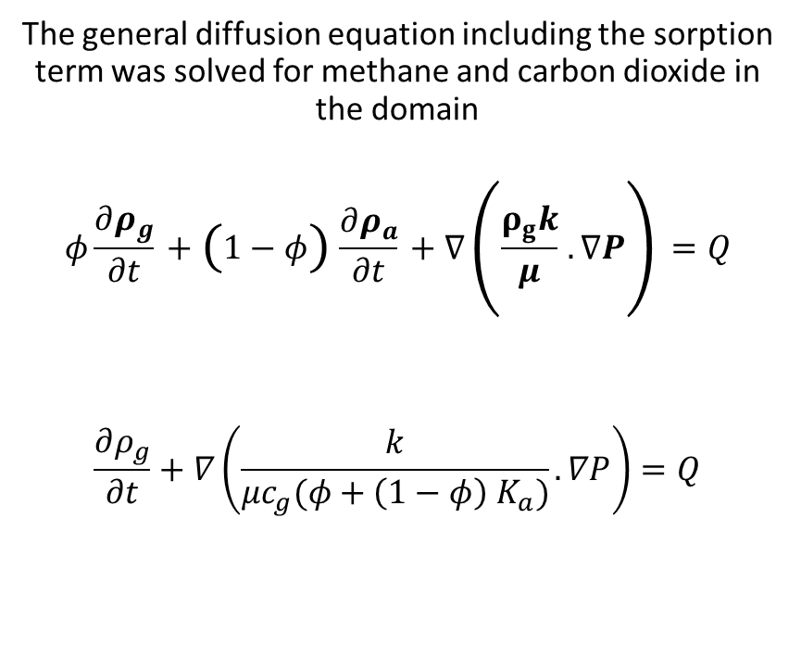
Reservoir Simulation
The general diffusion equation including the sorption term was solved for methane and carbon dioxide in the domain
$$φ\frac{∂ρ_{g}}{∂t}+\left(1−φ\right)\frac{∂ρ_{a}}{∂t}+∇\left(\frac{ρ_{g}k}{μ}.∇P\right)=Q$$
$$\frac{∂ρ_{g}}{∂t}+∇\left(\frac{k}{μc_{g}(φ+\left(1−φ\right){ K}_{a})}.∇P\right)=Q$$

Slide 8
Reservoir Simulation
Scenario 1
Scenario 2
10 Years Methane Production
10 Years Carbon Dioxide Injection
5 Years Methane Production
5 Years Carbon Dioxide Injection
5 Years Methane Production
5 Years Caron Dioxide Injection

Slide 9
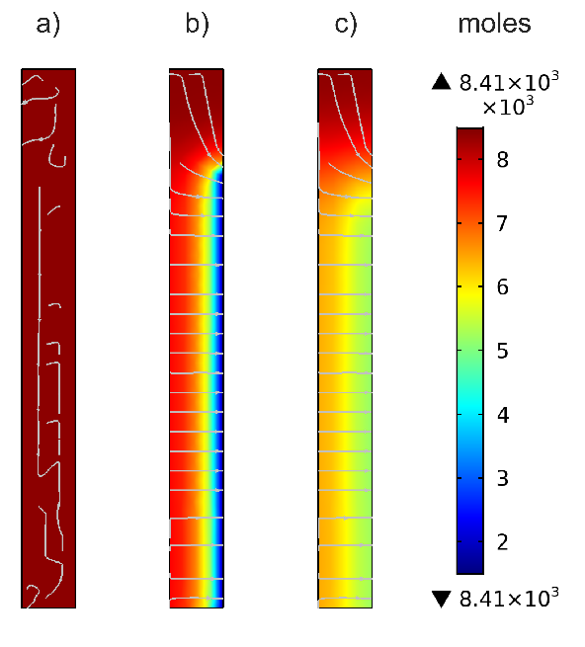
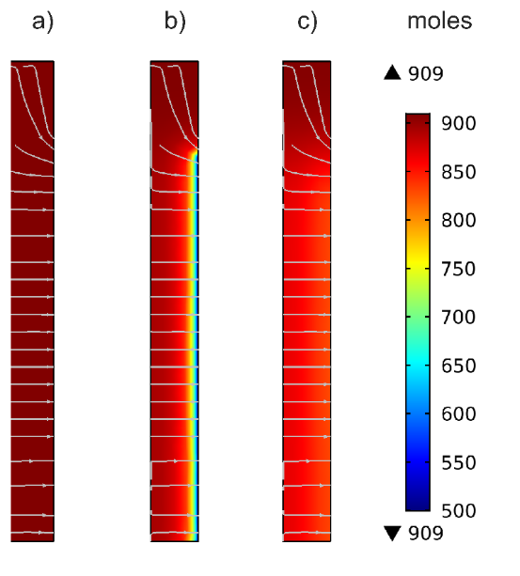
Distribution – Scenario 1
Methane Total
Methane Adsorbed
Subfigure a plots concentration before methane production.
Subfigure b plots concentration after methane production.
Subfigure c plots concentration after carbon dioxide injection.

Slide 10
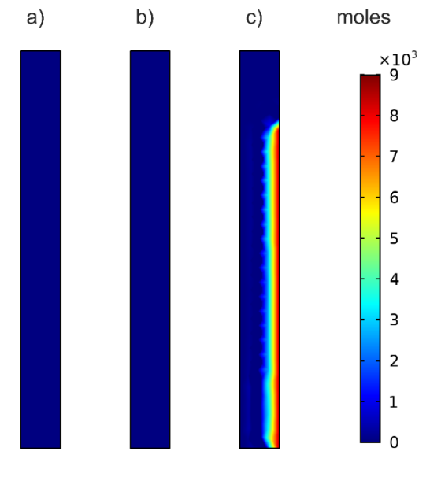
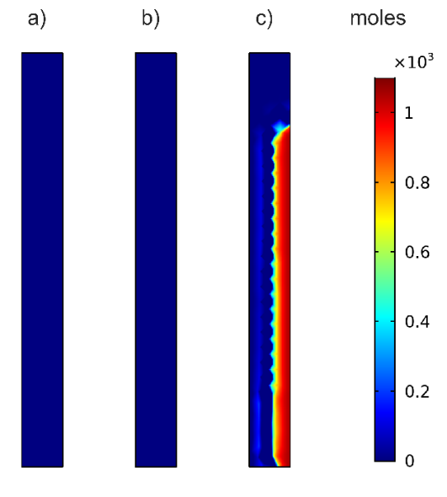
Distribution Scenario 1
CO2 Total
CO2 Adsorbed
Subfigure a plots concentration before methane production.
Subfigure b plots concentration after methane production.
Subfigure c plots concentration after carbon dioxide injection.

Slide 11
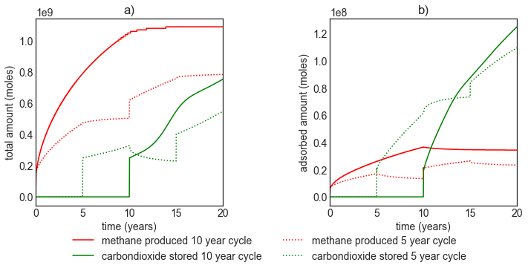
Reservoir Simulation
Methane production and Carbon dioxide sequestration Estimates.
Subfigure a plots total gas. Subfigure b plots adsorbed gas.

Slide 12
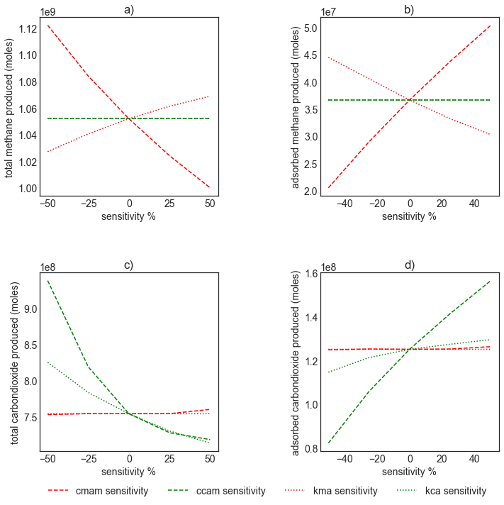
Sensitivity of Adsorption Parameters

Slide 13
Conclusion
Both adsorption and adsorption uptake parameters strongly influence carbon dioxide sequestration potential of shales.
Carbon dioxide sequestration through sorption is highly stable and less likely to leak.
Longer periods were required for carbon dioxide sequestration as compared to methane production to achieve a similar mass transfer, as sorbed gas decreases the diffusion rate.
Huff and puff carbon dioxide injection did not increase methane recovery from the reservoir.

Slide 14
Thank You

